Slide 1
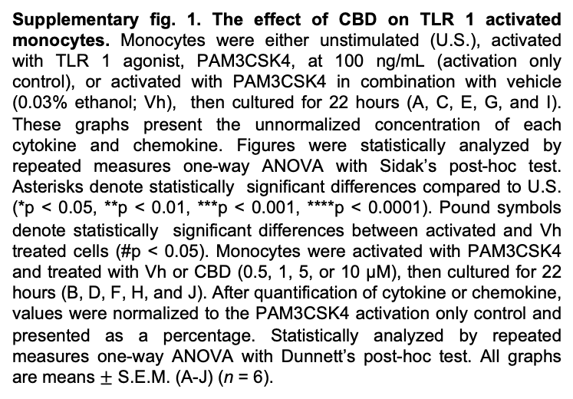
A
B
C
D
E
F
G
H
I
J
Supplementary fig. 1. The effect of CBD on TLR 1 activated monocytes. Monocytes were either unstimulated (U.S.), activated with TLR 1 agonist, PAM3CSK4, at 100 ng/mL (activation only control), or activated with PAM3CSK4 in combination with vehicle (0.03% ethanol; Vh), then cultured for 22 hours (A, C, E, G, and I). These graphs present the unnormalized concentration of each cytokine and chemokine. Figures were statistically analyzed by repeated measures one-way ANOVA with Sidak’s post-hoc test. Asterisks denote statistically significant differences compared to U.S. (*p < 0.05, **p < 0.01, ***p < 0.001, ****p < 0.0001). Pound symbols denote statistically significant differences between activated and Vh treated cells (#p < 0.05). Monocytes were activated with PAM3CSK4 and treated with Vh or CBD (0.5, 1, 5, or 10 µM), then cultured for 22 hours (B, D, F, H, and J). After quantification of cytokine or chemokine, values were normalized to the PAM3CSK4 activation only control and presented as a percentage. Statistically analyzed by repeated measures one-way ANOVA with Dunnett’s post-hoc test. All graphs are means $±$ S.E.M. (A-J) (n = 6).

Slide 2
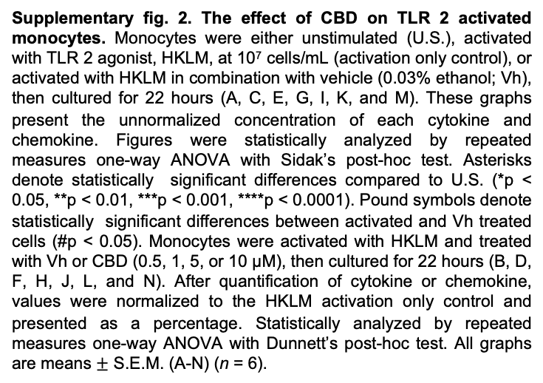
A
B
C
D
E
F
G
H
I
J
K
L
M
N
Supplementary fig. 2. The effect of CBD on TLR 2 activated monocytes. Monocytes were either unstimulated (U.S.), activated with TLR 2 agonist, HKLM, at 10⁷ cells/mL (activation only control), or activated with HKLM in combination with vehicle (0.03% ethanol; Vh), then cultured for 22 hours (A, C, E, G, I, K, and M). These graphs present the unnormalized concentration of each cytokine and chemokine. Figures were statistically analyzed by repeated measures one-way ANOVA with Sidak’s post-hoc test. Asterisks denote statistically significant differences compared to U.S. (*p < 0.05, **p < 0.01, ***p < 0.001, ****p < 0.0001). Pound symbols denote statistically significant differences between activated and Vh treated cells (#p < 0.05). Monocytes were activated with HKLM and treated with Vh or CBD (0.5, 1, 5, or 10 µM), then cultured for 22 hours (B, D, F, H, J, L, and N). After quantification of cytokine or chemokine, values were normalized to the HKLM activation only control and presented as a percentage. Statistically analyzed by repeated measures one-way ANOVA with Dunnett’s post-hoc test. All graphs are means $±$ S.E.M. (A-N) (n = 6).

Slide 3
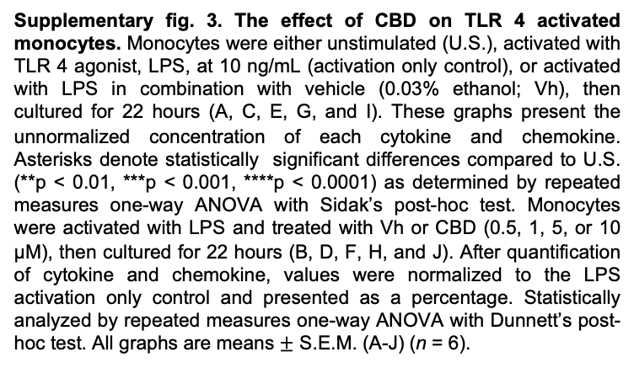
A
B
C
D
E
F
G
H
I
J
Supplementary fig. 3. The effect of CBD on TLR 4 activated monocytes. Monocytes were either unstimulated (U.S.), activated with TLR 4 agonist, LPS, at 10 ng/mL (activation only control), or activated with LPS in combination with vehicle (0.03% ethanol; Vh), then cultured for 22 hours (A, C, E, G, and I). These graphs present the unnormalized concentration of each cytokine and chemokine. Asterisks denote statistically significant differences compared to U.S. (**p < 0.01, ***p < 0.001, ****p < 0.0001) as determined by repeated measures one-way ANOVA with Sidak’s post-hoc test. Monocytes were activated with LPS and treated with Vh or CBD (0.5, 1, 5, or 10 µM), then cultured for 22 hours (B, D, F, H, and J). After quantification of cytokine and chemokine, values were normalized to the LPS activation only control and presented as a percentage. Statistically analyzed by repeated measures one-way ANOVA with Dunnett’s post-hoc test. All graphs are means $±$ S.E.M. (A-J) (n = 6).

Slide 4
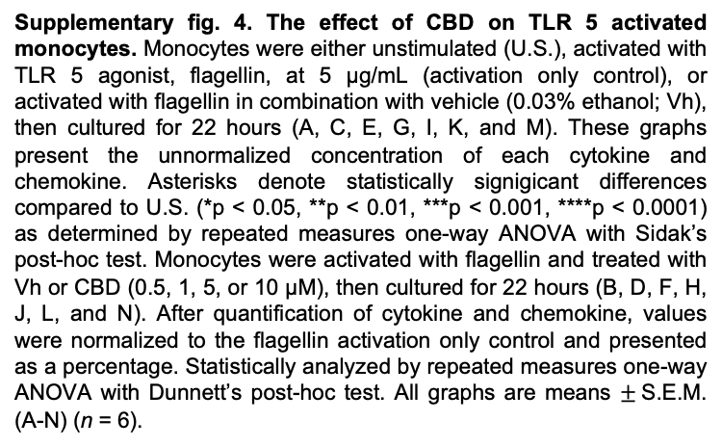
A
B
C
D
E
F
G
H
I
J
K
L
M
N
Supplementary fig. 4. The effect of CBD on TLR 5 activated monocytes. Monocytes were either unstimulated (U.S.), activated with TLR 5 agonist, flagellin, at 5 µg/mL (activation only control), or activated with flagellin in combination with vehicle (0.03% ethanol; Vh), then cultured for 22 hours (A, C, E, G, I, K, and M). These graphs present the unnormalized concentration of each cytokine and chemokine. Asterisks denote statistically signigicant differences compared to U.S. (*p < 0.05, **p < 0.01, ***p < 0.001, ****p < 0.0001) as determined by repeated measures one-way ANOVA with Sidak’s post-hoc test. Monocytes were activated with flagellin and treated with Vh or CBD (0.5, 1, 5, or 10 µM), then cultured for 22 hours (B, D, F, H, J, L, and N). After quantification of cytokine and chemokine, values were normalized to the flagellin activation only control and presented as a percentage. Statistically analyzed by repeated measures one-way ANOVA with Dunnett’s post-hoc test. All graphs are means $±$S.E.M. (A-N) (n = 6).

Slide 5
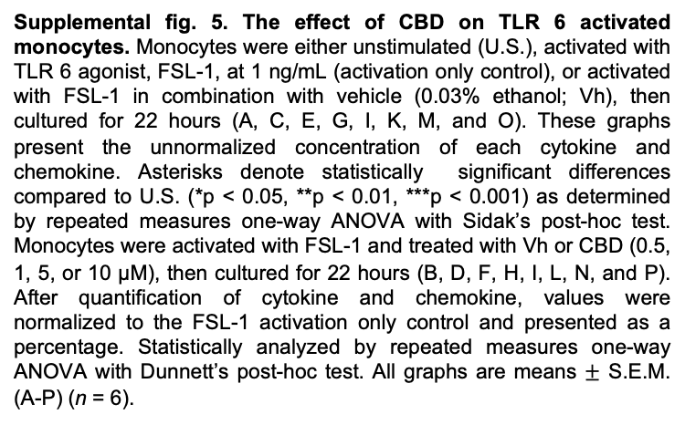
A
B
C
D
E
F
G
H
I
J
K
L
M
N
O
P
Supplemental fig. 5. The effect of CBD on TLR 6 activated monocytes. Monocytes were either unstimulated (U.S.), activated with TLR 6 agonist, FSL-1, at 1 ng/mL (activation only control), or activated with FSL-1 in combination with vehicle (0.03% ethanol; Vh), then cultured for 22 hours (A, C, E, G, I, K, M, and O). These graphs present the unnormalized concentration of each cytokine and chemokine. Asterisks denote statistically significant differences compared to U.S. (*p < 0.05, **p < 0.01, ***p < 0.001) as determined by repeated measures one-way ANOVA with Sidak’s post-hoc test. Monocytes were activated with FSL-1 and treated with Vh or CBD (0.5, 1, 5, or 10 µM), then cultured for 22 hours (B, D, F, H, I, L, N, and P). After quantification of cytokine and chemokine, values were normalized to the FSL-1 activation only control and presented as a percentage. Statistically analyzed by repeated measures one-way ANOVA with Dunnett’s post-hoc test. All graphs are means $±$ S.E.M. (A-P) (n = 6).

Slide 6
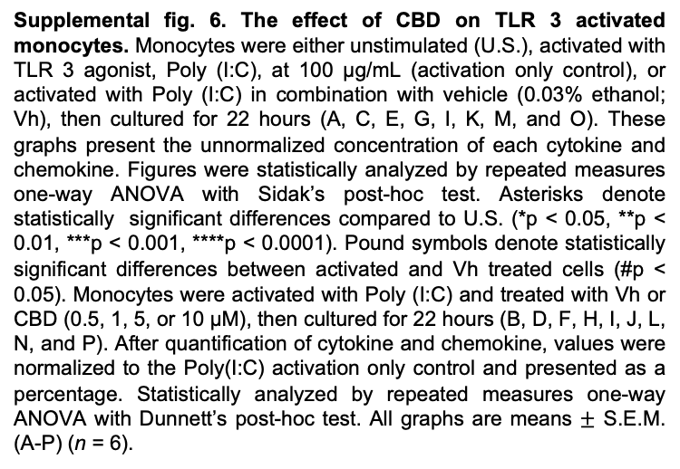
A
B
C
D
E
F
G
H
I
J
K
L
M
N
O
P
Supplemental fig. 6. The effect of CBD on TLR 3 activated monocytes. Monocytes were either unstimulated (U.S.), activated with TLR 3 agonist, Poly (I:C), at 100 µg/mL (activation only control), or activated with Poly (I:C) in combination with vehicle (0.03% ethanol; Vh), then cultured for 22 hours (A, C, E, G, I, K, M, and O). These graphs present the unnormalized concentration of each cytokine and chemokine. Figures were statistically analyzed by repeated measures one-way ANOVA with Sidak’s post-hoc test. Asterisks denote statistically significant differences compared to U.S. (*p < 0.05, **p < 0.01, ***p < 0.001, ****p < 0.0001). Pound symbols denote statistically significant differences between activated and Vh treated cells (#p < 0.05). Monocytes were activated with Poly (I:C) and treated with Vh or CBD (0.5, 1, 5, or 10 µM), then cultured for 22 hours (B, D, F, H, I, J, L, N, and P). After quantification of cytokine and chemokine, values were normalized to the Poly(I:C) activation only control and presented as a percentage. Statistically analyzed by repeated measures one-way ANOVA with Dunnett’s post-hoc test. All graphs are means $±$ S.E.M. (A-P) (n = 6).
Notes:
-remove IL-1b and IL-6 figures

Slide 7
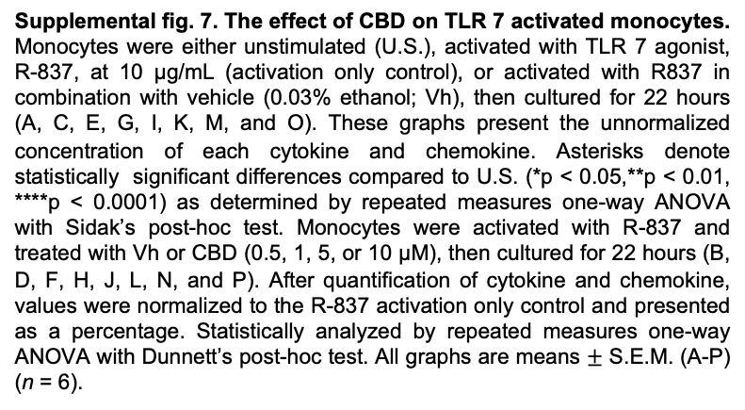
A
B
C
D
E
F
G
H
I
J
K
L
M
N
O
P
Supplemental fig. 7. The effect of CBD on TLR 7 activated monocytes. Monocytes were either unstimulated (U.S.), activated with TLR 7 agonist, R-837, at 10 µg/mL (activation only control), or activated with R837 in combination with vehicle (0.03% ethanol; Vh), then cultured for 22 hours (A, C, E, G, I, K, M, and O). These graphs present the unnormalized concentration of each cytokine and chemokine. Asterisks denote statistically significant differences compared to U.S. (*p < 0.05,**p < 0.01, ****p < 0.0001) as determined by repeated measures one-way ANOVA with Sidak’s post-hoc test. Monocytes were activated with R-837 and treated with Vh or CBD (0.5, 1, 5, or 10 µM), then cultured for 22 hours (B, D, F, H, J, L, N, and P). After quantification of cytokine and chemokine, values were normalized to the R-837 activation only control and presented as a percentage. Statistically analyzed by repeated measures one-way ANOVA with Dunnett’s post-hoc test. All graphs are means $±$ S.E.M. (A-P) (n = 6).

Slide 8
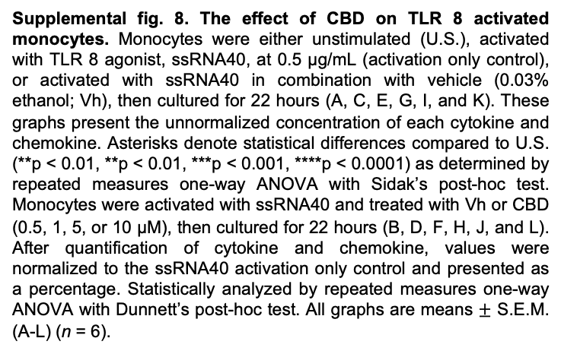
A
B
C
D
E
F
G
H
I
J
K
L
Supplemental fig. 8. The effect of CBD on TLR 8 activated monocytes. Monocytes were either unstimulated (U.S.), activated with TLR 8 agonist, ssRNA40, at 0.5 µg/mL (activation only control), or activated with ssRNA40 in combination with vehicle (0.03% ethanol; Vh), then cultured for 22 hours (A, C, E, G, I, and K). These graphs present the unnormalized concentration of each cytokine and chemokine. Asterisks denote statistical differences compared to U.S. (**p < 0.01, **p < 0.01, ***p < 0.001, ****p < 0.0001) as determined by repeated measures one-way ANOVA with Sidak’s post-hoc test. Monocytes were activated with ssRNA40 and treated with Vh or CBD (0.5, 1, 5, or 10 µM), then cultured for 22 hours (B, D, F, H, J, and L). After quantification of cytokine and chemokine, values were normalized to the ssRNA40 activation only control and presented as a percentage. Statistically analyzed by repeated measures one-way ANOVA with Dunnett’s post-hoc test. All graphs are means $±$ S.E.M. (A-L) (n = 6).
Notes:
Remove il-1b figures

Slide 9
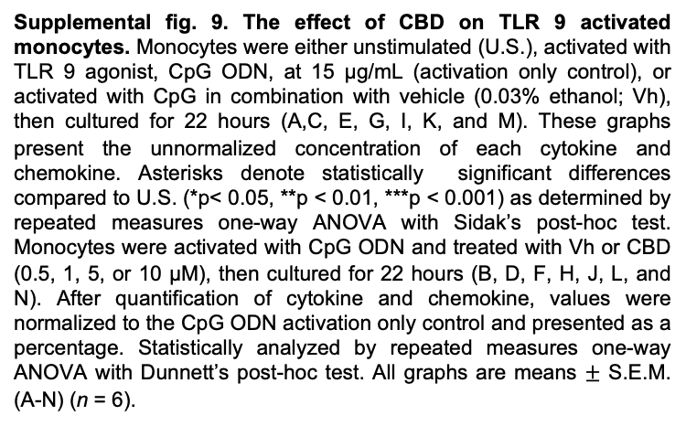
A
B
C
D
E
F
G
H
I
J
K
L
M
N
Supplemental fig. 9. The effect of CBD on TLR 9 activated monocytes. Monocytes were either unstimulated (U.S.), activated with TLR 9 agonist, CpG ODN, at 15 µg/mL (activation only control), or activated with CpG in combination with vehicle (0.03% ethanol; Vh), then cultured for 22 hours (A,C, E, G, I, K, and M). These graphs present the unnormalized concentration of each cytokine and chemokine. Asterisks denote statistically significant differences compared to U.S. (*p< 0.05, **p < 0.01, ***p < 0.001) as determined by repeated measures one-way ANOVA with Sidak’s post-hoc test. Monocytes were activated with CpG ODN and treated with Vh or CBD (0.5, 1, 5, or 10 µM), then cultured for 22 hours (B, D, F, H, J, L, and N). After quantification of cytokine and chemokine, values were normalized to the CpG ODN activation only control and presented as a percentage. Statistically analyzed by repeated measures one-way ANOVA with Dunnett’s post-hoc test. All graphs are means $±$ S.E.M. (A-N) (n = 6).

