Slide 1
Aloperine ameliorates IMQ-induced psoriasis by attenuating Th17 differentiation and facilitating their conversion to Treg

Slide 2
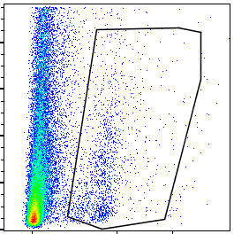
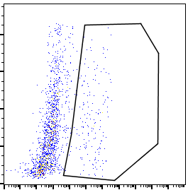
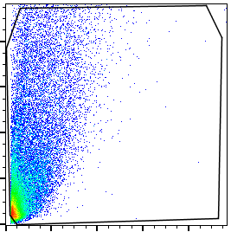
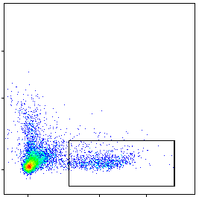
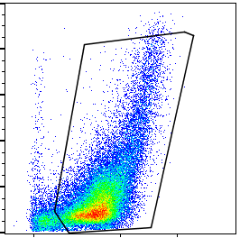
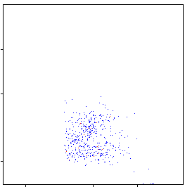
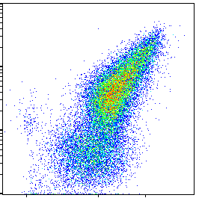
psoriasis
CD4+ cell
SSC
SSC
SSC
CD45
CD4
CD11c
dendritic cell
FSC
F4/80
SSC
CD11b
macrophage
neutrophil
Ly6G
air pounch model
CD45
CD11b
CD11b

