Slide 1
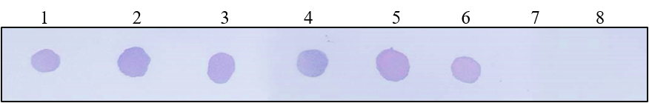
Supplement
Fig. S1
A
B

Slide 2
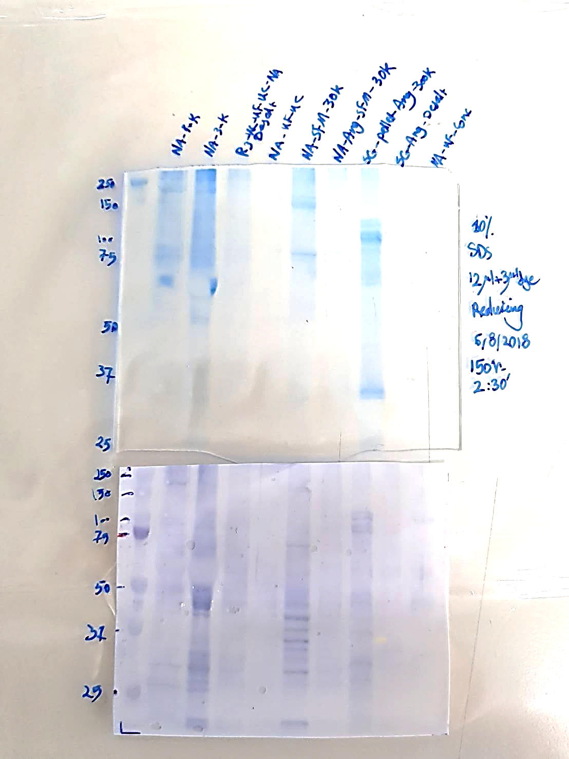
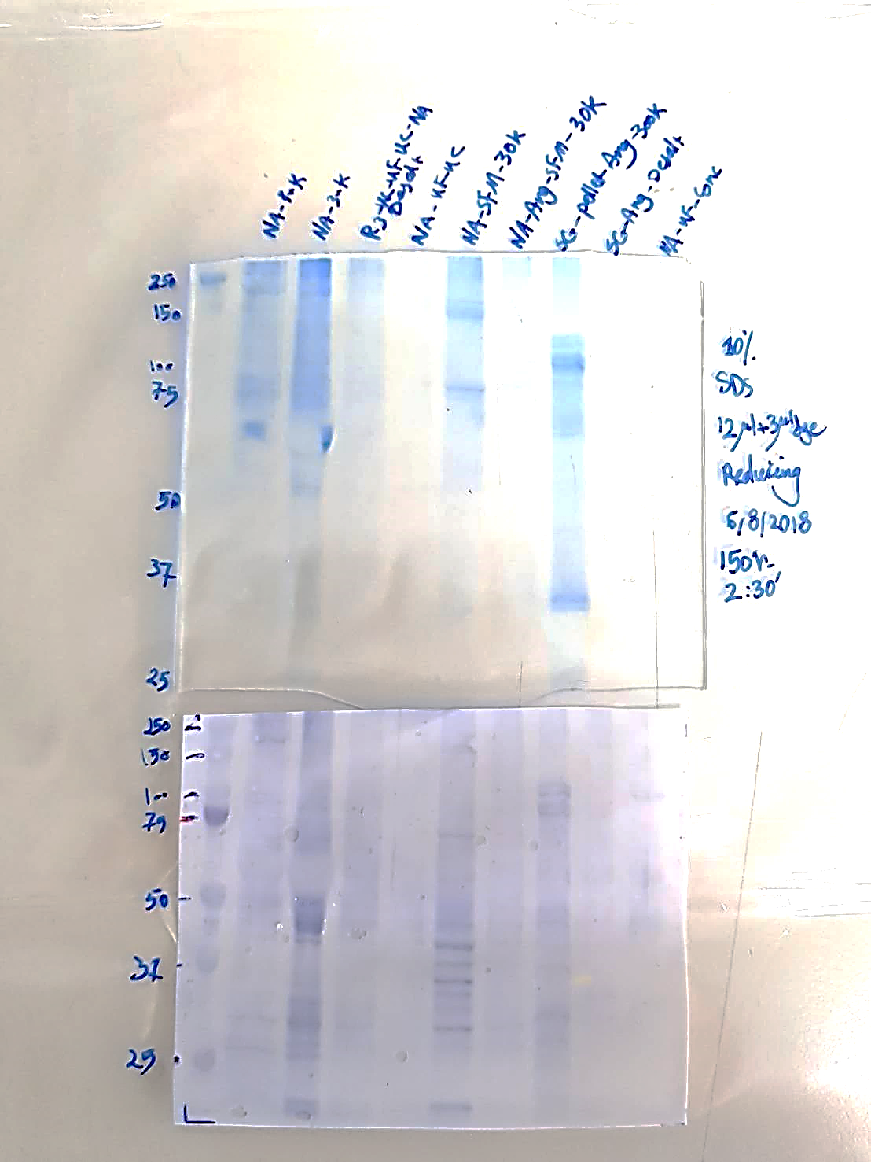
Supplement
Fig. S2
kDa
1
kDa
2
150
150
NA trimer
75
75
*
50
50
NA monomer
*
37
*
37
*
*
*
*
25
25
*

Slide 3
Supplement
Fig. S3

Slide 4
Supplement
Fig. S4
Mouse 3

