Slide 1
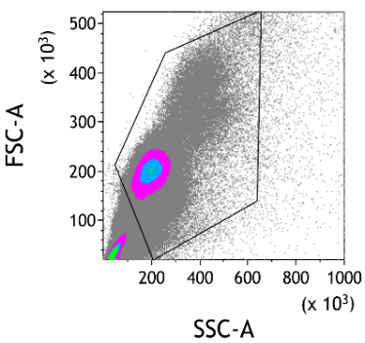
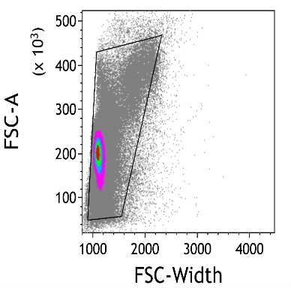
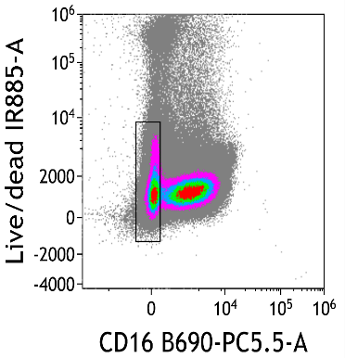
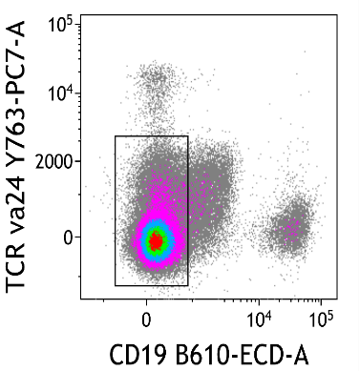
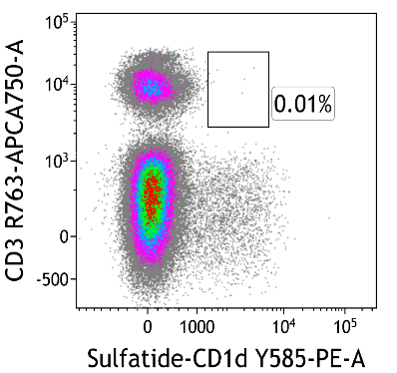
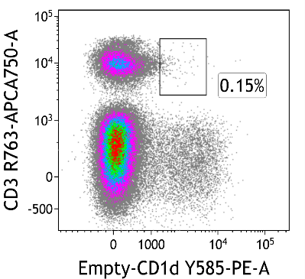
Singlets
Lymphocytes
Supplementary Figure 1. Sulfatide-loaded CD1d tetramer staining failed to identify T2NKT cells in PBMC.
CD1d tetramers were loaded with sulfatide and incubated with PBMC for 30 min at 4 °C. Cells were then stained for flow cytometry analysis. Dead cells, monocytes (CD16⁺), iNKT cells (TCRva24⁺) and B cells (CD19⁺) were excluded in the shown gating strategy. Empty CD1d tetramer was used as negative control. One experiment out of three is shown as an example.

Slide 2
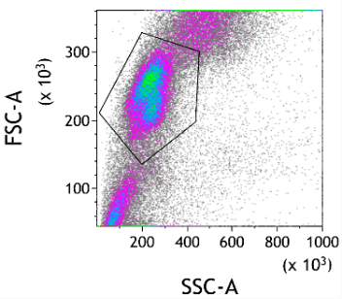
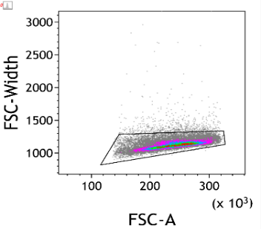
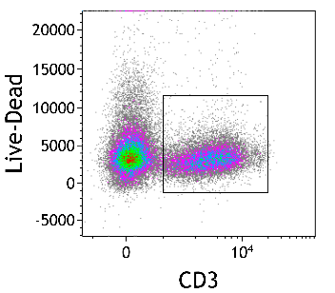
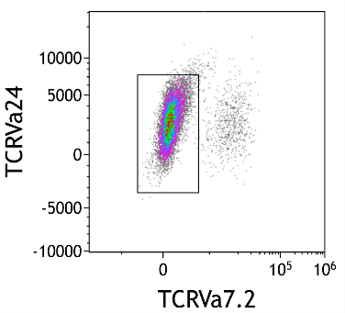
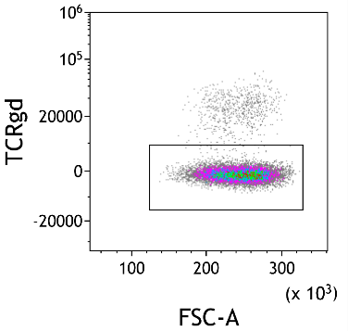
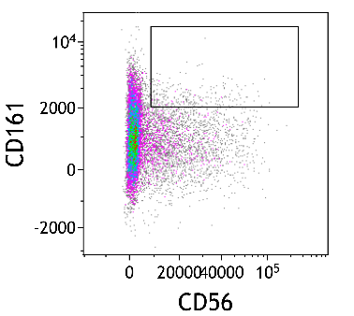
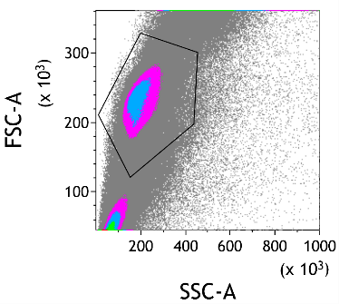
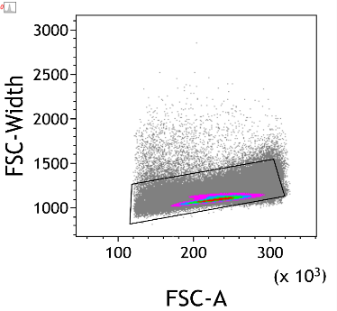
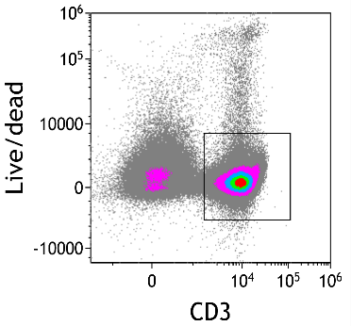
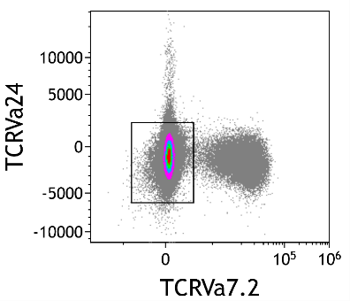
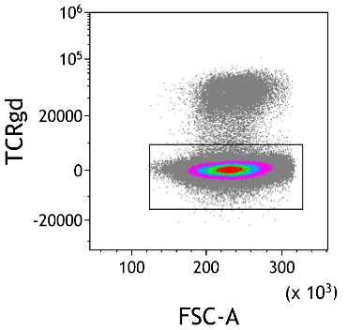
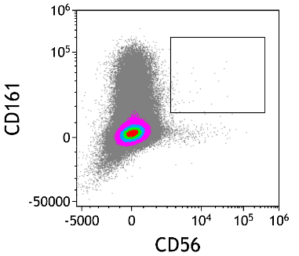
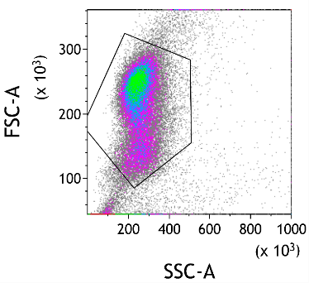
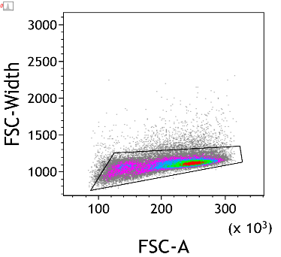
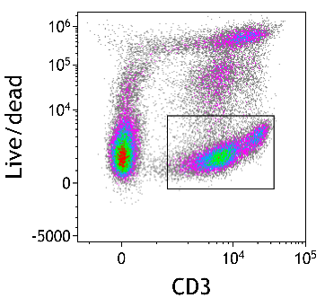
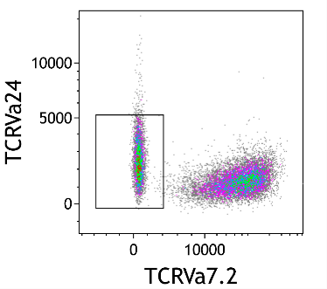
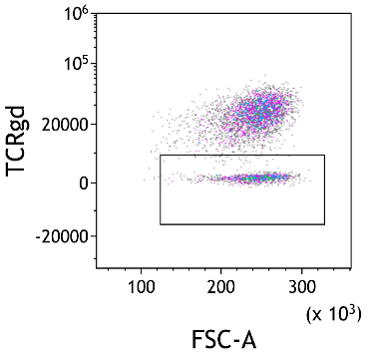
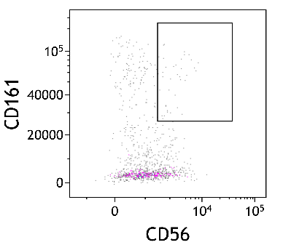
(A)
Strategy 1: CD3⁻ fraction of CD3 sort
Neg-selected cells I
Lymphocytes
Singlets
CD3⁺ T cells
T2NKT: 1.2%
Neg-selected cells II
(B)
Strategy 2: CD56⁻ fraction of the CD56 sort
Neg-selected cells I
Lymphocytes
Singlets
CD3⁺ T cells
T2NKT: 0.01%
Neg-selected cells II
(C)
Strategy 2: CD3⁻ fraction of the CD56/CD3 sort
Neg-selected cells I
Singlets
Lymphocytes
CD3⁺ T cells
Neg-selected cells II
T2NKT: 0.2%
Supplementary Figure 2. Sorting CD3⁺ cells prior to CD56⁺ (Strategy 1) showed greater loss of T2NKT cells than first sorting CD56⁺ cells (Strategy 2).
(A) PBMC were first sorted for CD3⁺ cells (Strategy 1). Analysis of the CD3⁻ fraction revealed a T2NKT cell loss of 1.2%. (B) In Strategy 2, PBMC were first sorted for CD56⁺ cells. Analysis of the CD56⁻ fraction revealed a smaller T2NKT cell loss of 0.01%. (C) CD56⁺ enriched cells were then sorted for CD3⁺ (Strategy 2). Analysis of the CD3⁻ fraction also revealed a smaller T2NKT cell loss of 0.2%. One example of a minimum of two independent experiments is shown. Loss of T2NKT cells is calculated as % of CD3⁺ T cells.

Slide 3
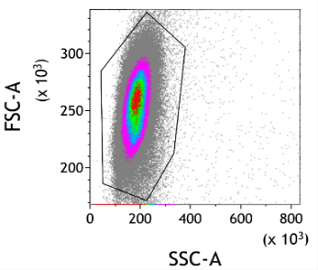
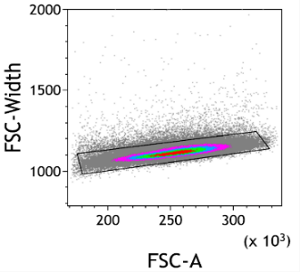
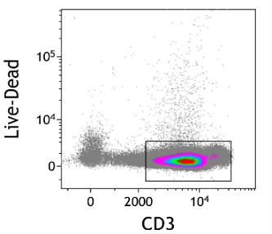
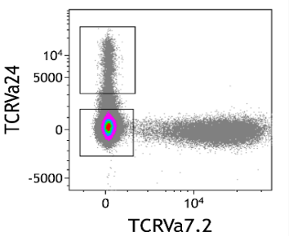
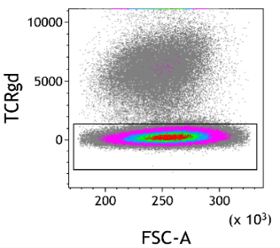
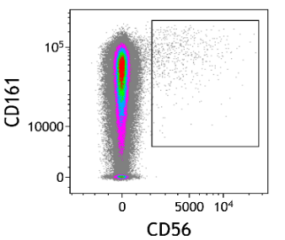
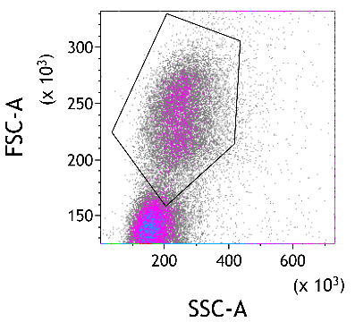
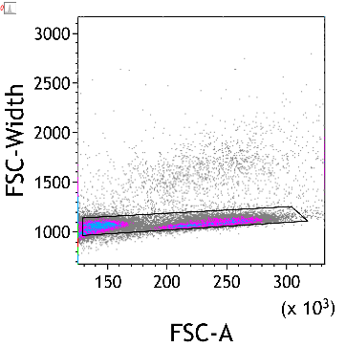
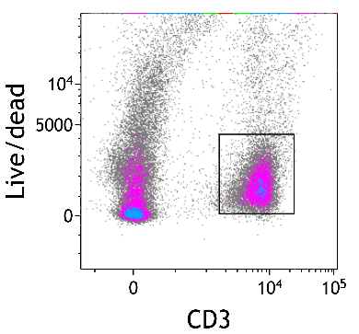
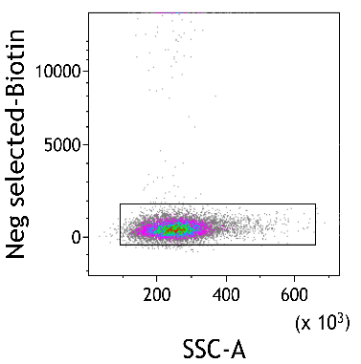
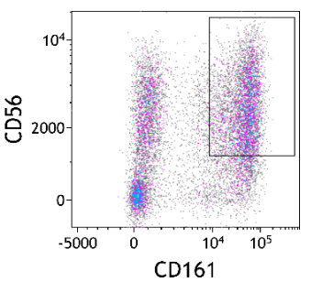
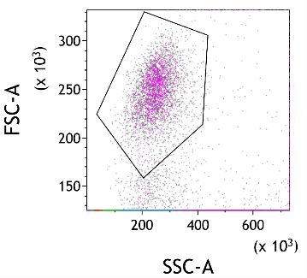
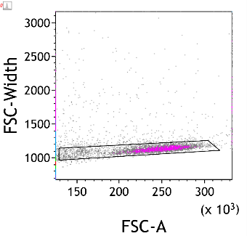
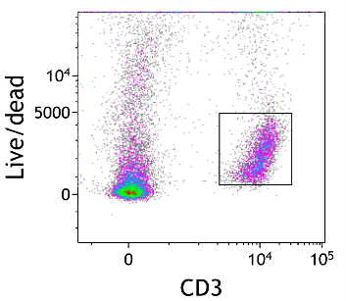
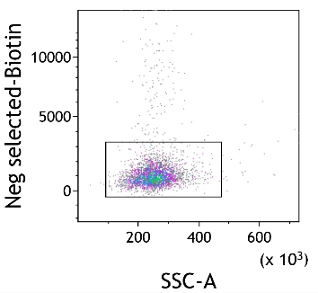
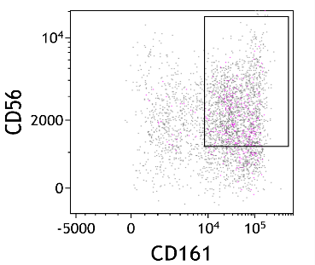
(A)
Strategy 3
iNKT: 1.6%
Lymphocytes
Singlets
CD3⁺ T cells
Neg-selected cells I
Neg-selected cells II
T2NKT: 0.2%
(B)
Strategy 4
Neg-selected cells
Lymphocytes
Singlets
CD3⁺ T cells
T2NKT: 41.6% 4834 events
(C)
Strategy 5
Neg-selected cells
Lymphocytes
Singlets
CD3⁺ T cells
T2NKT: 50.5% 2107 events
Supplementary Figure 3. Sorting Strategies 3-5 failed in enriching T2NKT cells.
(A) Miltenyi´s CD3⁺ CD56⁺ NKT Cell Isolation Kit (Strategy 3) resulted in enrichment of iNKT cells (1.6%) but not T2NKT cells (0.2%). (B) CD56⁺ sort of PBMC followed by a CD3⁺ sort and then depletion of γꝽ T cells, iNKT cells and MAIT cells (Strategy 4) resulted in increased frequency of T2NKT cells (41.6%) but yielded unacceptable low absolute number of T2NKT cells (4834 events). (C) In Strategy 5, PBMC were first sorted for CD56⁺ and CD3⁺, then depleted of γꝽ T cells, iNKT cells and MAIT cells and then further enriched for CD161⁺ cells. Again, sorting resulted in increased frequency of T2NKT cells (50.5%) but yielded unacceptable low absolute number of T2NKT cells (2107 events). Antibodies against TCRVa7.2, TCRVa24 and TCRgd were labeled with Biotin (Neg selected-Biotin). One experiment of a minimum of two is shown. Enrichment of T2NKT cells is calculated as % of CD3⁺ T cells.

Slide 4
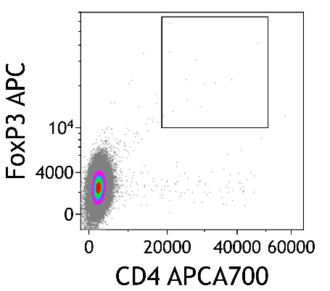
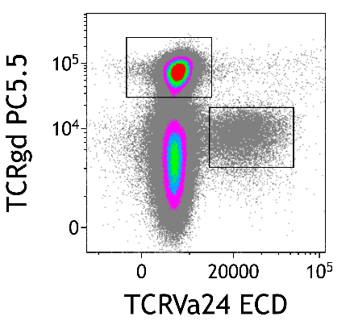
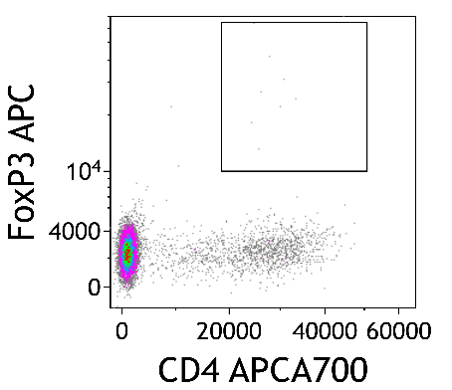
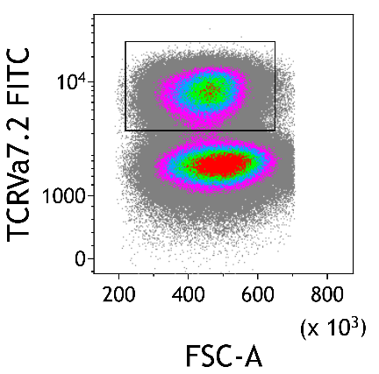
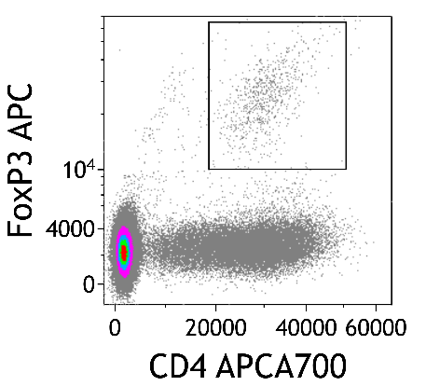
gd T cells
iNKT
MAIT
Supplementary Figure 4. Flow cytometry gating of γꝽ T cells, iNKT cells and MAIT cells from double-step MACS enriched CD3⁺ cells. Only MAIT cells presented a CD4⁺ Foxp3⁺ subset.

Slide 5
 |  | 488 nm |  |  | 561 nm |  |  |  | 638 nm |  |  | 405 nm |  |  | 808 nm
 |  | 525/40 | 610/20 | 690/50 | 585/42 | 610/20 | 710/50 | 763/43 | 660/10 | 712/25 | 763/43 | 450/45 | 525/40 | 763/43 | 885/40
 |  | FITC | ECD | PerCP | PE | AF594 | PC5.5 | PC7 | APC | AF700 | AFire750 | BV421 | BV510 | BV785 | Viability
FIGURE 1A | Antigen | TCR Vα7.2 | CD19 | CD16 | CD161 | CD8 | TCR γδ | TCR-Vα24 | NKG2A | CD4 | CD3 | NKG2D | TCRab | CD56 | Live/Dead
 | Clone | 3C10 | HD237 | 3G8 | HP-3G10 | RPA-T8 | IMMU510 | 6B11 | S19004C | SK3 | SK7 | 1D11 | IP26 | 5.1H11
 | Isotype | mIgG1 | mIgG2 | mIgG1 | mIgG1 | mIgG1 | mIgG1 | mIgG1 | mIgG1 | mIgG1 | mIgG1 | mIgG1 | mIgG1 | mIgG1
 | Fluorochrome | FITC | ECD | PerCP | PE | AF594 | PC5.5 | PC7 | APC | AF700 | APC-H7 | BV421 | BV510 | BV785 | ViaKr-808
 | Vol. (µl) in 100µl | 5 | 10 | 4 | 2 | 2 | 5 | 2 | 5 | 3 | 4 | 5 | 3 | 5 | 2.5
 | Supplier | BioLegend | BC | BioLegend | BioLegend | BioLegend | BC | BioLegend | BioLegend | BioLegend | BD | BioLegend | BioLegend | BioLegend | BC
 | Cat.# | 351703 | 6604551 | 302029 | 339904 | 301056 | A99021 | 342911 | 375108 | 344621 | 560176 | 320822 | 306734 | 362549 | C36628
 | Status | RUO | RUO | RUO | RUO | RUO | ASR | RUO | RUO | RUO | RUO | RUO | RUO | RUO | RUO
 |  | 488 nm |  |  | 561 nm |  |  |  | 638 nm |  |  | 405 nm |  | 808 nm
 |  | 525/40 | 610/20 | 690/50 | 585/42 | 610/20 | 710/50 | 763/43 | 660/10 | 712/25 | 763/43 | 450/45 | 763/43 | 885/40
 |  | FITC | ECD | PerCP | PE | AF594 | PC5.5 | PC7 | APC | AF700 | AFire750 | BV421 | BV785 | Viability
FIGURE 1B | Antigen | TCR Vα7.2 | CD19 | CD16 | Tetramer | CD8 | TCR γδ | TCR-Vα24 | CD161 | CD4 | CD3 | NKG2D | CD56 | Live/Dead
 | Clone | 3C10 | HD237 | 3G8 | NA | RPA-T8 | IMMU510 | 6B11 | HP-3G10 | SK3 | SK7 | 1D11 | 5.1H11
 | Isotype | mIgG1 | mIgG2 | mIgG1 | NA | mIgG1 | mIgG1 | mIgG1 | mIgG1 | mIgG1 | mIgG1 | mIgG1 | mIgG1
 | Fluorochrome | FITC | ECD | PerCP | PE | AF594 | PC5.5 | PC7 | PE | AF700 | APC-H7 | BV421 | BV785 | ViaKr-808
 | Vol. (µl) in 100µl | 5 | 10 | 4 | NA | 2 | 5 | 2 | 2 | 3 | 4 | 5 | 5 | 2.5
 | Supplier | BioLegend | BC | BioLegend | NHI | BioLegend | BC | BioLegend | BioLegend | BioLegend | BD | BioLegend | BioLegend | BC
 | Cat.# | 351703 | 6604551 | 302029 | NA | 301056 | A99021 | 342911 | 339912 | 344621 | 560176 | 320822 | 362549 | C36628
 | Status | RUO | RUO | RUO | RUO | RUO | ASR | RUO | RUO | RUO | RUO | RUO | RUO | RUO
 |  | 355 nm | 488 nm |  |  | 561 nm |  |  |  | 638 nm |  |  | 405 nm |  |  |  | 808 nm
 |  | 405/10 | 525/40 | 610/20 | 690/50 | 585/42 | 610/20 | 710/50 | 763/43 | 660/10 | 712/25 | 763/43 | 450/45 | 525/40 | 610/20 | 763/43 | 885/40
 |  | BUV395 | FITC | ECD | PerCP | PE | AF594 | PC5.5 | PC7 | APC | AF700 | AFire750 | BV421 | BV510 | BV605 | BV785 | Viability
FIGURE 2C | Antigen | CD3 | TCR Vα7.2 | TCR-va24 | CD16 | aGalCer | CD8 | TCR γδ | PLZF | FoxP3 | CD4 | CD161 | NKG2D | CD127 | CD56 | CD25 | Live/Dead
 | Clone | HIT3a | 3C10 | 6B11 | 3G8 | NA | RPA-T8 | IMMU510 | 9E12 | 259D | SK3 | HP-3G10 | 1D11 | A019D5 | HCD56 | M-A251
 | Isotype | mIgG2 | mIgG1 | mIgG1 | mIgG1 | NA | mIgG1 | mIgG1 | HamsterIgG | mIgG1 | mIgG1 | mIgG1 | mIgG1 | mIgG1 | mIgG2 | mIgG1
 | Fluorochrome | BUV395 | FITC | PE-Dazzle | PerCP | PE | AF594 | PC5.5 | PE/Cyanine7 | AF647 | AF700 | APC | BV421 | BV510 | BV605 | BV785 | ViaKr-808
 | Vol. (µl) in 100µl | 5 | 5 | 4 | 4 | 2 | 2 | 5 | 2.5 | 2 | 3 | 2 | 5 | 3 | 5 | 5 | 2.5
 | Supplier | BD | BioLegend | BioLegend | BioLegend | NHI | BioLegend | BC | eBioscience | BioLegend | BioLegend | BioLegend | BioLegend | BioLegend | BioLegend | BioLegend | BC
 | Cat.# | 740283 | 351703 | 342920 | 302029 | NA | 301056 | A99021 | 16340804 | 320213 | 344621 | 339911 | 320822 | 351332 | 318334 | 356140 | C36628
 | Status | RUO | RUO | RUO | RUO | RUO | RUO | ASR | RUO | RUO | RUO | RUO | RUO | RUO | RUO | RUO | RUO
 |  |  |  |  | 488 nm | 561 nm |  | 638 nm |  | 405 nm
 |  |  |  |  | 525/40 | 585/42 | 710/50 | 660/10 | 763/43 | 450/45
 |  | Biotin |  |  | FITC | PE | PC5.5 | APC | AFire750 | BV421
FIGURE 3A | Antigen | TCR γδ | TCR-Vα24 | TCR Vα7.2 | Biotin | CD161 | CD25 | CD56 | CD3 | CD4
 | Clone | 11F2 | REA948 | REA179 | REA746 | HP-3G10 | M-A251 | HCD56 | SK7 | SK3
 | Isotype | mIgG1 | rhuman IgG1 | rhuman IgG1 | rhuman IgG1 | mIgG1 | mIgG1 | mIgG1 | mIgG1 | rIgG1
 | Fluorochrome | N/A | N/A | N/A | Vio Bright B515 | PE | PC5.5 | APC | APC-H7 | BV421
 | Vol. (µl) in 100µl | 9 | 9 | 9 | 2 | 2 | 5 | 5 | 5 | 3
 | Supplier | Miltenyi | Miltenyi | Miltenyi | Miltenyi | BioLegend | BioLegend | BioLegend | BD | BioLegend
 | Cat.# | 130-113-502 | 130-117-958 | 130-100-187 | 130-110-957 | 339904 | 356112 | 318310 | 560176 | 344632
 | Status | RUO | RUO | RUO | RUO | RUO | RUO | RUO | RUO | RUO
 |  |  |  |  | 488 nm | 561 nm |  |  | 638 nm |  | 405 nm |  | 808 nm
 |  |  |  |  | 525/40 | 585/42 | 710/50 | 763/43 | 660/10 | 763/43 | 525/40 | 610/20 | 885/40
 |  | Biotin |  |  | FITC | PE | PC5.5 | PC7 | APC | AFire750 | BV510 | BV605 | Viability
FIGURE 3D | Antigen | TCR γδ | TCR-Vα24 | TCR Vα7.2 | Biotin | CD161 | CD25 | PLZF | FoxP3 | CD3 | CD127 | CD56 | Live/Dead
 | Clone | 11F2 | REA948 | REA179 | REA746 | HP-3G10 | M-A251 | 9E12 | 259D | SK7 | A019D5 | HCD56
 | Isotype | mIgG1 | rhuman IgG1 | rhuman IgG1 | rhuman IgG1 | mIgG1 | mIgG1 | HamsterIgG | mIgG1 | mIgG1 | mIgG1 | mIgG2
 | Fluorochrome | N/A | N/A | N/A | Vio Bright B515 | PE | PC5.5 | PE/Cyanine7 | AF647 | APC-H7 | BV510 | BV605 | ViaKr-808
 | Vol. (µl) in 100µl | 9 | 9 | 9 | 2 | 2 | 5 | 2.5 | 2 | 5 | 2 | 5 | 2.5
 | Supplier | Miltenyi | Miltenyi | Miltenyi | Miltenyi | BioLegend | BioLegend | eBioscience | BioLegend | BD | BioLegend | BioLegend | BC
 | Cat.# | 130-113-502 | 130-117-958 | 130-100-187 | 130-110-957 | 339904 | 356112 | 16340804 | 320213 | 560176 | 351332 | 318334 | C36628
 | Status | RUO | RUO | RUO | RUO | RUO | RUO | RUO | RUO | RUO | RUO | RUO | RUO
Supplementary Figure 5. Flow cytometry panels to characterize T2NKT cells in PBMC (Figure 1A) and liver (Figure 1B), MACS-enriched sample (Figure 2C), FACS sorting (Figure 3A), and expanded cells (Figure 3D).

