Slide 1
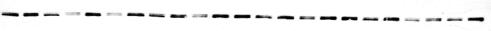
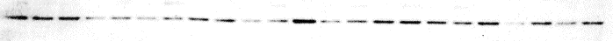
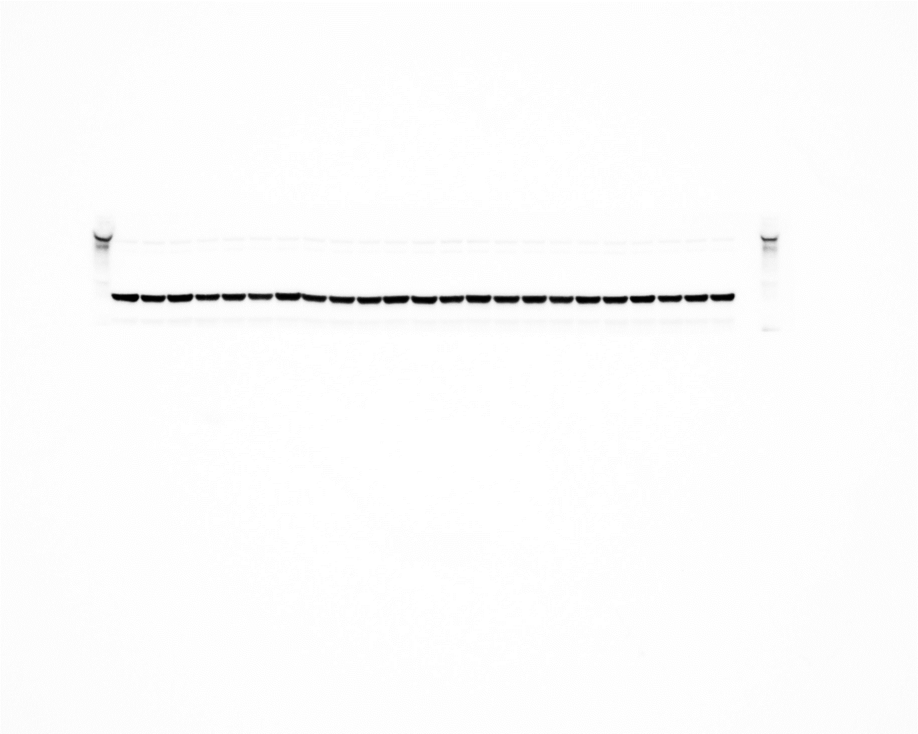
Supplementary Fig 2.
3 days post blast
Male
Female
Sham
Blast
Sham
Blast
ZO1
Occludin
Actin
Representative Western blot and densitometry quantification of ZO-1 and Occludin from brain amygdala lysates after 3d post-mbTBI from male and female rats (n=5-7 rats/group). Data are mean ± SEM. P ≤ 0.05* by 2-way ANOVA with Bonferroni post-hoc

