Slide 1
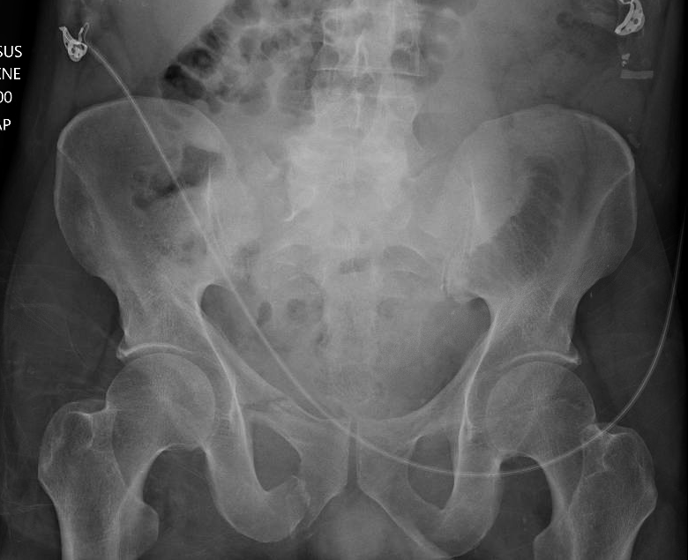
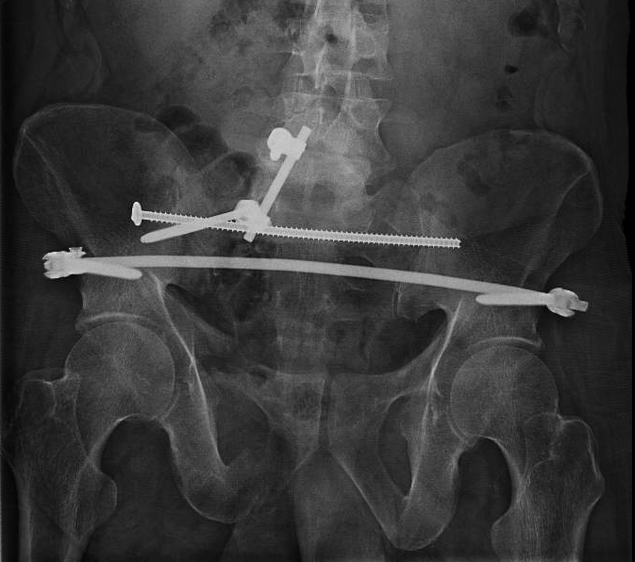
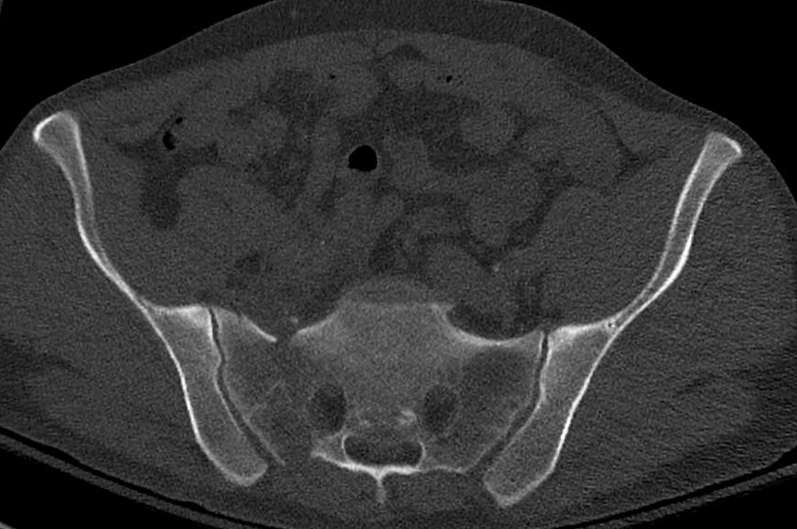
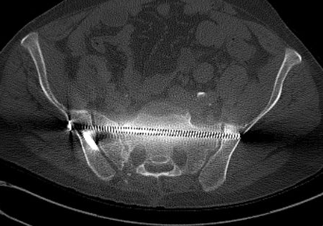
A
C
SD Content 1A: Patient #6 – OTA/AO 61C1.3(a). AP pelvis radiograph in the resus bay showing right sided sacral fracture with right sided pubic rami fractures(A). Pre-operative CT scan showing right sided comminuted sacral fracture (B). Immediate post-op AP radiograph showing right sided lumbopelvic fixation, right SI TS screw, and INFIX (C). Post op CT scan showing posterior pelvic reduction (D).
B
D

Slide 2
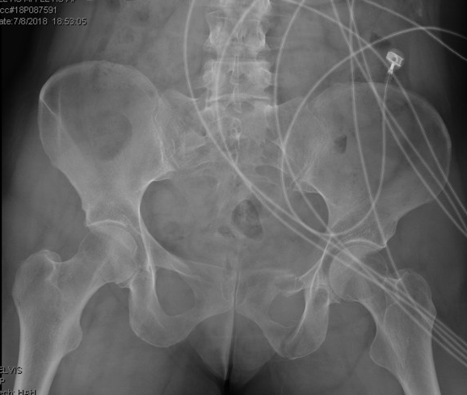
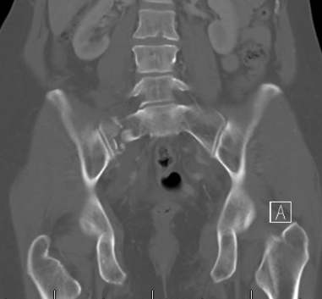
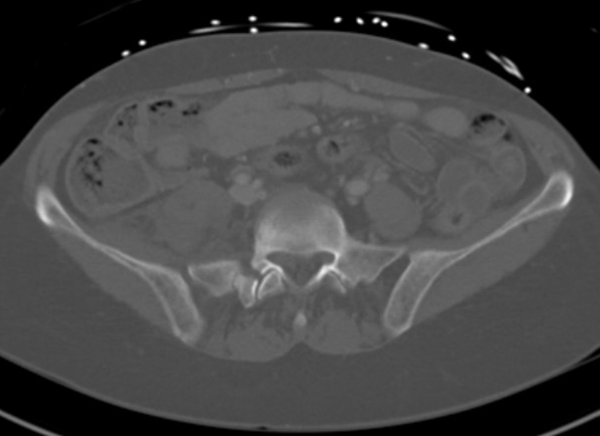
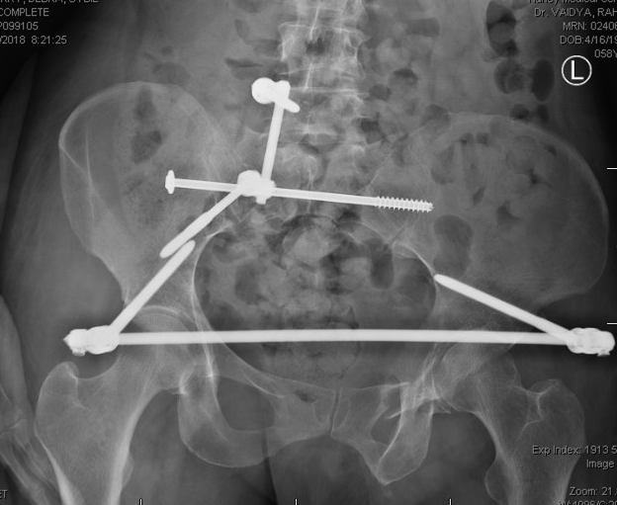
SD Content 1B: Example Case #2, right sided sacral fracture with extension into L5/S1 facet – Patient #7 OTA/AO 61C3.1(c) - AP pelvis x-ray in ED showing right sided sacral fracture with left sided pubic rami fractures (A). Coronal CT scan (bone window) showing right sided comminuted sacral ala fracture (B). Axial CT scan (bone window) showing extension of sacral fracture into right L5-S1 facet (C). AP pelvis at three months follow up showing R sided triangular osteosynthesis and INFIX. The posterior pelvic ring is well reduced and healed (D).
A
B
C
D

Slide 3
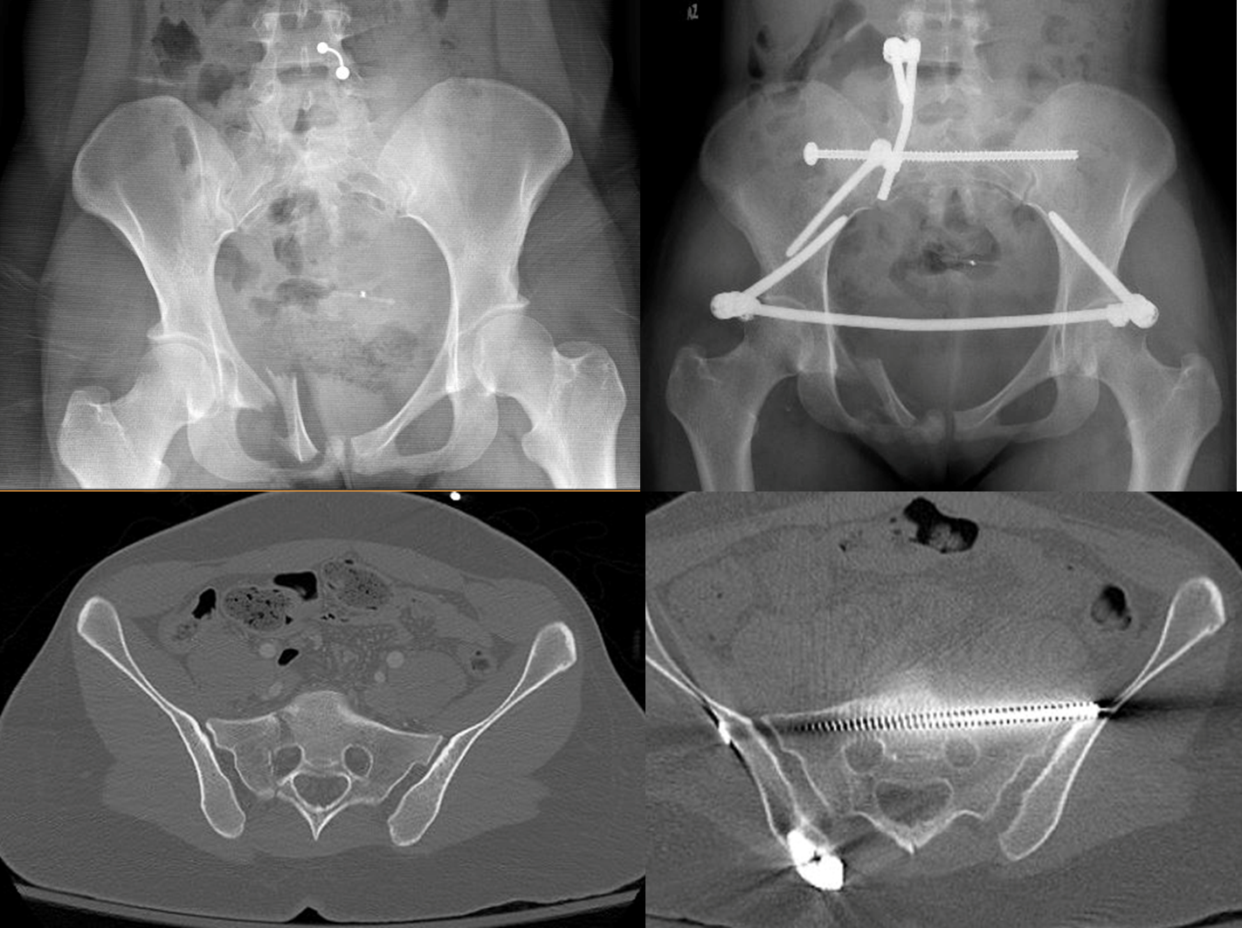

C
SD Content 1C: Patient #8 – OTA/AO 61C1.3(a,f). AP pelvis radiograph in the resus bay showing right sided sacral fracture with right sided pubic rami tilt fracture (A). Pre-operative CT scan showing right sided comminuted sacral fracture (B). Immediate post-op AP radiograph showing right sided lumbopelvic fixation, right side S1 TS screw, and INFIX (C). Post op CT scan showing posterior pelvic reduction (D).
B
D

Slide 4
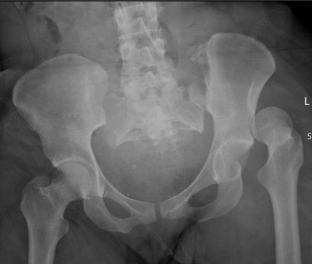
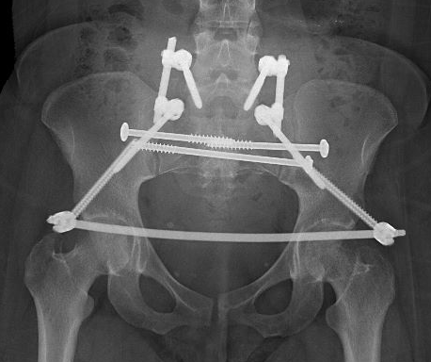
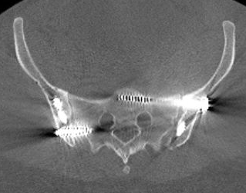
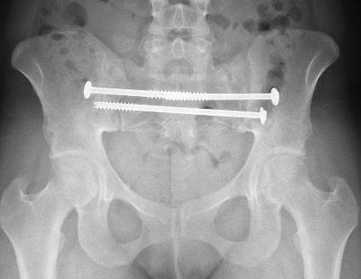
A
B
SD Content 1D: Example Case #3, bilateral vertical SI joint fracture dislocations – Patient #10 OTA/AO 61C3.1(j) - AP pelvis x-ray in ED showing L hip dislocation and bilateral vertical SI joint fracture dislocations (A). Postoperative AP radiograph showing final bilateral lumbopelvic fixation with bilateral S1 iliosacral screws, left side S2 trans-sacral screw, and anterior pelvic INFIX (B). Postoperative axial CT scan showing reduced posterior pelvis (C). AP pelvis x-ray at one year follow-up after hardware removal of INFIX and bilateral lumbopelvic fixation showing a reduced and healed pelvis (D).
C
D

Slide 5
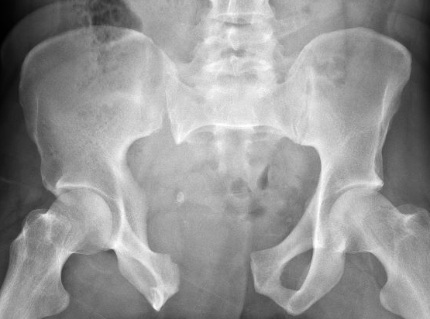
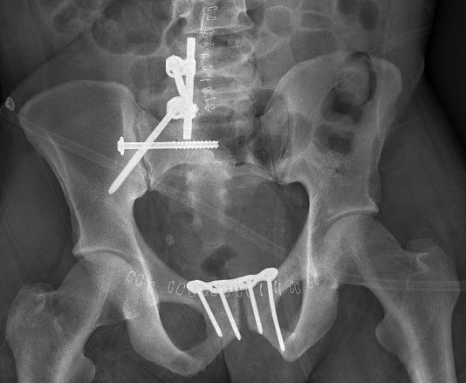
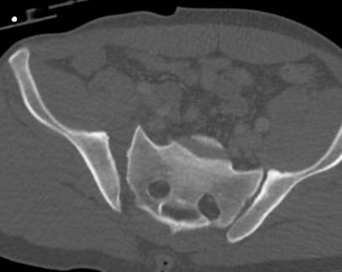
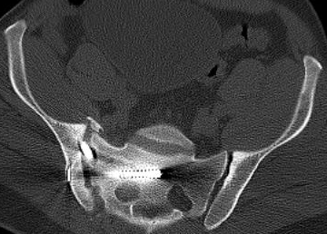
A
C
SD Content 1E: Patient #12 – OTA/AO 61C1.2(d). AP pelvis radiograph in the resus bay showing APC3 pelvic injury with right sided sacral fracture and SI joint disruption (A). Pre-operative CT scan showing right sided SI joint widening. This patient also had sacral fracture extension into the L5-S1 facet joint (B). Immediate post-op AP radiograph showing right sided lumbopelvic fixation, side S1 SI screw, and pubic symphysis plating (C). Post op CT scan showing posterior pelvic reduction. The iliac screw can be seen crossing the SI joint as part of the triangular fixation (D).
B
D

Slide 6
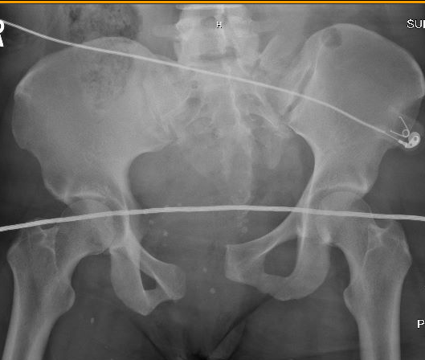
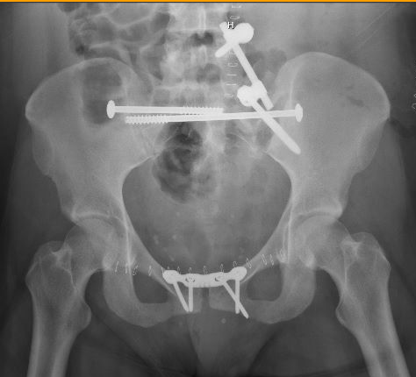
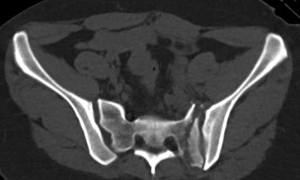
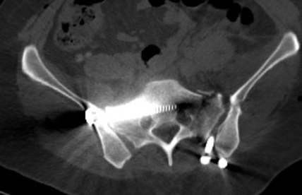
A
C
SD Content 1F: Patient #13 – OTA/AO 61C2.3(d,n). AP pelvis radiograph in the resus bay showing left sided sacral fracture, right side APC2 injury, and pubic symphysis widening (A). Pre-operative CT scan showing left sided comminuted sacral fracture and widening of the right SI joint (B). Immediate post-op AP radiograph showing left sided lumbopelvic fixation, left side S1 TS screw, right side S1 SI screw, and pubic symphysis plating (C). Post op CT scan showing posterior pelvic reduction (D).
B
D

Slide 7
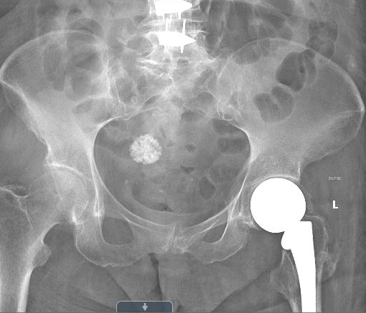
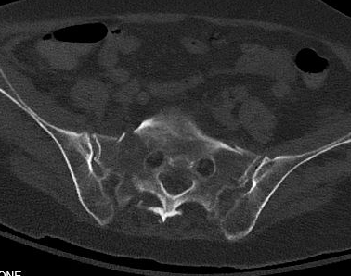
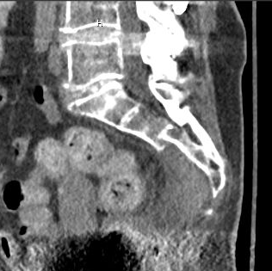
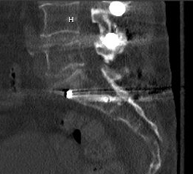
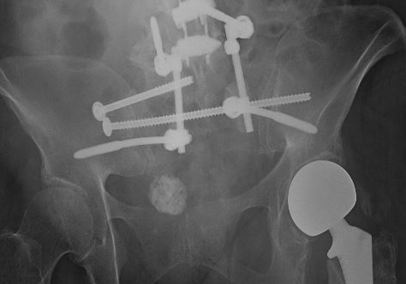
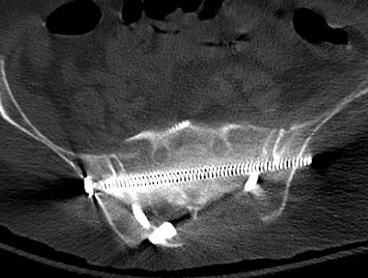
A
B
C
E
D
F
SD Content 1G: Patient #18 – OTA/AO 61C1.3. AP pelvis radiograph in the resus bay showing bilateral sacral fractures (A). Pre-operative axial CT scan showing bilateral sacral fractures (B). Preoperative sagittal CT scan showing kyphotic deformity of sacrum due to U-type fracture (C). Immediate post-op AP radiograph showing bilateral lumbopelvic fixation, right side S1 SI screw, and right S2 TS screw (D). Post op sagittal (E) and axial (F) CT scans showing reduction of sacral kyphosis and of posterior pelvic ring.

