Slide 1
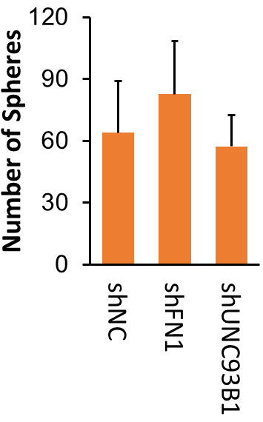
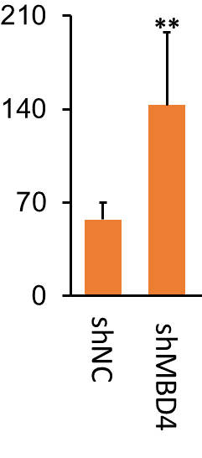
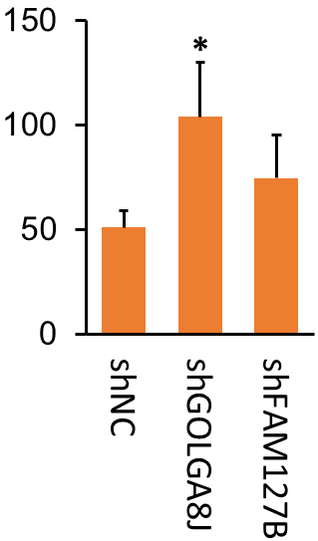
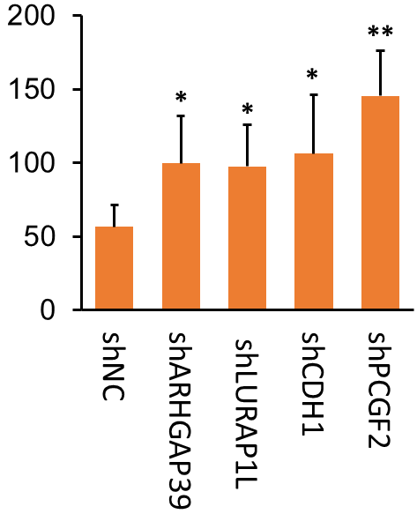
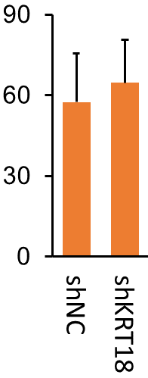
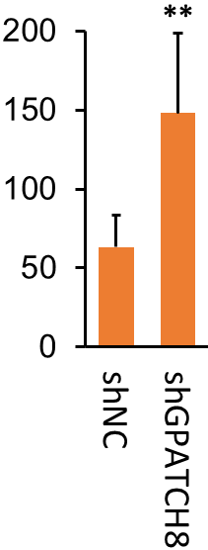
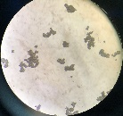
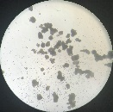
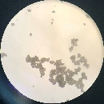
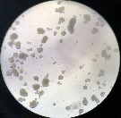

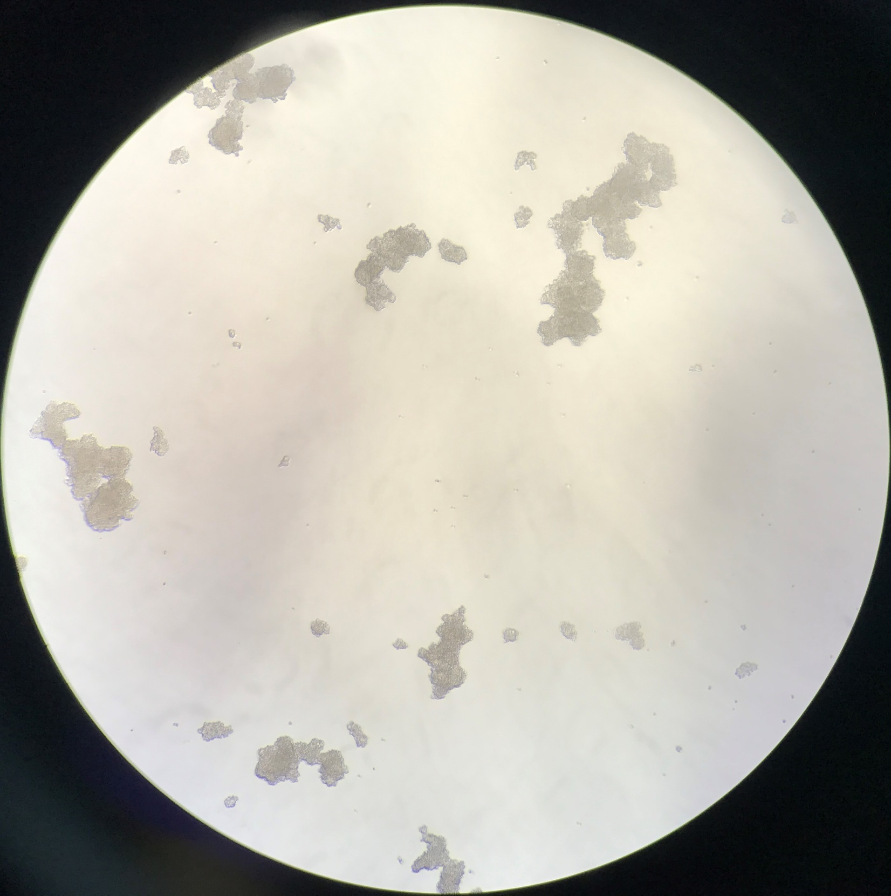
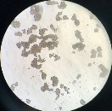
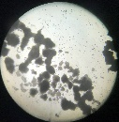





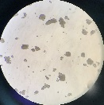



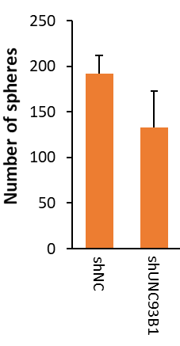
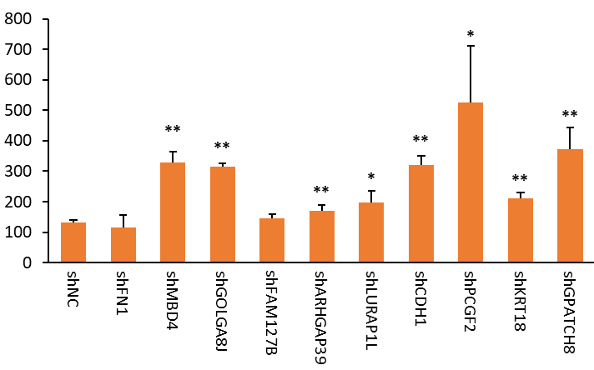


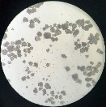










Supplementary Figure 1
a
HCT116
b
SW620
Notes:
Supplementary Figure 1. Sphere formation and subpopulation ratio of knock-down cells of mutant genes that coexisted in E/133⁺, E/133⁺44⁺ and E/44⁺ CRCIC cells in scWES data. a. Sphere formation of each knock-down HCT116 cells and shNC cells. b. Sphere formation of each knock-down SW620 cells and shNC cells. Magnification: 40 X. c,d. Compared with shNC cells, the percentage changes of each CRCIC or CRCC group in each knock-down HCT116 (c) and SW620 (d) cells by FACS assays, n=3. Student t-test was used. Data are presented as mean ± SD. * P < 0.05; ** P < 0.01. shNC and shNC-GFP cells are negative control cells transfected with lentivirus-packing plasmids.

Slide 2
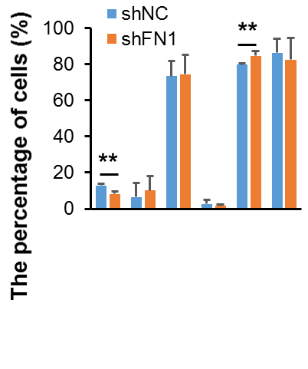
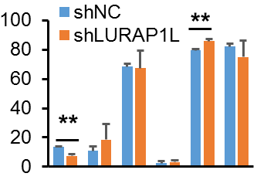
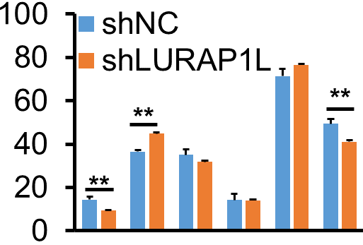
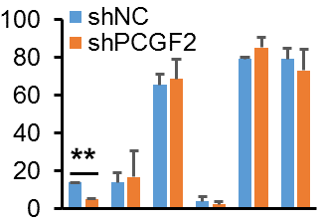
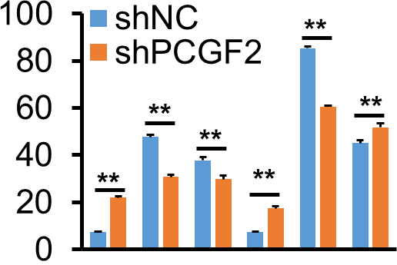
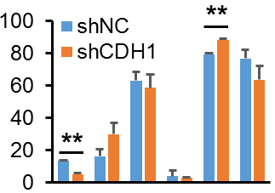
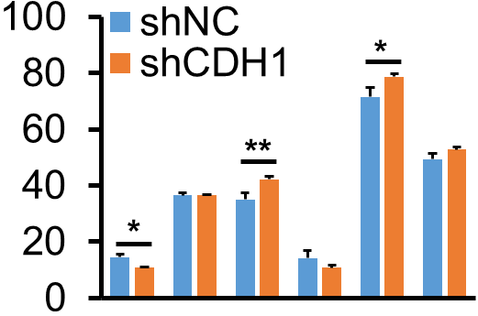
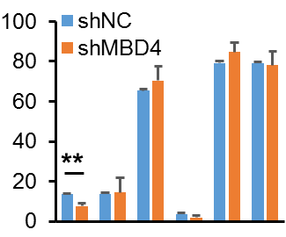
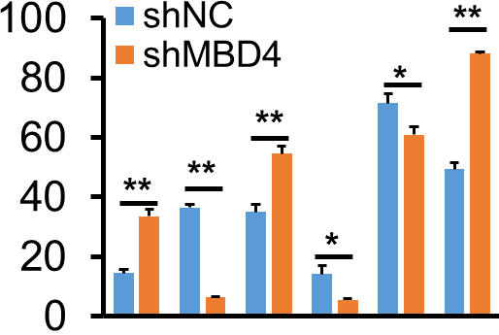
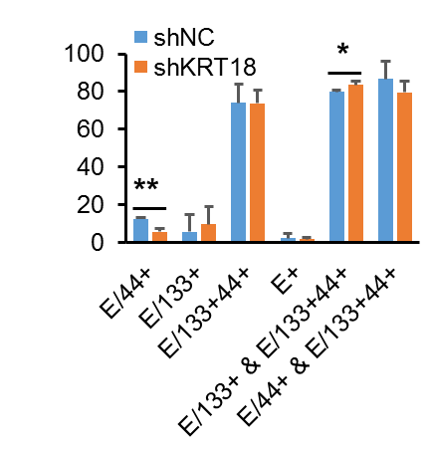
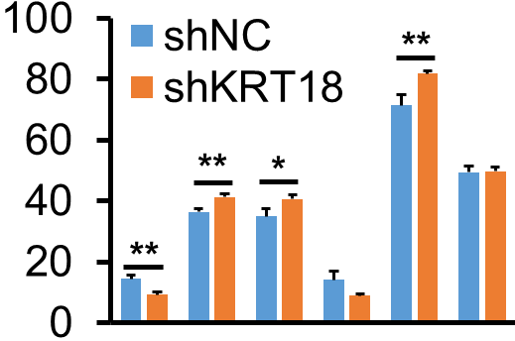
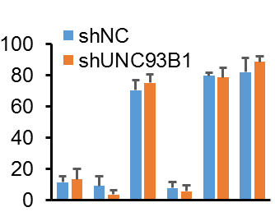
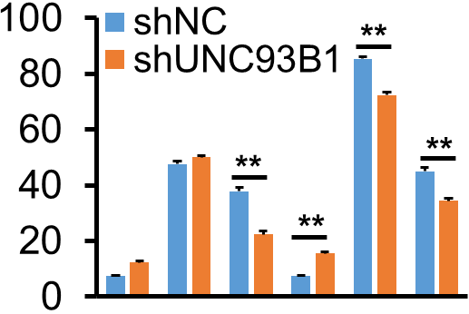
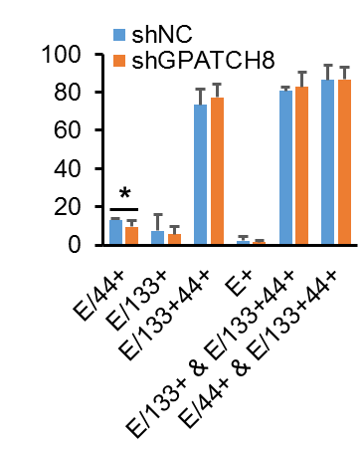
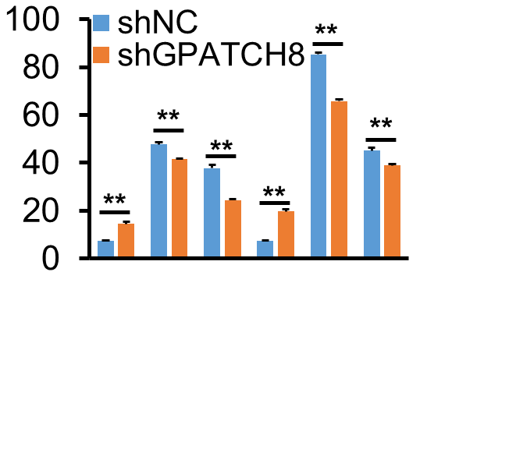
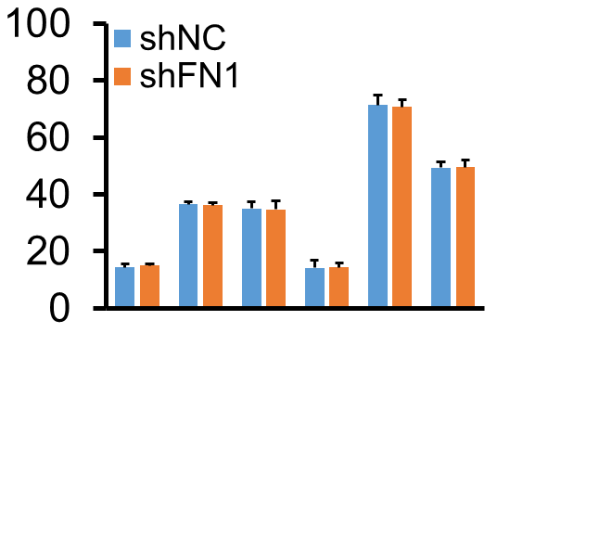
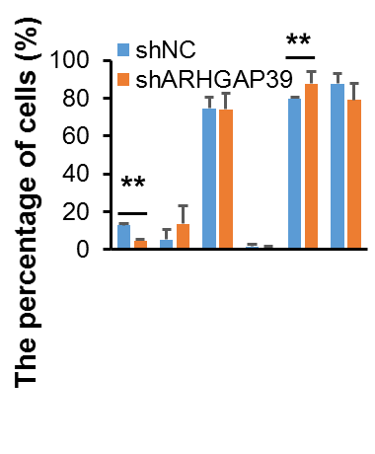
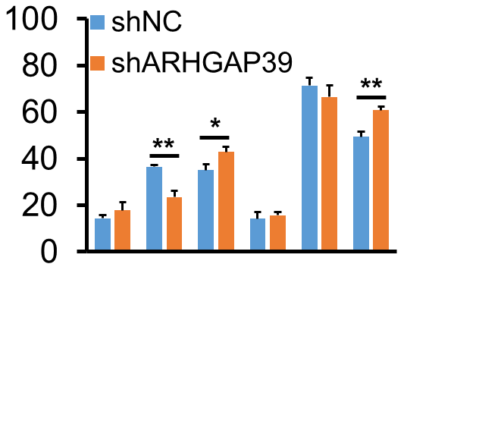
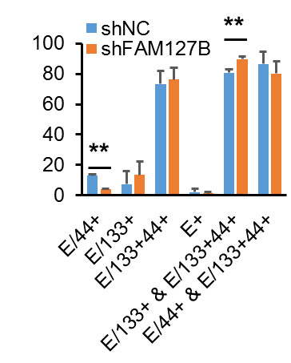
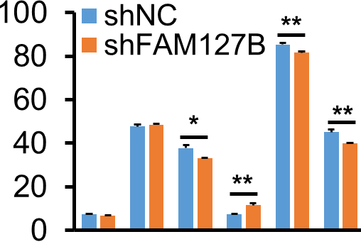
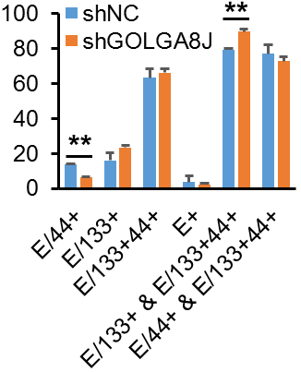
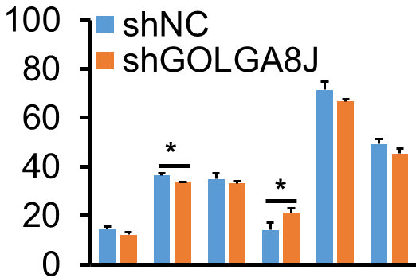
Supplementary Figure 1
c
HCT116
d
SW620
Notes:
Supplementary Figure 1. Sphere formation and subpopulation ratio of knock-down cells of mutant genes that coexisted in E/133⁺, E/133⁺44⁺ and E/44⁺ CRCIC cells in scWES data. a. Sphere formation of each knock-down HCT116 cells and shNC cells. b. Sphere formation of each knock-down SW620 cells and shNC cells. Magnification: 40 X. c,d. Compared with shNC cells, the percentage changes of each CRCIC or CRCC group in each knock-down HCT116 (c) and SW620 (d) cells by FACS assays, n=3. Student t-test was used. Data are presented as mean ± SD. * P < 0.05; ** P < 0.01. shNC and shNC-GFP cells are negative control cells transfected with lentivirus-packing plasmids.

Slide 3
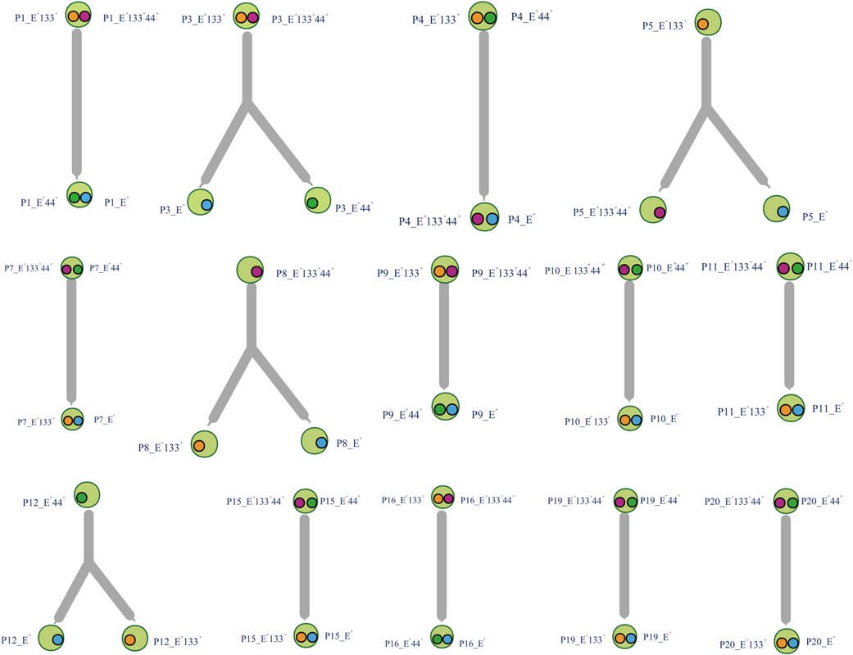
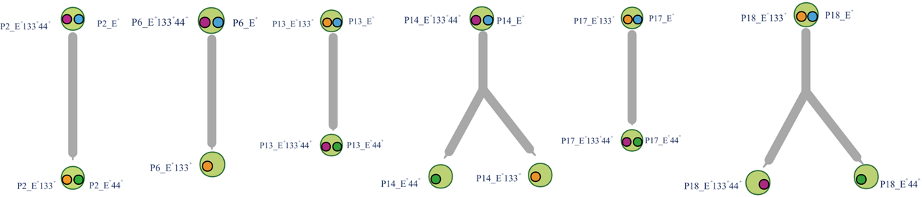
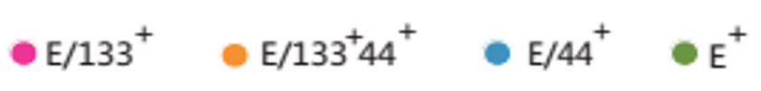
Supplementary Figure 2
a
b
Notes:
Supplementary Figure 2. Clonal evolution of CRCICs and CRCCs in other 14 patients. a. Clonal evolution of other 8 CRC patients that the cancer cells of which were origin from cancer stem cells (E/133⁺44⁺ or E/44⁺). The E/133⁺44⁺, E/44⁺, E/133⁺ and E⁺ cells of each patient were sorted by FACS. b. Clonal evolution of other 6 CRC patients that the cancer cells of which were origin from cancer stem cells (E/133⁺ or E/133⁺44⁺) or cancer cells that without cancer stem cell markers (E⁺). E/133+cells are marked as solid pink circles, while E/133+44+ cells are solid yellow circles, E/44+ cells are solid blue circles, and E+ cells are solid green circles.

Slide 4

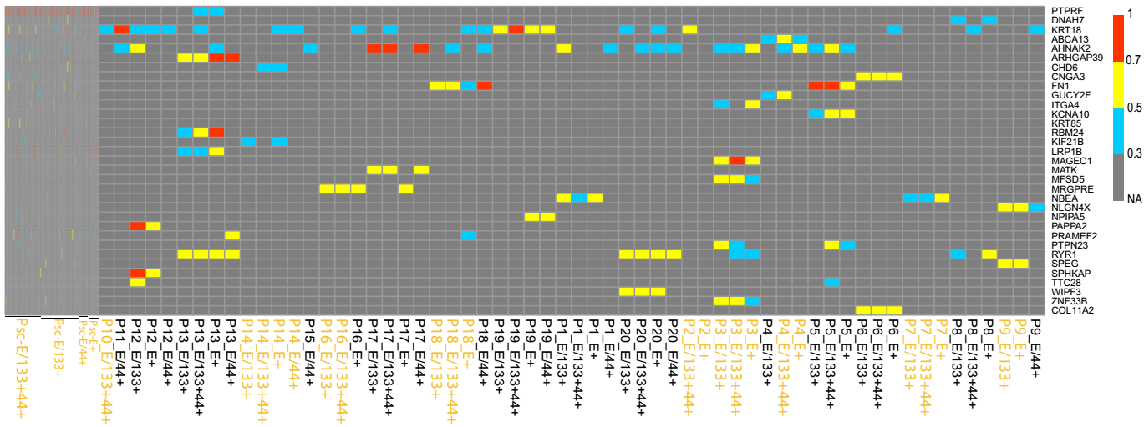
Supplementary Figure 3
scWES
Panel
(2/21)
(14/21)
(2/21)
(12/21)
(2/21)
(1/21)
(2/21)
(3/21)
(2/21)
(3/21)
(5/21)
(2/21)
(3/21)
(2/21)
Notes:
Supplementary Figure 3. The same genes those tended to mutate in CRCICs in scWES data and targeted sequencing data. Px means the serial number of each CRC patient for targeted sequencing data. Psc means the patient for scWES data. Green solid circle means that the subcellular location of the gene is at the cell surface. ‘x’ in (x/21) means how many patients has this mutation, while ‘21’ in (x/21) means there are totally 21 patients including the patient for scWES and the 20 patients for validation. KRAS-mutant cells are marked with yellow fonts.

