Slide 1
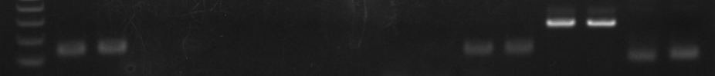
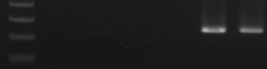
NAC42
NAC68
NAC94
NAC21/22
ZFP1
ZFP3
Actin
AGO5
-
+
-
+
-
+
-
+
-
+
-
+
-
+
-
+
200bp
FAR1
Trihelix
Actin
-
+
-
+
-
+
200bp
Supplementary Fig. S1 Agarose gel electrophoresis of qRT-PCR products amplified from RNAs extracted from healthy and BaMV-infected N. benthamiana leaves.
The expression levels of eight TFs genes (NAC21/22, NAC42, NAC68, NAC94, ZFP1, ZFP3, Far1-related sequence 4 isoform 3 and Trihelix transcription factor GT-2) were analyzed by qRT-PCR with specific primers using RNAs extracted from healthy or BaMV-infected N. benthamiana leaves as templates. -, healthy; +, BaMV-infected and actin was used as a reference gene.

