Slide 1
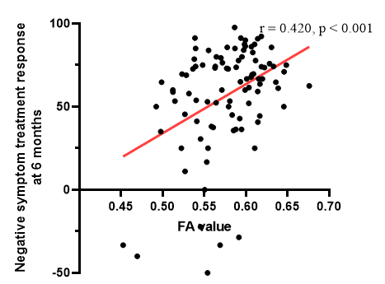
Supplementary figure 2. FAs of right SLF II is positively correlated with treatment response of negative symptoms at 6 months in patients with schizophrenia. Treatment response of negative symptoms was defined as [(baseline PANSS negative syndrome subscale) – (6-month PANSS negative syndrome subscale)] / (baseline PANSS negative syndrome subscale-7) × 100. FA, fractional anisotropy; SLF, superior longitudinal fasciculus; PANSS, Positive and Negative Syndrome Scale.

