Slide 1
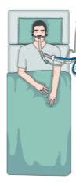

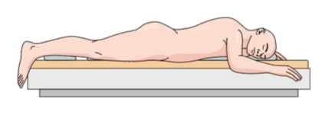
Classical 16 hours PP / 8 hours SP scheme
1st PP session
2nd PP session
3rd PP session
4th PP session
5th PP session
Decision to start PP
11 A.M.
11 A.M.
11 A.M.
11 A.M.
11 A.M.
11 A.M.
Day 1
Day 2
Day 3
Day 4
Day 5
Day 6
Alternative: 48 hours PP / 24 hours SP scheme
2nd PP session
P/F deterioration, decision to resume PP before 11 AM the next morning
In the absence of a life-threatening hypoxemia:
PP is always initiated during day-time
1st PP session
2nd PP session
No P/F deterioration and persistance of prone indication:
PP sessions are spaced 24 hours apart

