Slide 1
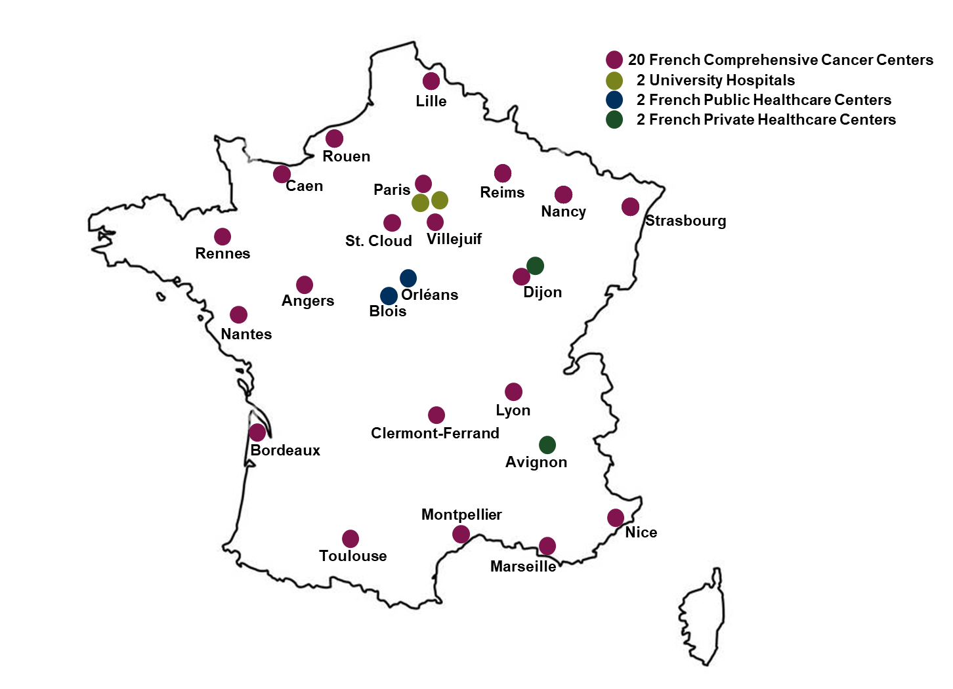
Supplementary Figure 1: CANTO participating centers

