Slide 1
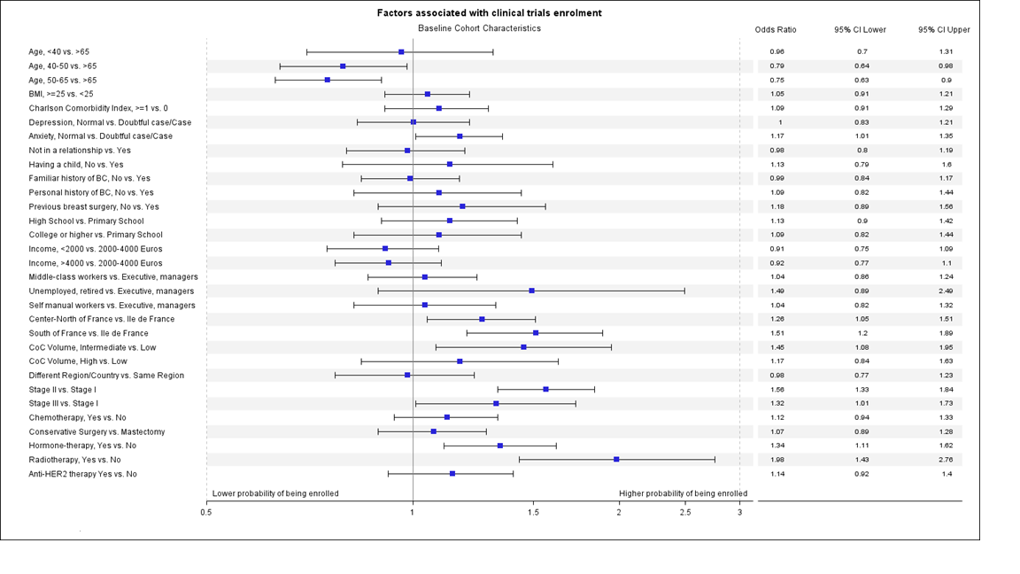
Supplementary Figure 2. Forest plot of factors associated with enrolment in clinical trials. Abbreviations: AUC, area under the curve; BC, breast cancer; BMI, body mass index, CoC, center of care; HER2, human epidermal growth factor receptor 2

