Slide 1
Supplementary Figure 1
***
Supplementary Figure 1. MSCs migrate towards melanoma cells. MSCs were cultured on top of 8.0 μm transwells with conditioned media (CM) from A375 melanoma cells or control RPMI media in the bottom chamber for 4 hours. Trypan blue exclusion assay allowed counting of number of MSCs migrating to the bottom chamber.

Slide 2

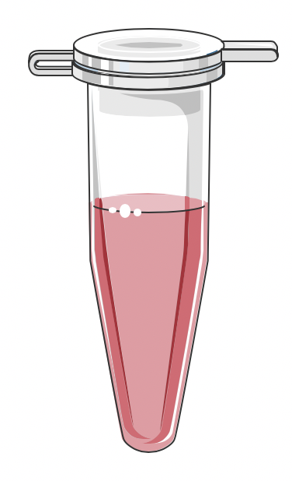
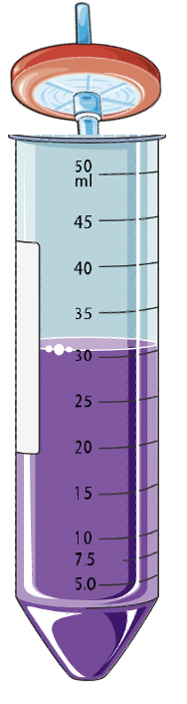
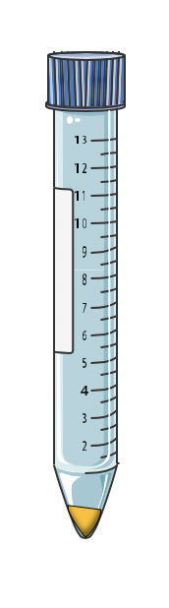

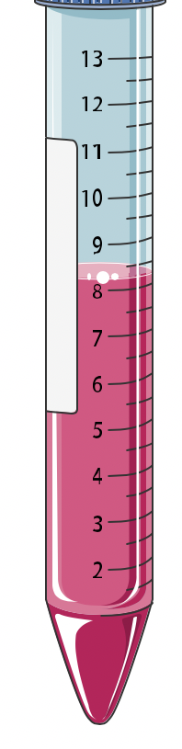
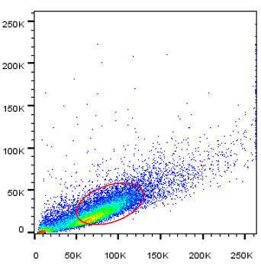
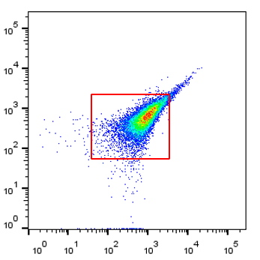
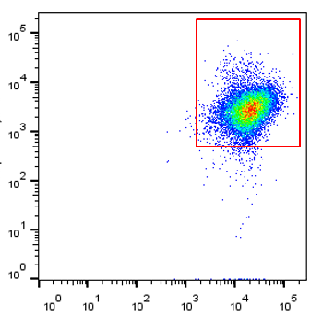
Supplementary Figure 2
A
Discard Supernatant
Discard Supernatant
Trypsin
1500 rpm 5 mins
Add Collagenase
Filter in 70 um filter
1500 rpm 5 mins
B
SSC-A
CD45
CD146
FSC-A
CD31
CD166
Supplementary Figure 2. Isolation steps for isolation and characterization of primary melanoma cells. (A) isolation of melanoma (B) Representative flow plot for the characterization of primary melanoma.

Slide 3
Supplementary Figure 3
Biogenesis
Fusion
Fission
MSC
5
4
3
2
1
0
5
4
3
2
1
0
MSC+SKM
MSC
5
4
3
2
1
0
5
4
3
2
1
0
MSC+M#1
PGC1a
TFAM
NRF1
MFN1
MFN2
OPA1
FIS1
TF1BM
PPARb
GABPA
TF2BM
DNM1L
Supplementary Figure 3. Primary melanoma cells and cell lines induce mitochondrial biogenesis in MSCs. MSCs were co-cultured with primary melanoma cells or the cell line SKMEL28 in transwells for 24 hours. RNA from MSCs was isolated and analysed by qPCR and results are expressed as a heatmap.

