Slide 1
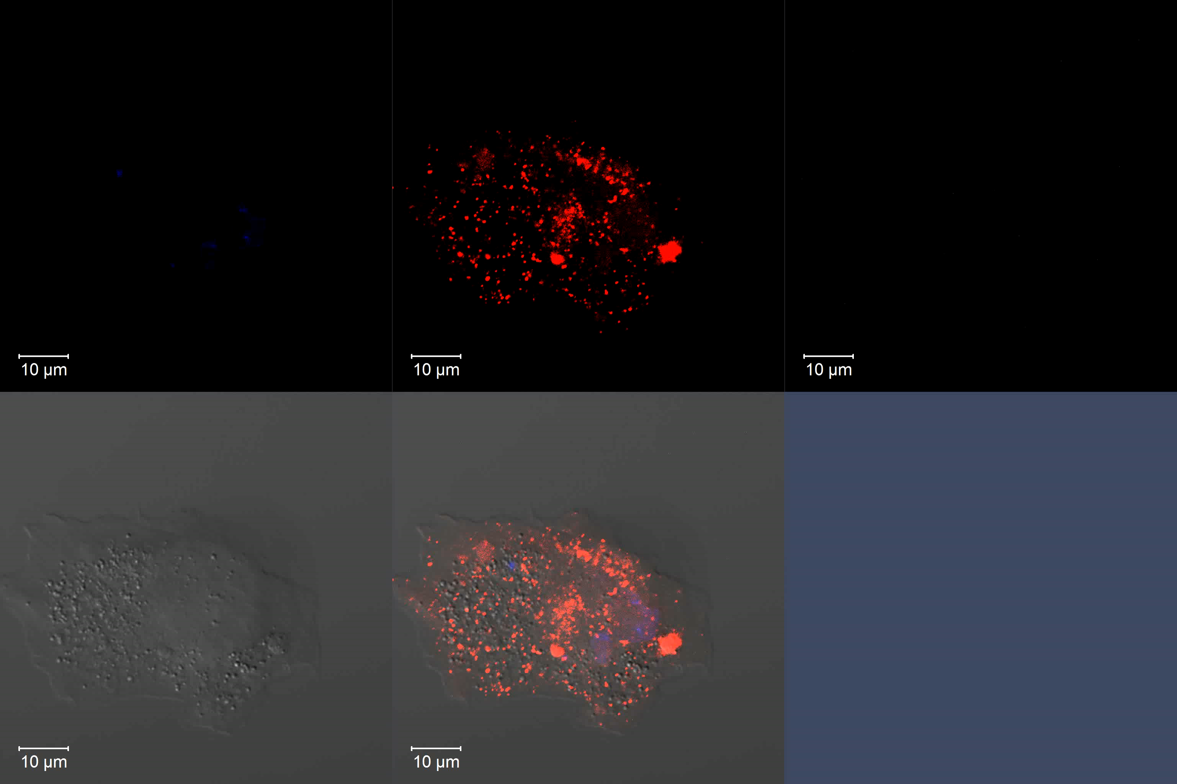
DAPI
mCherry/AKT PHD
eGFP/AKT PHD
DIC
Merge DIC
Movie S1. Representative video of externalized PI(3,4)P₂ and PI(3,4,5)P₃ detection using a recombinant eGFP/AKT PHD fusion protein on CHO cells expressing mCherry/AKT PHD fusion protein. Apoptosis was induced in CHO cells that stably expressed mCherry/AKT PHD fusion protein to visualize intracellular PI(3,4)P₂ and PI(3,4,5)P₃, while externalized PIPs were visualized using the recombinant eGFP/AKT PHD fusion protein. Differential interference contrast (DIC) microscopy.

