Slide 1
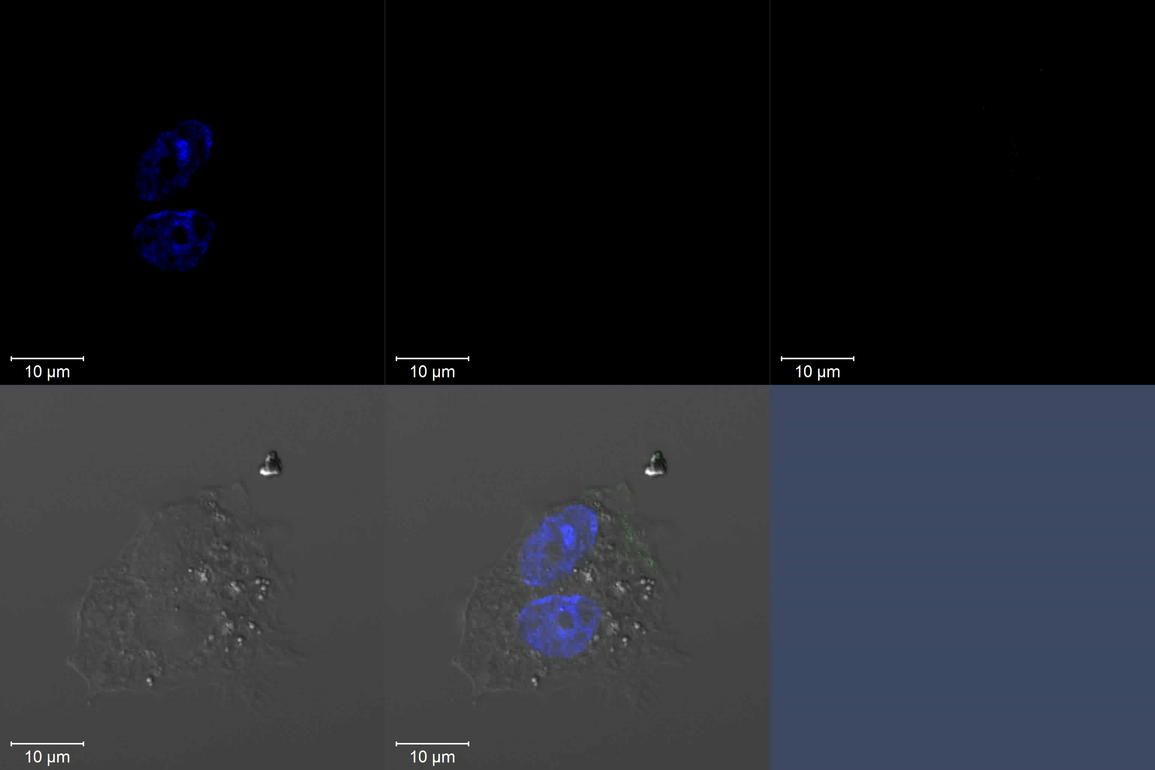
DAPI
Annexin V-Taxas Red
AKT PHD-FITC
DIC
Merge DIC
Movie S2. Representative video of Annexin V and AKT PHD binding of apoptotic cells. CHO cells treated 6 h with 10 μM camptothecin and incubated with Annexin V and AKT PHD were detected with primary antibodies and Texas Red- or FITC-labeled secondary antibodies, respectively. Differential interference contrast (DIC) microscopy.

