Slide 1
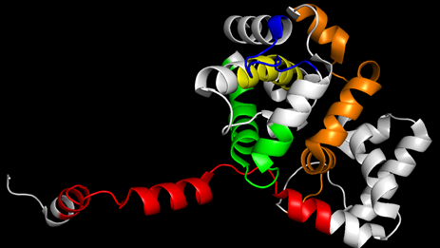
Additional File 5 Figure S3: 3D structure of the N protein and peptides detected by MS/MS analysis. Each peptide is assigned a different color: red (7th-26th), orange (100th-136th), yellow (165th-179th), green (191th-215th), or blue (223th-233th).

