Slide 1

Domains and outcomes of the core outcome set of congenital melanocytic naevi for clinical practice and research, part 2 (the OCOMEN project)
A.C. FLEDDERUS,^{1,2} S.G.M.A. PASMANS,³ A. WOLKERSTORFER,² W. OEI,³ H.C. ETCHEVERS,⁴ M.S. VAN KESSEL,⁵ C.M.A.M. VAN DER HORST¹ AND P.I. SPULS²
1. DEPARTMENT OF PLASTIC, RECONSTRUCTIVE AND HAND SURGERY, AMSTERDAM UNIVERSITY MEDICAL CENTER, UNIVERSITY OF AMSTERDAM
2. DEPARTMENT OF DERMATOLOGY, AMSTERDAM PUBLIC HEALTH, AMSTERDAM UNIVERSITY MEDICAL CENTER
3. DEPARTMENT OF DERMATOLOGY, ERASMUS MC UNIVERSITY MEDICAL CENTER ROTTERDAM- SOPHIA CHILDREN’S HOSPITAL
4. AIX MARSEILLE UNIV, INSERM, MMG, FACULTÉ DE MÉDECINE AMU
5. PRESIDENT NAEVUS GLOBAL, PATIENT REPRESENTATIVE NAEVUS INTERNATIONAL, THE NETHERLANDS
British Journal of Dermatology. DOI: 10.111/bjd. 20437

Slide 2

Lead Researcher
Anne Clarice Fledderus (MD)
Amsterdam University Medical Center
British Journal of Dermatology. DOI: 10.111/bjd. 20437

Slide 3
Introduction
What’s already known?
Congenital melanocytic nevi (CMN) can be associated with psychosocial burden and increased risk of melanoma and/or neurological complications.
Outcomes measured for research and care of CMN are heterogeneous and this impedes comparison.
A ‘core outcome set’ (COS) may enhance standardized use and reporting and reduce selective reporting bias.
In previous research, relevant stakeholders reached consensus on what domains should be included in the core domain set (CDS).
British Journal of Dermatology. DOI: 10.111/bjd. 20437

Slide 4
Definitions
A core outcome set is a consensus-derived minimum set of outcomes that should be measured and reported in all care of or clinical research concerning a certain health condition.
British Journal of Dermatology. DOI: 10.111/bjd. 20437

Slide 5
Definitions
In this study, we define ‘domains and outcomes’ as aspects of disease that could be measured to evaluate different management strategies.
‘Domains’ are broader aspects of a disease, whereas ‘outcomes’ are defined as more precise aspects of a disease on a lower hierarchical level
‘Presence of melanoma’ is an outcome of the domain ‘neoplasm’.
British Journal of Dermatology. DOI: 10.111/bjd. 20437

Slide 6
Objective Outcomes for Congenital Melanocytic Naevi (OCOME) project
To reach international consensus together with relevant stakeholders (patients and professionals) on the core outcome set of congenital melanocytic naevi.
British Journal of Dermatology. DOI: 10.111/bjd. 20437

Slide 7
Objective current study
To reach consensus on the specific core outcomes describing the core domains of the core outcome set of CMN clinical care and research.
British Journal of Dermatology. DOI: 10.111/bjd. 20437

Slide 8
Methods
A list of provisional outcomes, obtained earlier, were critically reviewed by the OCOMEN research team and by relevant stakeholders through an online questionnaire, to refine this list and provide clear definitions for every outcome.
When needed, discussion with individual participants was undertaken over the telephone or by e-mail.
British Journal of Dermatology. DOI: 10.111/bjd. 20437

Slide 9
Methods
During an online consensus meeting, stakeholders discussed the inclusion of potential outcomes.
After the meeting, participants voted for inclusion of outcomes in two rounds.
British Journal of Dermatology. DOI: 10.111/bjd. 20437

Slide 10
Results
Forty-four stakeholders from nineteen countries participated in the study.
Nine core outcomes were included in the core outcome set relative to clinical care and ten core outcomes for research.
.
British Journal of Dermatology. DOI: 10.111/bjd. 20437

Slide 11
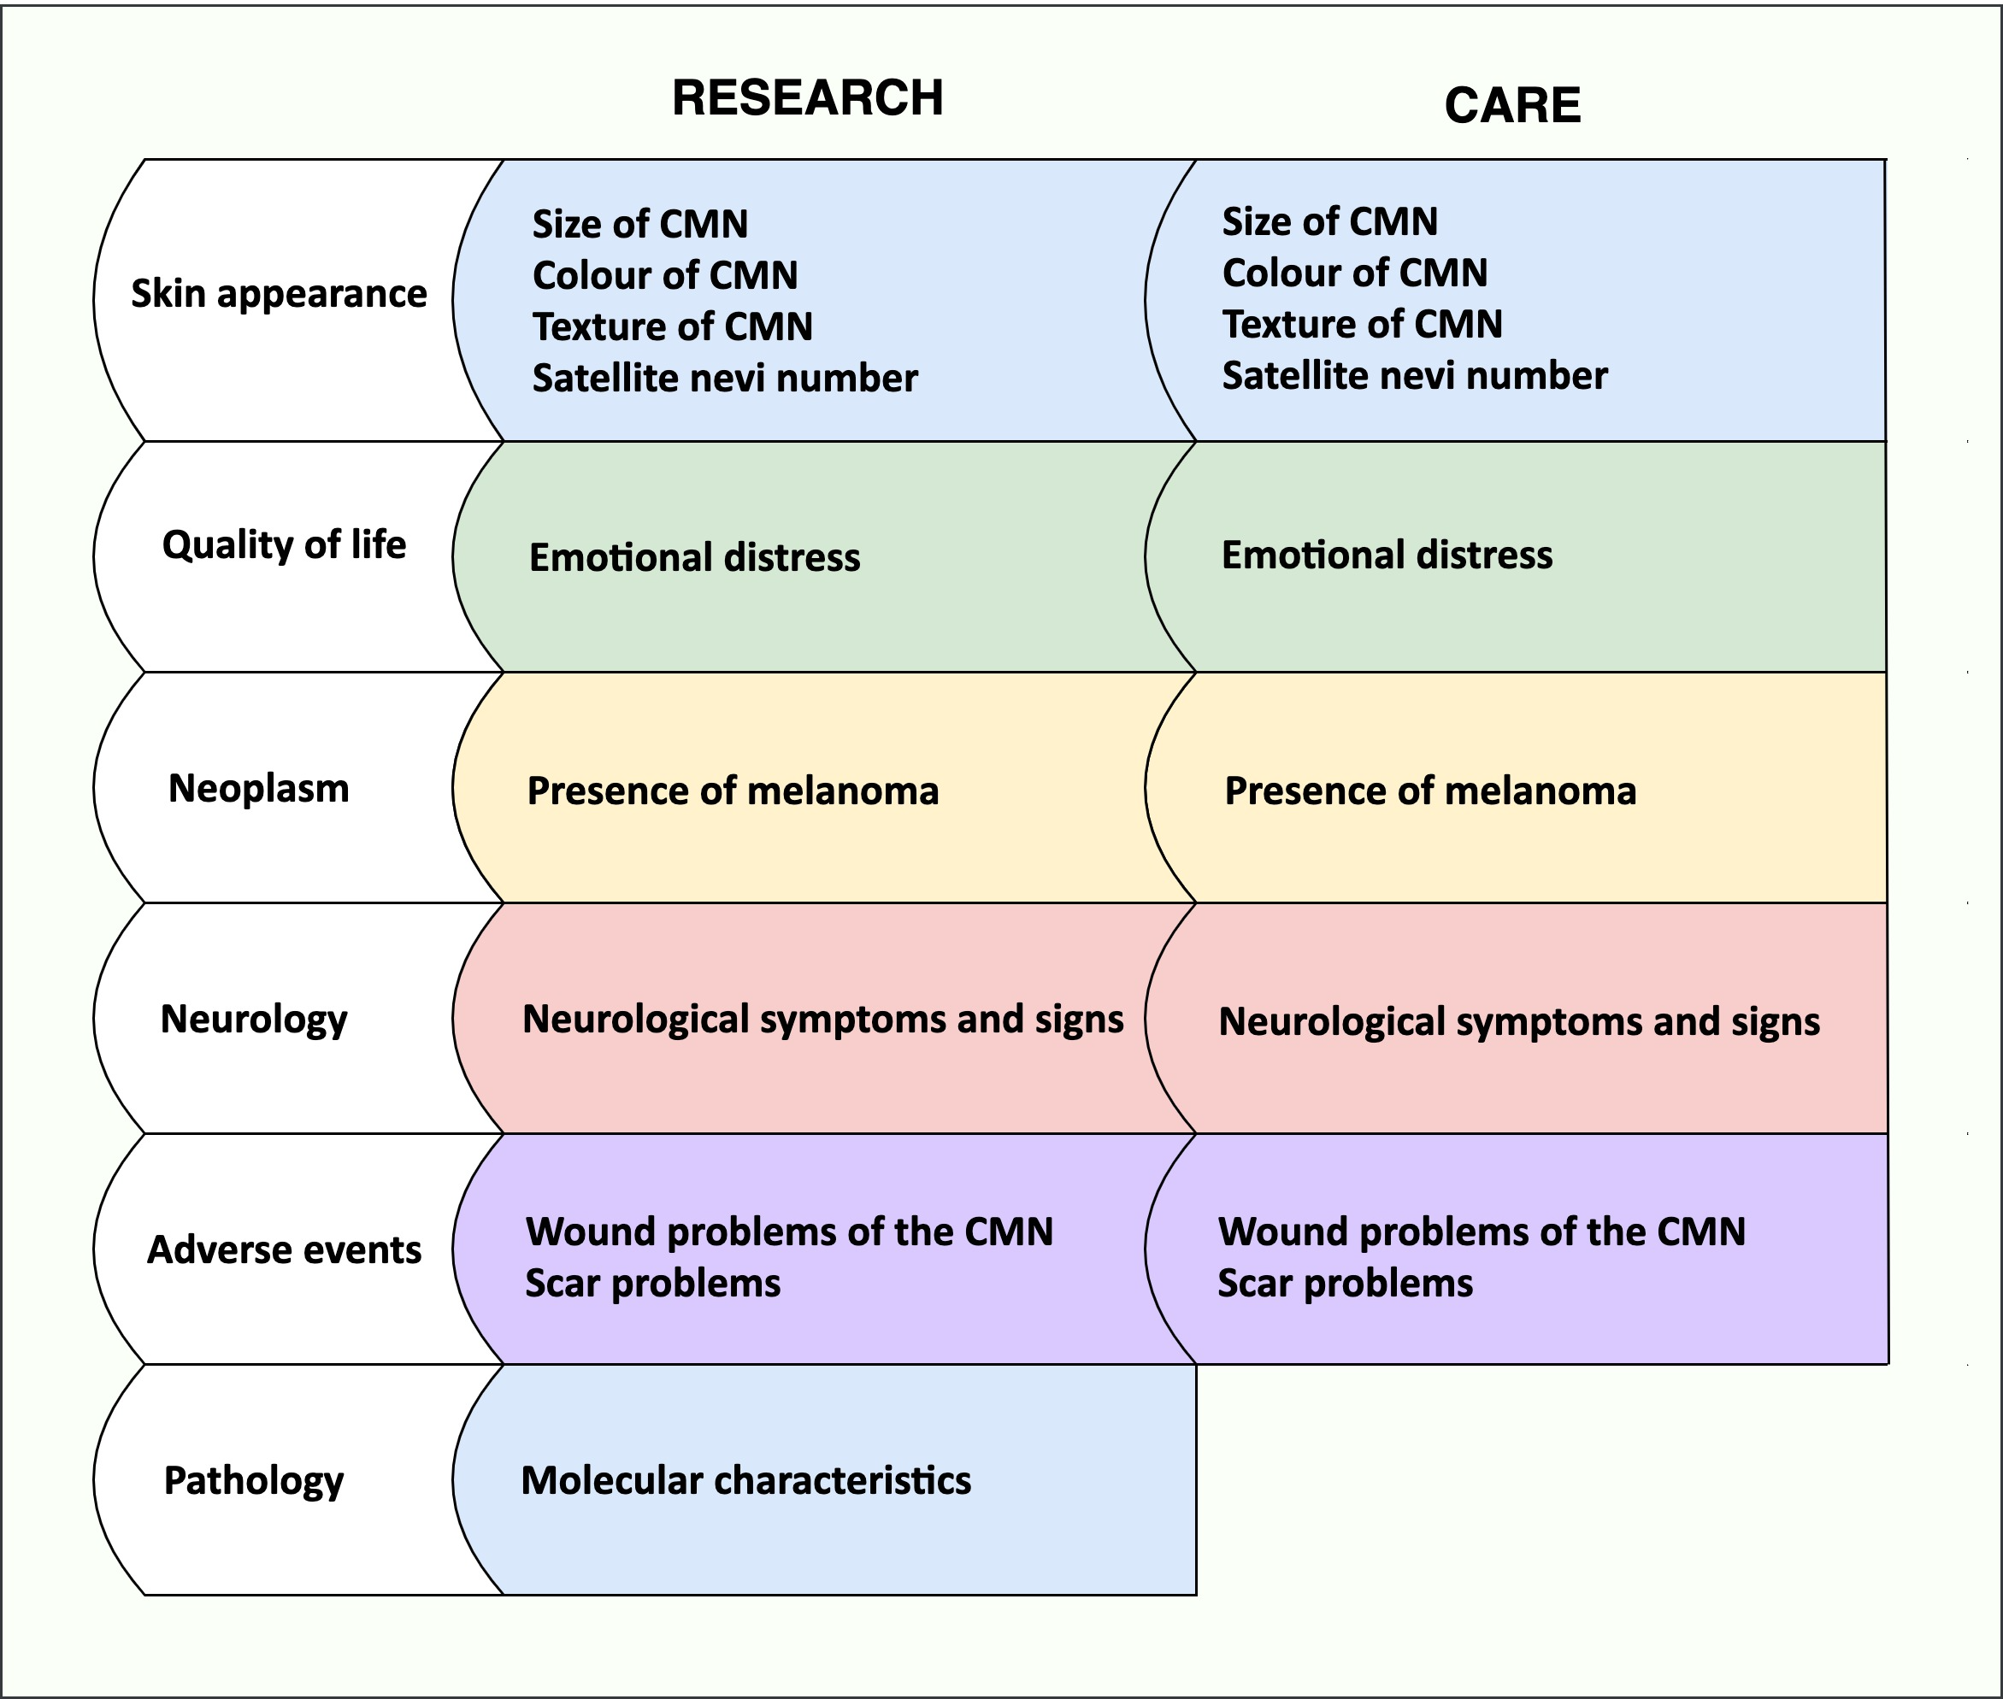
Results
Domains Outcomes

Slide 12
Discussion
These core outcomes will enable standard reporting in future care and research of CMN.
This study facilitates the next step of core outcome set development: selecting the appropriate measurement instruments for every outcome.
British Journal of Dermatology. DOI: 10.111/bjd. 20437

Slide 13
Conclusions
What does this study add?
To select the appropriate measurement instruments for the domains included in the CDS, the domains should be further specified by outcomes.
With this current study we reached consensus on what outcomes should describe the domains of the CDS of CMN care and research. Through a consensus procedure including online discussions, online consensus meeting and voting, relevant stakeholders reached consensus on a limited number of core outcomes describing the core domains.
British Journal of Dermatology. DOI: 10.111/bjd. 20437

Slide 14








The Team
Professor Phyllis Spuls (MD, PhD)
Professor of Evidence Based Dermatology
Expert in COS development
Professor Chantal van der Horst (MD, PhD)
Professor of Plastic and Reconstructive Surgery, Expert in CMN
Professor Suzanne Pasmans (MD, PhD)
Professor of Paediatric Dermatology, Expert in CMN
Heather Etchevers (PhD)
Researcher department of genetis
Anne Fledderus (MD)
Researcher department Plastic and Reconstructive surgery
Welling Oei (MD, PhD)
Researcher at the department of dermatology
Marjolein van Kessel
Parent of CMN patient
Patient representative Naevus Internetional
Albert Wolkerstorfer (MD, PhD)
Dermatologist, Laser specialist
Methodological assistance by the CS-COUSIN member: Prof. dr. Jan Kottner
British Journal of Dermatology. DOI: 10.111/bjd. 20437

Slide 15
Call for correspondence
Please let us know if you like to participate in the next step of this project:
To reach international consensus on what outcome measurement instruments should be used in all future care and research
Contact: a.c.fledderus@amsterdamumc.nl

Slide 16
Call for correspondence
Why not join the debate on this article through our correspondence section?
Rapid responses should not exceed 350 words, four references and one figure
Further details can be found on the BJD website

