Slide 1
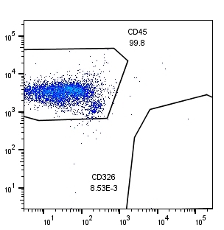
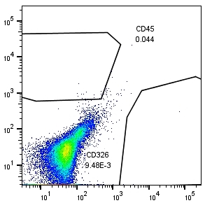
Supplementary data 1
Comparison of the calculation of TLR in a representative sample
(Peritoneal lavage of a patient with early gastric cancer)
Previous method
CD45(+)
Leukocytes
Non-specific
binding for CD45
CD45, CD326 staining
7-AAD(-) dots:13171
CD45(+) %=8122/13171=61.67%
CD326(+)%=2/13171=0.015%
Anti-CD45
Mouse-IgG1
Negative control staining
7-AAD(-) dots:13171
IgG1-FITC(+) %=5/12109=0.083%
IgG1-PE (+)%=18/12109=0.149%
CD326(+)
Tumor cells
Non-specific
binding for CD326
TLR=2/8122x100= 0.25%
0.015-0.149 61.67-0.083
Modified TLR= x100 =- 0.22%
Anti-CD326
Mouse-IgG1
New method
CD45(+)
Leukocytes
Non-specific
binding for CD45
CD45, CD326 staining
DAPI(+)FVS780(-) dots:23727
CD45(+) %=23393/23727
CD326(+)%=2/23727
Anti-CD45
Mouse-IgG1
Negative control staining
DAPI(+)FVS780(-) dots:31647
CD45(+) %=14/31647=0.044%
CD326(+)%=2/31647=0.0063%
CD326(+)
Tumor cells
Non-specific
binding for CD326
TLR= 2/23393x100=0.0085%
Anti-CD326
Mouse-IgG1

Slide 2
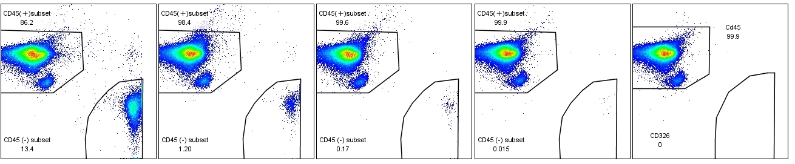
Supplementary data 2
Experiment 1. Flow cytometry profile and calculation of TLR in experimental system
Added
MKN45
10⁴ 10³ 10² 10 0
TLR=13.6% TLR=1.29% TLR=0.16% TLR=0.015% TLR=0%
CD45(+)
Leukocytes
89246
CD45(+)
Leukocytes
85763
CD45(+)
Leukocytes
87068
CD45(+)
Leukocytes
86796
CD45(+)
Leukocytes
90910
CD45
CD326(+)
Tumor cells
12165
CD326(+)
Tumor cells
1109
CD326(+)
Tumor cells
136
CD326(+)
Tumor cells
13
CD326(+)
Tumor cells
0
CD326
Experiment 2. Variation of TLR among experiments.
Added number of MKN45 | 103 | 102 | 10
Mean | 1.18% | 0.11% | 0.019%
Standard deviation | 0.11% | 0.020% | 0.0046%
Variation coefficient | 9.2% | 17.6% | 24.4%
Upper: Various number (10 ~ 103) of MKN45, a human gastric cancer cell, were mixed with 10⁵ cells derived from lavages of a patient without peritoneal metastasis and evaluated the TLR.
Lower: TLR was calculated in 10 different tubes made in the same way and Mean, Standard deviation and Variation coefficient were described.

Slide 3
Supplementary data 3
ROC curves on the correlations between TLR and CY1 or P1 (A) and CY1 (B) in the whole patients
and CY1 in P1 patients (C) and correlation with recurrence in T4 patients (D).
(A) P1 or CY1 vs P0CY0 (B) CY1 vs CY0 (C) CY1 vs CY0 (D) Recurrence (+) vs Recurrence(-)
in whole patients in P1 patients in T4 patients
AUC | 0.8745 | 0.9097 | 0.8481 | 0.8697
95% CI | 0.8188-0.9302 | 0.8596-0.9598 | 0.7426-0.9535 | 0.7345-1.000
Optimal cut off point by Youden Index | 0.07405 | 0.08115 | 0.08115 | 0.0559
Sensitivity | 76.81% | 87.27% | 87.27% | 80.00%
Specificity | 87.84% | 86.21% | 78.57% | 87.88%
Positive predictive value | 85.48% | 91.46% | 61.11% | 61.11%
Negative predictive value | 80.25% | 80.00% | 94.11% | 94.11%

