Slide 1

Early melanoma invasivity correlates with gut fungal and bacterial profiles
Francesco Vitali ^{*1}, Roberta Colucci ^{*2}, Monica Di Paola ³, Massimo Pindo ⁴, Carlotta De Filippo ¹, Silvia Moretti ^{$2}, Duccio Cavalieri ^{$3}
1- Institute of Agricultural Biology and Biotechnology (IBBA), National Research Council (CNR), Via Moruzzi 1, 56124, Pisa, Italy.
2- Section of Dermatology, Department of Health Sciences (DSS), University of Florence, Palagi Hospital, Viale Michelangelo 41,50125 Florence, Italy
3- Department of Biology, University of Florence, Via Madonna del Piano 6, 50019 Sesto Fiorentino, Florence, Italy.
4- Genomics Platform, Unit of Computational Biology, Edmund Mach Foundation, Via E. Mach 1,San Michele a/A, 38010, Trento, Italy
* = author contributed equally; $ = corresponding authors
British Journal of Dermatology. DOI: https://doi.org/10.1111/bjd.20626

Slide 2


Lead Researchers
Francesco Vitali, PhD
Bioinformatic
Institute of Agricultural Biology and Biotechnology (IBBA), National Research Council (CNR), Via Moruzzi 1, 56124, Pisa, Italy
Roberta Colucci, MD PhD
Dermatologist
Section of Dermatology, Department of Health Sciences (DSS), University of Florence, Palagi Hospital, Viale Michelangelo 41,50125 Florence, Italy
British Journal of Dermatology. DOI: https://doi.org/10.1111/bjd.20626

Slide 3
Introduction
What’s already known?
  The microbial community living in symbiosis with our human body (i.e. the microbiota) plays a critical role in health and disease.
  In the cancer field, in particular in melanoma, the gut microbiota is drawing attention due to its ability to control immune checkpoint and to determine success of immune therapies.
British Journal of Dermatology. DOI: https://doi.org/10.1111/bjd.20626

Slide 4
Objectives
  Evaluate the gut bacterial and fungal community composition in a group of stage I and II melanoma patients
    (i) Comparison with healthy controls to highlight differences possibly connected with pathogenesis.
    (ii) Association of clinical and histopathological features of early stage melanoma with the identified microbial profiles, in order to discover putative microbial biomarkers and evidences for melanoma progression.
    (iii) Comparison of early and advanced (metastatic) melanoma with a meta-analysis, to evaluate the relations between melanoma progression and microbiota.
British Journal of Dermatology. DOI: https://doi.org/10.1111/bjd.20626

Slide 5
Methods (1)
Study participants:
20 patients with histopathological diagnosis of melanoma (M)
16 age- and gender- matched healthy controls (HC) living in the province of Florence (Tuscany - Italy)
Exclusion criteria:
Under 18 years
Presence of clinically evident inflammatory disorders
Gastro-enteric symptoms in the month preceding the collection of faecal samples
Irritable Bowel Syndrome, Inflammatory Bowel Disease, Coeliac disease or other autoimmune disorders
History of colorectal cancer or colectomy
Use of systemic antibiotics in the three months
Presence of dietary and nutrition spectrum disorders, obesity
British Journal of Dermatology. DOI: https://doi.org/10.1111/bjd.20626

Slide 6
Methods (2)
Histological parameters of melanoma: body site, histopathological subtype, Breslow thickness, ulceration, mitotic index, lymphovascular invasion, microsatellite/in transit metastasis, perineural invasion/neurotrophism, growth phase, tumour infiltrating lymphocytes and type (brisk or not brisk), regression, Clark level.
Melanoma staging was defined according to American Joint Cancer Committee 8th edition.
Meta-taxonomic analysis: Faecal sample collection was performed after the excision of the tumor and the subsequent histopathological diagnosis of melanoma, within 12 months.
Genomic DNA was extracted, and sequenced for Bacteria (target V3-V4 of the 16S rRNA gene) and Fungi (target ITS1 region) using an Illumina MiSeq with V3 chemistry 600 cycle PE300.
British Journal of Dermatology. DOI: https://doi.org/10.1111/bjd.20626

Slide 7
Methods (3)
Data analysis: Reads were grouped in zOTU (zero-radius OTU) using UNOISE algorithm in MICCA software.
R software was used for data normalization (CSS transformation), for diversity analysis (i.e. PCoA ordination based on Bray-Curtis, alpha diversity indices, PERMANOVA test) and for differential abundance testing (LEfSe, DESeq2, Random forest)
Meta-analysis: We compared bacterial community from our study to the metastatic melanoma patients cohort from Matson et al. 2018.
Sequence data of both studies were cropped to the V4 region (common region between the two studies), and joined prior to OUT picking using denovo algorithm. For diversity analysis data were normalized using rarefaction.
British Journal of Dermatology. DOI: https://doi.org/10.1111/bjd.20626

Slide 8
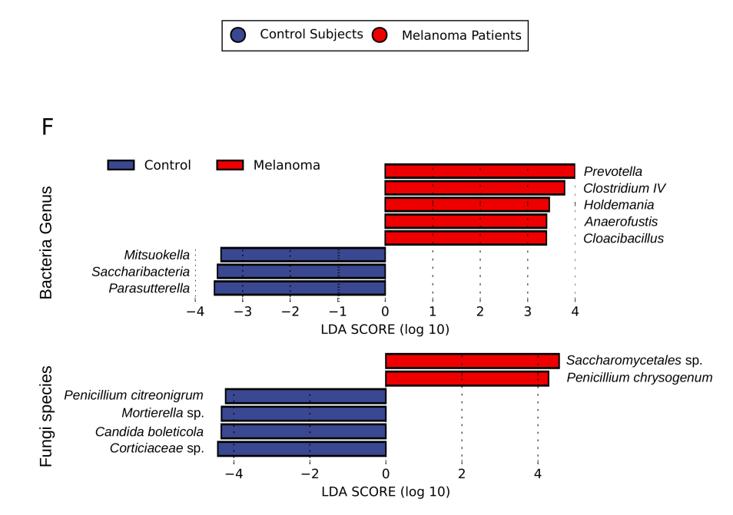

Results (1) - Different gut microbial communities between melanoma patients and healthy controls
Slight, but significant, differences were observed in the gut microbial communities (Bacteria + Fungi) between M and HC
A set of both Bacteria and Fungi were identified as biomarkers for the two samples groups
British Journal of Dermatology. DOI: https://doi.org/10.1111/bjd.20626

Slide 9
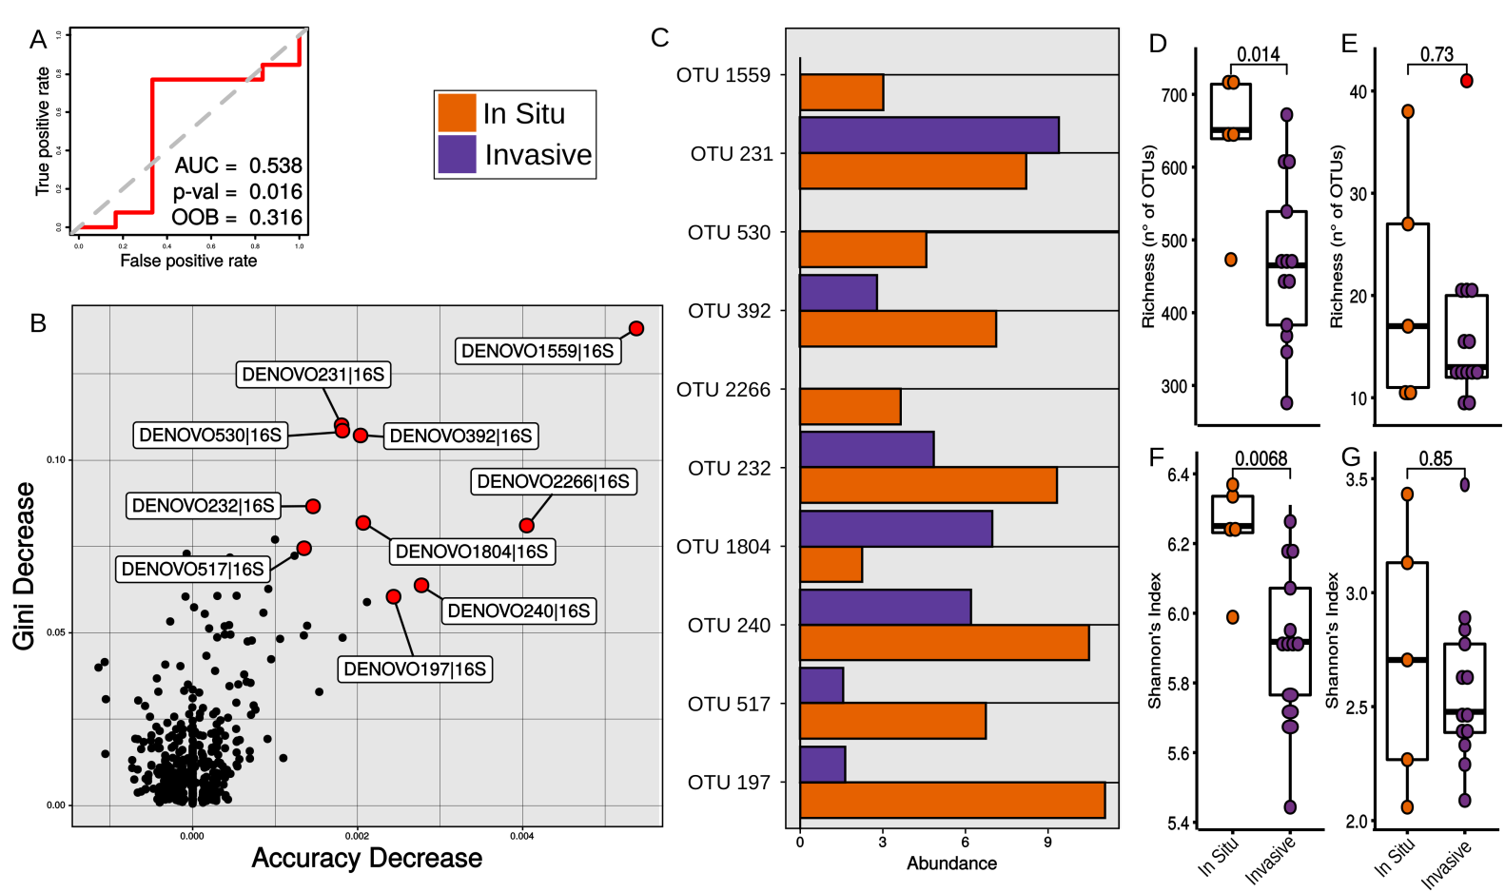
Results (2)- Microbial profiles of melanoma patients differ according to histopathological features
Microbiota resulted significantly different when M patients were stratified for regression and, mainly, invasiveness of melanoma
Most of those were enriched in in situ melanoma (8/10); all belonged to the Clostridia class – Butyrate producers
Bacterial richness decreases from in situ to invasive melanoma
British Journal of Dermatology. DOI: https://doi.org/10.1111/bjd.20626

Slide 10
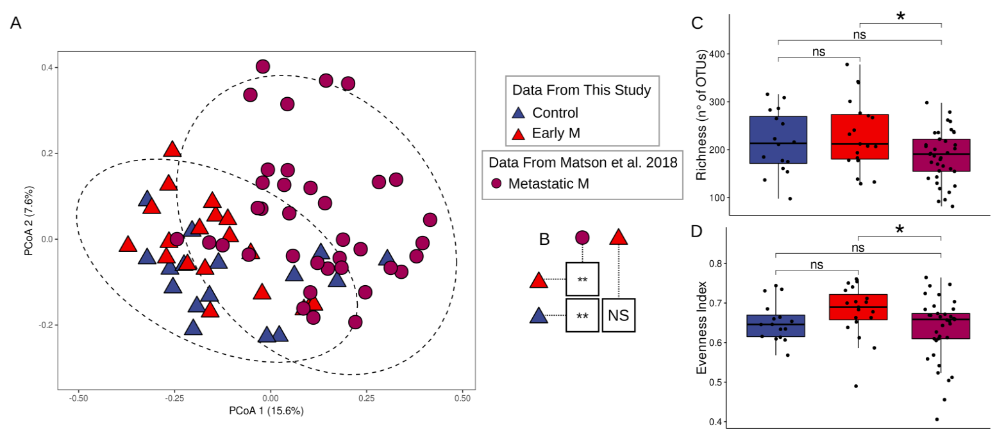
Results (3)- A meta-analysis between metastatic and non metastatic melanoma patients
Changes in community structure between tumour stages were observed by PCoA ordination (A).
Significant differences between bacterial communities of metastatic melanoma patients and both early M and control subject
No significant differences were found between the latter and control subjects (B).
Bacterial richness and evenness showed a significant decline in community diversity in advanced metastatic melanoma with respect to early melanoma (C and D) .
British Journal of Dermatology. DOI: https://doi.org/10.1111/bjd.20626

Slide 11
Discussion (1)
The observed microbiota features connected to melanoma progression from in situ to invasive suggest imbalance in butyrate-producing.
As butyrate producers were also found associated to in situ melanoma, butyrate-producers might promote melanoma evolution towards both an invasive phenotype, or towards a non-invasive phenotype.
Highly immunogenic melanoma might be characterized by invasion and regression together, and connected to a worse prognosis.
  Peculiar zOTU belonging to the Bacteroides genus were shared by regressive and invasive melanoma.
  Selected strains of Bacteroides ovatus capable of eliciting IgM and IgG mediated responses in vitro toward human acute myelogenous leukaemia cells have been isolated from the human gut.
  Enrichment of Bacteroidetes phylum, connected to worst prognosis and limited responsiveness to immune therapy in metastatic melanoma cohort.
British Journal of Dermatology. DOI: https://doi.org/10.1111/bjd.20626

Slide 12
Discussion (2)
Gut microbiota composition and the immunogenicity degree of early stage melanoma might change along the gradient from in situ to invasive.
This observed trend of deterioration in gut microbiota from in situ to invasive, also likely accompanies the transition from an early and local melanoma phenotype, to the advanced and metastatic one.
British Journal of Dermatology. DOI: https://doi.org/10.1111/bjd.20626

Slide 13
Discussion (3)
Limitations and future direction
Re-evaluation of results on larger and better balanced cohorts of early melanoma patients
Metastatic patients should be included in the recruiting to fully explore the in situ – invasive – metastatic progression.
However, overlap in ordination analysis is reassuring about the soundness of the analysis and its correspondence with the real biology of the system.
The difficulty in cultivating the microbes hamper our ability to prove their causal role, future studies should consider cultivation of bacteria and fungi
Future studies should also consider evaluation of skin microbiota
British Journal of Dermatology. DOI: https://doi.org/10.1111/bjd.20626

Slide 14
Conclusions
What does this study add?
  This study evaluates for the first time the gut microbial community of early melanoma patients (stage I and II), including bacteria, yeasts, and fungi.
  Promising associations between gut microbial profiles and histopathological features of melanoma along the in situ – invasive axis were found.
  Promising future developments in early melanoma research, where the microbiota could represent a valuable tool for early patient classification
  Microbial profiles evaluation might contribute to the better prognosis of early stage melanoma through a direct or indirect immunomodulation.
British Journal of Dermatology. DOI: https://doi.org/10.1111/bjd.20626

Slide 15







The Team
Francesco Vitali, Roberta Colucci, Monica Di Paola, Massimo Pindo, Carlotta De Filippo, Silvia Moretti, and Duccio Cavalieri
British Journal of Dermatology. DOI: https://doi.org/10.1111/bjd.20626

Slide 16
Call for correspondence
Why not join the debate on this article through our correspondence section?
Rapid responses should not exceed 350 words, four references and one figure
Further details can be found on the BJD website

