Slide 1
Supplementary Table 1
Baseline Patient Characteristics According to Up-to-seven Criteria (1)
Characteristics | Group | Category | TACE alone | TACE plus sorafenib | p-value
Age | ALL | Median(range) | 73.0(53-86) | 72.0(36-85) | 0.317
 | Up-to-7 IN | Median(range) | 74.3(57-86) | 71.5(50-85) | 0.076
 | Up-to-7 OUT | Median(range) | 70.0(53-85) | 73.0(36-84) | 0.687
Gender (n) | ALL | Male/Female | 55/21 | 63/17 | 0.353
 | Up-to-7 IN | Male/Female | 36/14 | 43/11 | 0.363
 | Up-to-7 OUT | Male/Female | 19/7 | 20/6 | 0.749
Performance status (n) | ALL | 0/1 | 67/9 | 71/9 | 0.908
 | Up-to-7 IN | 0/1 | 46/4 | 48/6 | 0.691
 | Up-to-7 OUT | 0/1 | 21/5 | 23/3 | 0.442
HBV (n) | ALL | Positive/negative | 2/74 | 10/70 | 0.021
 | Up-to-7 IN | Positive/negative | 0/50 | 8/46 | 0.005
 | Up-to-7 OUT | Positive/negative | 2/24 | 2/24 | 1.000
HCV (n) | ALL | Positive/negative | 53/23 | 38/42 | 0.015
 | Up-to-7 IN | Positive/negative | 39/11 | 27/27 | 0.003
 | Up-to-7 OUT | Positive/negative | 14/12 | 11/15 | 0.469

Slide 2
Supplementary Table 1 (Continewed)
Baseline Patient Characteristics According to Up-to-seven Criteria (2)
Characteristics | Group | Category | TACE alone | TACE plus sorafenib | p-value
Child-Pugh score (n) | ALL | 5/6/7 | 54/17/5 | 64/15/1 | 0.170
 | Up-to-7 IN | 5/6/7 | 33/14/3 | 41/12/1 | 0.393
 | Up-to-7 OUT | 5/6/7 | 21/3/2 | 23/3/0 | 0.352
BCLC stage (n) | ALL | A/B/C | 30/37/9 | 25/46/9 | 0.515
 | Up-to-7 IN | A/B/C | 28/18/4 | 23/25/6 | 0.391
 | Up-to-7 OUT | A/B/C | 2/19/5 | 2/21/3 | 0.741
Prior TACE (n) | ALL | 0/1-2 times | 48/28 | 45/35 | 0.379
 | Up-to-7 IN | 0/1 | 29/21 | 26/28 | 0.315
 | Up-to-7 OUT | 0/1 | 19/7 | 19/7 | 1.000
AFP (n) | ALL | >200ng/ml/<200ng/ml | 16/60 | 16/64 | 0.871
 | Up-to-7 IN | >200ng/ml/<200ng/ml | 7/43 | 10/44 | 0.534
 | Up-to-7 OUT | >200ng/ml/<200ng/ml | 9/17 | 6/20 | 0.358

Slide 3
Supplementary Table 2 Overall survival rate
Survival rate | TACE plus Sorafenib (%) | TACE alone (%)
6-months | 97.5 | 94.7
12-months | 93.6 | 81.6
18-months | 84.5 | 71.1
24-months | 75.2 | 60.5
36-months | 50.2 | 44.7
48-months | 34.3 | 32.7
60-months | 23.4 | 25.6
The median length of follow-up was 33.4 (range, 0.1-110.7 months) for all randomized patients.

Slide 4
Supplementary Table 3 Progression free survival rate (updated)
Progression free survival rate | TACE plus Sorafenib (%) | TACE alone (%)
6-months | 89.9 | 74.7
12-months | 69.6 | 51.6
18-months | 63.3 | 44.6
24-months | 49.4 | 33.4
36-months | 30.0 | 18.0
48-months | 23.2 | 12.0
60-months | 8.7 | 6.2
The median length of follow-up was 33.4 (range, 0.1-110.7 months) for all randomized patients.

Slide 5
Supplementary Table 4 Patterns of UnTACEable Progression
 | TACE plus Sorafenib (n=80) | TACE alone (n=76) | Total (n=156)
Growth of Intrahepatic lesion (>25%) | 32 (40.0) | 36 (47.4) | 68 (43.6)
Appearance of MVI | 13 (16.3) | 8 (10.5) | 21 (13.5)
Appearance of EHS | 11 (13.8) | 7 (9.2) | 18 (11.5)
Liver function deterioration to Child-Pugh grade C | 6 (7.5) | 0 (0.0) | 6 (3.8)
TACE refractoriness | 3 (3.8) | 5 (6.6) | 8 (5.1)
Death | 7 (8.8) | 6 (7.9) | 13 (8.3)
No event | 5 (6.3) | 7 (9.2) | 12 (7.7)
Censored (switched to other therapy) | 3 (3.8) | 7 (9.2) | 10 (6.4)
Results reported at n (%), unless otherwise indicated MVI, macrovascular invasion; EHS, extrahepatic spread

Slide 6
Supplementary Table 5. Comparison of TACE combination Trials
Trial | Post-TACE¹⁾ | SPACE²⁾ | TACE-2⁵⁾ | BRISK-TA³⁾ | ORIENTAL⁴⁾ | TACTICS⁶⁾
Phase | Phase III | Randomized Phase II | Phase III | Phase III | Phase III | Randomized Phase II
Agent | Sorafenib | Sorafenib | Sorafenib | Brivanib | Orantinib | Sorafenib
CP Class | A | A (no ascites) | A | A and B | A | A5-B7
ECOG PS | 0-1 | 0 | 0-1 | 0-1 | 0-1 | 0-1
Tumor burden for inclusion criteria | < 7cm < 10 nodules | Unresectable multi-nodules | Not a candidate for resection or transplanation | <4 nodules, >5 cm >4nodules, >2 cm | >4 nodules, <1 cm 2-3 nodules, >3 cm 1 nodule, >5 cm | < 10cm < 10 nodules
TACE procedure | cTACE On demand | DEB-TACE Scheduled | DEB-TACE On demand | cTACE or DEB-TACE On demand | cTACE On demand | cTACE On demand
Progression criteria | RECICL 2004 | mRECIST | RECIST v1.1 | mRECIST | TACE discontinuation criteria | RECICL & TACE discontinuation Criteria
PFS or TTP (TACE alone) | 5.4 M (vs. 3.7 M) HR=0.87, P=0.252 | 5.6 M (vs. 5.5 M) HR=0.79, P=0.072 | 7.9 M (vs. 7.9 M) HR=0.99, P=0.94 | 8.4 M (vs. 4.9M) HR=0.61, P<0.0001 | 2.9M (vs. 2.5M) P=0.03 | 22.8 M (vs. 13.5 M) HR=0.66, P=0.02
TTUP, TTDP, TTTF | - | TTUP:3.0 (vs. 7.4) HR=1.56, P=0.99 | - | TTDP: 12.0M (vs. 10.9M) HR=0.94, P=0.62 | TTTF: 23.9 M (vs. 19.8M) HR=0.88, P=0.245 | TTUP: 26.7 M (vs. 20.6M) HR=0.57, P=0.02
OS | 29.7 M (N.E) HR=1.06, P=0.79 | N.E (N.E) HR=0.90, P=0.29 | 20.9 M (vs. 19.8 M) HR=0.91, P=0.57 | 26.4 M (vs. 26.1 M) HR=0.90, P=0.52 | 31.1 M (vs. 32.3 M) HR=1.09, P=0.435 | 36.2 M (vs. 30.8 M) Δ5.4 HR=0.86, P=0.40
DOT | 17.0 wks | 21.0 wks | 17.1wks | 24.0 wks | 43.6 wks | 69.9 wks
RECICL, response evaluation criteria in cancer of the liver; RECIST, response evaluation criteria in solid tumors; mRECIST, modified RECIST; cTACE, conventional transarterial chemoembolization; DEB-TACE, drug-eluting beads TACE;TTUP, time to untreatable progression; TTDP, time to disease progression; TTTF, time to treatment failure; HR, hazard ratio; DOT, duration of treatment

Slide 7
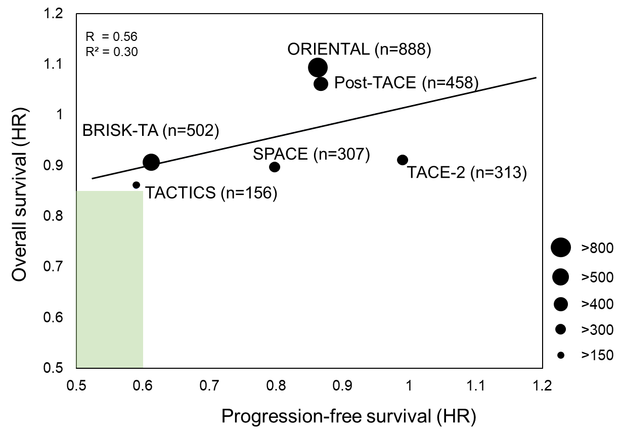
Supplementary Fig 1

