Slide 1
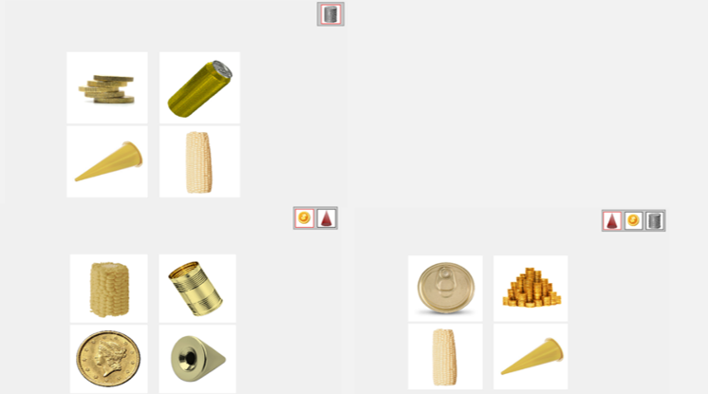
Figure S1. Examples of phonological, semantic, and unrelated task versions at each sequence length. Top left example screen is sequence length 1, bottom left example screen is sequence length 2, bottom right example screen is sequence length 3.
Figure S1a. Phonological version

Slide 2
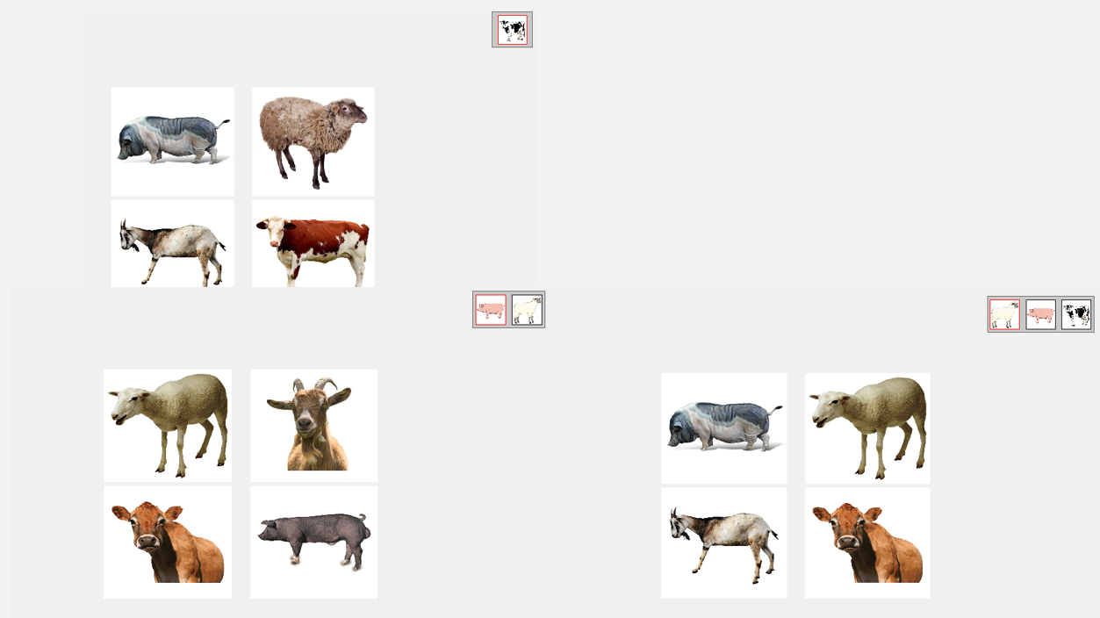
Figure S1. Examples of phonological, semantic, and unrelated task versions at each sequence length. Top left example screen is sequence length 1, bottom left example screen is sequence length 2, bottom right example screen is sequence length 3.
Figure S1b. Semantic version

Slide 3
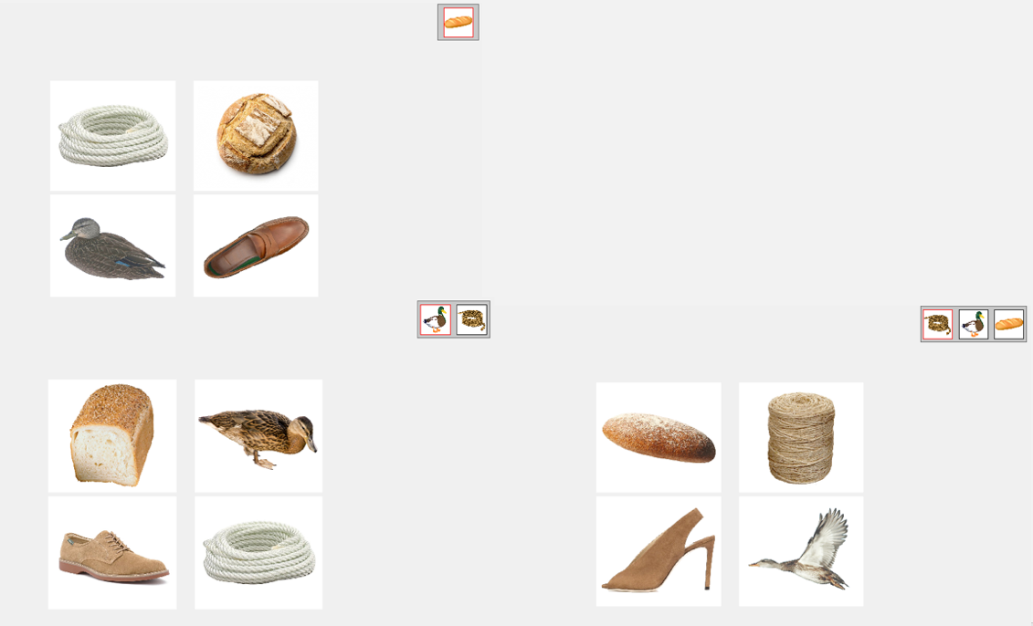
Figure S1. Examples of phonological, semantic, and unrelated task versions at each sequence length. Top left example screen is sequence length 1, bottom left example screen is sequence length 2, bottom right example screen is sequence length 3.
Figure S1c. Unrelated version

Slide 4
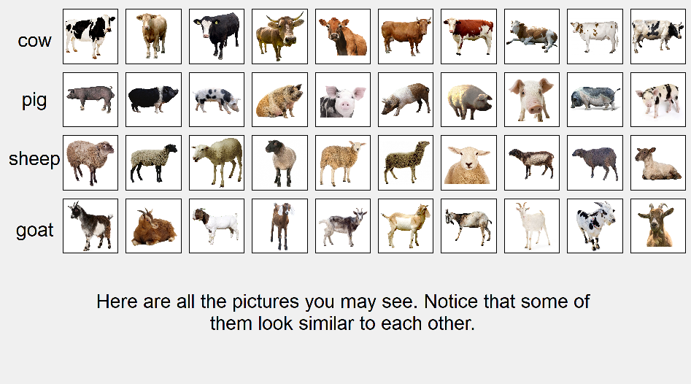
Figure S2. Exemplar pictures of each object for semantic, unrelated, and phonological task versions.
Semantic version

Slide 5
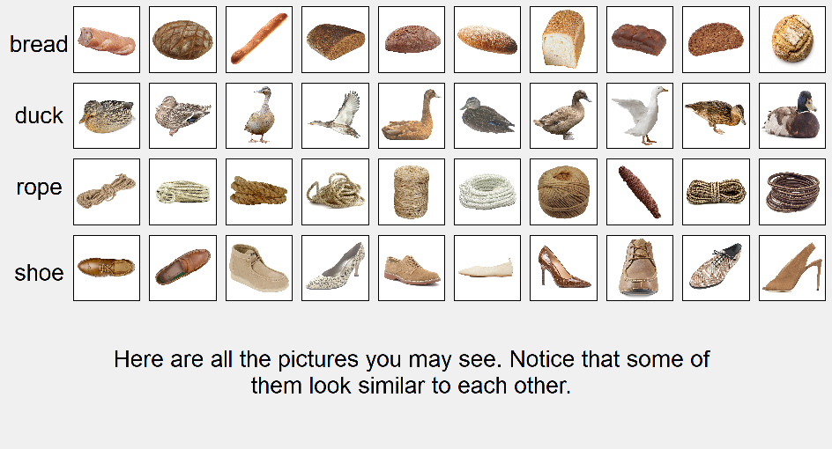
Figure S2. Exemplar pictures of each object for semantic, unrelated, and phonological task versions.
Unrelated version

Slide 6
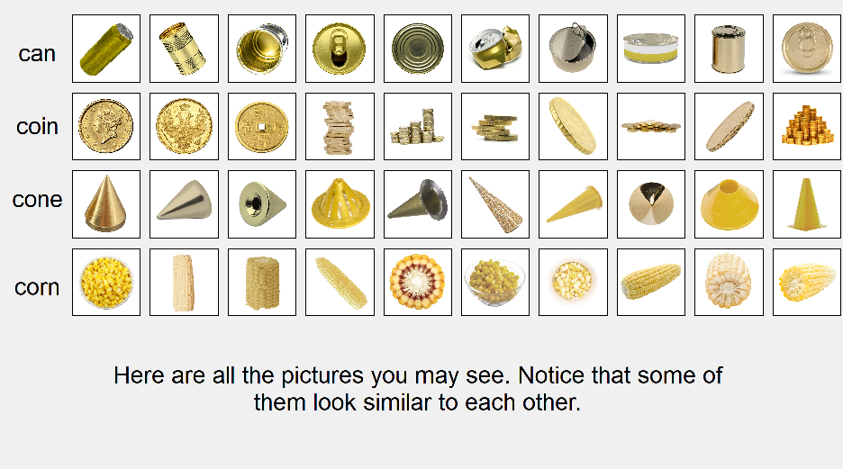
Figure S2. Exemplar pictures of each object for semantic, unrelated, and phonological task versions.
Phonological version

