Slide 1
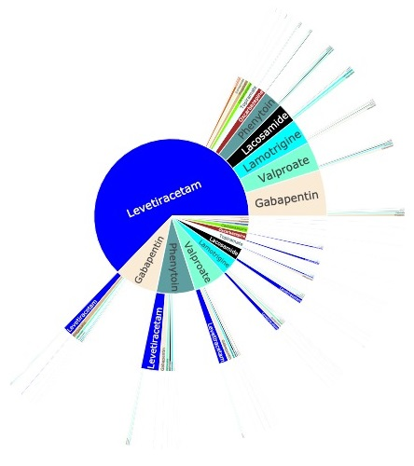
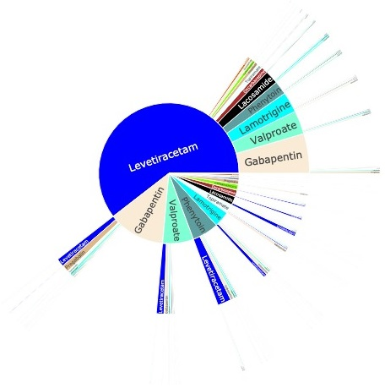
Restricted to beneficiaries with only one new ASM each date
Restricted to beneficiaries with
at least two epilepsy codes

