Slide 1
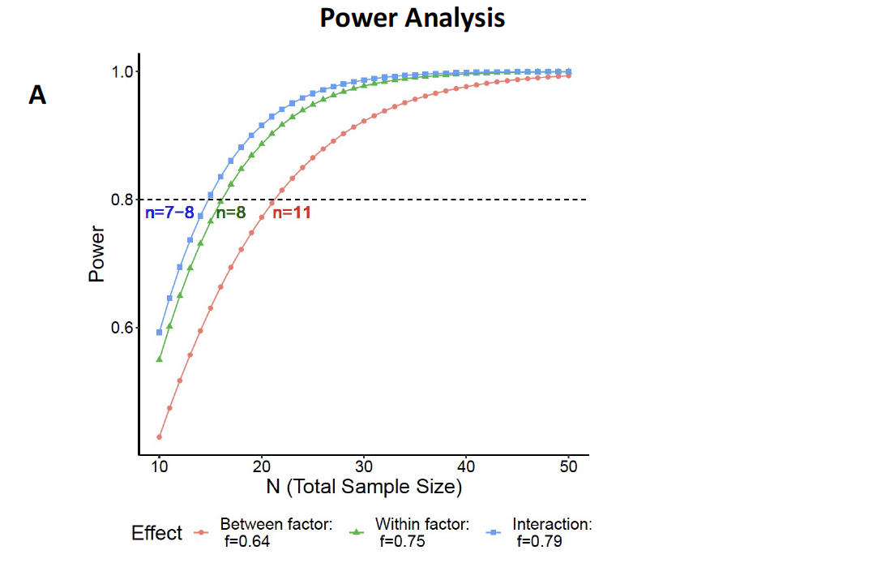
B
Condition | Group | n
Real Cliff | Sighted | 10
 | Blind | 9
Artificial Cliff | Sighted | 12
 | Blind | 11
Artificial Cliff w/3D Edge | Sighted | 9
 | Blind | 8
Artificial Cliff w/High Distal Boundary | Sighted | 9
Figure S1. A. Power analysis Based on pilot study from data obtained in the Real Cliff condition. Estimated effect size effects: 0.64, 0.75, and 0.79, for the main effect of Groups (sighted vs. blind), Day of Training (3 vs. 4), and Interaction. Power fixed at 0.80 (80%), alpha significance level at 0.05, and nonsphericity correction coefficient parameter at a neutral value of 1. B. Since our focus was on the interaction, sample size of all designs remained at the optimal minimal size (n=8), except in the artificial Cliff condition in which the size increased toward the most demanding value (n=11).
Figure S1

Slide 2
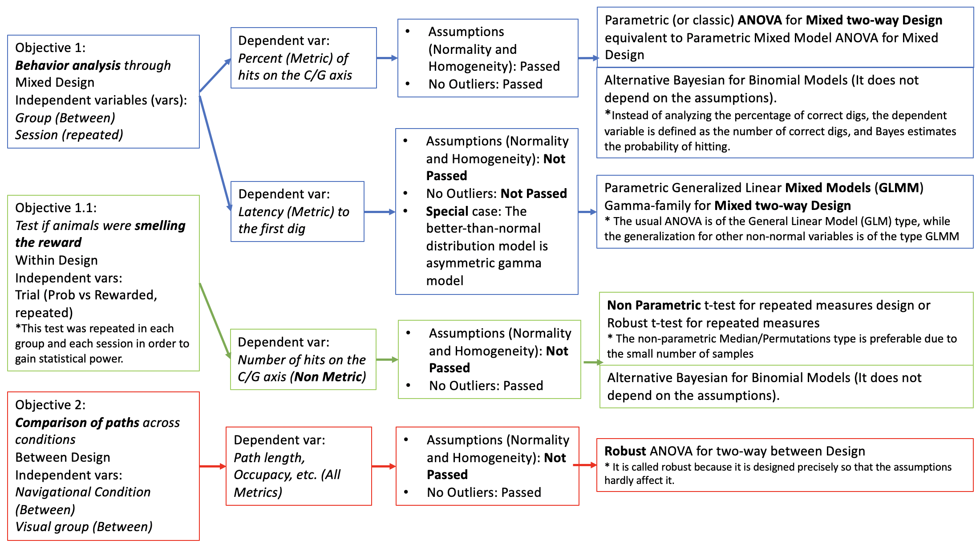
Figure S2. Schematic of Statistical Analysis Design. Note that when data passed the normality and equal variance requirements, parametric statistics were used. However, when there were violations, Generalized Linear Mixed Models were used when the data included repeated measures and Robust ANOVAs were conducted when groups were compared across conditions on a single test day (path analyses). All statistical analyses were performed using GNU R software, version 4.0.3 (Team, 2020) with parallel, data.table, Hmisc, and ggplot2, as general libraries; afex and emmeans for ANOVA; nlme, lme4, lmerTest and GLMMadaptive for GLMM analysis; WebPower for Power Analysis; Wilcox’ Rallfun-v37.txt library (https://dornsife.usc.edu/labs/rwilcox/software/) for robust analysis (see Yuan et al., in Press for functions details); effectsize for effect size estimations, and rjags, runjags, and BayesFactor for Bayesian Analysis. Generalized Linear Mixed Models (GLMM) Gamma-family were used to analyse the latency to the first dig through the different groups and sessions. The optimal model from a maximal random effect structure was of the type random intercepts and random slopes for subject within trial [glmer(latency ~ Group*Session + (1 + Trial | Subject), family=Gamma(link="identity"),Data)].
Figure S2

Slide 3
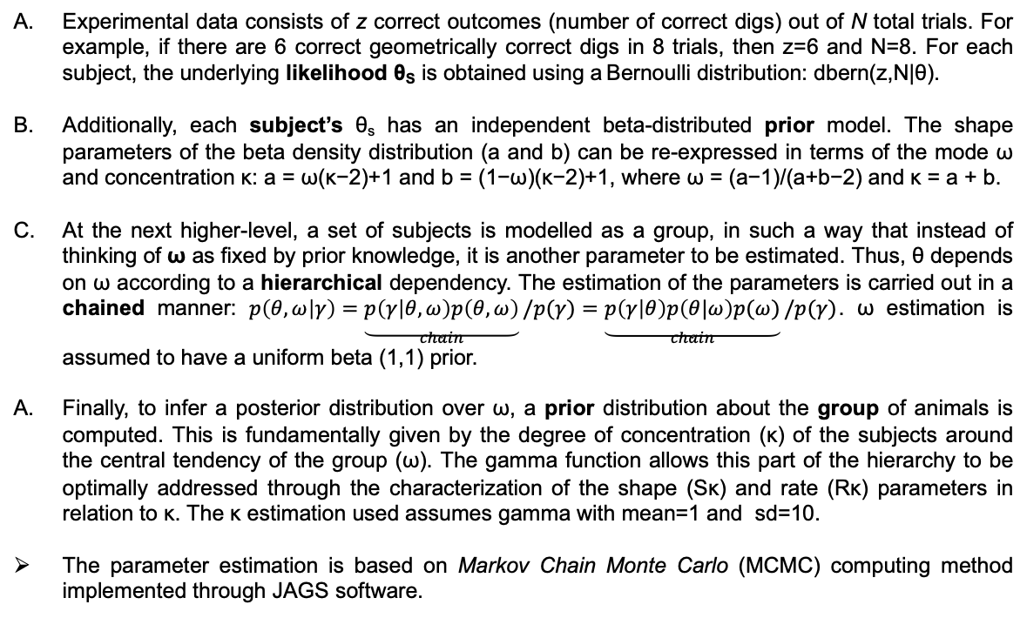
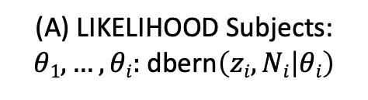
Hierarchical Bayesian Analysis
Generic PRIOR ω
Generic PRIOR κ
(C) POST Group: beta(ω|a_{ω},b_{ω})
(D) PRIOR Group: gamma(κ|Sκ, Rκ)
Hierarchical:
[Data | θ, ω] * [θ, ω] →
[Data | θ] * [θ | ω] * [ω]
(beta(ω(κ−2)+1, (1−ω)(κ−2)+1)
(B) PRIOR Subjects
𝜃_{S}
(A) LIKELIHOOD Subjects:
$θ1,…,θi:$dbern$\left(zi,Ni | θi\right)$
Experimental data consists of z correct outcomes (number of correct digs) out of N total trials. For example, if there are 6 correct geometrically correct digs in 8 trials, then z=6 and N=8. For each subject, the underlying likelihood θ_{S} is obtained using a Bernoulli distribution: dbern(z,N|θ).
Additionally, each subject’s θ_{s} has an independent beta-distributed prior model. The shape parameters of the beta density distribution (a and b) can be re-expressed in terms of the mode ω and concentration κ: a = ω(κ−2)+1 and b = (1−ω)(κ−2)+1, where ω = (a−1)/(a+b−2) and κ = a + b.
At the next higher-level, a set of subjects is modelled as a group, in such a way that instead of thinking of ω as fixed by prior knowledge, it is another parameter to be estimated. Thus, θ depends on ω according to a hierarchical dependency. The estimation of the parameters is carried out in a chained manner: $p\left(θ,ω | γ\right)=\underset{chain}{\underbrace{p\left(γ | θ,ω\right)p\left(θ,ω\right)}}/p(γ)=\underset{chain}{\underbrace{p\left(γ | θ\right)p\left(θ|ω\right)p(ω)}}/p(γ)$. ω estimation is assumed to have a uniform beta (1,1) prior.
Finally, to infer a posterior distribution over ω, a prior distribution about the group of animals is computed. This is fundamentally given by the degree of concentration (κ) of the subjects around the central tendency of the group (ω). The gamma function allows this part of the hierarchy to be optimally addressed through the characterization of the shape (Sκ) and rate (Rκ) parameters in relation to κ. The κ estimation used assumes gamma with mean=1 and sd=10.
The parameter estimation is based on Markov Chain Monte Carlo (MCMC) computing method implemented through JAGS software.
Figure S3

Slide 4
A B
C D
Figure S4. Parameters of Border exploration in the Artificial Cliff w/High Distal Boundaries. Note that animals in this condition do not occupy or spend substantial time at the border, which likely contributed to their inability to reorient using geometry.
Figure S4

Slide 5
Group Bayes Analysis
Condition | Group | Training Day | Mean | Median | Mode | HDI _{LOW} | HDI _{HIGH} | %<0.5 | BF | Log (BF)
Real Cliff | S | 3 | 0.74 | 0.74 | 0.73 | 0.58 | 0.89 | 99.66 | 552.824 | 2.74
 | S | 4 | 0.70 | 0.70 | 0.70 | 0.55 | 0.85 | 99.38 | 33.920 | 1.53
 | B | 3 | 0.46 | 0.46 | 0.46 | 0.27 | 0.63 | 32.06 | 0.001 | -2.86
 | B | 4 | 0.75 | 0.75 | 0.74 | 0.59 | 0.95 | 99.53 | 1172.344 | 3.07
Artificlal Cliff | S | 3 | 0.54 | 0.54 | 0.55 | 0.39 | 0.69 | 71.93 | 0.011 | -1.97
(AC) | S | 4 | 0.52 | 0.52 | 0.53 | 0.30 | 0.74 | 56.77 | 0.014 | -1.86
 | B | 3 | 0.49 | 0.49 | 0.49 | 0.32 | 0.66 | 46.64 | 0.003 | -2.59
 | B | 4 | 0.48 | 0.48 | 0.49 | 0.32 | 0.64 | 40.12 | 0.001 | -2.99
AC w/3D Edge | S | 3 | 0.38 | 0.39 | 0.39 | 0.13 | 0.59 | 18.82 | 0.001 | -3.28
 | S | 4 | 0.52 | 0.52 | 0.51 | 0.24 | 0.69 | 57.90 | 0.010 | -2.01
 | B | 3 | 0.54 | 0.54 | 0.54 | 0.26 | 0.81 | 64.40 | 0.109 | -0.96
 | B | 4 | 0.80 | 0.80 | 0.80 | 0.65 | 0.97 | 99.91 | 4980.680 | 3.70
AC w/High | S | 3 | 0.56 | 0.56 | 0.55 | 0.37 | 0.75 | 74.24 | 0.057 | -1.25
Distal Boundary | S | 4 | 0.40 | 0.40 | 0.42 | 0.11 | 0.67 | 18.82 | 0.001 | -2.86
Table S1. Parameter estimators and Group Bayes Factors (BF) for the real cliff (green), artificial cliff (red), artificial cliff w/3 edge (blue), and artificial cliff w/high distal boundaries (gray). AC=Artificial Cliff. The results appear broken down for each group and day. The Highest Density Intervals (HDIs) are values that serve to summarize a distribution by specifying a range that spans most of its values, e.g., 95% of the parameter estimation. Column %<0.5 is the percentage of estimated values for the parameters below chance level (0.5). This summary aims to bring the Bayes estimation and model comparison approaches to a convergent point. For example, sighted mice in the Real Cliff on Day 3 showed a Mode of 73, and a 95% HDI [0.58, 0.89], which does not contain the level of chance. Additionally, 99.66% of the parameter estimates exceeded the level of chance. In agreement with this observation, a BF of 522.824 (BF>3) favored the alternative hypothesis (H_{alt}) that animals preferentially dug in the geometrically correct axis. BFs log scale (log (BF)), allow to assess the weight of evidence in favor of the two models: 1) H_{null} supporting chance over learning (negative value), or 2) H_{alt} learning over chance (positive values. For example, the values -3.28 (AC w/3D Edge, Sighted Group, Day 3) and 3.70 (AC w/3D Edge, Blind Group, Day 4) represent solid evidence of comparable magnitude but of opposite sign: supporting H_{null} in the first condition and in favor of H_{alt} in the second condition.
Table S1

Slide 6
Subject Bayes Analysis
Table S2. Subjects’ Bayes analysis corresponding to the performance on the Real Cliff (left panel) and Artificial Cliff (right panel). For details see Table S1.
Table S2

Slide 7
Subject Bayes Analysis
Table S3. Subjects’ Bayes analysis corresponding to the performance in the Artificial Cliff w/3D Edge (top panel) and Artificial Cliff w/High Distal Boundaries (bottom panel). For details see Table S1.
Table S3

Slide 8
Table S4. Comparison of rewarded and probe trials. To test if animals smelled the reward, the number of digs in the correct location were compared on rewarded and probe trials, for each condition, group, and day of testing. In order to strengthen the decision around the hypotheses, the results of two non-parametric tests (Median, and Permutation) and the Bayesian approach were compared. In the Bayesian test, BF was obtained for the H_{null} stating that the standardized effect size of the difference was 0, versus the H_{alt} that the standardized effect size was not 0. AC=artificial cliff, Rec. B.=Rectangular Boundary
Table S4

