Slide 1
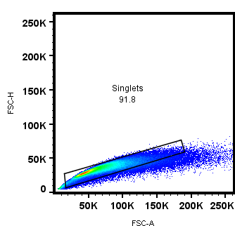
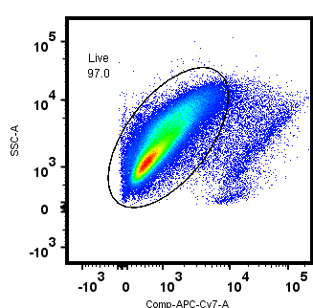
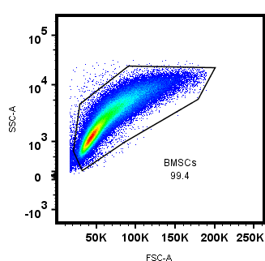
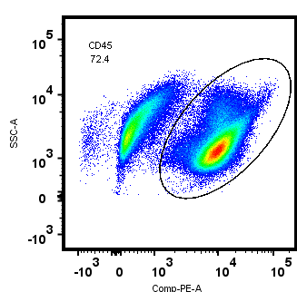
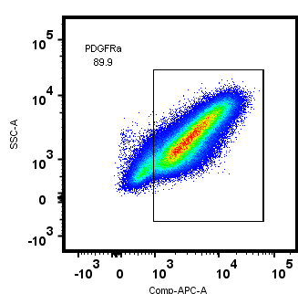
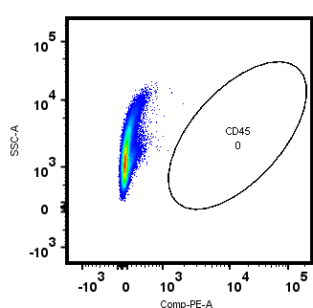
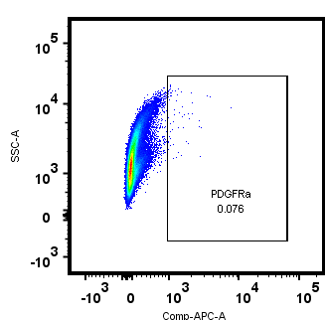
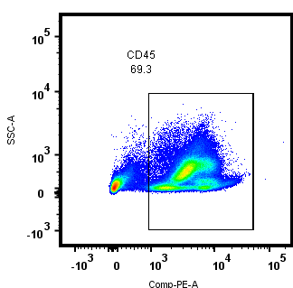
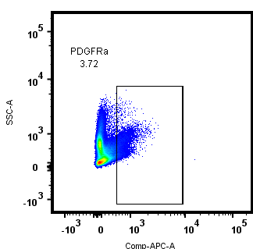
SUPPLEMENTAL FIGURE 1
A
singlets
live cells
FSC-H
SSC-A
SSC-A
BMSCs
FSC-A
Anime-reactive dye
FSC-A
SSC-A
Stained
SSC-A
Isotype
CD45
PDGFRα
B
Rinse
3h post plating
Flow Cytometry
Analysis
Non-adherent Cells
65.0 ± 2.67
2.67 ± 0.53
SSC-A
CD45
PDGFRα

Slide 2
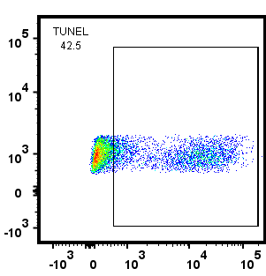
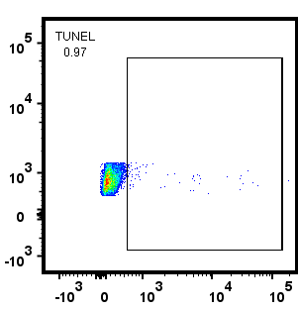
SUPPLEMENTAL FIGURE 2
Positive Control
Negative Control
SSC-A
TUNEL

