Slide 1
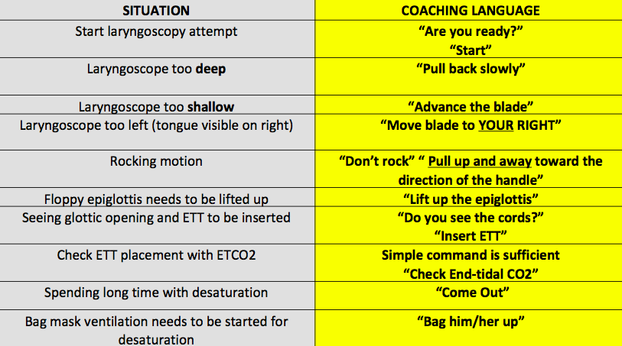
Supplemental Figure A: Standardized Coaching Language
Notes:
This is the recommended coaching language. All coaches and intubators were in-serviced on this prior to implementation, and a cognitive aid with the language is available as a laminated card on each video laryngoscopy tower in the unit.

