Slide 1
Supplemental materials
Supplemental figure S1. in vitro cell lines mono, GI₅₀
Supplemental figure S2. in vitro assessment of signalling, western blots.
Supplemental figure S3. in vivo pharmacodynamics for monotherapy.
Supplemental figure S4. in vitro chemo combination heatmap & in vivo body weights
Supplemental figure S5. Olaparib combination signalling blots & in vivo body weight
Supplementary Table S1. Mouse PK.
Supplementary Table S2. Mouse tolerability table for chemo combos
Supplementary Table S3. in vivo efficacy %TGI and statistical significance
Supplementary materials and methods.
Supplementary file (Excel). Excel spreadsheet of all cell line GI₅₀’s

Slide 2
Supplemental figure S1. A) Scatter plot of the 50% growth inhibition (GI₅₀) values of cancer cell lines treated for 72 hours with the AZD6738. Each dose represents an individual cell line. The median GI₅₀ (black line) is shown for each cell line panel. Data table for B) ATM-deficiency (mixed cell types) and C) Breast CCNE1 cell lines used in figure 1.
A)
B)
Cancer cell line name | Tissue type | ATM total protein expression (baseline) | ATM pSer1981 increase 1 hr after IR | CHK2 pThr68 increase 1 hr after IR | Other ATM pathway defect (if known) | Overall ATM classification | AZD6738 GI50 (μM)
AT4* | A-T skin fibroblast | None | None | None | ATM-/- mutant | Deficient | 0.33
NHDF* | Normal skin fibroblast | High | High | High | ND | Proficient | >10
Granta-519* | Mantle cell lymphoma | Low | None | Low | 11q23 del+ATM mutant | Deficient | 0.58
SKCO-1 | Colon cancer | None | None | None | ND | Deficient | 0.6326
LoVo | Colon cancer | High | High | High | MRE11A-mutant | Deficient | 0.435
HT-29 | Colon cancer | High | High | High | ND | Proficient | 2.563
Colo-205 | Colon cancer | High | High | High | ND | Proficient | 5.843
NCI-1793 | Lung cancer | High | High | High | ND | Proficient | 1.954
NCI-H2126 | Lung cancer | High | High | High | ND | Proficient | 1.874
A549 | Lung cancer | High | High | High | ND | Proficient | 5.441
NCI-H23 | Lung cancer | Low | None | None | ND | Deficient | 0.6972
HX-147 | Lung cancer | High | High | High | ND | Proficient | 3.368
HCC1395* | Breast cancer | Low | Low | Low | ND | Deficient | 0.8631
HCC1937 | Breast cancer | High | Low | High | ND | Proficient | 0.7958
MDA-MB-231 | Breast cancer | High | Low | High | ND | Proficient | 3.493
UPCI_SCC-090 | Head&Neck cancer | High | High | Low | ND | Proficient | 0.8064
UPCI-SCC-131 | Head&Neck cancer | None | None | None | 11q23 del(single) | Deficient | 1.044
PE/CA-PJ15 | Head&Neck cancer | Low | Low | High | ND | Proficient | 9.047
PE/CA-PJ34 | Head&Neck cancer | Low | None | None | 11q23 del(single) | Deficient | 2.524
PE/CA-PJ41 | Head&Neck cancer | Low | None | None | 11q23 del(single) | Deficient | 1.928
FaDu | Head&Neck cancer | High | High | High | ND | Proficient | 2.253
CAl27 | Head&Neck cancer | High | High | Low | 11q23 del(single) | Proficient | 2.16
UPCI-SCC-172 | Head&Neck cancer | High | High | High | ND | Proficient | 3.205
*AT4 Sickel cell (ATM-mutant) and NHDF (normal human dermal fibroblast) skin fibroblast cells, Granta-519 and HCC1395 were not part of main cancer panels and GI50’s determined independently, but using same methods
C)
Cancer cell line name | Tissue type | CCNE1 status (CCLE database) | Other DDR pathway defect (if known) | AZD6738 GI50 (μM)
MDA-MB-468 | Breast | WT |  | 2.513
MDA-MB-436 | Breast | WT | BRCA1m | 2.765
MDA-MB-231 | Breast | WT |  | 3.493
BT-20 | Breast | WT |  | 1.419
MDA-MB-157 | Breast | Amplified |  | 0.9052
HCC-1806 | Breast | Amplified |  | 0.4706
HCC-1569 | Breast | Amplified |  | 0.582
HCC1187 | Breast | WT |  | 0.433
HCC1143 | Breast | WT |  | 0.7621
HCC1937 | Breast | WT | BRCA1m | 0.7958
HCC70 | Breast | Amplified |  | 1.366
CAL-120 | Breast | WT |  | 4.326
EFM-19 | Breast | WT |  | 4.838
T47D | Breast | WT |  | 5.203
HCC1419 | Breast | WT |  | 2.801
JIMT-1 | Breast | WT |  | 1.157
BT-474 | Breast | WT |  | 1.53
HCC1954 | Breast | WT |  | 1.78
DU-4475 | Breast | WT |  | 2.315
BT-549 | Breast | WT |  | 1.146
CAMA-1 | Breast | WT |  | 2.602
MFM-223 | Breast | WT |  | 2.624
MCF7 | Breast | WT |  | 1.033
Notes:
Data:

Slide 3
Supplemental figure S2. A) Scatter plots of cell line GI₅₀ versus indicated gene mutation or copy number. Disease indications follows TCGA codes. Bars = median GI₅₀ ± 95% confidence interval

Slide 4
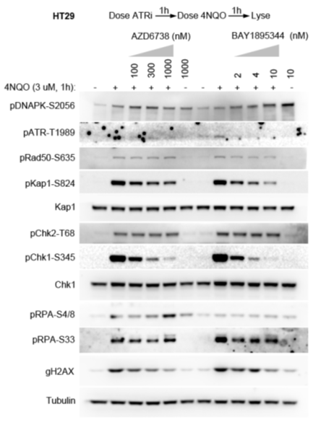
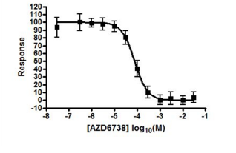
Supplemental figure S3. In vitro assessment ATM and ATR dependent signalling modulation by AZD6738. A) Representative concentration response curve pCHK1 HT-29 cell assay +4NQO. B) Western blot of pCHK1 Ser345 ATR specificity in HT-29 cells +4NQO with AZD6738. C) Western blot of ATM and ATR-dependent signalling in FaDu WT and FaDu ATM knockout cells 24 hours following treatment with increasing concentrations of AZD6738 alone.
A)
B)
% pCHK1 (Ser345)
IC₅₀ = 0.074 μM
IC₉₀ = 0.666 μM
C)
Notes:
Data:
1B) D360 IT20135; Natalie Stratton; n=6
1C) HT29 +4NQO western blot: PH/E/13034 Kay Eckersley
1D) LoVo & HCC1806 BE002562_21 Summary Yann Wallez

Slide 5
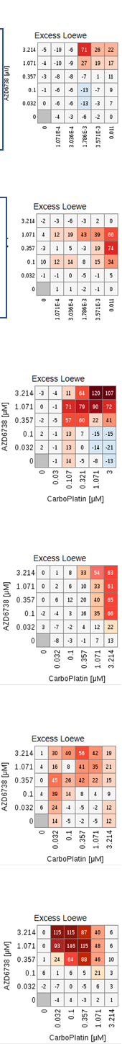
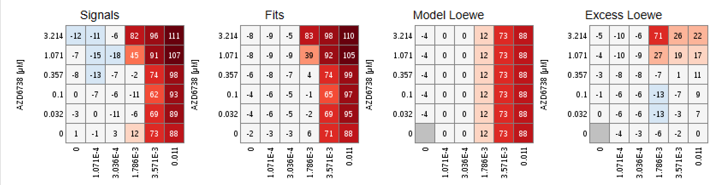
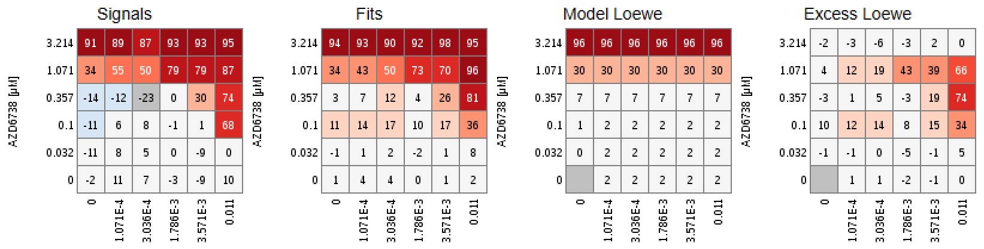
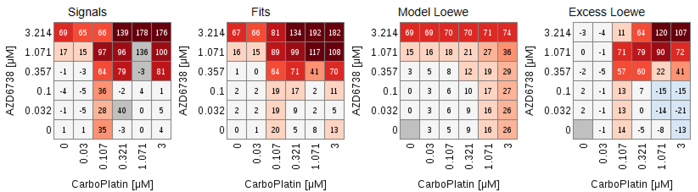
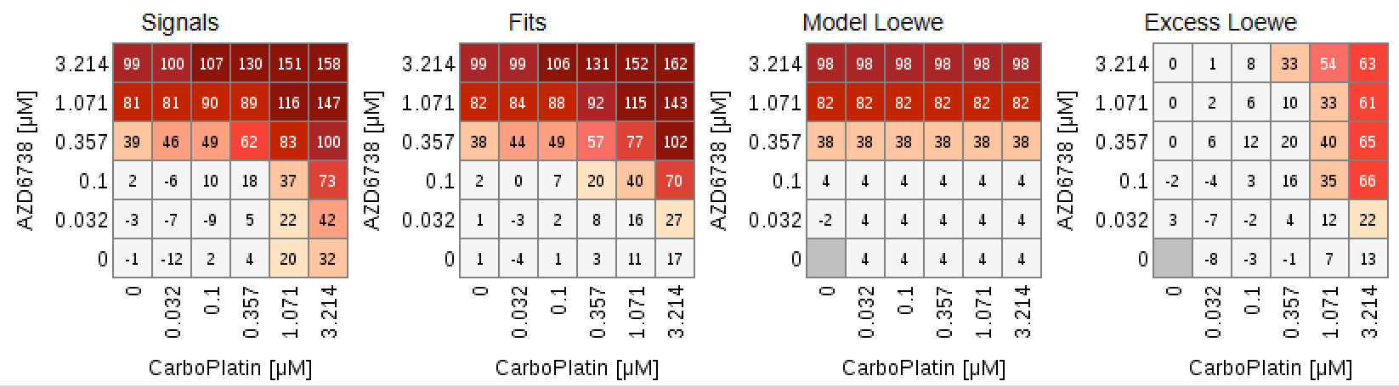
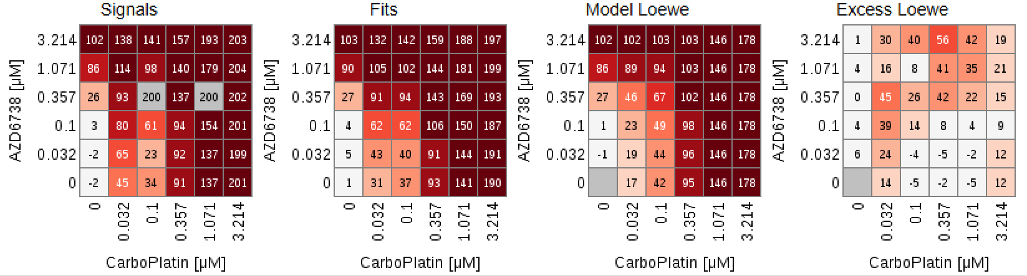
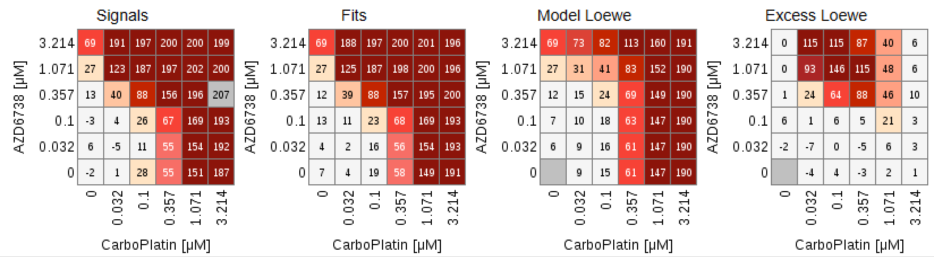
Supplemental figure S4. In vitro combinations. A) Representative chemotherapy combinations heatmap examples. Molecular characterisations are listed in Supplemental figure S1 and LoVo is MRE11A while all others are proficient. B) Scatter plots of combination synergy scores in cell by DDR proficiency/WT or deficiency as defined in supplemental figure S1A and S1B (where data were available)
A)
Colo-205 SN38 (MP01) 2.154
Remove “model” panels
Be consistent format with Crafter et al 2015 paper
LoVo SN38 (MP01) 2.645
HCC-1143 TNBC carbo (MP01) 11.789
MDA-468 TNBC carbo (MP01) 7.107
MCF-7 ER+ carbo (MP01) 9.902
DU4475 TNBC carbo (MP01) 23.477

Slide 6
Supplemental figure S4 continued
B)

Slide 7
Supplemental figure S5. Olaparib combination body weights A) HBCx-9 in Fig 5A. B) HBCx-10 in Fig 5B.
A)
B)

Slide 8
Supplementary Table S1. Mouse pharmacokinetics (PK) for AZD6738.
Mouse dose* | Free C_{max} (μM) | Free AUC₀₋₂₄ (μM.h) | Time above IC₉₀# (h per day)
10 mg/kg qd | 3.1 | ~7.6 | ~4
25 mg/kg qd | 8.8 | 22 | 6.4
50 mg/kg qd | 18 | 44 | 8.1
6.25 mg/kg bid | 2.2 | 11 | 6.1
12.5 mg/kg bid | 4.4 | 22 | 9.5
25 mg/kg bid | 8.9 | 44 | 13.0
*qd = quaque die or once a day
*bid = bis in die or twice a day
#ATR cell IC₉₀ = 0.67 µM

Slide 9
Supplementary Table S2. Carboplatin and Irinotecan tolerated dose-schedules.
Compound 1 | Compound 1 dose (mg/kg) | Compound 1 schedule | Compound 2 | Compound 2 dose (mg/kg) | Compound 2 schedule | Tolerated Y/N? | Mice
Irinotecan | 20 | 1 day on 3 days off | AZD6738 | 25 | qd 3 days on, 1 day off | N | Male nude
Irinotecan | 20 | 1 day on 3 days off | AZD6738 | 12.5 | qd 3 days on, 1 day off | Y | Male nude
Irinotecan | 20 | weekly | AZD6738 | 50 | 24hr gap, 3 days on 4 days off | Y | Male nude
Irinotecan | 20 | 1 day on 3 days off | AZD6738 | 12.5 | bid, 3 days on 1 day off | Y (3/4 mice) | Male nude
Compound 1 | Compound 1 dose (mg/kg) | Compound 1 schedule | Compound 2 | Compound 2 dose (mg/kg) | Compound 2 schedule | Tolerated Y/N? | Mice
Carboplatin | 100 | 1 day on 13 days off | AZD6738 | 25 | Qd 3 days on, 11 day off, days 1-4 | Y | Male nude

Slide 10
Supplementary Table S3. In vivo tumour growth inhibition (%TGI) and p-values
Model | Dose mg/kg QD = once daily BID = twice daily | Day (end-of-treatment cycle) | %TGI (mean change in tumour volume in treated vs control group)s | P-value Non-significant (ns) =P>0.05 *=P≤ 0.05 **=P≤ 0.01 ***=P≤ 0.001
HCC1806 | 6.25 BID | 20 | 10 | ns
HCC1806 | 12.5 BID | 20 | 40 | ***
HCC1806 | 50 QD | 20 | 60 | ***
HCC1954 | 50 QD | 21 | 31 | ns
LoVo | 10 QD | 15 | 0 | ns
LoVo | 25 QD | 15 | 37.8 | **
LoVo | 50 QD | 15 | 89.2 | ***
Granta-519 | 12.5 BID | 21 | 85.2 | ***
Granta-519 | 25 QD | 21 | 45.3 | ***
Granta-519 | 50 QD | 21 | 82.1 | ***
NCI-H23 | 50 QD | 28 | >100 | ***
A549 | 50 QD | 21 | 15 | ns
FaDu ATM^{-/-/-} | 25 QD Continuous | 13 | 82 | ***
FaDu ATM^{-/-/-} | 25 QD 3d-on/4d-off | 13 | 57 | ***
FaDu ATM^{-/-/-} | 50 QD | 14 | 76.6 | ***

Slide 11
Supplementary materials and methods
Supplemental figure S1
ATM functionality in cell lines
ATM functionality assessment was carried out on cancer cell lines from multiple tumour types including breast, colon, lung, head&neck as well as skin fibroblasts established from normal and Ataxia-telangiectasia (ATM loss-of-function mutant) patients. Briefly, exponentially growing cells were either irradiated or not with 6 Gy x-ray radiation and harvested after 30 minutes. Whole cell protein lysates were prepared and analysed by standard western blotting to determine levels of total ATM and CHK2 as well as their ATM-dependent phosphorylated forms, ATM pSer1981 and CHK2 pThr68. Cell lines which showed no or low detectable total ATM expression and no/low additional increase in both ATM pSer1981 and CHK2 pThr68 after irradiation were classed as ATM-deficient. Cells derived from Ataxia-telangiectasia patients and those with known deleterious ATM or MRE11A mutations were also classed as ATM-deficient. Cell lines with moderate to high levels of total ATM expression and showing increases in both ATM pSer1981 and CHK2 pThr68 after irradiation were classed as ATM-proficient. Cells lines which show increases in either ATM pSer1981 or CHK2 pThr68 but not both together were classed as proficient.

Slide 12
Supplementary file (Excel). Excel spreadsheet of all cell line GI₅₀’s

