Slide 1
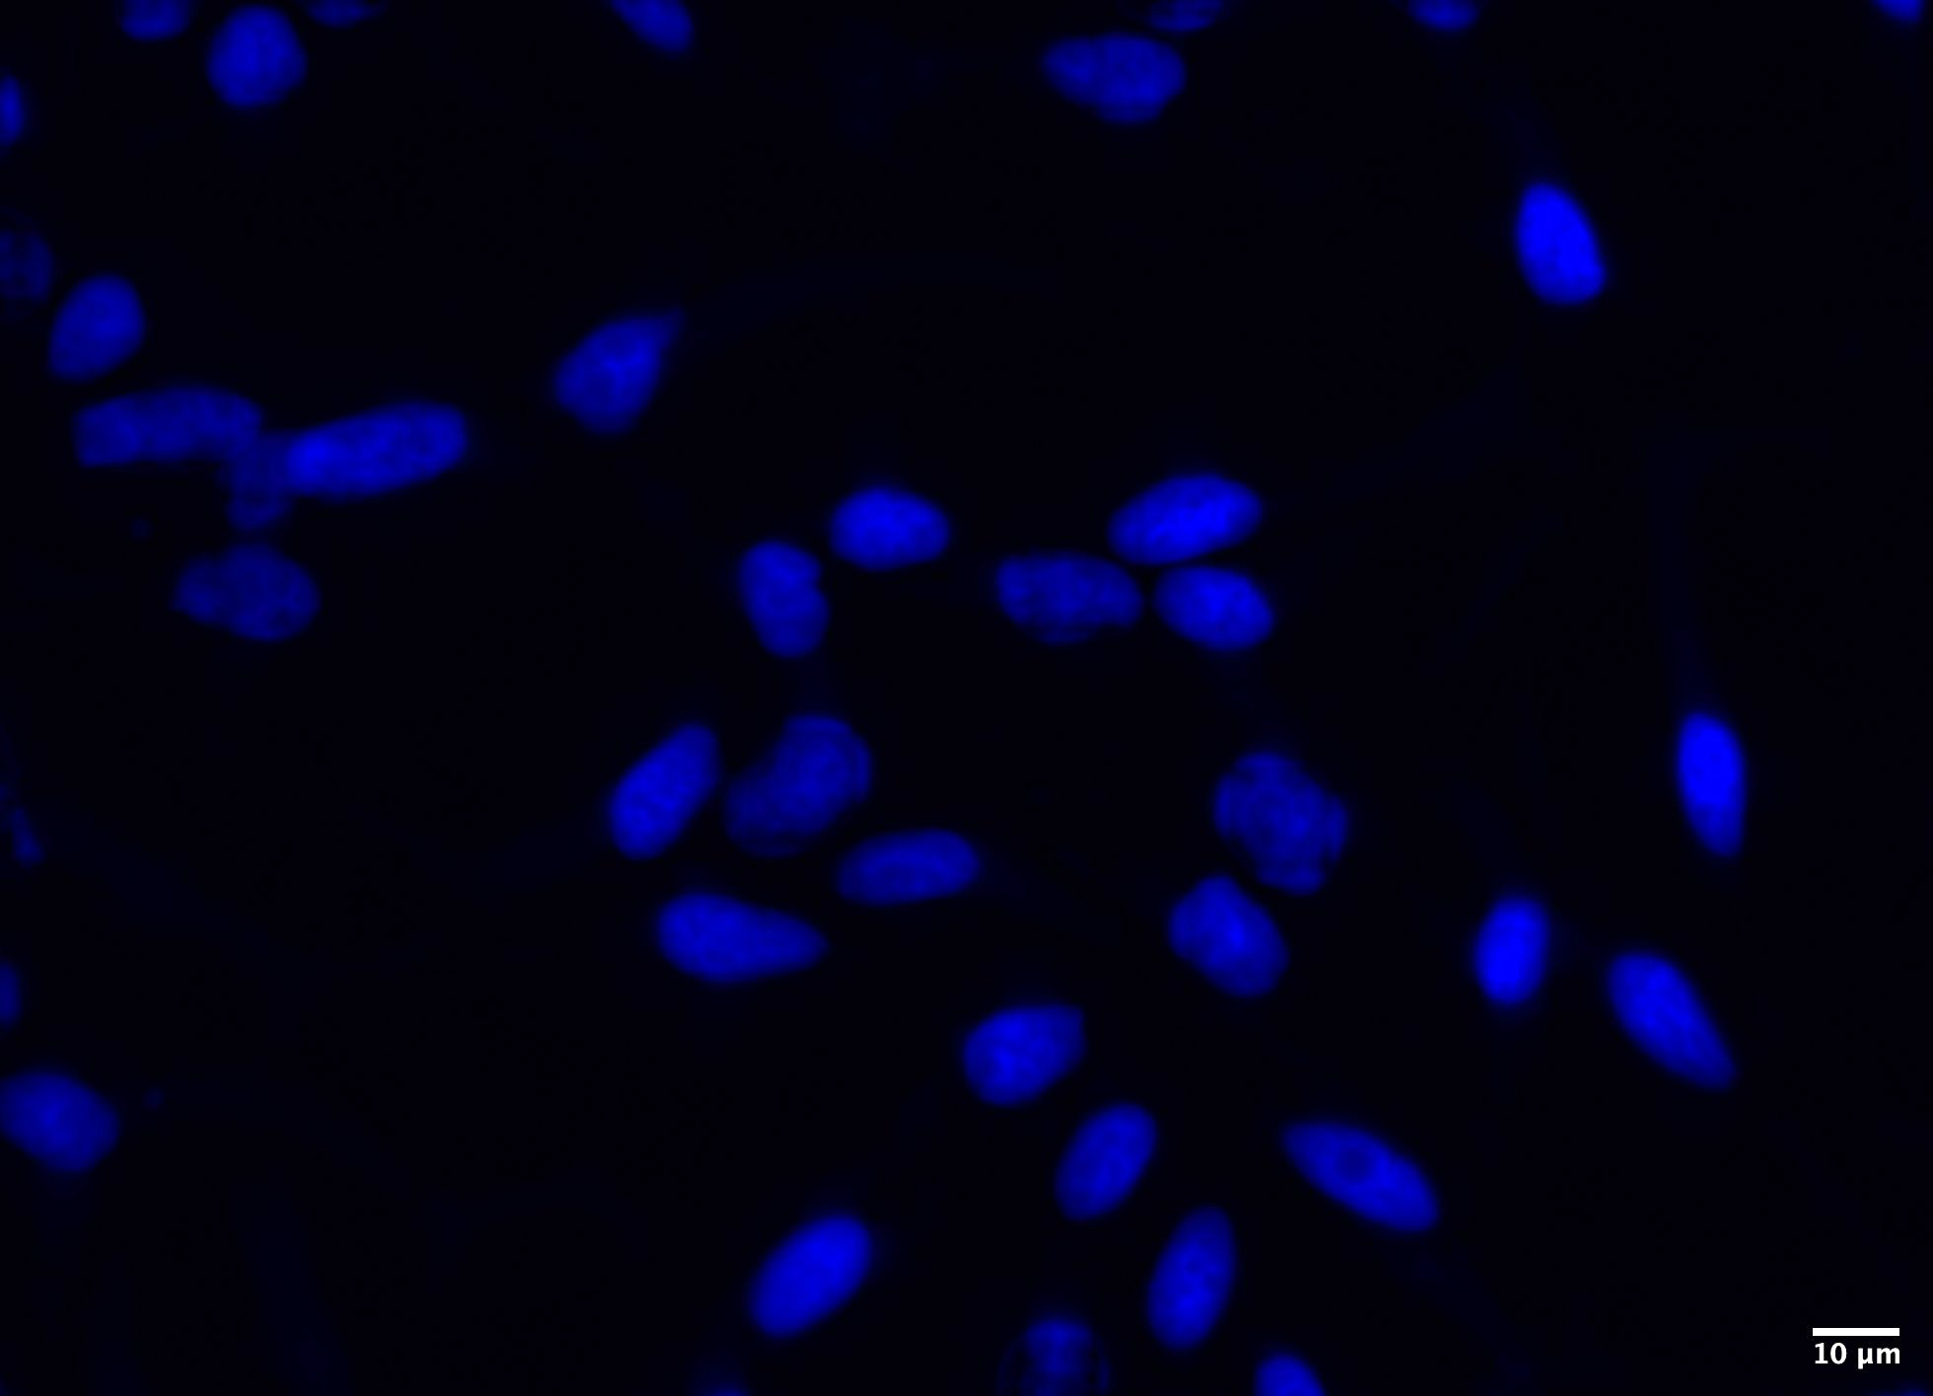
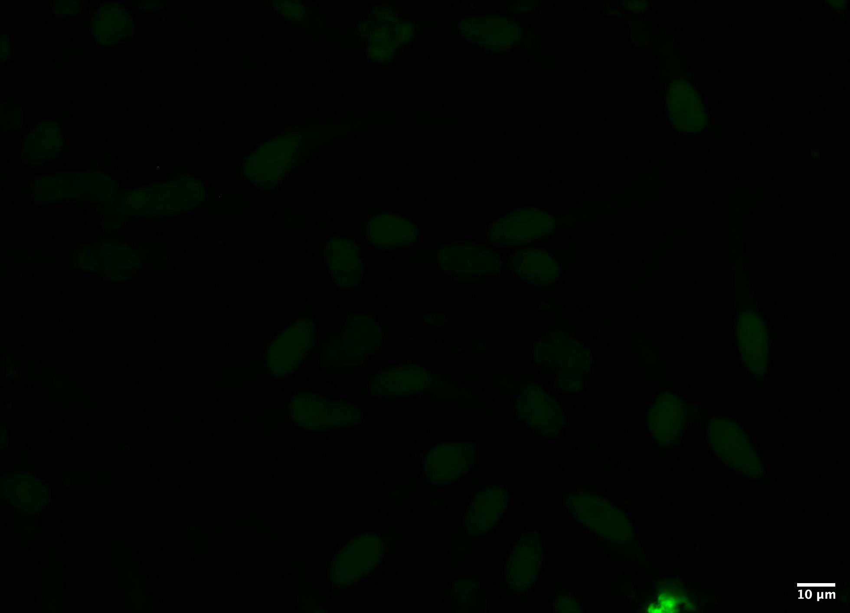
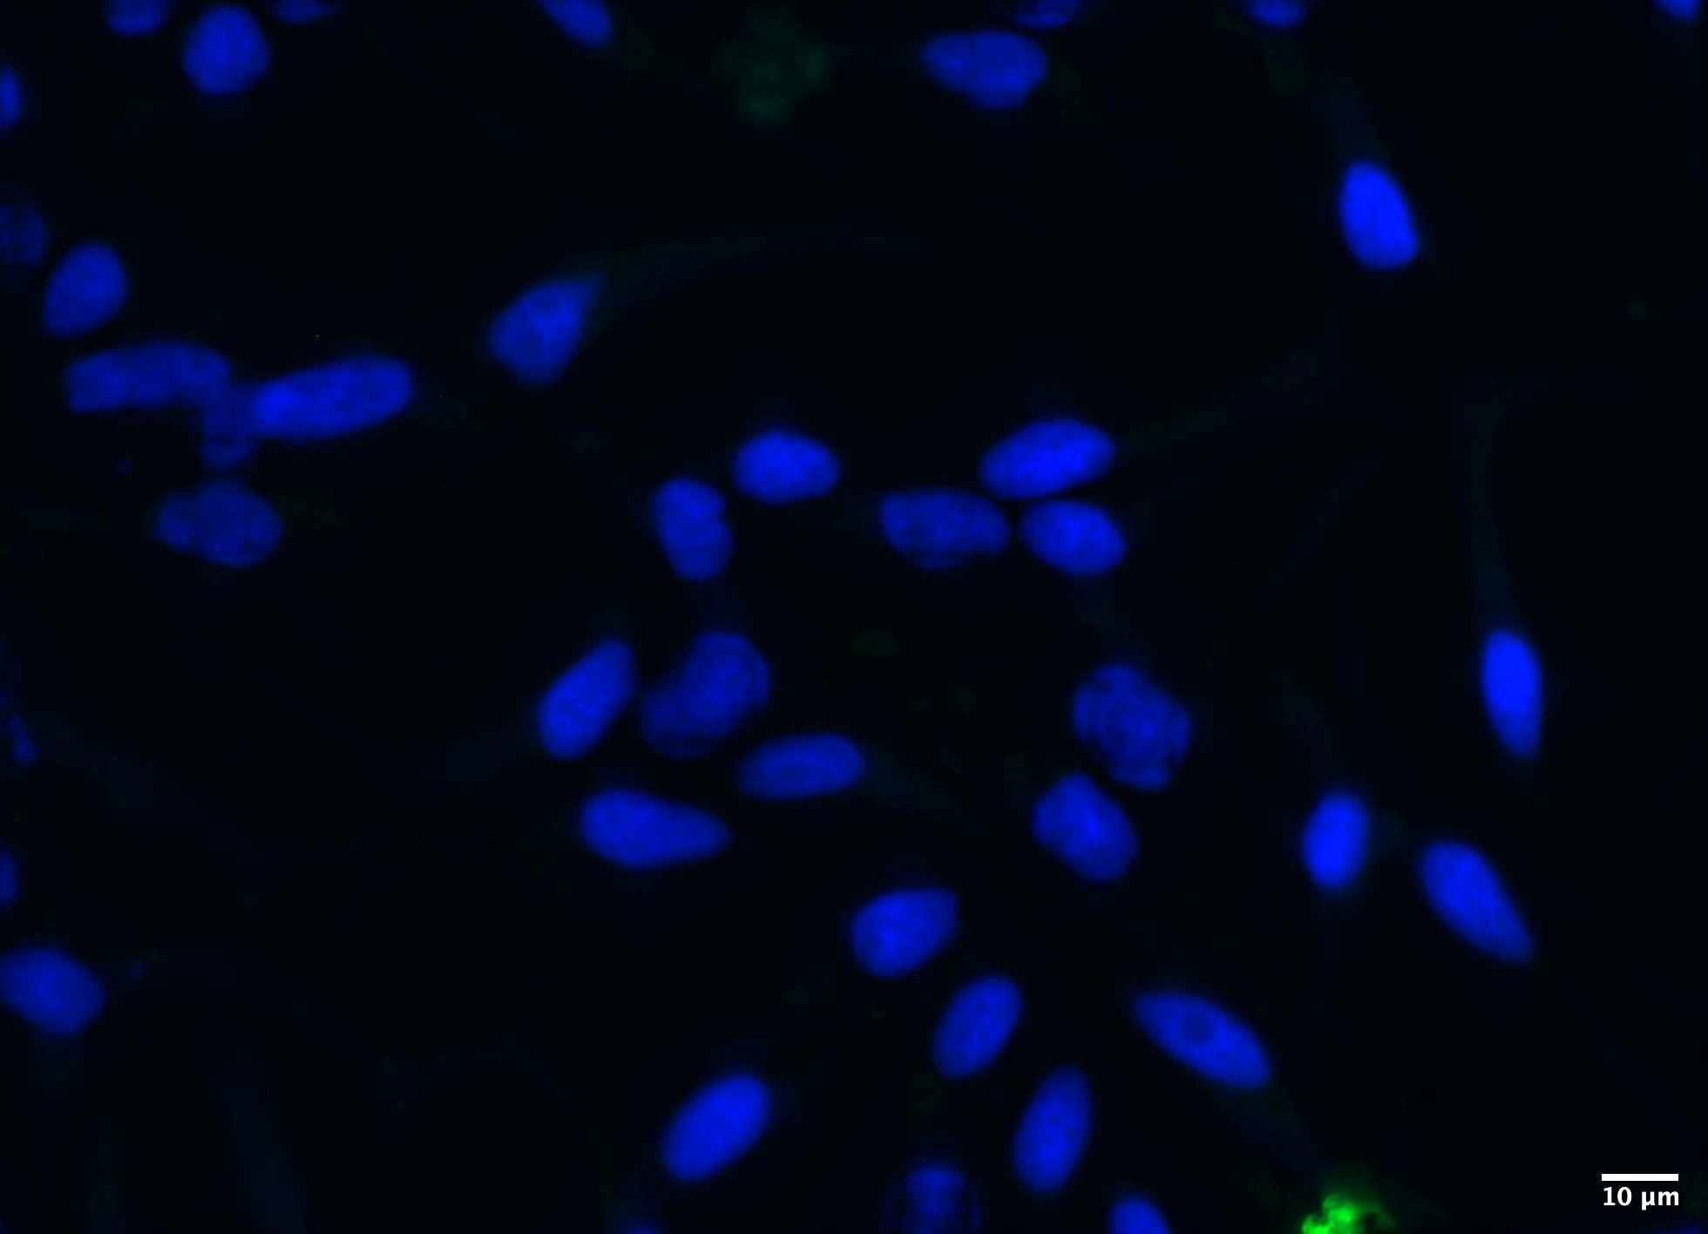




Supplemental Figure 1
A.
B.
DAPI
GSEA Hallmark
GSEA KEGG
Negative
Isotope
Control
Merge
C.
D.
C4-2
C4-2
Input
ALDOA
IgG
IP
Input
IgG
IP: ALDOA
IP :PKM2
IP
DNA-PK
DNA-PK
IgG
PKM2
PKM2
ALDOA
E.
F.
Aldolase
Activity
Pyruvate Kinase
Activity
22Rv1
22Rv1
Supplemental Figure 1. DNA-PK interacts with novel partners and modulates activity of glycolytic enzymes without changes in protein levels. A) DNA-PK interacts with known and novel proteins that play a role in various pro-tumorigenic pathways. B) Immunofluorescence images using DAPI and negative isotope control (40X). C) ALDOA and PKM2 interact with DNA-PK in C4-2 cells. D) Predicted DNA-PK phosphorylation sites on ALDOA and PKM2. E) Aldolase and F) pyruvate kinase activity assays performed in 22Rv1 cells upon DNA-PK inhibition (1 μM, 3hours). G) Glycolytic protein expression levels upon DNA-PK inhibition (NU7441, 1 μM, 24 hours) and DNA-PK knockdown (96 hours post transfection) (right). ns= nonsignificant, * p<0.05, ** p<0.01, ***p<0.001

