Slide 1
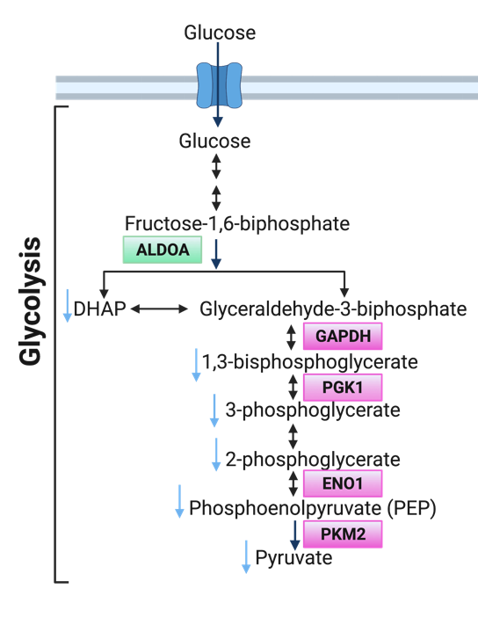
A.
B.
Supplemental Figure 3
Amino Acids
Peptide
Nucleotide
Lipids
Supplemental Figure 3. DNA-PK inhibition modulates metabolic pathways. A) Number of metabolites (up and down) shown for each sub pathway in the super pathways. B) Metabolites changed in the energy super-pathway. B) Schematic of glycolysis, highlighting DNA-PK partners identified using RIME (green and magenta) and with blue arrows representing downregulated metabolites found in metabolomics upon DNA-PK inhibition (NU7441, 1μM, 24hours).

