Slide 1
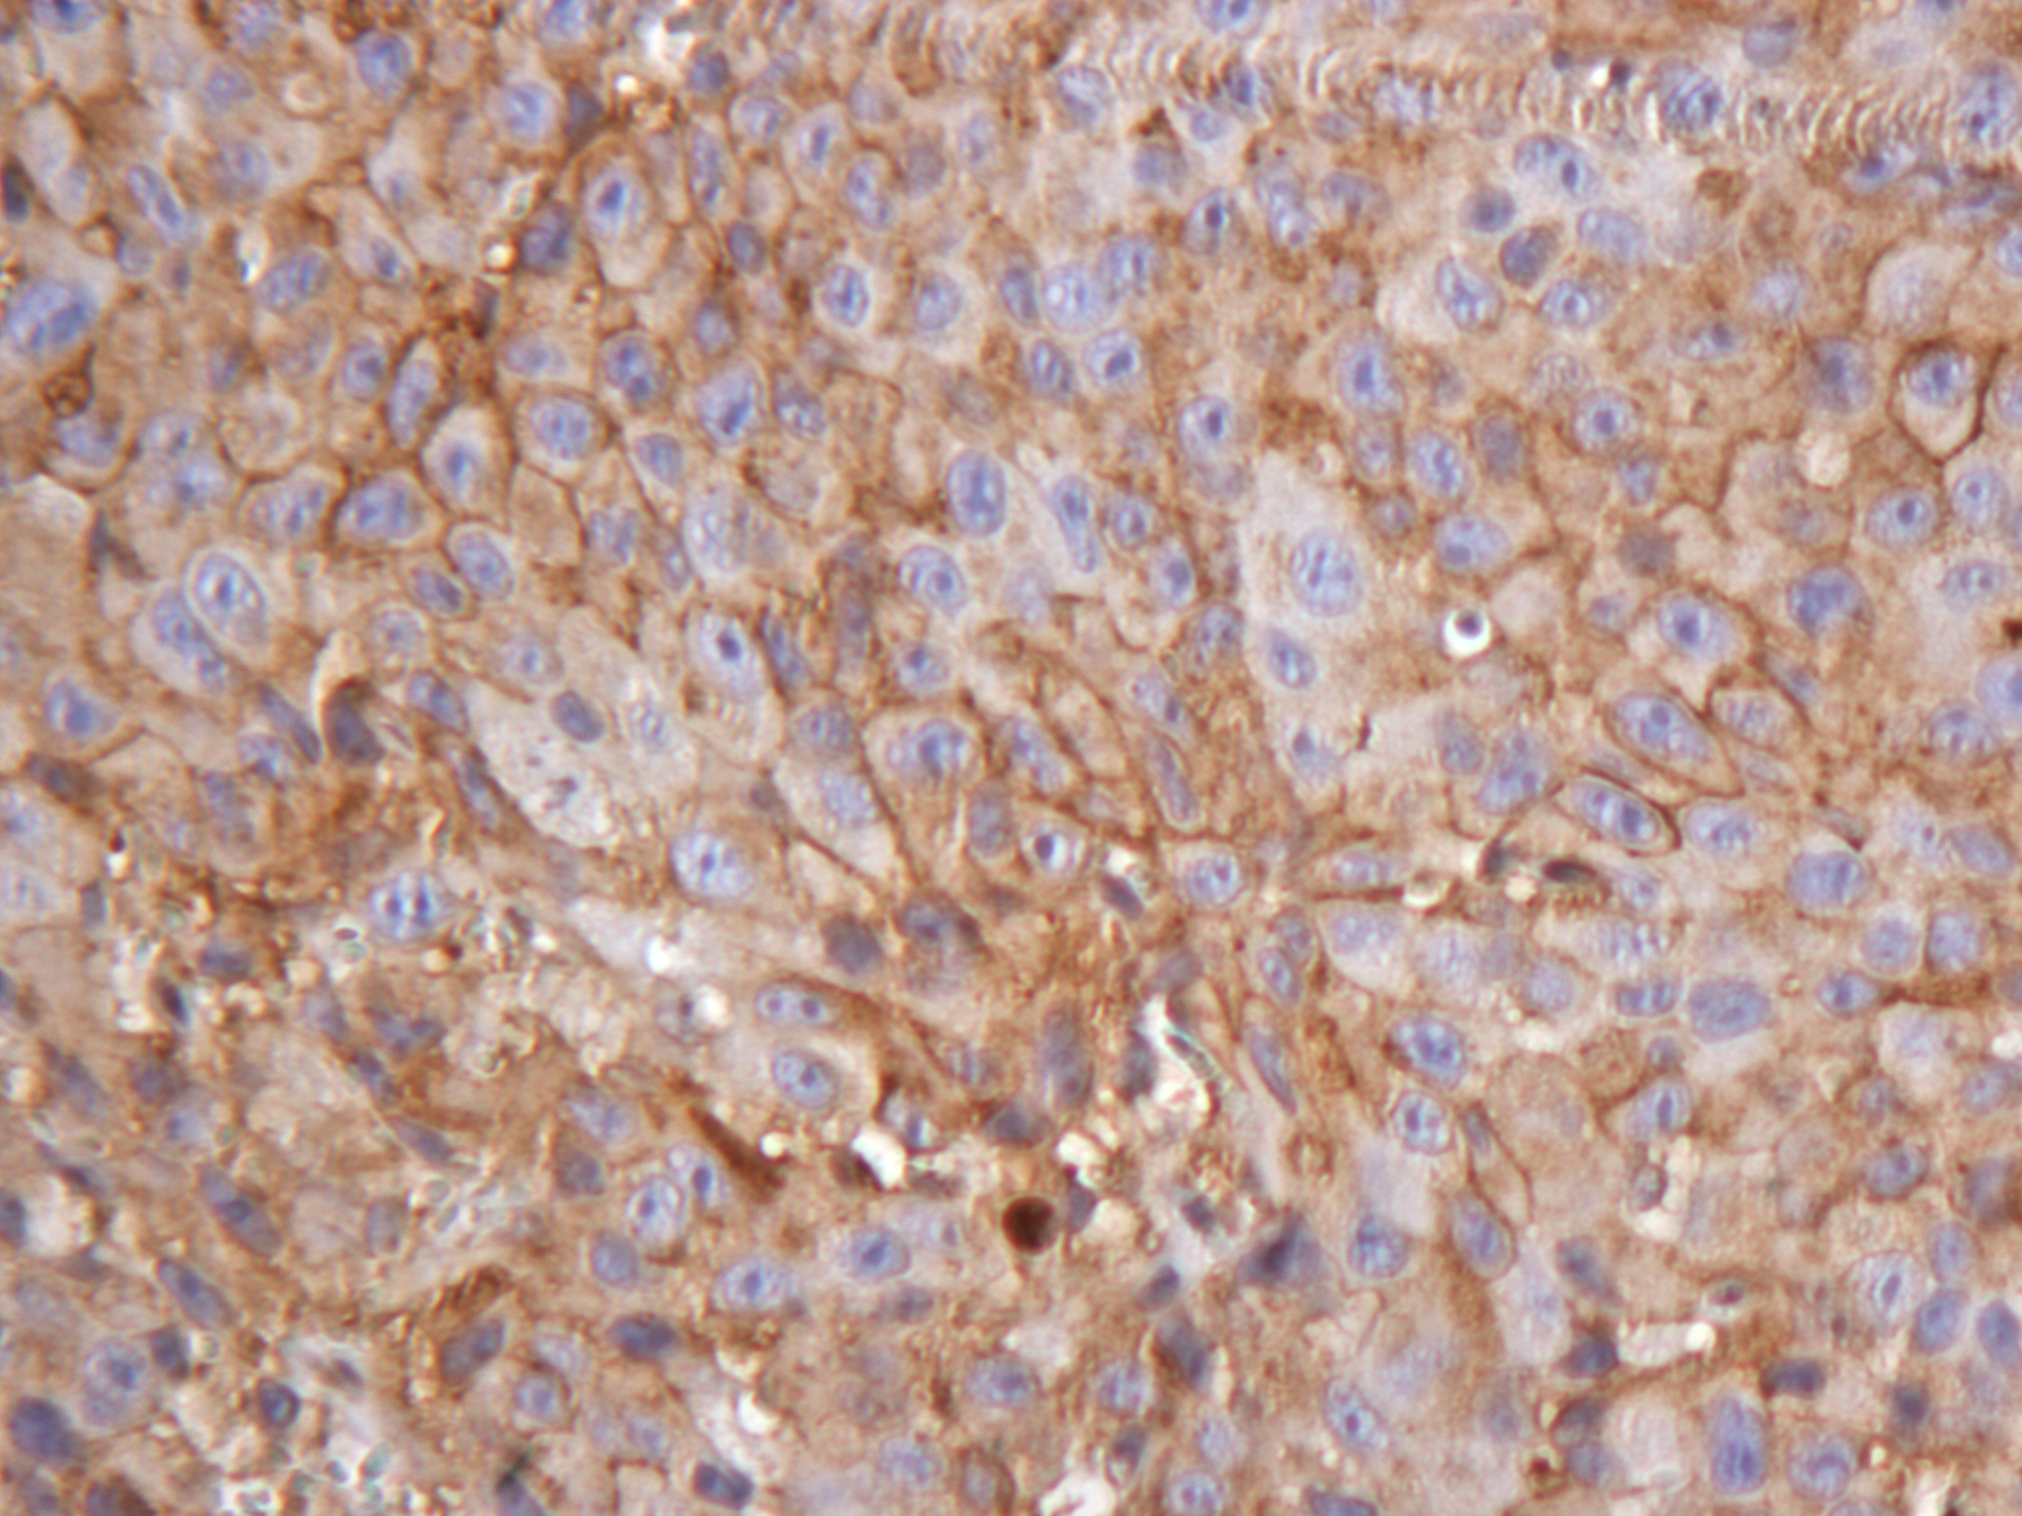
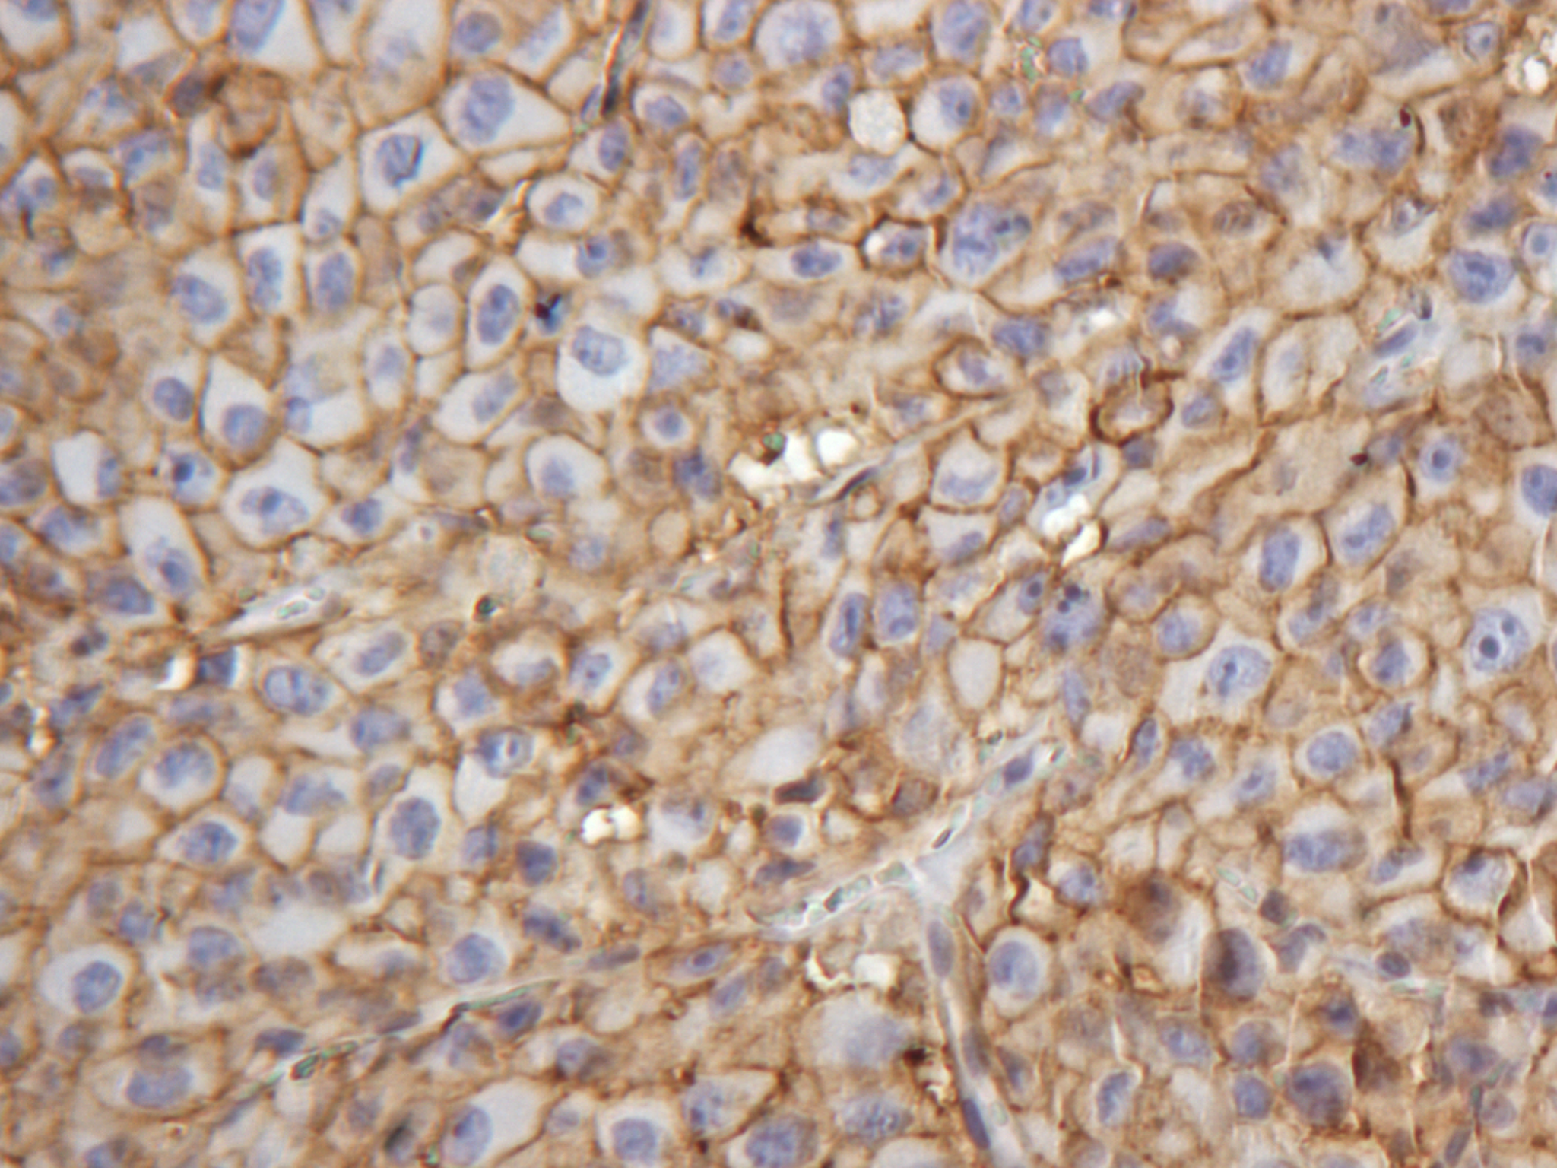
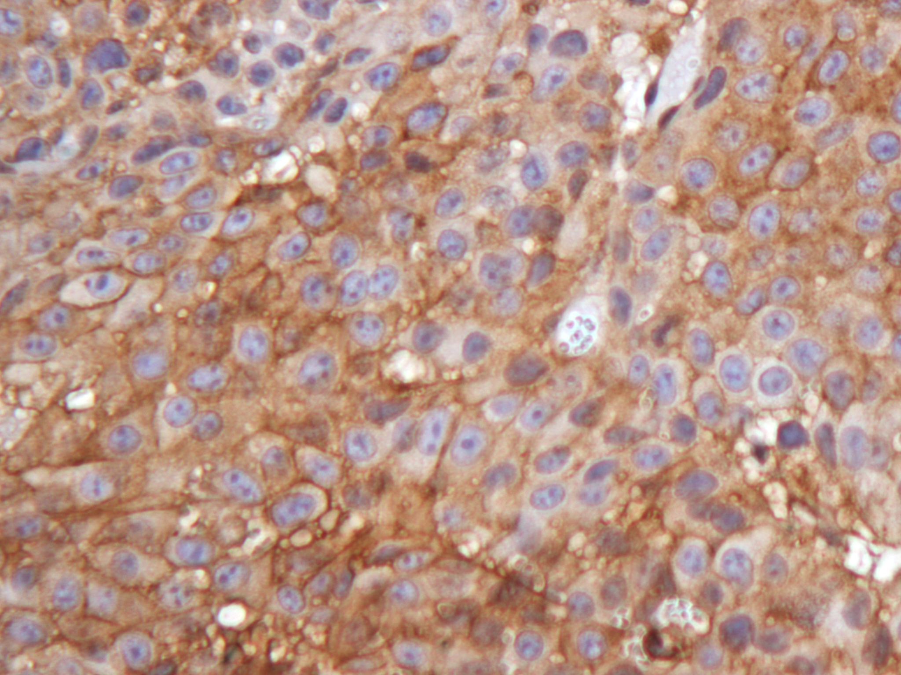
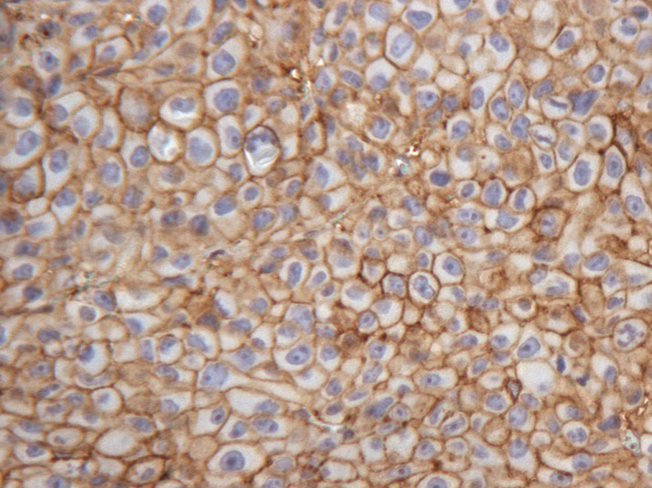
Supplemental Figure 5
A.
GLUT-1
MCT1
Control
20X
NU7441
Supplemental Figure 5. DNA-PK inhibition does not affect protein levels of glycolytic markers in vivo. Representative IHC staining of xenograft tissues stained for glycolytic markers GLUT-1 and MCT1 (20X).

