Slide 1
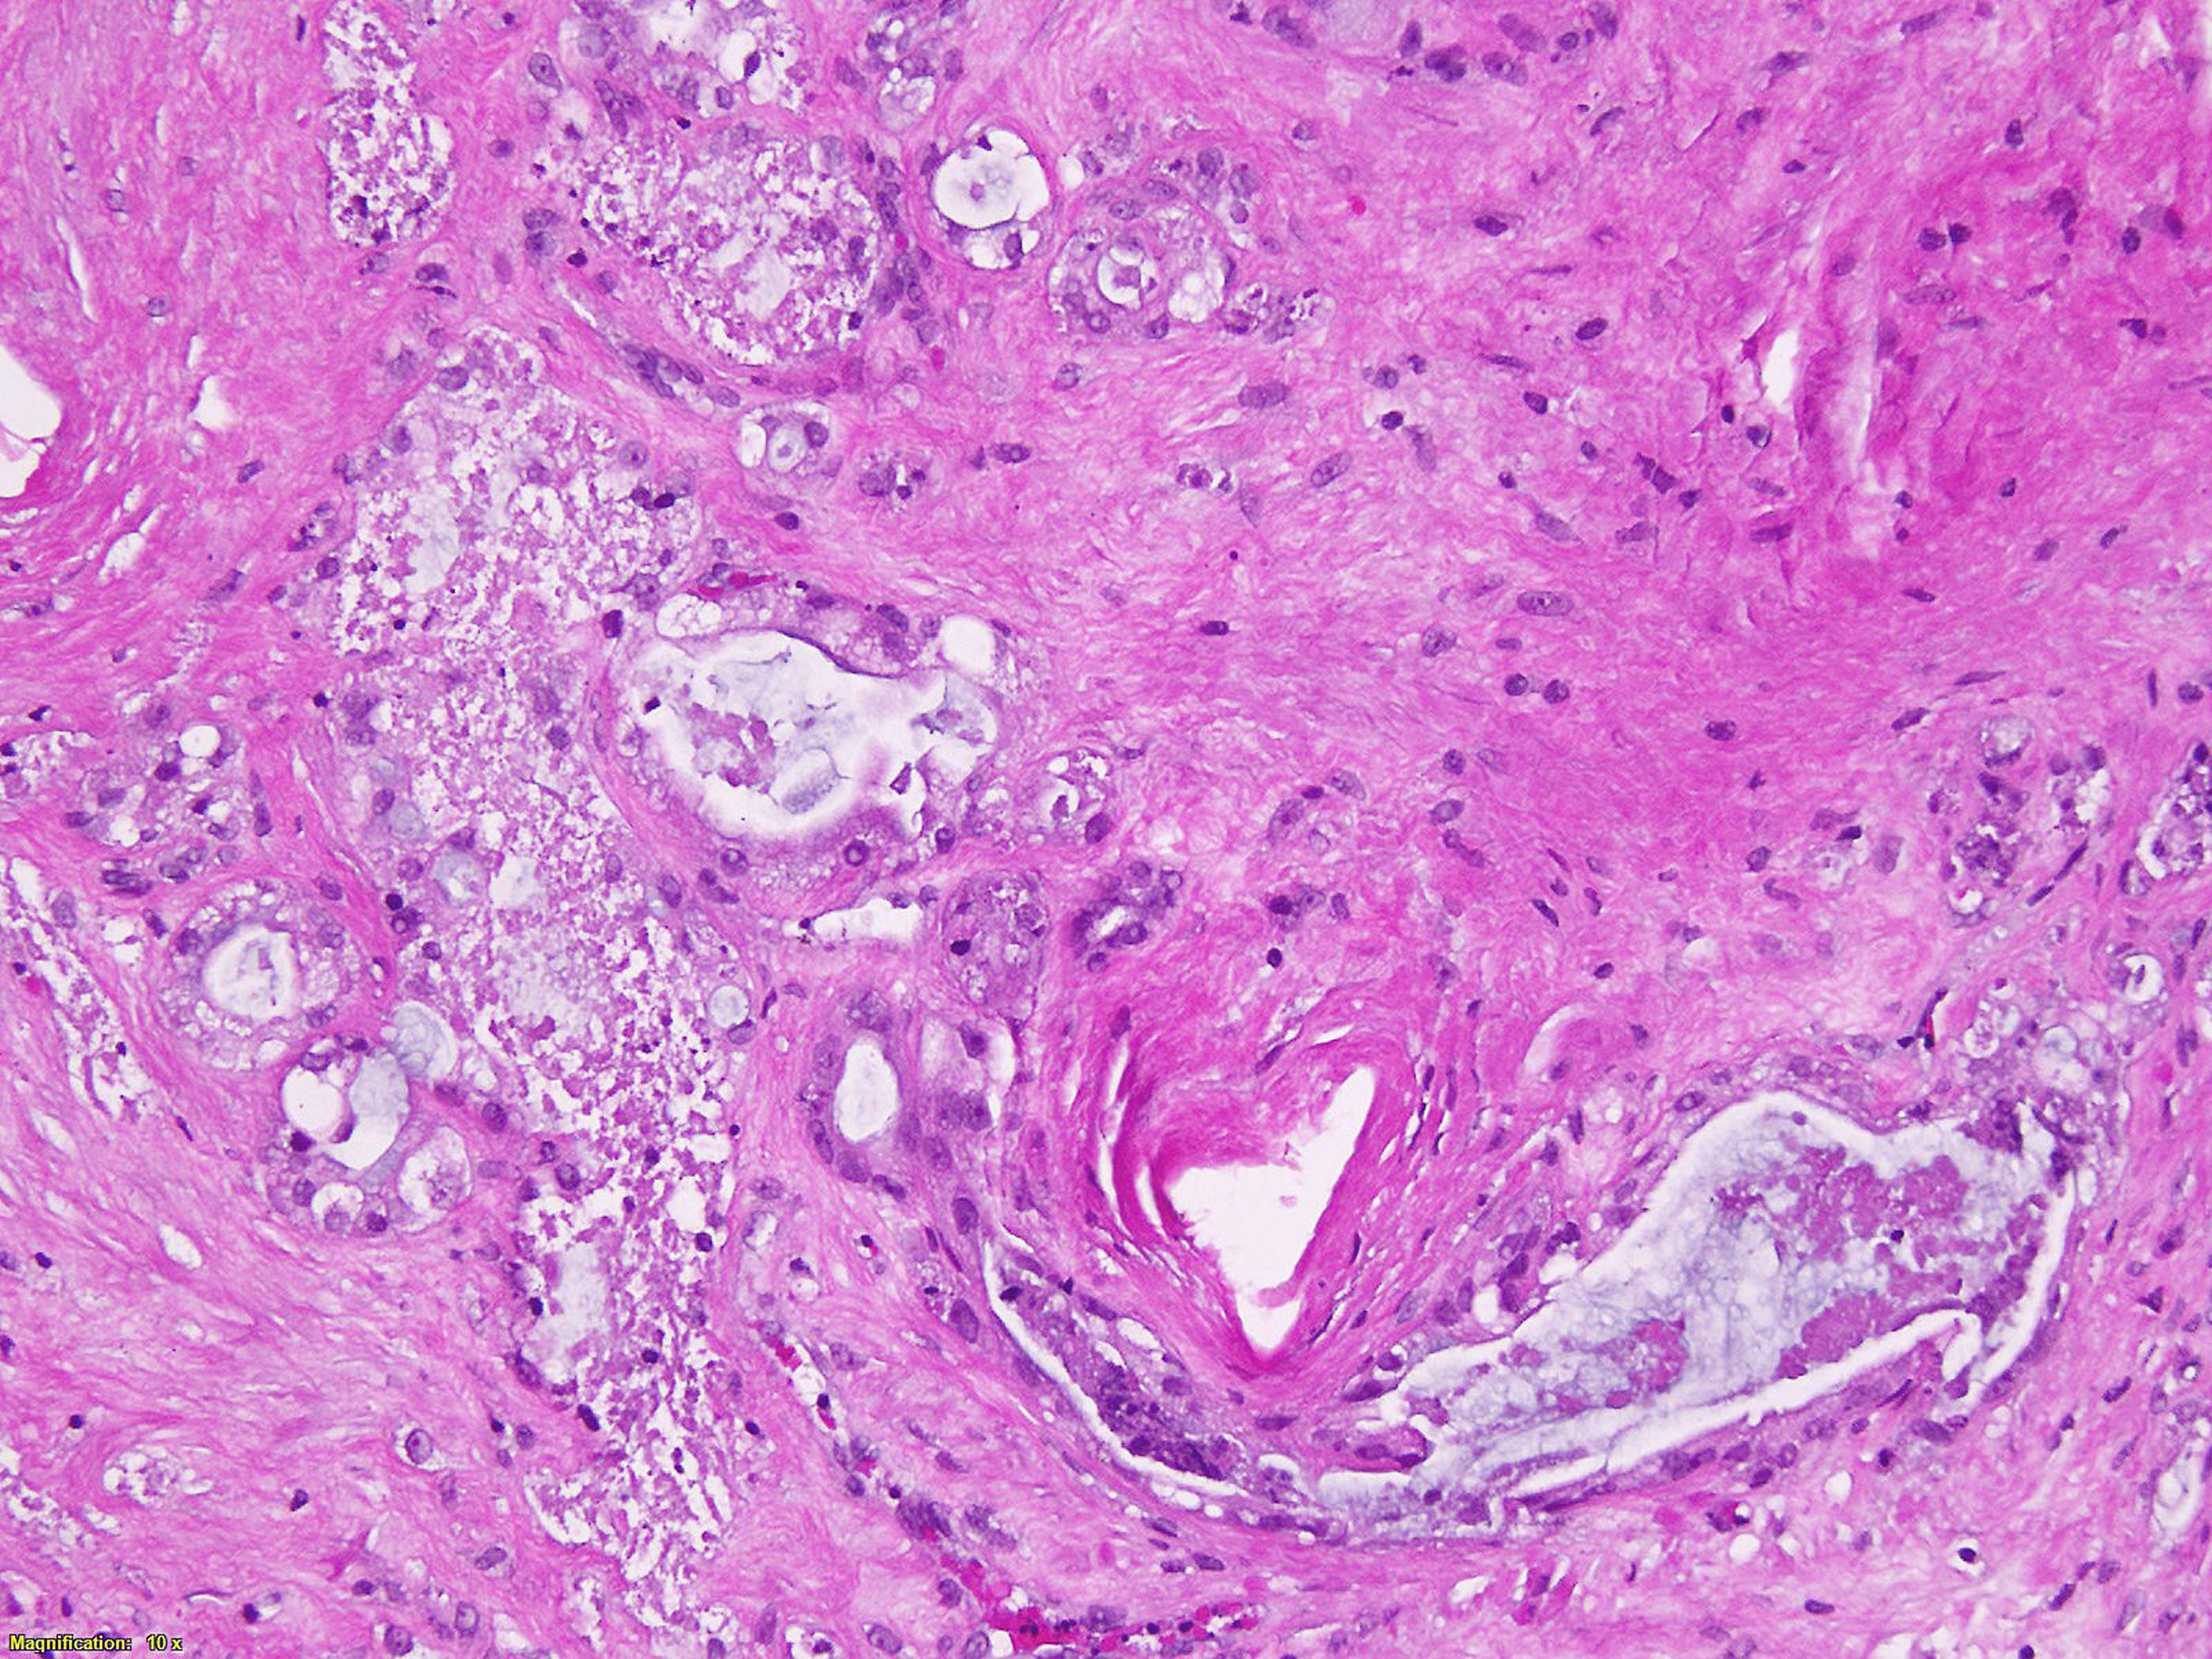
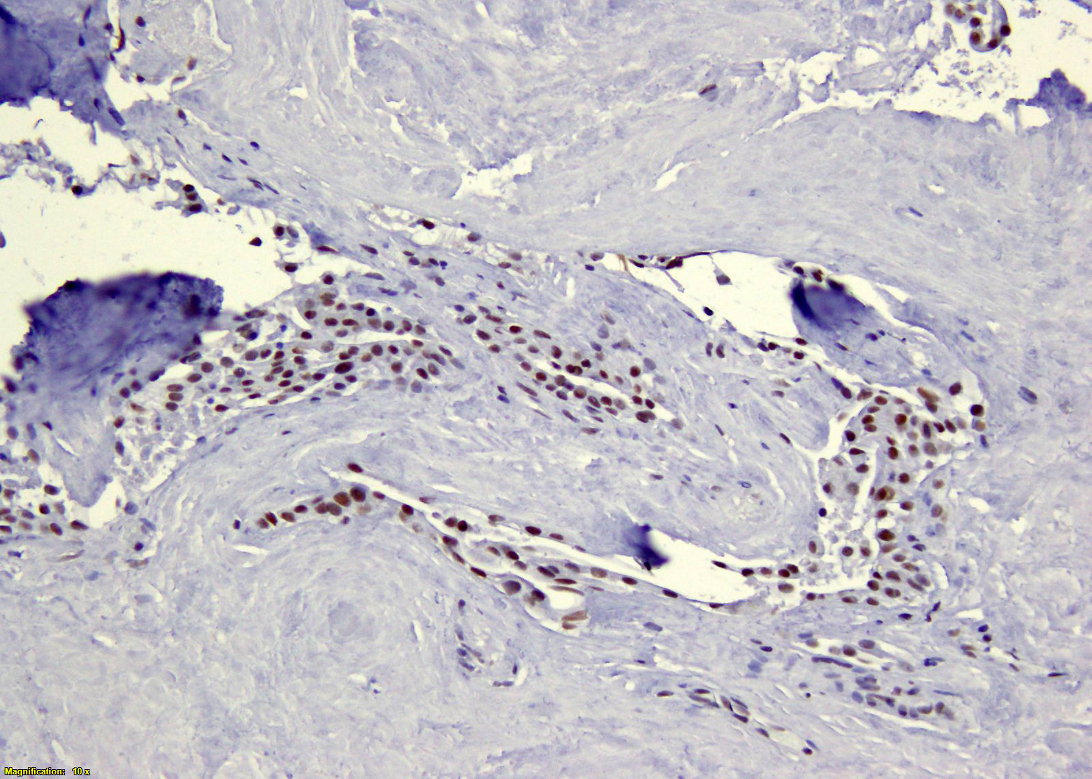
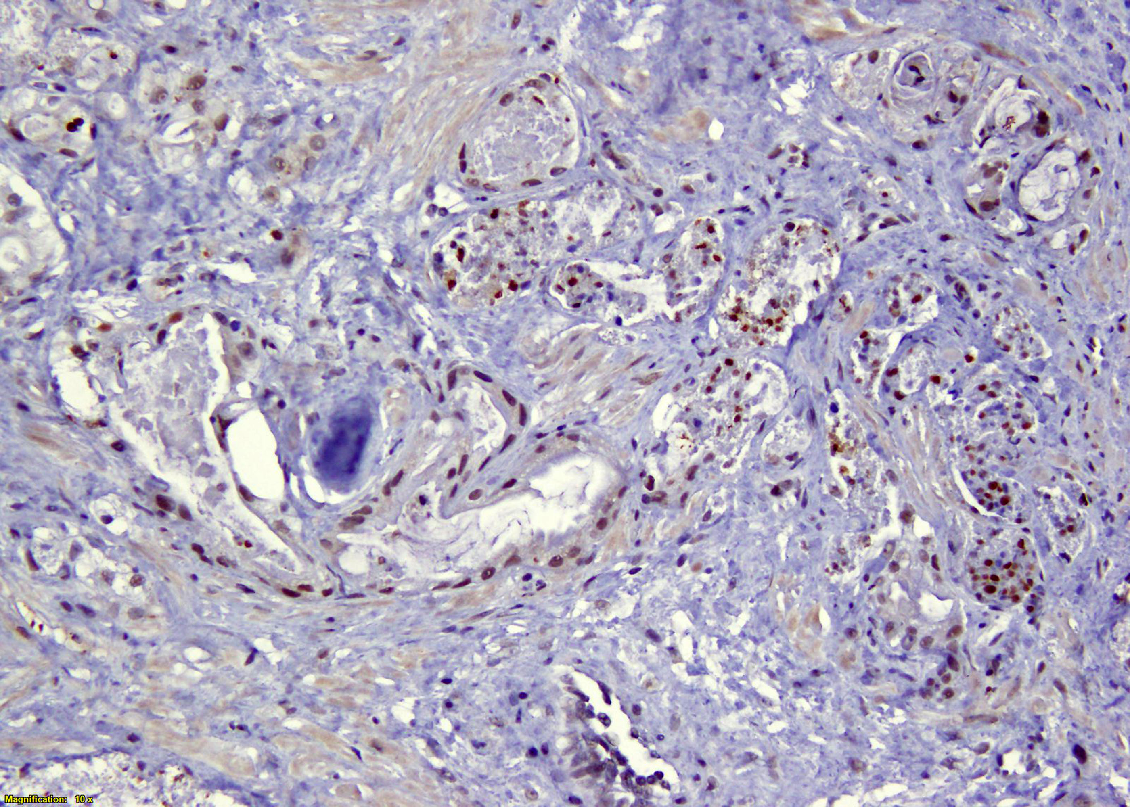
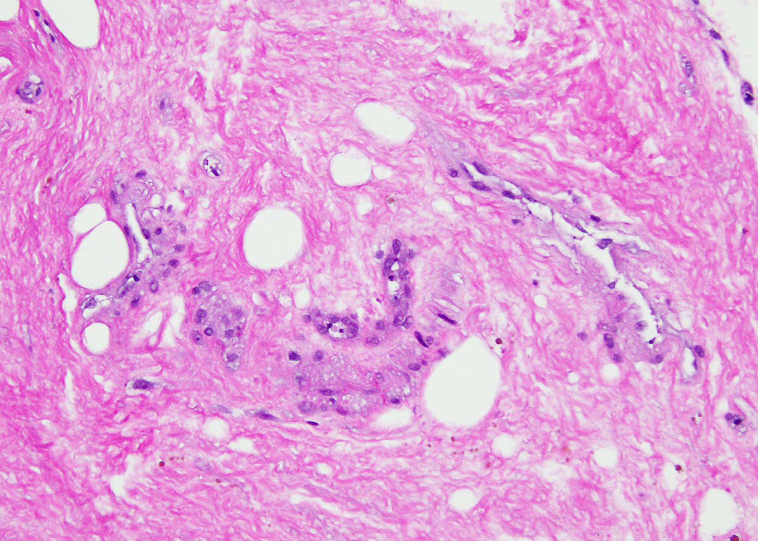
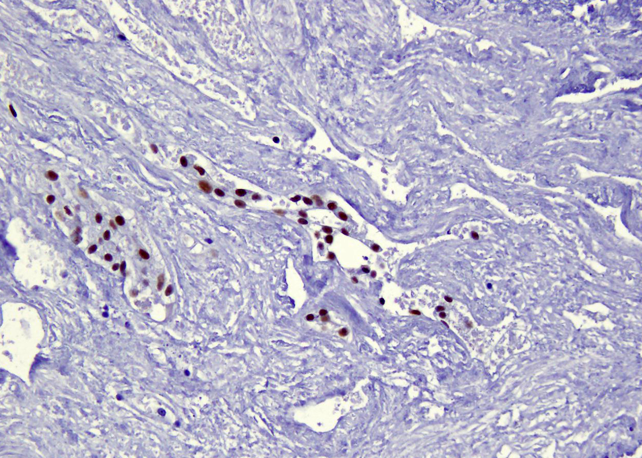
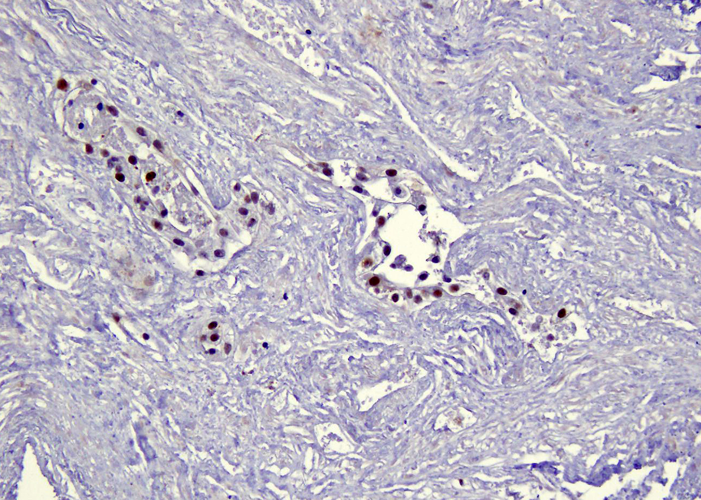
Supplemental Figure 6
A.
H&E
DNA-PK
pDNA-PK
Control
20X
NU7441
B.
DNA-PK
20X
C.
Supplemental Figure 6. DNA-PK inhibition reduces glucose-derived lactate synthesis ex vivo. Representative IHC staining of patient derived explants stained for A) H&E, pDNA-PK and DNA-PK from PDEs used for pyruvate kinase activity and pyruvate level assays. B) IHC staining for DNA-PK from PDEs used for flux analysis. C)Glucose-derived lactate synthesis measured after DNA-PK inhibition (NU7441, 2μM).

