Slide 1
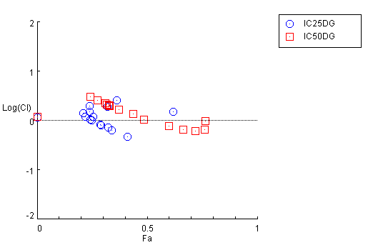
Supplemental Figure 7
A.
C4-2
NU7441 IC₂₅ + 2-DG
NU7441 IC₅₀ + 2-DG
Antagonism
Log Combination index
Additive Effect
Synergism
0
50
100
% Reduced C4-2 Proliferation
Supplemental Figure 7. DNA-PK inhibition sensitizes CRPC cells to glycolysis inhibitor 2-DG. A) Combination index analysis using varying concentration of 2-DG with IC₂₅ and IC₅₀ of NU7551 in C4-2 cell model.

