Slide 1
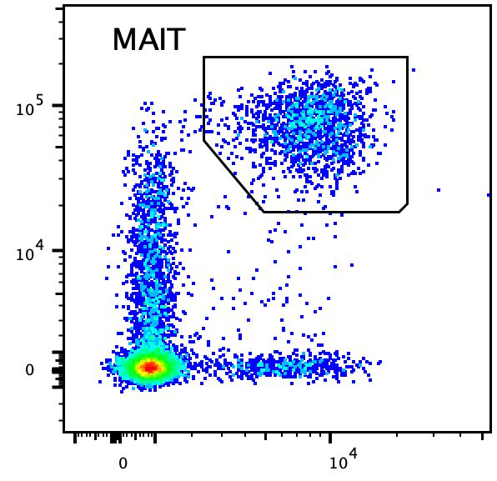
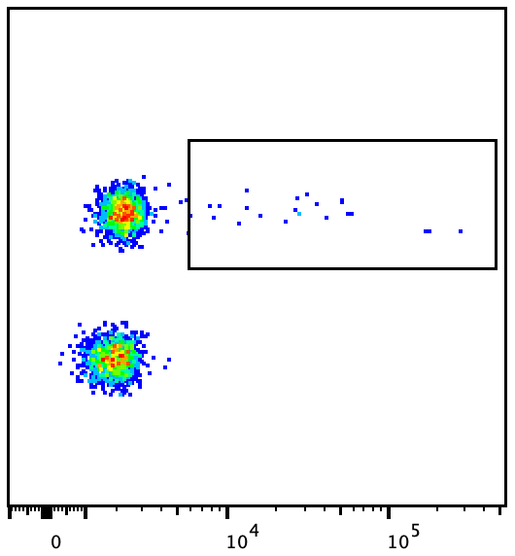
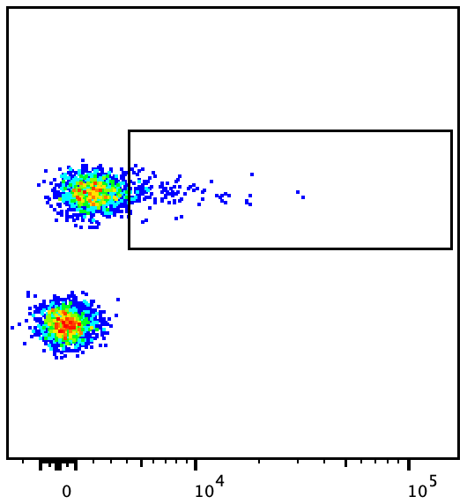
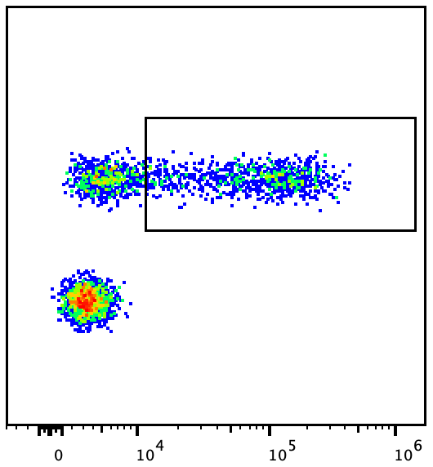
Gated on CD3⁺ CD8⁺
CD161
TCR Vα7.2
1.07
7.86
61.51
PMA/Ionomycin
Unstimulated
IL-17
GM-CSF
IFNγ
Suppl. Fig1. Representative plot from one NEDA-pwMS showing MAIT cells IFNγ, IL17, and GM-CSF production by MAIT cells. Freshly isolated PBLs were stimulated for 4hours with PMA and ionomicin and then surface-stained with aCD3, aCD8, aVa7.2, and aCD161. Cells were then fixed and permeabilzed and stained intracellularly with a IFNγ, aIL-17, and aGM-CSF. Files from control and stimulated samples were concatenated to display both in one plot. Numbers indicate percentage of cytokine+ cells in the stimulated sample.

Slide 2
Gated on CD3+CD8+CD161^{bright}Vα7.2+
A
B
Gated on CD3+CD8+CD161^{bright}Vα7.2+
Suppl. Fig.2. MAIT cells from pwMS express higher levels of the IL-23R. A. Freshly isolated PBLs from pwMS and HC were stained with aCD3, aCD8, aCD161, TCR Va7.2, and IL-23R. MFI: Median fluorescence intensity of IL-23R staining. n=3 donors in each group. Horizontal bars represent mean with SEM. Donor groups were compared by unpaired t-test. *P < 0.05. B. Staining for IL-23R in one representative HD (green) and on NEDA-MS (red). Gray histograms represent FMO controls.

