Slide 1
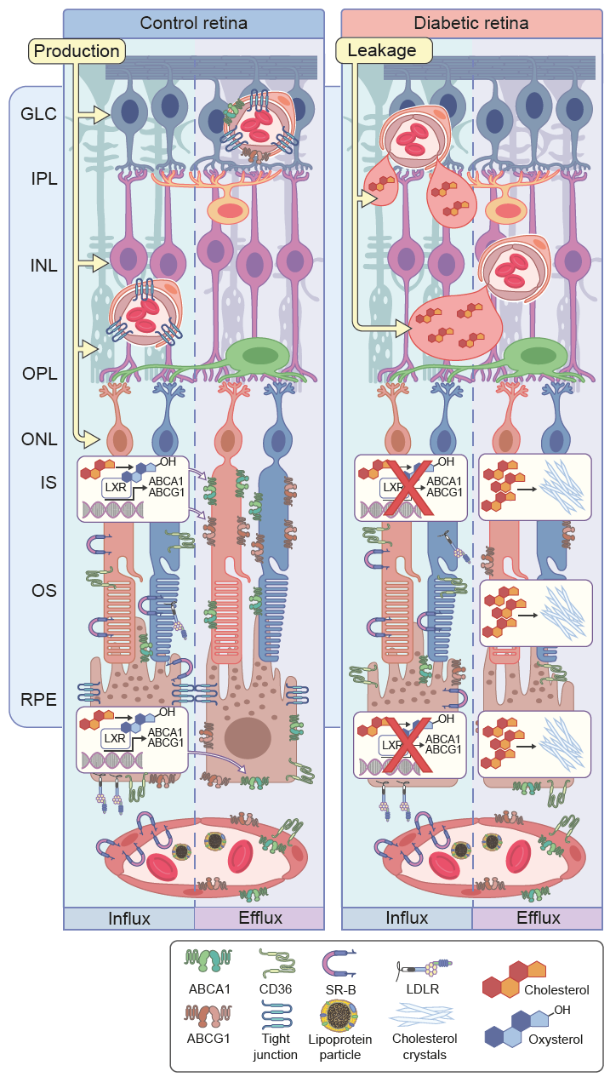
Dysregulation of cholesterol metabolism leading to cholesterol accumulation and formation of hyperreflective crystalline deposits (CCs) in diabetic retina
Jenkins et al (2022) Diabetologia DOI 10.1007/s00125-022-05655-z
© The Author(s), under exclusive licence to Springer-Verlag GmbH Germany, part of Springer Nature 2022

Slide 2
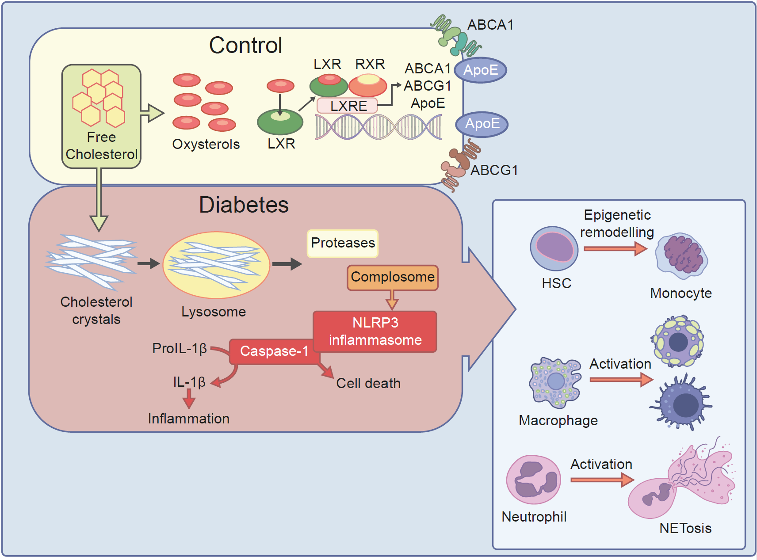
Dysregulation of cholesterol metabolism in diabetes and immune system
Jenkins et al (2022) Diabetologia DOI 10.1007/s00125-022-05655-z
© The Author(s), under exclusive licence to Springer-Verlag GmbH Germany, part of Springer Nature 2022

Slide 3
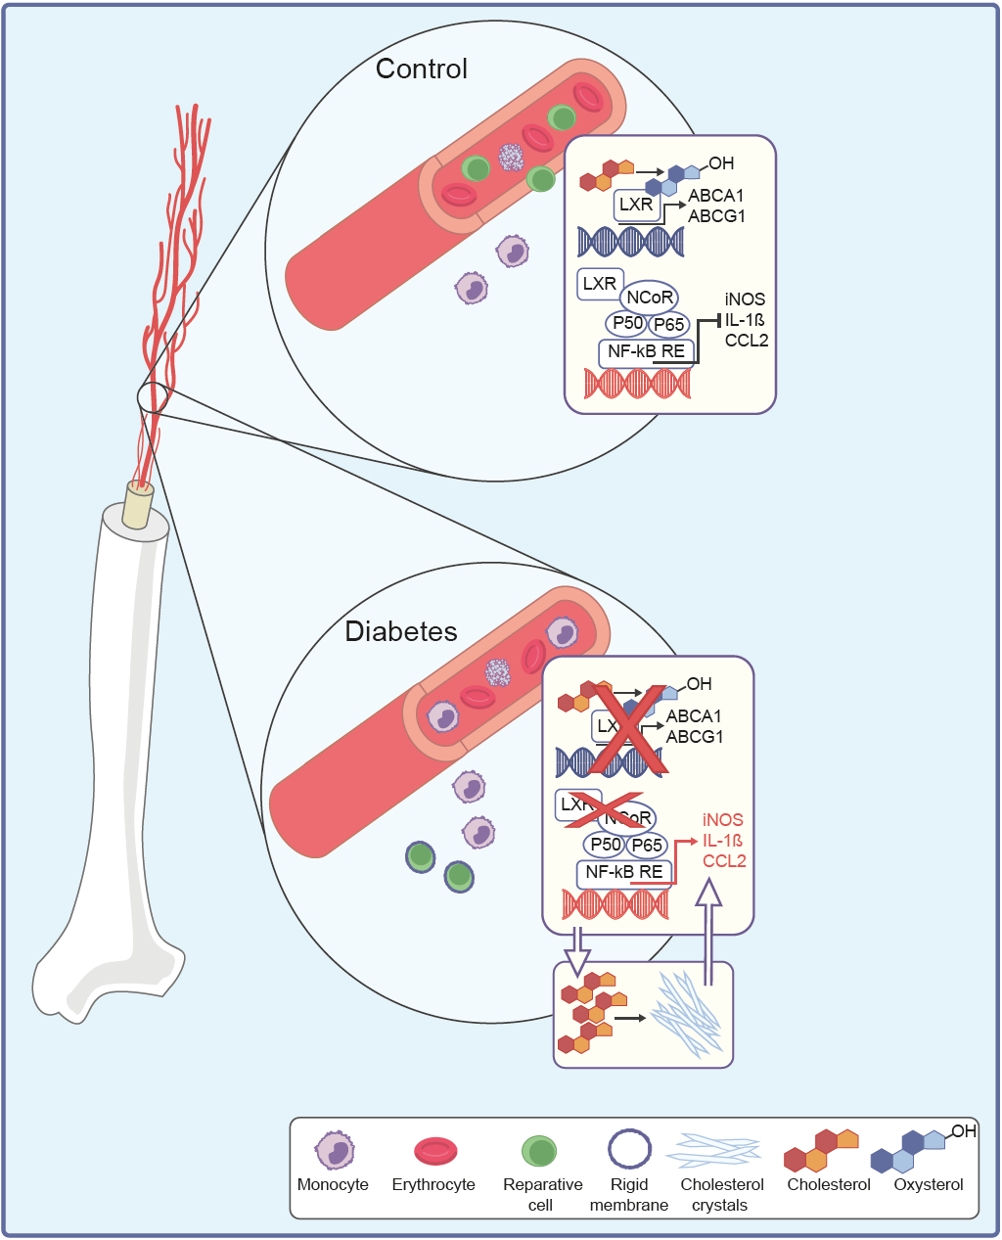
Dysregulation of cholesterol metabolism in diabetes in bone marrow-derived cells
Jenkins et al (2022) Diabetologia DOI 10.1007/s00125-022-05655-z
© The Author(s), under exclusive licence to Springer-Verlag GmbH Germany, part of Springer Nature 2022

