Slide 1
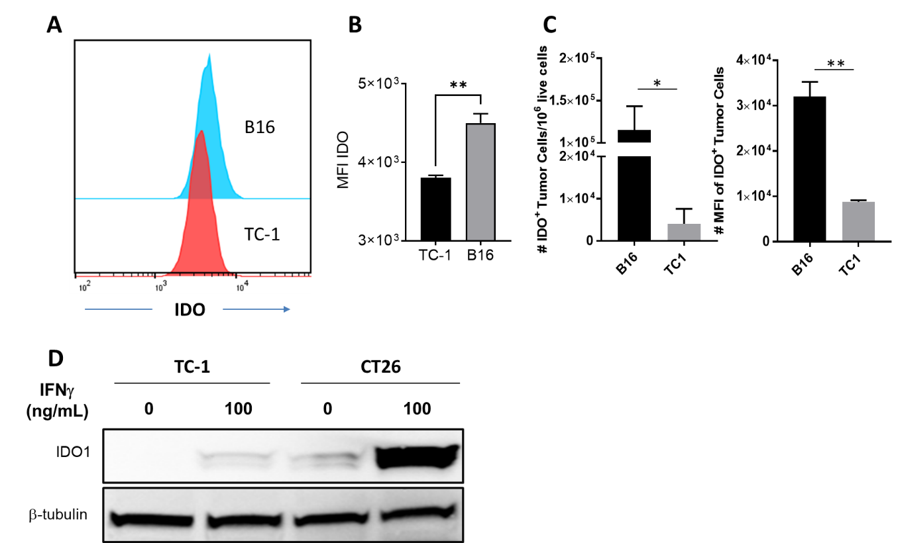
Supplementary Figure 1: IDO expression in different tumor cell lines. A: Representative FACS micrograph for IDO expression in B16F10 and TC-1 tumor cell lines. B-C: IDO expression in B16F10 and TC-1 cells under in vitro (B) and in vivo (C) conditions by flow cytometric analysis. *p ≤ 0.05, **p ≤ 0.01. D: IDO1 expression in TC-1 and CT26 tumor cell lines with and without treatment with IFN-γ (100 ng/mL) by Western blot assay. Expression of β-tubulin is shown as a control.

Slide 2
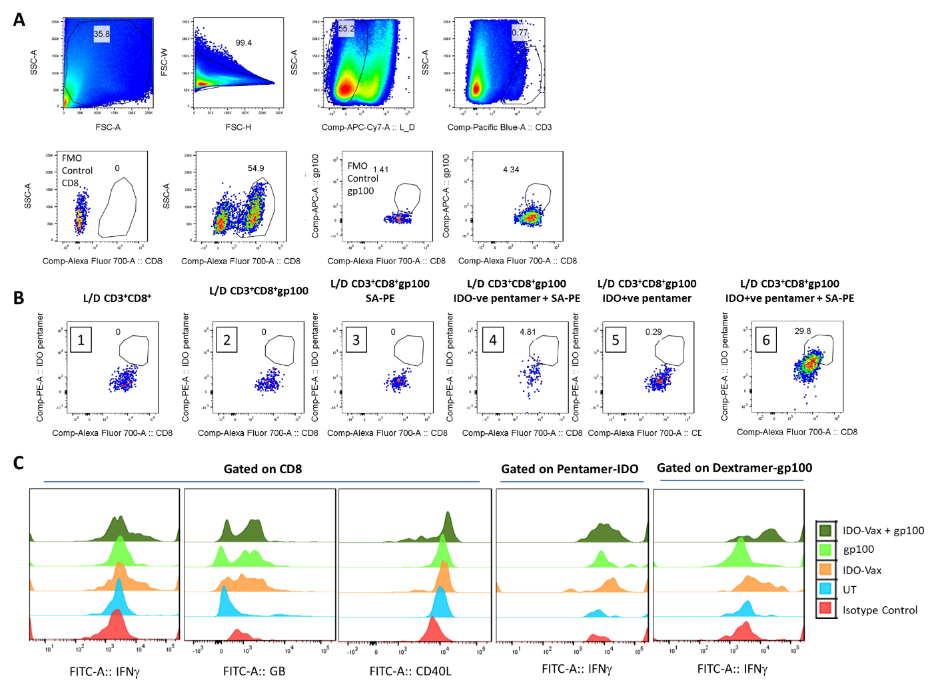
Supplementary Figure 2: Gating strategy. Gating strategy for gp100 CD8⁺ T cells (A); IDO pentamer specificity (B): IDO-specific pentamer was biotinylated and was detected by binding of PE conjugated streptavidin (SA-PE). 1. No pentamer/dextramer staining, 2-6. gp100 dextramer staining was present, 2. No IDO pentamer staining, 3. No pentamer but staining with SA-PE, 4. Staining with IDO-ve pentamer and SA-PE, 5. Staining with IDO-specific pentamer but without SA-PE, and 6. Staining with IDO-specific pentamer and SA-PE; and FACS micrographs for the expression of various markers in B16F10 model (C).

Slide 3
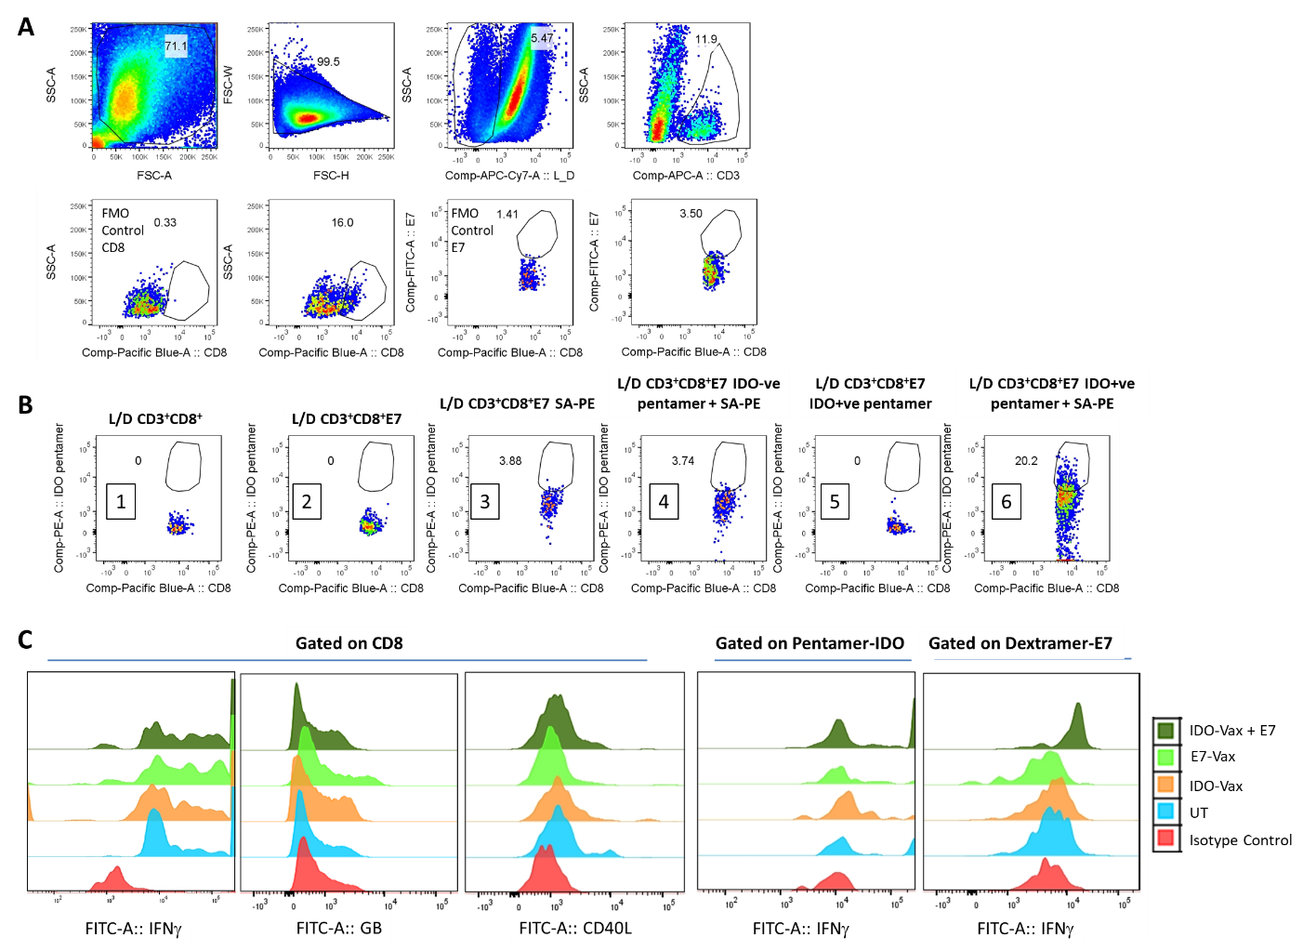
Supplementary Figure 3: Gating strategy. Gating strategy for E7 CD8⁺ T cells (A); IDO pentamer specificity (B): IDO-specific pentamer was biotinylated and was detected by binding of PE conjugated streptavidin (SA-PE). 1. No pentamer/dextramer staining, 2-6. E7 dextramer staining was present, 2. No IDO pentamer staining, 3. No pentamer but staining with SA-PE, 4. Staining with IDO-ve pentamer and SA-PE, 5. Staining with IDO-specific pentamer but without SA-PE, and 6. Staining with IDO-specific pentamer and SA-PE; and FACS micrographs for the expression of various markers in TC-1 model (C).

Slide 4
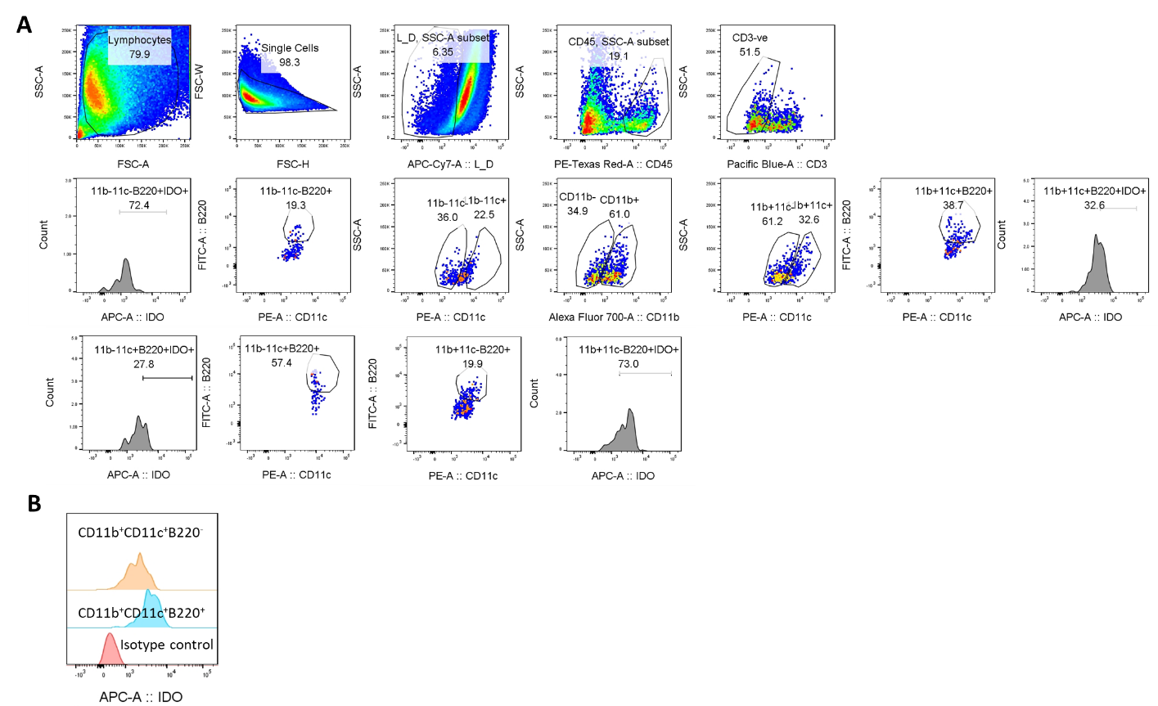
Supplementary Figure 4: Gating Strategy. A. Gating strategy to show various B220⁺CD11c⁺ DCs in CD11b^{hi} and CD11b^{lo} populations. B. FACS micrograph showing IDO expression in CD11b⁺CD11c⁺B220⁺ and CD11b⁺CD11c⁺B220¯ DCs.

Slide 5
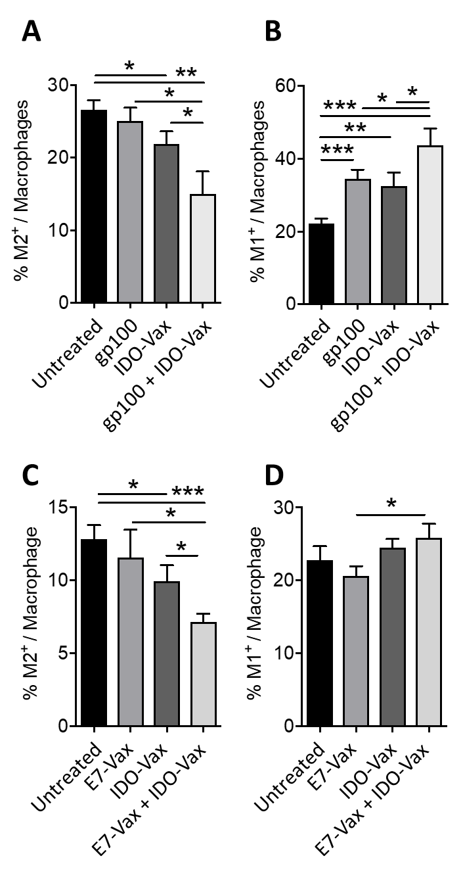
Supplementary Figure 5: IDO-vaccine enhances anti-tumor macrophage population in the TME. Phenotypic characteristics of macrophage populations were analyzed by flow cytometry. The frequency of B16F10 tumor-infiltrated A: M2-macrophages, B: M1-macrophages and the frequency of TC-1 tumor-infiltrated C: M2-macrophages, D: M1-macrophages. Data are shown from one representative experiment (n = 4-7 per group) of two independent experiments. *p ≤ 0.05, **p ≤ 0.01, ***p ≤ 0.001.

