Slide 1
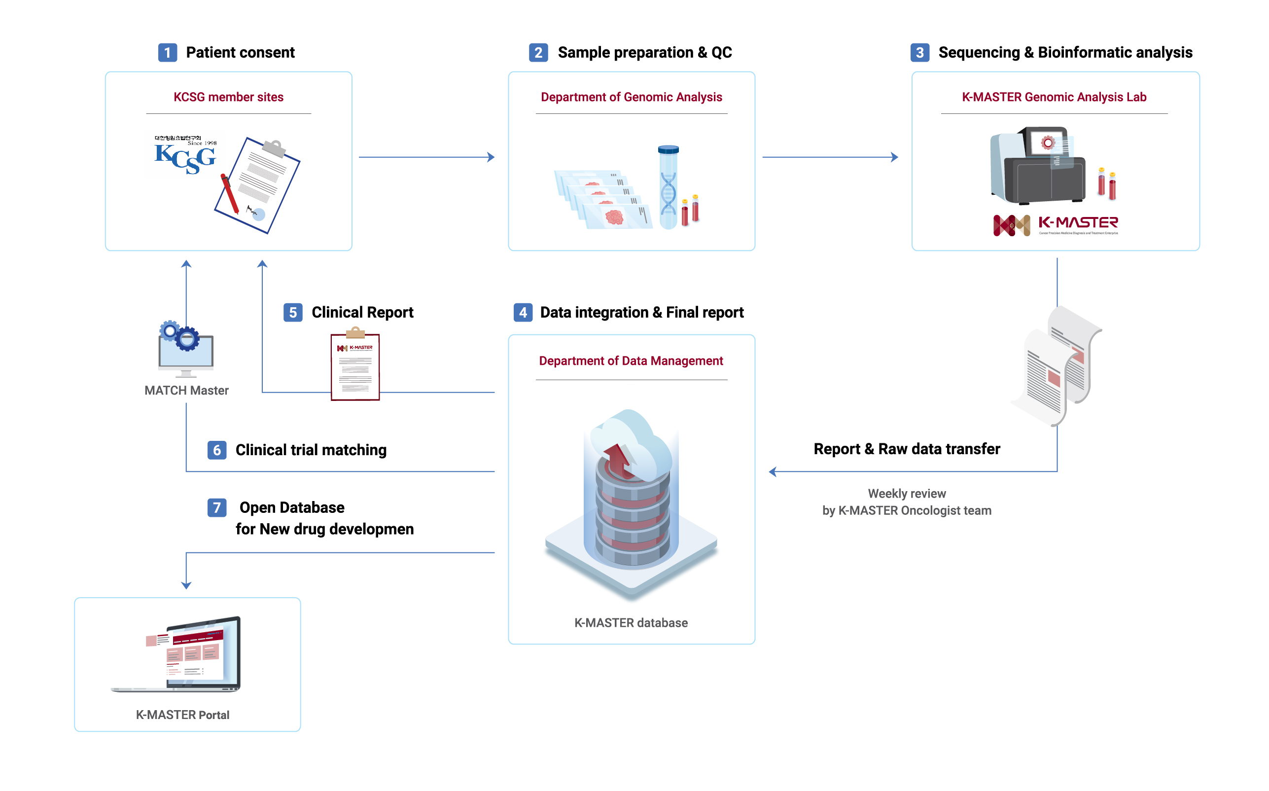
Supplementary Figure 1. Workflow of K-MASTER program. Oncologists at the nationwide KCSG member sites receive informed consents from patients and tumor tissue specimens and matched blood are delivered to K-MASTER headquarter. Genomic DNA from tissue or plasma samples are centrally prepared and subjected to appropriate quality control. Afterwards, they are sent to K-MASTER genomic analysis laboratory for sequencing. Sequenced raw data and report are transferred to K-MASTER and data are reviewed by K-MASTER oncologists on a weekly basis. Final clinical reports are generated and reported to the site oncologists and data are stored in the K-MASTER database. Match Master serves as a search platform for clinical trials matching or drug information for treating physicians. Anonymized data for genomic landscape of K-MASTER program is available on the K-MASTER portal.
Supplementary Figure 1

Slide 2
A
R175*
R273*
B
G12*
Supplementary Figure 2. Lollipop plots demonstrating distribution of nonsynonymous mutations based on amino acid position in TP53 in A and KRAS in B
Supplementary Figure 2

Slide 3
Supplementary Figure 3. Supervised clustering of pan-cancer patients based on cancer types. Patients have been marked with mutation for each pathway if the patient harbors at least one mutation that belongs to the corresponding pathway.
Supplementary Figure 3

Slide 4
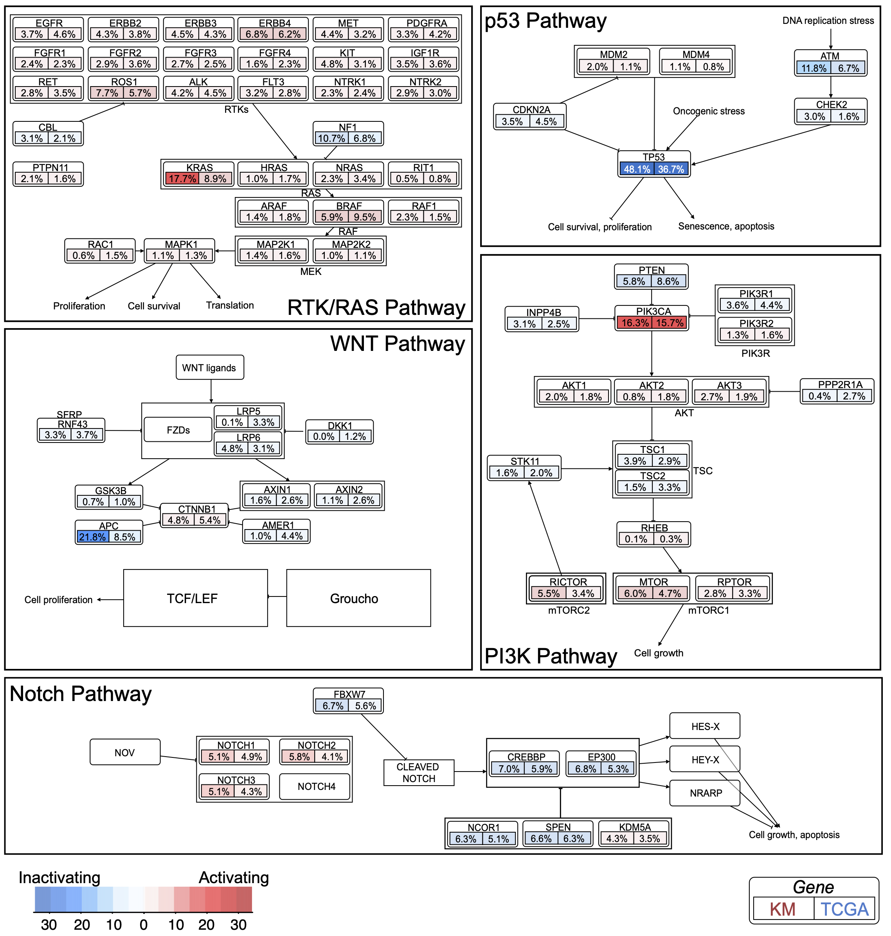
Supplementary Figure 4. Pathway alteration frequency between K-MASTER and TCGA cohorts. Genes are altered at different frequencies based on each major canonical pathway and have been colored in red for oncogenic and blue for tumor suppressive roles. All major pathways have been derived from pathwaymapper.org
Supplementary Figure 4

Slide 5
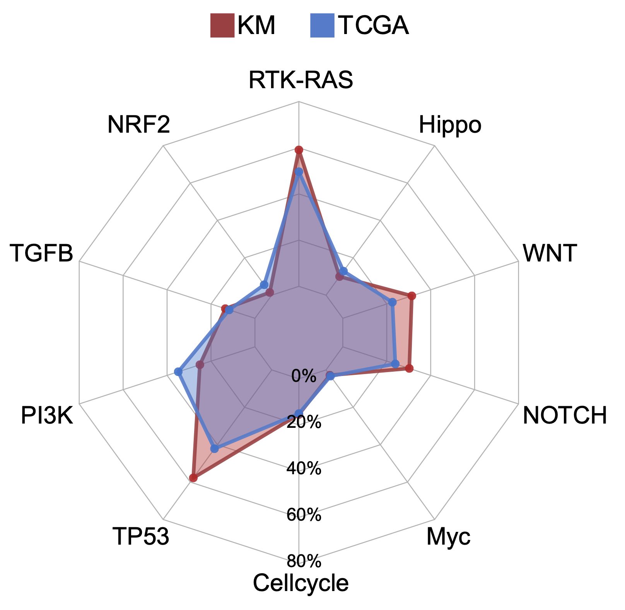
Supplementary Figure 5. Spider chart representation of frequencies of major oncogenic canonical pathways between K-MASTER and TCGA cohorts.
Supplementary Figure 5

Slide 6
Supplementary Figure 6. Genomic landscape of major driver mutations in K-MASTER cholangiocarcinoma patients.
Supplementary Figure 6

Slide 7
Supplementary Figure 7. Distribution of major mutations based on their clinical actionability between K-MASTER and TCGA cohorts. Mutations are categorized as “druggable” if they are FDA-recognized biomarkers for FDA-approved drugs. Mutations are labeled as “Actionable” if there are substantial compelling evidences supporting the use of biomarkers as predictive of response, especially resistance, to current FDA-approved drugs. Mutations are annotated as “COSMIC” if they have been previously reported in COSMIC database. Rest of the mutations that do not belong on above categories are depicted as “SNV”.
Supplementary Figure 7

Slide 8
Total number of tumors
Supplementary Figure 8. Number of patients with therapeutically actionable mutations for each tumor class.
Supplementary Figure 8

Slide 9
A
Frequency of tumors (%)
B
K-MASTER (n=240)
TCGA (n=567)
26.7%
25.7%
Fisher’s exact
P = 1.58 x 10⁻³⁶
73.3%
74.3%
Supplementary Figure 9. A. Frequency of tumors with actinable ”hot-spot” mutations between K-MASTER and TCGA cohorts. B. Frequency of patients with either BRAF V600E ”hot-spot” mutation or others among all BRAF-mutant tumors beween K-MASTER and TCGA cohorts.
Supplementary Figure 9

