Slide 1
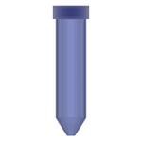
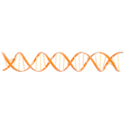

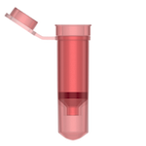


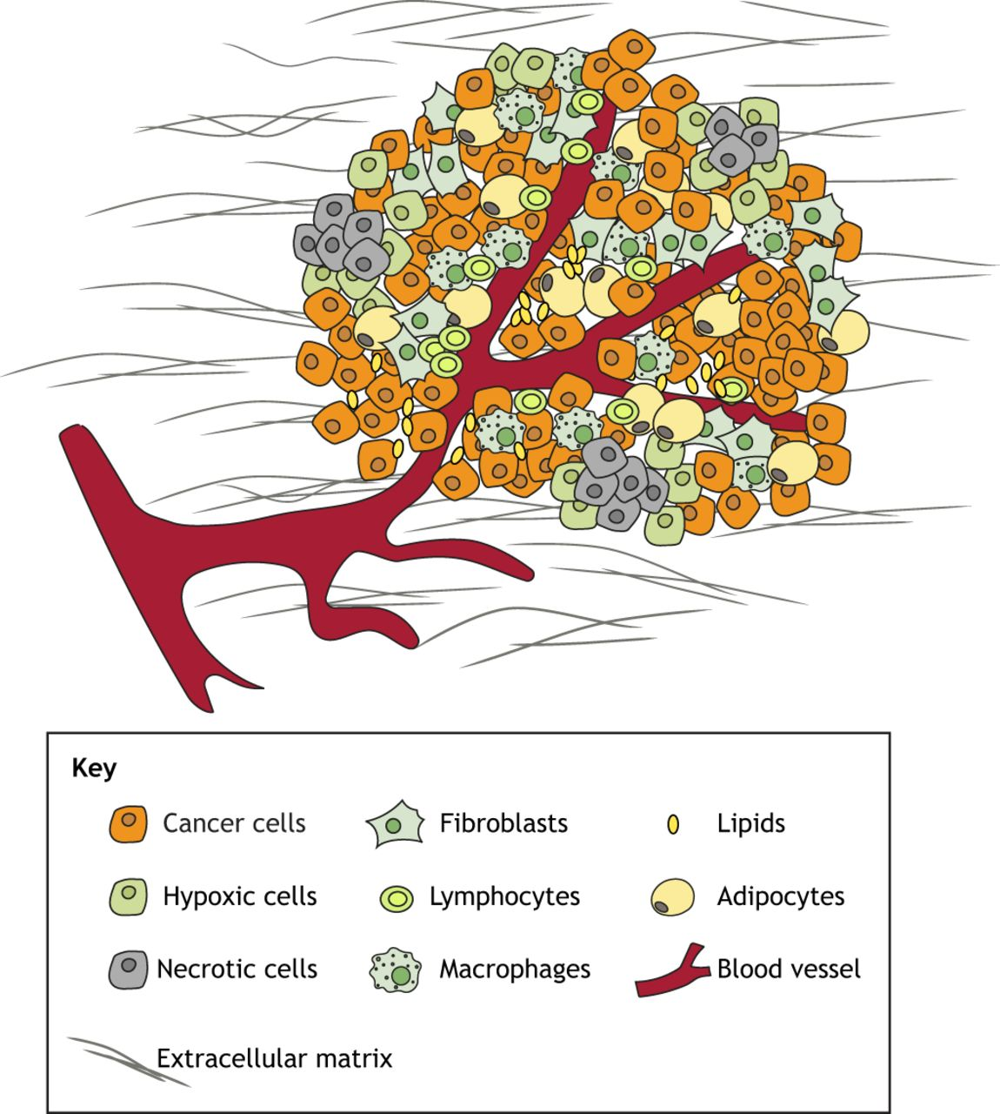
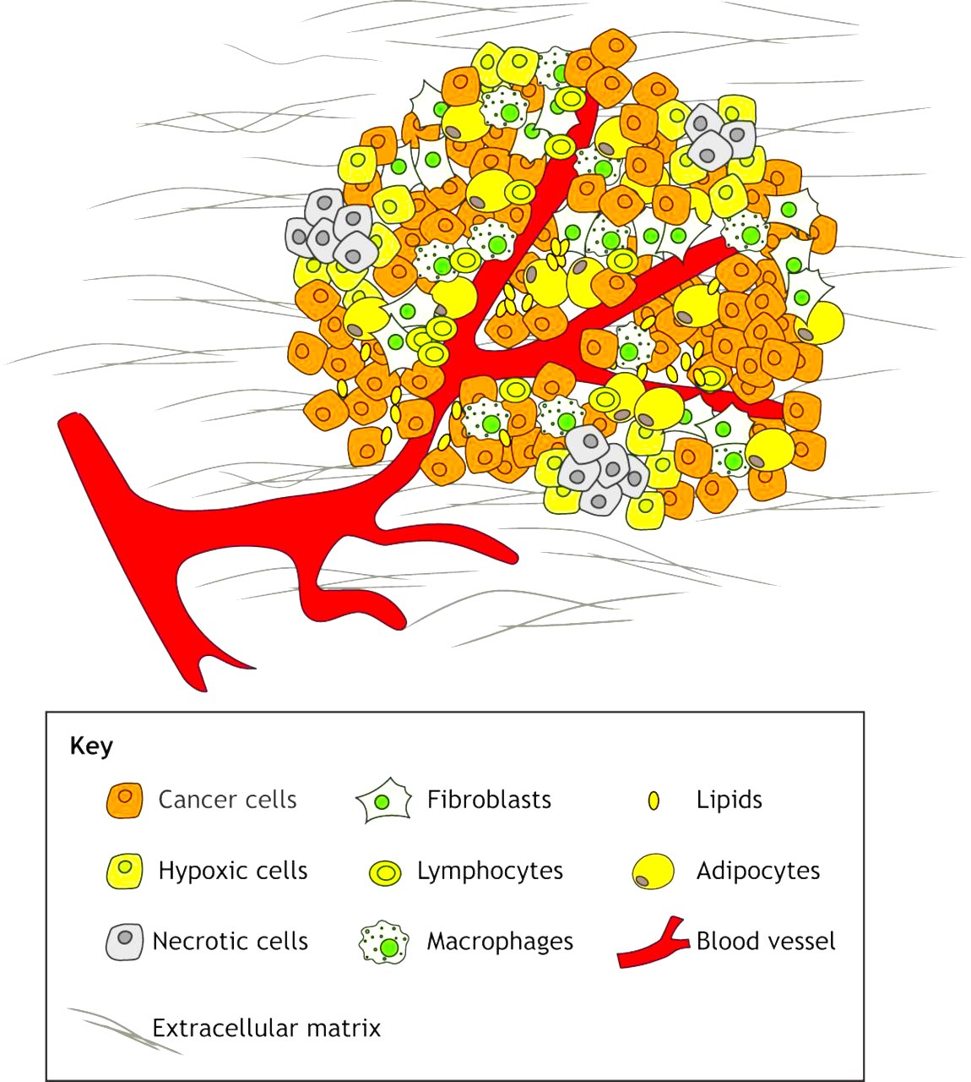
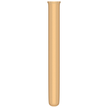
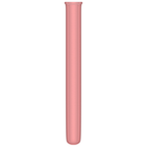
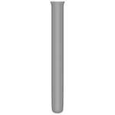
SUPPLEMENTAL FIGURE 1
A
Bronchoalveolar
Lavage (BAL)
Supernatant
CAPP-Seq
BAL
BAL cfDNA
Cell Pellet
CAPP-Seq
BAL cellular DNA
Tumor
STAMP
Tumor Mutations
Plasma
CAPP-Seq
Plasma
Plasma cfDNA
Blood
Leukocytes
CAPP-Seq
Germline DNA
PDWB
B
BAL cfDNA
n = 35
Plasma cfDNA
n=38
Tumor mutations
n = 34
Notes:
Supplementary Figure 1

