Slide 1
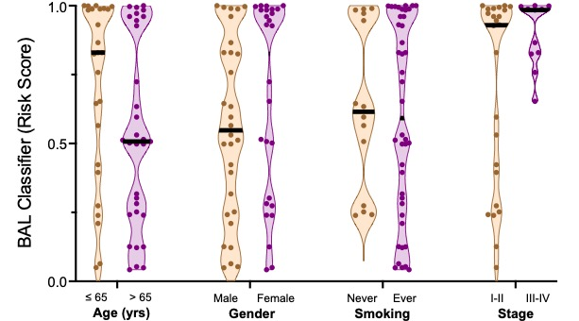
SUPPLEMENTAL FIGURE 4
A
B
0.67
0.27
0.84
0.16
Notes:
Supplementary Figure 4

