Slide 1
JAMA Ophthalmology Journal Club Slides:
Peripheral Lesions on Ultra-widefield Imaging and Risk of Diabetic Retinopathy Worsening
Marcus DM, Silva PS, Liu D, et al; DRCR Retina Network. Association of predominantly peripheral lesions on ultra-widefield imaging and the risk of diabetic retinopathy worsening over time. JAMA Ophthalmol. Published online August 18, 2022. doi:10.1001/jamaophthalmol.2022.3131

Slide 2
Introduction
Importance:
  Ultra-widefield (UWF) imaging improves the ability to identify peripheral diabetic retinopathy (DR) lesions compared with standard imaging.
  Single-center studies have suggested that the presence of predominantly peripheral lesions (PPLs) may identify eyes at higher risk for future DR worsening over time, but a larger, multicenter study is needed for independent validation of these preliminary results.
Objective:
  To determine whether PPLs identified on UWF imaging are associated with increased disease worsening beyond the risk associated with baseline Early Treatment Diabetic Retinopathy Study (ETDRS) Diabetic Retinopathy Severity Scale (DRSS) score.
  To assess whether extent and location of retinal nonperfusion identified on UWF–fluorescein angiography (FA) are associated with DRSS score worsening or DR treatment over time.

Slide 3
Methods
Study Design, Setting, and Participants:
  This prospective, multicenter cohort study (DRCR Retina Network Protocol AA) was conducted at 37 US and Canadian sites.
  Data for 544 study eyes from 367 participants with nonproliferative DR (NPDR) were analyzed.
  Follow-up visits occurred annually for 4 years.
  Initiation of treatment for DR or diabetic macular edema was at investigator discretion.
Main Outcomes and Measures:
  PPL peripheral lesions were defined as DR lesions with a greater extent outside vs inside the 7 standard ETDRS fields.
  Primary outcome was disease worsening defined as worsening 2 steps or more on the DRSS or receipt of DR treatment. The outcome was assessed within the ETDRS fields from the UWF-color images.

Slide 4
Methods
Limitations:
  The last year of follow-up was affected by the COVID-19 pandemic.
    4-y Follow-up was 77% (excluding deaths).
  Most UWF images (97.5%) for this study were captured on P200Tx (Optos) imaging devices.
    Subsequent advances in retinal imaging have led to the development of newer UWF technology with improved superior and inferior image capture that also allows imaging of the retinal far periphery with improved resolution.
  The ability of clinicians to identify peripheral DR lesions or assess a retina for nonperfusion was not assessed in this study.
  The association between FA PPL and visual impairment and the effect on rates of visual loss should FA PPL be overlooked clinically were not directly addressed

Slide 5
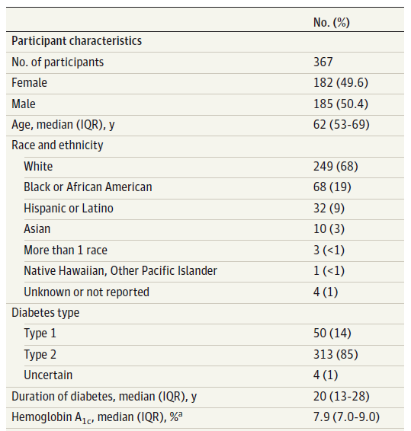
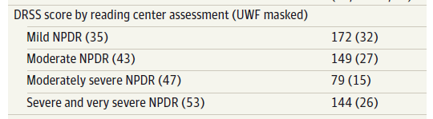
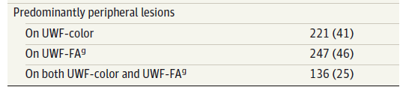
Results
Baseline Characteristics in the Overall Cohort
Nonperfusion on UWF-FA (n = 208)
None: 9%
Low: 30%
Medium: 30%
High: 30%

Slide 6
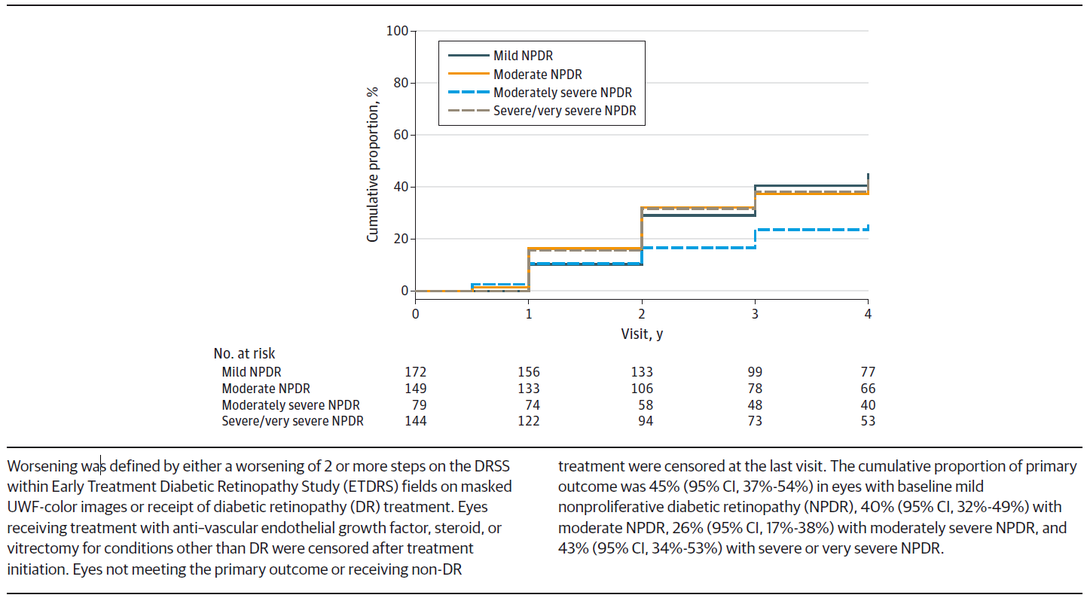
Results
Cumulative Proportion of Disease Worsening Through 4 Years by Baseline DRSS Score on Masked UWF Color Images

Slide 7
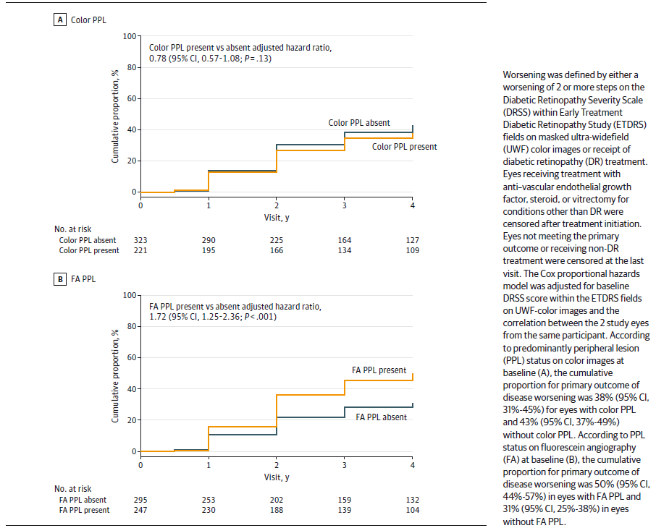
Results
Cumulative Proportion of Disease Worsening Through 4 Years

Slide 8
Results
DR Disease Worsening Over Time and Color-PPL by Baseline DRSS
By baseline DRSS | No. (cumulative %)
 | PPL absent | PPL present
Mild NPDR (level 35) | 83 (54) | 89 (38)
Moderate NPDR (level 43) | 75 (49) | 74 (32)
Moderately severe NPDR (level 47) | 63 (24) | 16 (31)
Severe and very severe NPDR (level 53) | 102 (40) | 42 (50)
DR Disease Worsening Over Time and FA-PPL by Baseline DRSS
By baseline DRSS | No. (cumulative %)
 | PPL absent | PPL present
Mild NPDR (level 35) | 67 (36) | 104 (50)
Moderate NPDR (level 43) | 80 (30) | 69 (50)
Moderately severe NPDR (level 47) | 64 (22) | 14 (43)
Severe and very severe NPDR (level 53) | 84 (36) | 60 (51)

Slide 9
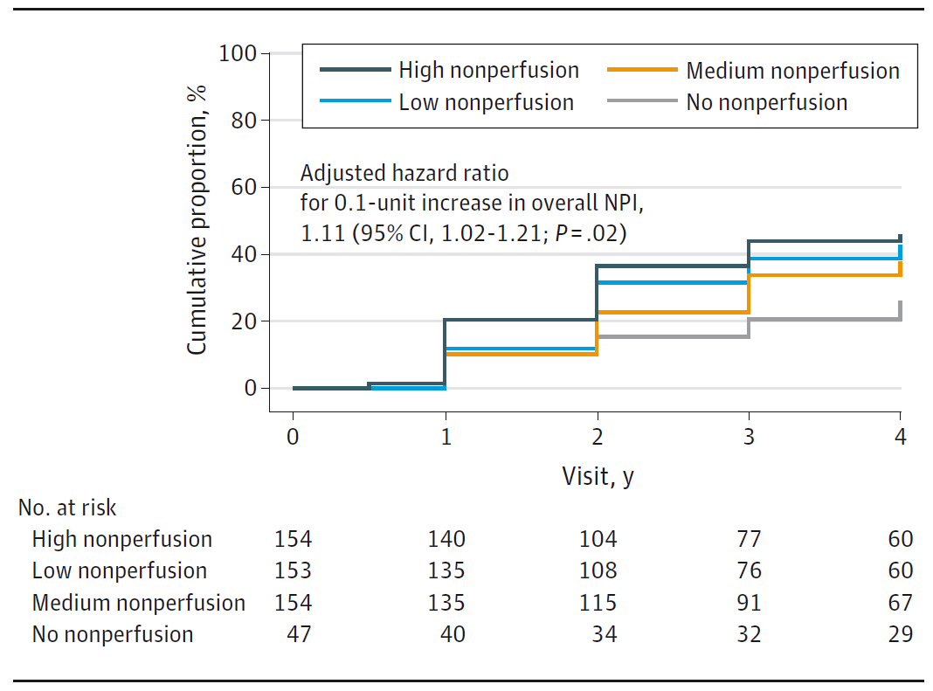
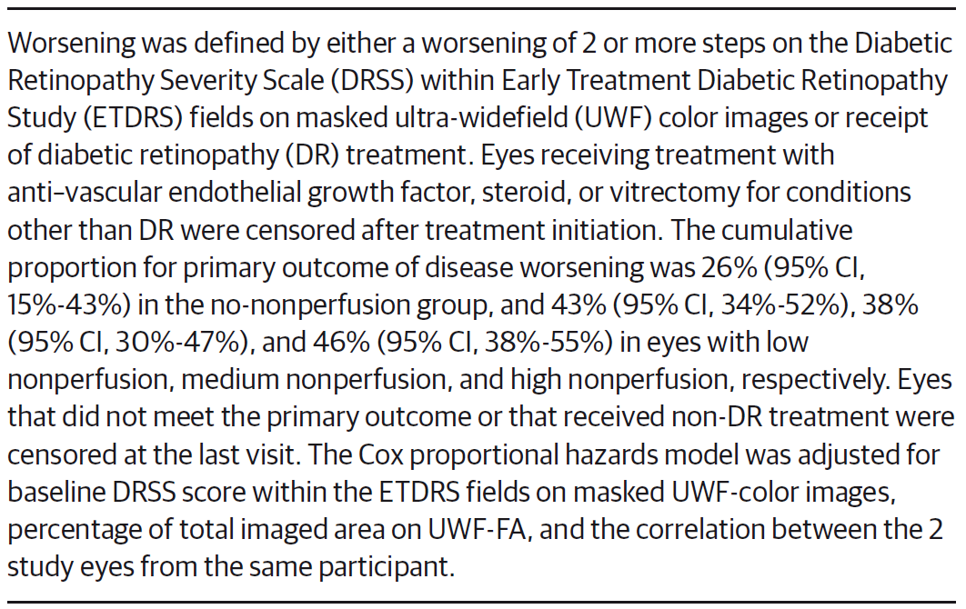
Results
Cumulative Proportion of Disease Worsening Through 4 Years by Baseline Overall Nonperfusion Index (NPI) on UWF-FA

Slide 10
Results
DR Disease Worsening Over Time with Retinal Nonperfusion and FA-PPL
 | Adjusted hazard ratio (95% CI)^{b} | Adjusted Hazard Ratio (95% CI) *
 | For 0.1-unit Increase in NPI | For PPL present vs PPL absent
With adjustment for baseline DR severity and participant-level characteristicsª | 1.14 (1.04-1.24); P = .003 | Not applicable
 | 1.11 (1.02-1.22); P = .02 | 1.89 (1.35-2.63); P < .001
ªAdjusting for baseline DRSS level on UWF-color images, % of total gradable area on UWF-FA, and correlation between 2 study eyes in the same participant.
^{b}Participant-level systemic risk factors included age, diabetes type (excluding uncertain type), duration of diabetes, hemoglobin A_{1c}, and albuminuria.

Slide 11
Comment
The DRCR Retina Network Protocol AA study provides robust information on the natural history of a contemporary DR cohort followed up over 4 years using UWF imaging.
Although no association was identified with color PPL, the presence of FA PPL was associated with a significantly greater risk of ETDRS DRSS worsening or treatment over 4 years independent of DR severity level.
Greater baseline retinal nonperfusion on UWF-FA, in addition to FA-PPL, is associated with higher risk of DR worsening or treatment, even after adjusting for baseline ETDRS DRSS level, and participant-level risk factors including diabetes duration and glycemic control.
These results suggest that evaluation of the retinal far periphery is important in best predicting which eyes with NPDR will experience future disease worsening.
Peripheral findings on UWF-FA should be incorporated into future DR staging systems and efforts to develop less invasive and less costly ways to identify FA-PPL and nonperfusion markers, or their surrogates, are warranted. The associations between disease worsening and retinal nonperfusion and FA-PPL support the increased use of UWF-FA to complement color fundus photography in future efforts for DR prognosis, clinical care, and research.

Slide 12
Contact Information
If you have questions, please contact the corresponding author:
  Adam R. Glassman, MS, Jaeb Center for Health Research, 15310 Amberly Dr, Ste 350, Tampa, FL 33647 (drcrstat2@jaeb.org).
  Funding/Support
Research reported in this article was supported by the National Eye Institute and the National Institute of Diabetes and Digestive and Kidney Diseases of the National Institutes of Health under award UG1EY014231, grants from the Juvenile Diabetes Research Foundation, and supplies from Optos.

Slide 13
Conflict of Interest Disclosures
Dr Marcus reported fees from Jaeb Center for Health Research for serving as protocol chair during the conduct of the study; grants from Allergan, Amgen, Boehringer Inglheim, Alcon, Kalvista, Ionis, Xplore, Mylan, Samsung, Novartis, Opthea, Chenghdu, Clearside, Ophthotech/Iveric, Outlook, Gemini, Genentech, Graybug, Topcon, Optos, Gyroscope, Stealth Spiam, Apellis, Roche, Novartis, Xplore, Regenxbio, Kodiak, Zeiss, Annexon, Oculis, Alexion, and Regeneron Pharmaceuticals; and serving as a consultant for Regenxbio, Genentech/Roche, Regeneron, Clearside, and Vial outside the submitted work. Dr Silva reported grants from Optos, the Massachusetts Lions Eye Research Foundation, the Medical Research Council (United Kingdom), and the Philippine Council of Health Research and Development; personal fees and nonfinancial research support from Optos during the conduct of the study; personal fees and nonfinancial support from Optomed outside the submitted work; and professional fees from the American Diabetes Association outside the submitted work. Ms Liu reported grants from the National Institutes of Health (NIH) and JDRF; loaner ophthalmic cameras to clinical sites from Optos, Zeiss, and Optovue; and additional funding or devices outside of the submitted work from Regeneron, Helmsley Charitable Trust, PhotoOptx, and Roche. Dr Aiello reported professional fees from Guidepoint Global, Japan Society of Ophthalmology and Diabetes, Johns Hopkins, Novo Nordisk, Perfuse Therapeutics, Samsung, System Analytic, and Valo Health and equity stock and professional fees from Kalvista. Dr Antoszyk reported research support from Apellis, Gemini Therapeutics, Genentech, Kodiak, NGM Biopharmaceutical, Novartis, Novo Nordisk, Amgen, Regeneron, Roche, and Notal and serving on an advisory board for Allergan. Dr Elman reported grants from the Jaeb Center for Health Research during the conduct of the study. Dr Friedman reported research support from Amgen, Boehringer Ingelheim, Chengdu Kang Hong, Opthea, and Regeneron. Mr Glassman reported grants from the NIH and JDRF; loaner ophthalmic cameras to clinical sites from Optos, Zeiss, and Optovue; and additional funding or devices outside of the submitted work from Regeneron, Helmsley Charitable Trust, PhotoOptx, and Roche. Dr Jampol reported professional fees from Alkahest. Ms Melia reported grants from the NIH and JDRF; loaner ophthalmic cameras to clinical sites from Optos, Zeiss, and Optovue; and additional funding or devices outside of the submitted work from Regeneron, Helmsley Charitable Trust, PhotoOptx, and Roche. Ms Preston reported grants from the NIH and JDRF; loaner ophthalmic cameras to clinical sites from Optos, Zeiss, and Optovue; and additional funding or devices outside of the submitted work from Regeneron, Helmsley Charitable Trust, PhotoOptx, and Roche. Dr Wykoff reported grants and other research or professional fees from AbbVie, Adverum, Aerie, AGTC, Aldeyra, Alexion, Alimera Sciences, Alkahest, Allergan, Amgen, Allgenesis, Alnylam, Annexon Biosciences, Apellis, Arrowhead, Asclepix, Bausch and Lomb, Bayer, Boehringer Ingelheim, Bionic Vision, Chengdu Kang Hong, Cholgene Therapeutics, Clearside Biomedical, Curacle, EyePoint, Frontera, Gemini Therapeutics, Genentech, Graybug, Gyroscope Therapeutics, IACTA, Ionis Pharmaceuticals, Irenix, Iveric Bio, Janssen Pharmaceuticals, Kato Pharmaceuticals, Kiora, Kodiak, Kriya, Lowy Medical Research Institute, Nanoscope Technologies, Neurotech, NGM Biopharmaceuticals, Novartis, Ocular Therapeutix, Ocuphire Phara, OccuRx, OliX, ONL Therapeutics, Opthea, Oxurion, Palatin, Perfuse, Polyphotonix, Ray, Recens Medical, Regeneron, RegenXBio, Roche, SamChunDang Pharm, Sandoz, Stealth, Surrozen, THEA, Taiwan Liposome Company, Tissue Gen, Unity Biotechnology, Unity Valo Health, Vitranu, and Xbrane Biopharma and equity or stock in ONL Therapeutics, Polyphotonix Tissue, Gen Visgenx, and Vitranu. Dr Sun reported grants from Jaeb Center for Health Research during the conduct of the study; grants from Optovue, JDRF, Kalvista, Novartis, Novo Nordisk, Boerhinger Ingelheim, Genentech/Roche, Physical Sciences, Janssen, and the Massachusetts Lions Eye Research Foundation outside the submitted work; nonfinancial support from Optovue, Merck, Novartis, Novo Nordisk, Genentech/Roche, Boston Micromachines, and Adaptive Sensory Technologies outside the submitted work; and professional fees from the American Medical Association and American Diabetes Association outside the submitted work. No other disclosures were reported.

