Slide 1
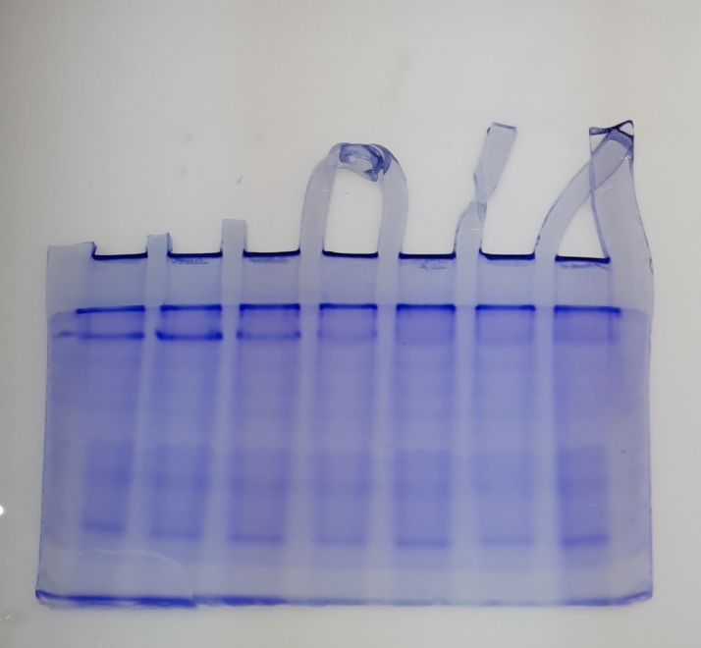
Supporting information file for original gel images
Fig 1. Qualitative analysis of total protein in native PAGE, of T. castaneum adult after treatment with essential oil of C. citrinus
1
2
3
4
1-control, 2-LC_{20,} 3-LC_{30,} 4-LC₄₀

Slide 2
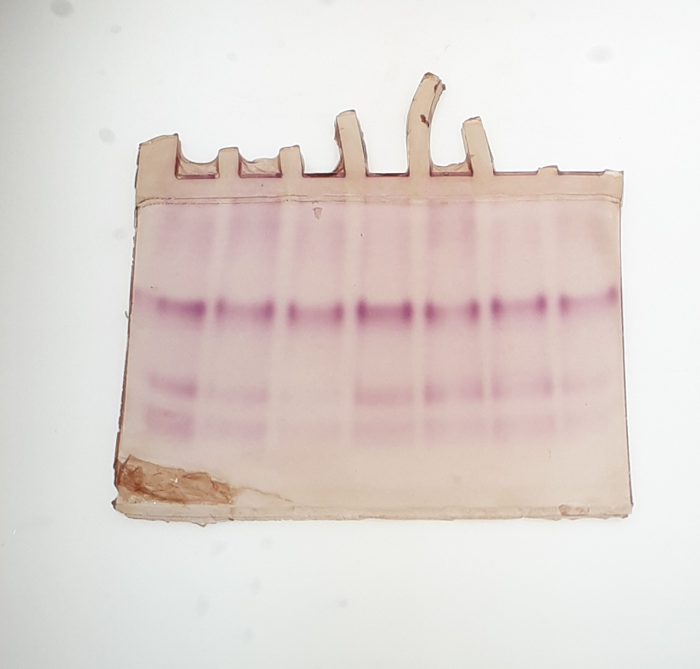
Fig 2. Qualitative analysis of isoenzyme of β-Carboxylesterases of T. castaneum adult after treatment with essential oil of C. citrinus
4
3
2
1
1-control, 2-LC_{20,} 3-LC_{30,} 4-LC₄₀

Slide 3
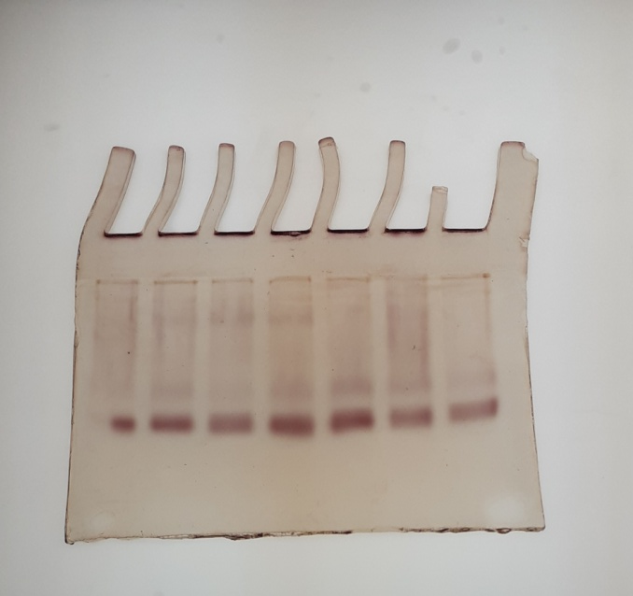
Fig 3. Qualitative analysis of acid phosphatises of T. castaneum adult after treatment with essential oil of C. citrinus
1
2
3
4
1-control, 2-LC_{20,} 3-LC_{30,} 4-LC₄₀

Slide 4
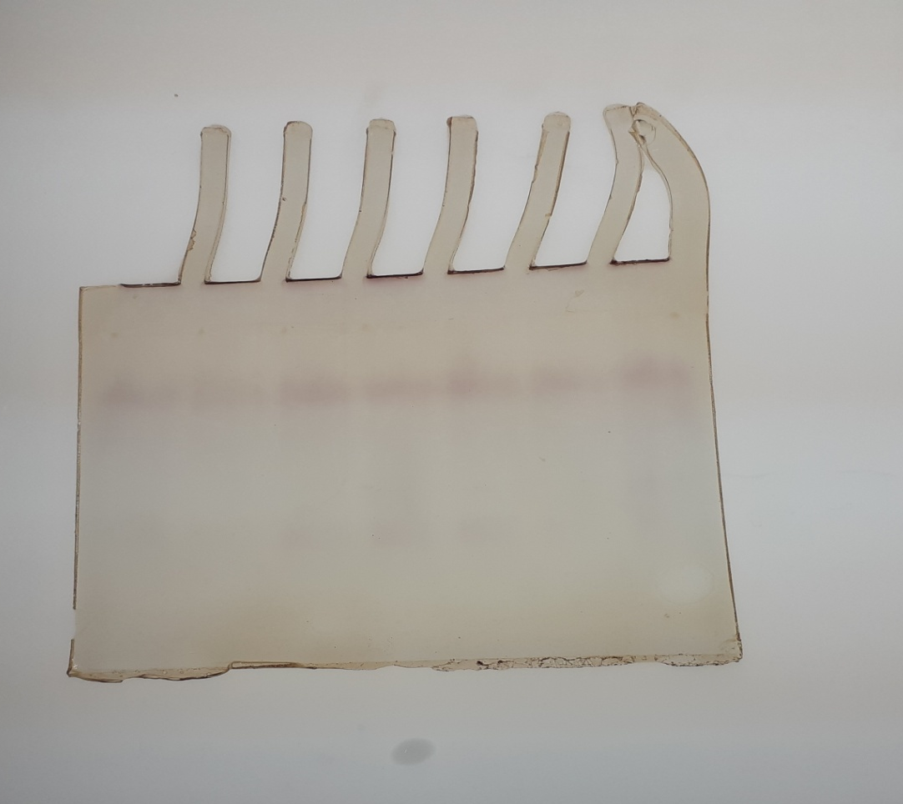
Fig 4. Qualitative analysis of alkaline phosphatases T. castaneum adult after treatment with essential oil of C. citrinus
4
3
2
1
1-control, 2-LC_{20,} 3-LC_{30,} 4-LC₄₀

