Slide 1
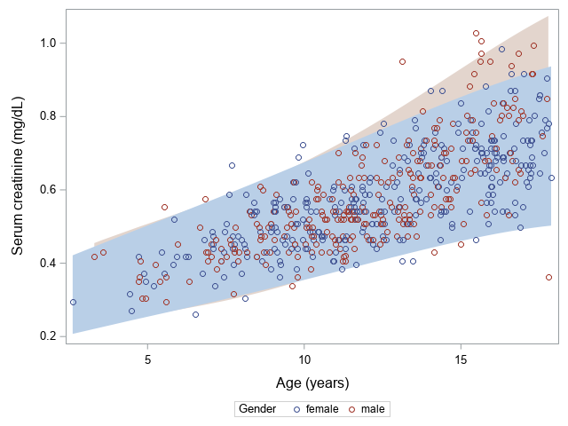
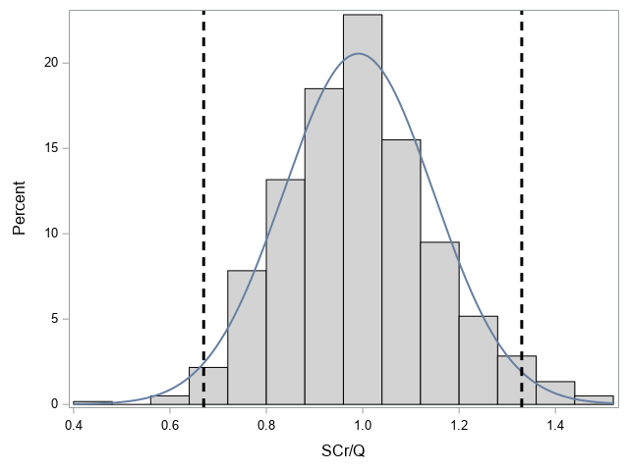
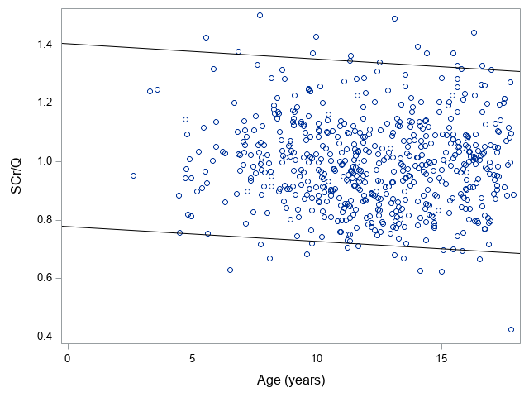
Creatinine-based GFR-estimating equations in children with overweight and obesity
HYPOTHESIS: We hypothesize that there is a difference in performance of various creatinine-based eGFR-equations in children with adiposity
DESIGN & OUTCOMES:
600 children with overweight and obesity without overt kidney disease
Normalization of SCr using reference Q-age polynomials works very well in this cohort.
Evaluated creatinine-based eGFR equations:
FAS age
FAS height
EKFC
CKiD (‘bedside Schwartz’)
Schwartz-Lyon
CKiDU25
Adjusted-creatinine revised Lund-Malmö (LMR18)
CKD-EPI with age-adjusted creatinine values
iCARE
53.5% female
Mean age: 12.2 ± 3.3 years
Mean BMI-z score: 3.31 ± 0.75
96.5% of the children have a SCr/Q within the reference band
[0.67 – 1.33], corresponding to the 2.5th and 97.5th percentile.
Q-age polynomials reference values were used to determine SCr/Q
CONCLUSION: Serum creatinine values of children with overweight and obesity are mostly within the reference range for children. FAS age, FAS height and LMR18 equations had the least age- and sex-dependency among the estimating equations examined.
van Dam et al. 2022

