Slide 1
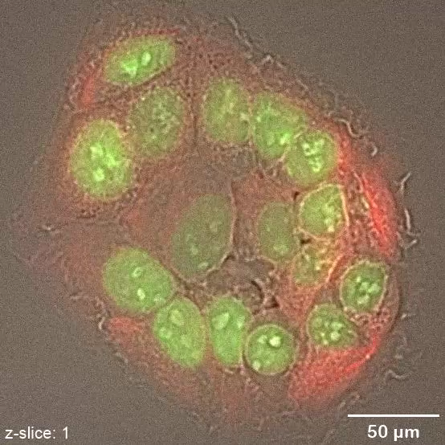
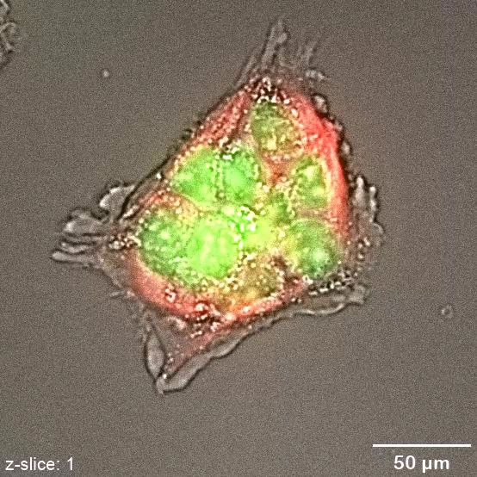
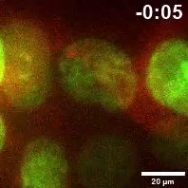
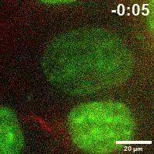
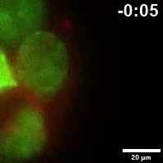
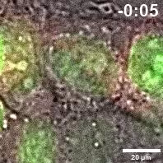
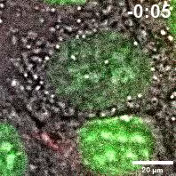
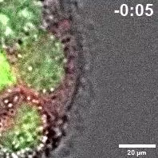
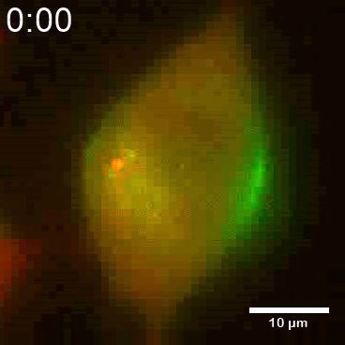
A
Videos
CTL
FILIP1L KD
B
CTL
FILIP1L KD
FILIP1L KD-Prolonged
C
(A-B) Time-lapse imaging of Caco2 clones that were incubated with SPY-595 DNA and SPY-650-tubulin fluorescent dyes. (A) Videos of vertical z-stack images (from bottom to top of cell clusters) of control and FILIP1L knockdown clones are shown. A total of six z-stacks with a step size of 1.7 μm (total thickness=10.2 μm) was imaged. Scale bar = 50 μm. (B) Videos of mitotic progression in control and FILIP1L knockdown clones. FILIP1L knockdown clones exhibiting prolonged cytokinesis are also shown. The lower column of videos show fluorescent images combined with phase contrast. Time is designated in the upper right (hr:min). Scale bar = 20 μm. (C) Time-lapse imaging of HEK293 cells transfected with FILIP1L-eGFP and mCherry-PFDN1. Merged video is shown. Time is designated in the upper left (hr:min). Scale bar = 10 µm.

