Slide 1
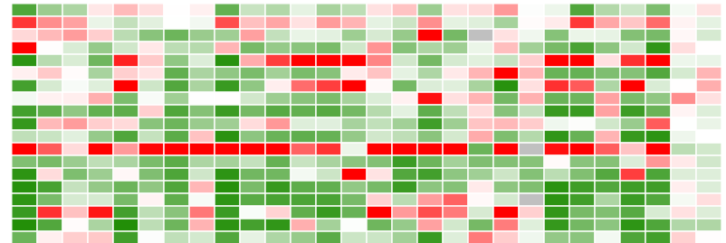
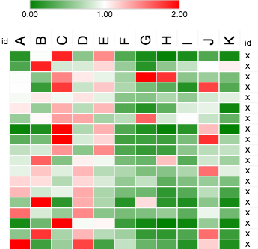
Supplementary Figure 3
CXCL9
CXCL10
CXCL1
CCL2
CCL5
TGFB1
IL10
IL6
IFNG
TNFA
IRF7
MX1
ISG15
OASL
PDGF2
FGFR1
FGFR2
FGFR3
IGF1
FGF2
FAS
FASLG
TNFSF10
PD-L1
PD-L2
PDCD1
VEGFA
VEGFB
A
PDGFR𝜷
PDGFR𝜷, DAPI
BAFF
Day 13
Control
B
*
*
*
Control
BAFF
C
D
E
TAMs

Slide 2
Supplementary Figure 3. BAFF tumors are characterized by decreased expression of PD-L1. C57BL/6 mice were inoculated subcutaneously with 5 x 10⁵ of BAFF-expressing or control cells and tumors were analyzed as indicated (A) PDGFRβ protein expression in BAFF and control tumors was assessed using fluorescent immunohistochemistry at day 13 (a representative image of n = 3-4 mice is shown). Scale bar indicates 50 µm. (B) Gene expression level of various cytokines, growth factors and immunosuppressive and inflammatory regulators were determined in whole tumors harvested at Day 18 post tumor inoculation. Expression was normalized to GAPDH and then to control tumors within each independent experiment (n = 7-12, pooled from two independent in vivo experiments). (C) FACS Gating strategy for monocytes, granulocytes and TAMs is shown. (D) PD-L1 expression was measured on tumor associated macrophages (TAMs) and CD19⁺ cells using FACS analysis (n = 3-6) harvested from BAFF-expressing and control tumors 13 days post inoculation. (E) BAFF-expressing or GFP expressing B16.F10 (BAFF and control respectively) polyclonal cell population was re-generated using the pLenti-C-Myc-DDK-P2A-Puro vectors through lentiviral transduction followed by puromycin selection. C57BL/6 mice were inoculated subcutaneously with 5 x10⁵ of BAFF-expressing or control cells. PD-L1 expression on monocytes harvested from tumors was assessed by FACS is shown 13 days post-tumor inoculation (n = 11-12, pooled form two independent in vivo experiments.) Error bars in all experiments indicate SEM; *P < 0.05 as determined by a Student´s t-test (unpaired, 2 tailed).

