Slide 1
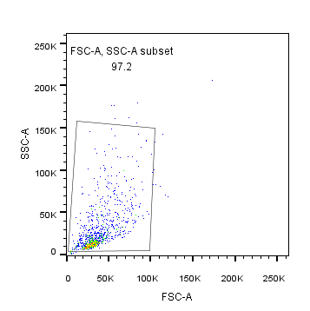
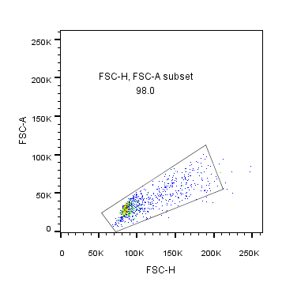
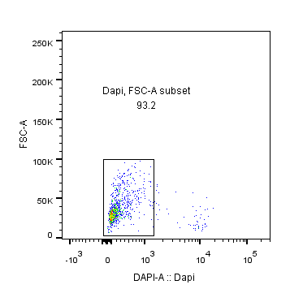
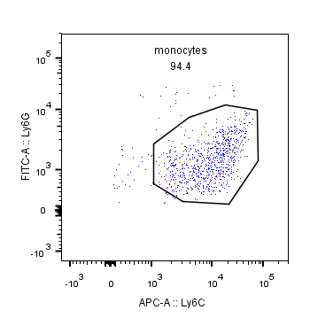
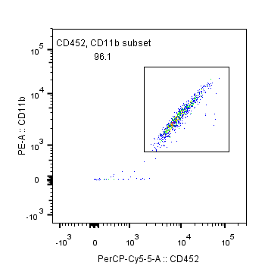
Supplementary Figure 4
A
B
C
D
Monocytes

Slide 2
Supplementary Figure 4. BAFF induces differential gene expression in tumor infiltrating monocytes. C57BL/6 mice were inoculated subcutaneously with 5 x 10⁵ of BAFF-expressing or control cells. 13 days post-inoculation, monocytes were sorted from BAFF and control tumors. Isolated monocytes were analyzed using RNA-Seq analysis. (A) Gating strategy of tumoral sorted monocytes is shown. (B) A PCA plot showing the distribution of the individual samples is shown. (C) PD-L1 gene expression level was determined in monocytes harvested from tumors at day 13. Expression was normalized to GAPDH and then to control monocytes (n = 3). (D) Top upstream regulator as assessed by Ingenuity Pathway Analysis (IPA) in monocytes harvested form Control tumors are shown. (n = 3).

