Slide 1
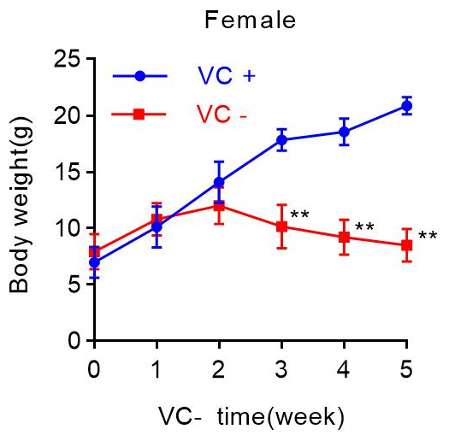
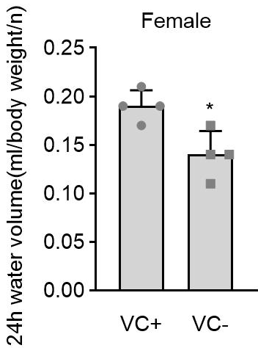
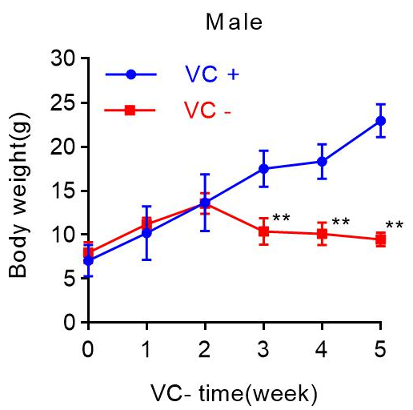
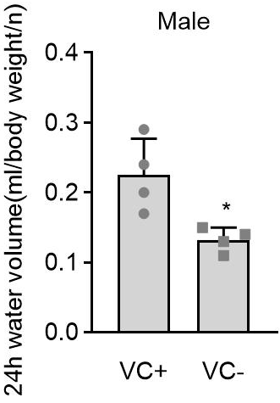
A
C
B
D
Figure S1. VC deprivation decreased body weights and water intake in both female and male Gulo^{-/-} pups. (A and B) Body weights in male or female Gulo^{-/-} pups after VC deprivation for the indicated weeks. (C and D) Average water intake of 24 h relative to body weight in per pups was calculated during the period of VC deprivation for 3 weeks. VC+: VC supplement, VC-: VC deprivation; Welch's t-test, n=6, mean SD; *p<0.05, **p<0.01 versus VC+.

Slide 2
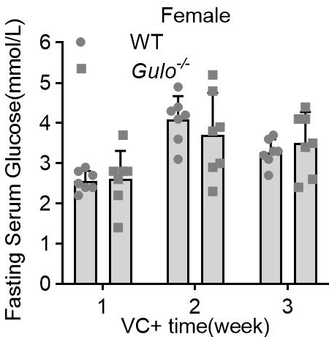
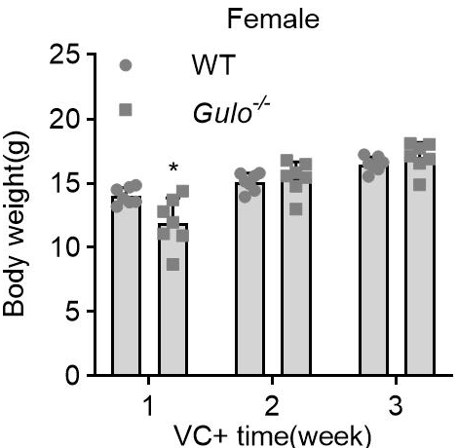
A
B
Fig. S2. The hypoglycemia in female Gulo^{-/-} pups was not related to the genetic manipulation or knockout of Gulo gene. (A) Fasting serum glucose levels in female WT pups or Gulo^{-/-} pups supplemented with 3.3 g/L of VC at week 3, 4, and 5 post-weaning. (B) Body weights in female WT pups or female Gulo^{-/-} pups supplemented with 3.3 g/L of VC at week 3, 4, and 5 post-weaning. VC+: VC supplement, WT: wild-type; Welch's t-test, n=7, mean SD; *p<0.05 versus wild-type pups.

Slide 3
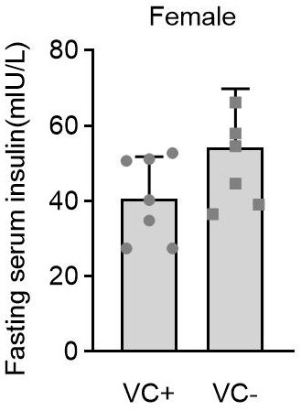
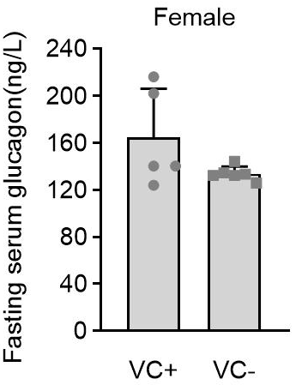
A
B
Fig. S3. VC deprivation for 4 weeks didn’t affect serum insulin or glucagon level in female Gulo^{-/-} pups. (A) Fasting serum insulin levels in female Gulo^{-/-} pups supplemented with or without 3.3 g/L of VC for 4 weeks post-weaning. (B) Fasting serum glucagon levels in female Gulo^{-/-} pups supplemented with or without 3.3 g/L of VC for 4 weeks post-weaning. VC+: VC supplement, VC-: VC deprivation; Welch's t-test, n=7, mean SD.

Slide 4
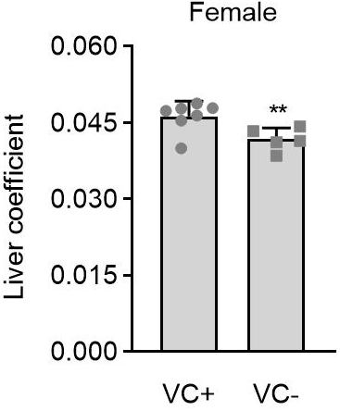
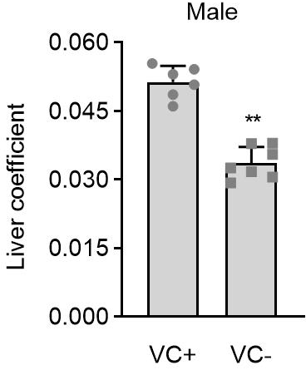
A
B
Fig. S4. VC deprivation for 5 weeks decreased liver coefficient in both female and male Gulo^{-/-} pups. (A) Liver coefficient in female Gulo^{-/-} pups supplemented with or without 3.3 g/L of VC for 5 weeks post-weaning. (B) Liver coefficient in male Gulo^{-/-} pups supplemented with or without 3.3 g/L of VC for 5 weeks post-weaning. VC+: VC supplement, VC-: VC deprivation; Welch's t-test, n=6, mean SD; **p<0.01 versus VC+.

Slide 5
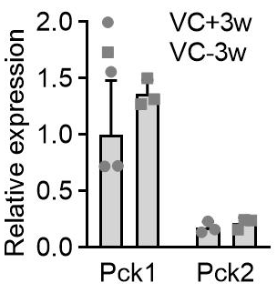
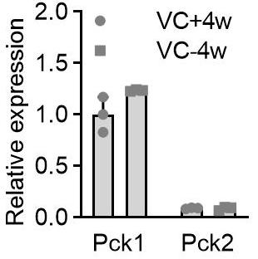
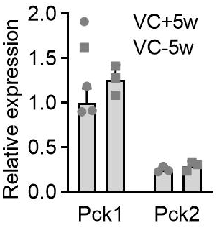
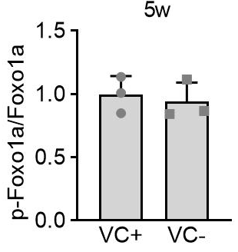
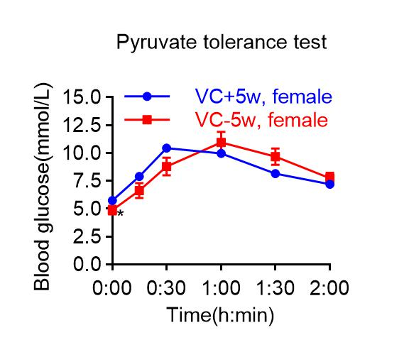
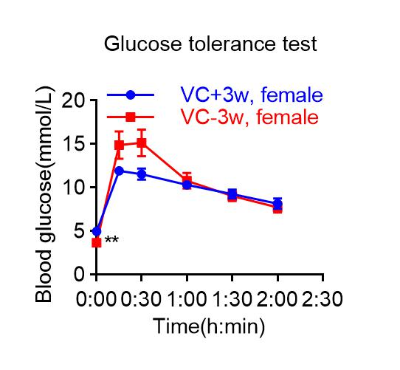
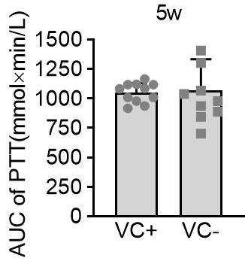
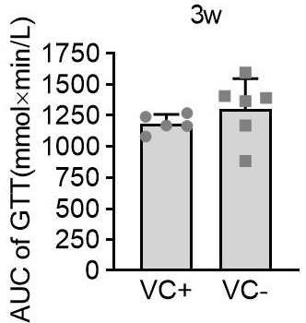
A
B
C
D
VC+3w
VC-3w
VC+4w
VC-4w
Pck1
Mr(K)
Pck1
Mr(K)
Pck2
69
Pck2
69
Gapdh
71
Gapdh
71
37
37
E
F
G
VC+5w
VC-5w
H
VC+5w
VC-5w
Mr(K)
Mr(K)
Pck1
69
p-FoxO1a
69
Pck2
71
FoxO1a
71
Gapdh
37
Gapdh
37
I
J
K
L
Fig. S5. VC deprivation didn’t affect gluconeogenesis or peripheral glucose uptake in female Gulo^{-/-} pups. (A-F) Western analyses and their semi-quantification for Pck1 and Pck2 in livers of female Gulo^{-/-} pups with supplement or deprivation of VC for 3, 4 or 5 weeks. Welch's t-test, n=3, mean SD. (G and H) Western analyses and their semi-quantification for p-FoxO1(Ser256) and FoxO1 in livers of female Gulo^{-/-} pups with supplement or deprivation of VC for 5 weeks. Welch's t-test, n=3, mean SD. (I and J) Female Gulo^{-/-} pups with supplement or deprivation of VC for 5 weeks. After starvation for 16 h, pups were intraperitoneally injected with 1.5 g/kg body weight of sodium pyruvate, and blood glucose concentrations were then measured at the indicated time points. Blood glucose values for the area under the curve (AUC) were calculated. Welch's t-test, n=10, mean SD; *p<0.05 versus VC+5w. (K and L) Female Gulo^{-/-} pups with supplement or deprivation of VC for 3 weeks. After starvation for 16 h, pups were intraperitoneally injected with 1 g/kg body weight of D-glucose, and blood glucose concentrations were then measured at the indicated time points. Blood glucose values for AUC were calculated. Welch's t-test, n=5, mean SD; **p<0.05 versus VC+3w.
Notes:
E：2021-10-15

Slide 6
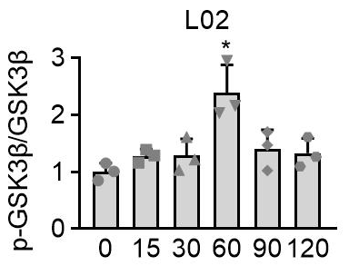
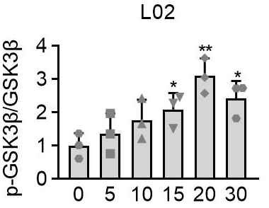

A
B
VC(μM)
0 15 30 60 90 120
p-GSK3β
Mr(K)
GSK3β
47
Gapdh
47
37
C
D
Time(min)
0 5 10 15 20 30
p-GSK3β
Mr(K)
GSK3β
47
Gapdh
47
37
Fig. S6. VC inactivated GSK3β. (A-D) Western analyses and their semi-quantification for p-Ser9-GSK3β in L02 cells after treatment with VC at the indicated concentrations for 30 min (A and B) or at 60 µM (C and D) for the indicated times. Welch's t-test, n=3, mean SD; *p<0.05, **p<0.01 versus Lane 1.
Notes:
A：WB（2021-06-12）；B：WB（2021-09-07+2021-09-10）；

Slide 7
balanced
Fig. S7. The root-mean-square deviations (RMSDs) of all the atoms of GSK3β with respect to its initial structure as function of time.

Slide 8
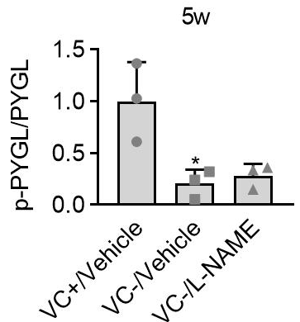


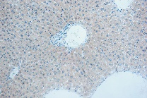
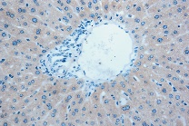
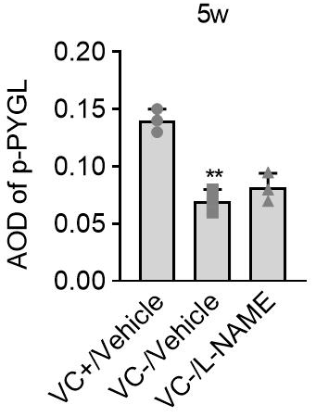
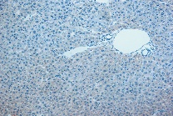
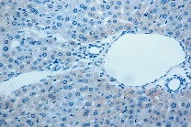
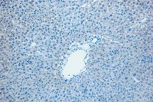
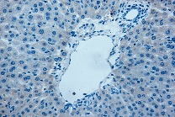
A
B
VC+/Vehicle
VC-/Vehicle
VC-/L-NAME
p-PYGL
Mr(K)
97
PYGL
97
Gapdh
37
C
VC-/L-NAME VC-/Vehicle VC+/Vehicle
p-PYGL(Ser15)
D
Fig. S8. L-NAME did not affect the decrease in p-Ser15-PYGL levels in response to VC deprivation. Female Gulo^{-/-} pups were given tap water with or without 3.3 g/L of VC at three weeks of age and were injected peritoneally with or without L-NAME at 0.8 mg/10g body weight once daily for five weeks. Western analyses and semi-quantification (A and B) and immunohistochemistry staining and semi-quantification for p-Ser15-PYGL (C and D) in livers of female Gulo^{-/-} pups of each group at the end of week 5. Mean SD, n=3, one-way ANOVA and Dunnett's multiple comparison tests; *p<0.05, **p<0.01 versus VC+/Vehicle; Square frames define the magnified regions.

Slide 9
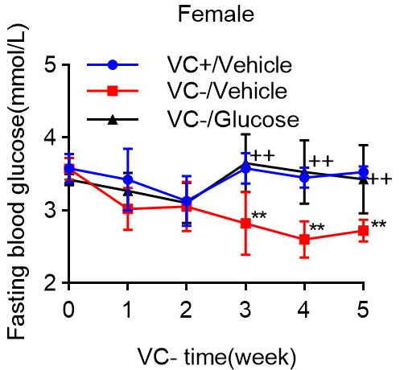
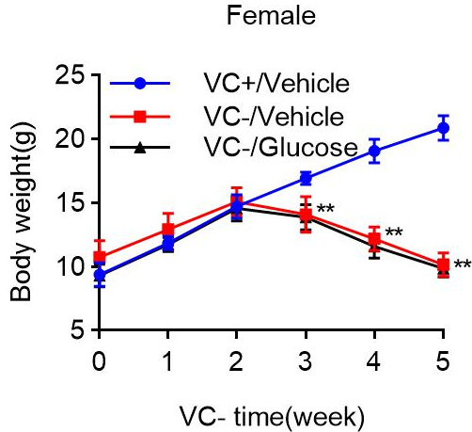
A
B
Fig. S9. The effect of glucose supplementation on the FSG levels and body weights in female Gulo^{-/-} pups with VC deprivation. Female Gulo^{-/-} pups were randomly given tap water containing 3.3 g/L of VC and no glucose (VC+ Glu-), 2 g/L of glucose, and no VC (VC- Glu+), or neither VC nor glucose (VC- Glu-) for five weeks post-weaning. FSG levels (A) and body weights (B) of these pups were measured once a week after a 16-hour fast. Mean SD, n=6, one-way ANOVA and Dunnett's multiple comparison tests; **p<0.01 versus VC+/Vehicle, ⁺⁺p<0.01 versus VC-/Vehicle.

