Slide 1
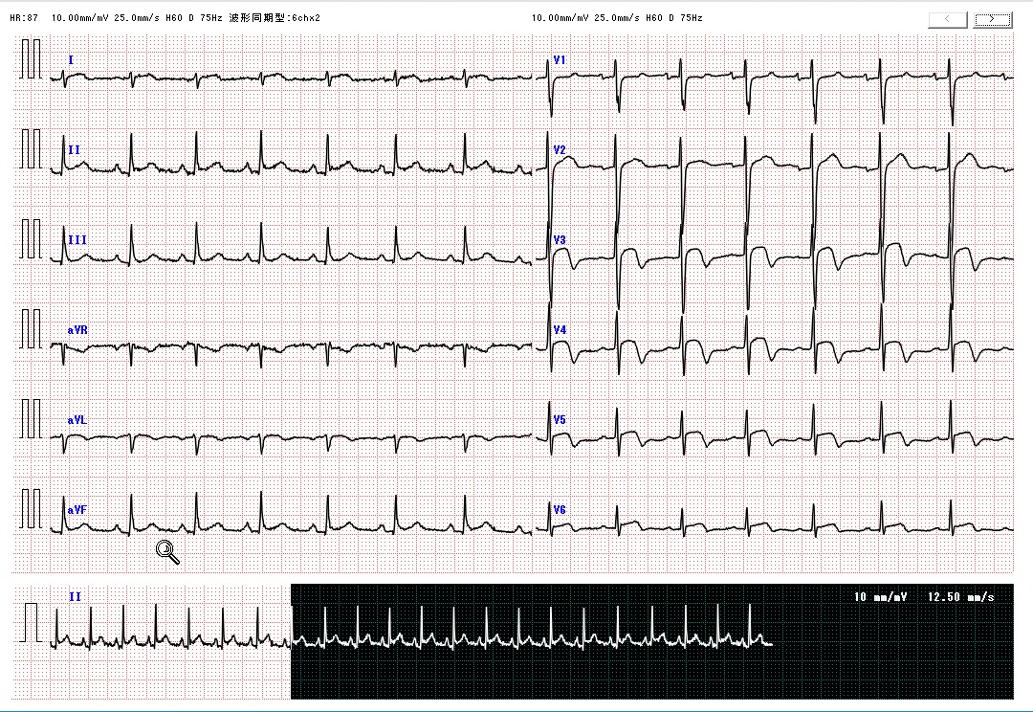
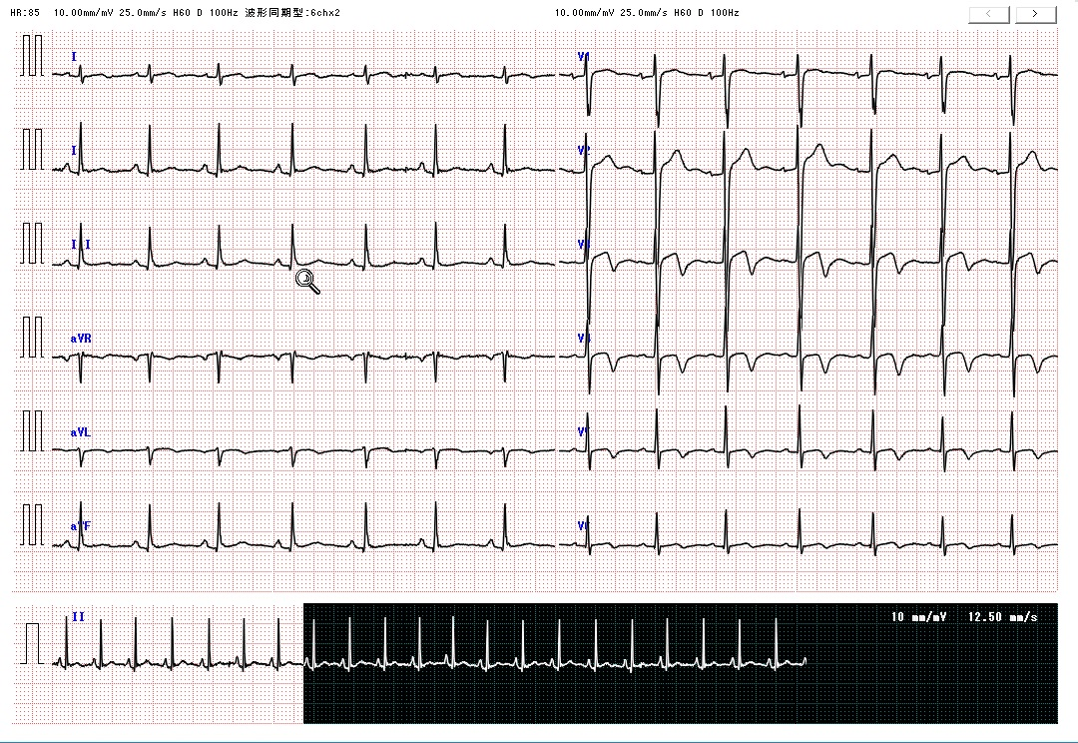
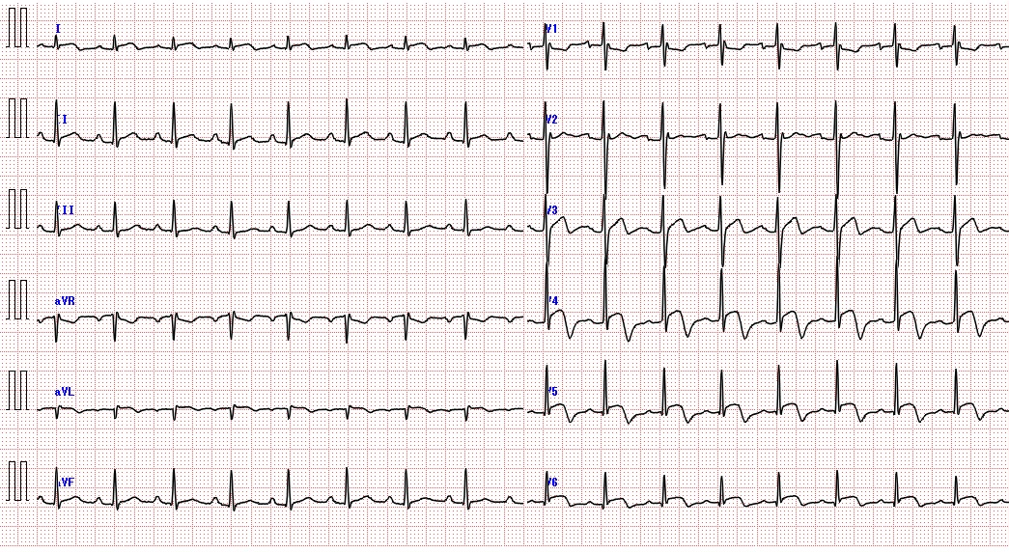
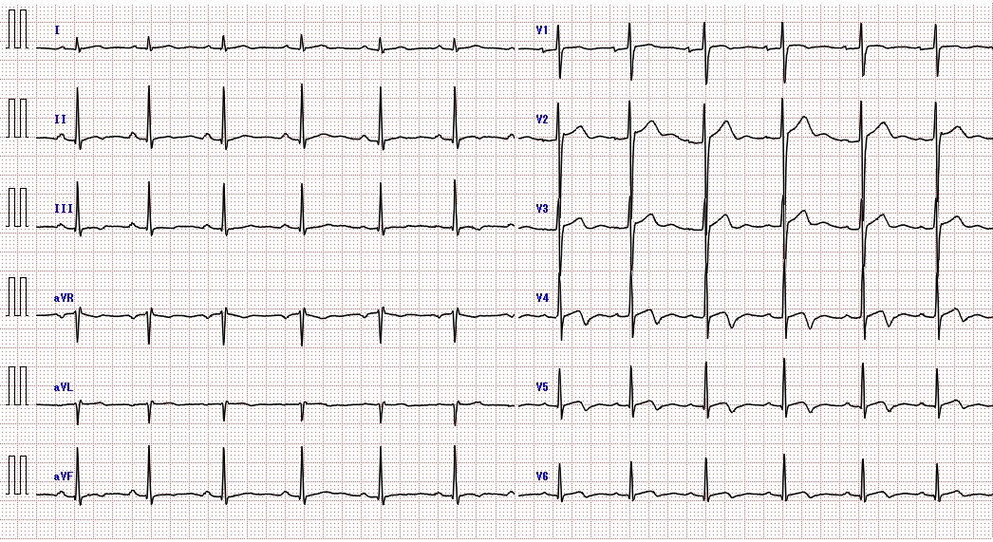
a
Patient 1 on admission
b
Patient 1 after one month
*
*
*
*
*
*
*
*
*
*
*
*
*
*
*
*
*
*
*
*
c
Patient 2 on admission
d
Patient 2 after one month
*
*
*
*
*
*
*
*
*
*
*
*
*
*
*
*
*
*
*
*
*
*
*
*
Sup Figure 1
Notes:
Figure legends
Supplemental Figure 1:
ECG examination
(a) Patient 1 on admission: ST elevation in I, II, III, aVF, V3-V6 (red arrows), and negative T waves in V3-5 (blue asterisks).
(b) Patient 1 after one month: ECG changes improved.
(c) Patient 2 on admission: ST elevation at I, aVL, V3-V6 (red arrows), and negative T waves at V3-6 (blue asterisks).
(d) Patient 2 after one month: ECG changes improved.

