Slide 1
ID | Age | Race | Sex | HCC stage | Fibrosis | Notes
NJ033 | 70 | white | male | pT1N0M0; necrotic | 6 | Patient has pT1N0M0 tumor
NJ034 | 68 | white | female | n/a | 6 | No HCC
NJ035 | 65 | AA | female | n/a | 6 | No HCC
NJ036 | 59 | white | male | n/a | 6 | Patient has pT1N0M0 tumor
NJ037 | 59 | white | male | pT1N0M0 | Tumor | Tumor from patient NJ036
NJ038 | 62 | hispanic | male | pT1N0M0 | Tumor | Patient has pT1N0M0 tumor
ND16690-07 | 92 | white | male | n/a | n/a | Cardiopulmonary arrest
ND16727_17 | 61 | white | male | n/a | n/a | Cardiac arrest
ND16762-05 | 63 | white | male | n/a | n/a | Cardiac arrest
ND16776-02 | 72 | white | male | n/a | n/a | Respiratory failure
Hlady et al Supplemental Table S1

Slide 2
Hlady et al Supplemental Table S2

Slide 3
 |  | vs Hu1545 |  |  |  |  | vs Hu1545_HCV |  | vs Huh7.5 |  |  |  |  | vs Huh7.5_HCV
Methylation change |  | HCV | IFN | DAA | HCV_IFN | HCV_DAA | HCV_IFN | HCV_DAA | HCV | IFN | DAA | HCV_IFN | HCV_DAA | HCV_IFN | HCV_DAA
>0.05 |  | 83989 | 74113 | 61652 | 72988 | 82686 | 49314 | 27210 | 84934 | 58720 | 20294 | 81533 | 89640 | 68194 | 76732
<-0.05 |  | 278576 | 232108 | 38625 | 289035 | 272857 | 65515 | 18883 | 177946 | 139222 | 61773 | 196635 | 143280 | 65054 | 25364
>0.1 |  | 44442 | 36833 | 6152 | 38272 | 44781 | 8040 | 2694 | 54117 | 12541 | 3222 | 51320 | 56650 | 19996 | 15327
<-0.1 |  | 210305 | 148411 | 4930 | 213957 | 206321 | 10302 | 2408 | 104921 | 42901 | 7934 | 97260 | 87423 | 12414 | 4344
>0.15 |  | 26834 | 18965 | 620 | 22130 | 27409 | 1321 | 446 | 38267 | 2490 | 540 | 35499 | 40813 | 6989 | 3911
<-0.15 |  | 161006 | 92139 | 765 | 160537 | 156023 | 1364 | 438 | 71874 | 12838 | 1056 | 61145 | 61625 | 3311 | 1136
>0.2 |  | 15543 | 8850 | 126 | 12076 | 16003 | 242 | 108 | 26794 | 504 | 109 | 24265 | 28968 | 2615 | 1181
<-0.2 |  | 118912 | 52043 | 145 | 117650 | 113754 | 210 | 101 | 50466 | 2877 | 184 | 39984 | 43437 | 1058 | 308
Hlady et al Supplemental Table S3

Slide 4
Human cell lines
Primary human tissue
Genome-wide profiling
Naïve immortalized hepatocyte cell line
Hu1545
Hu1545-HCV
Hu1545-HCV
cure
Normal liver
Stable chronic replication of JFH-1 genotype 2a
interferon-α
or
DAA treatment
HCV-infected liver
HCV-exposed transformed hepatocyte cell line
Huh7.5
Huh7.5-HCV
Huh7.5-HCV
cure
HCV-SVR liver
5-azadC
treatment
Hlady et al Supplemental Fig. S1

Slide 5
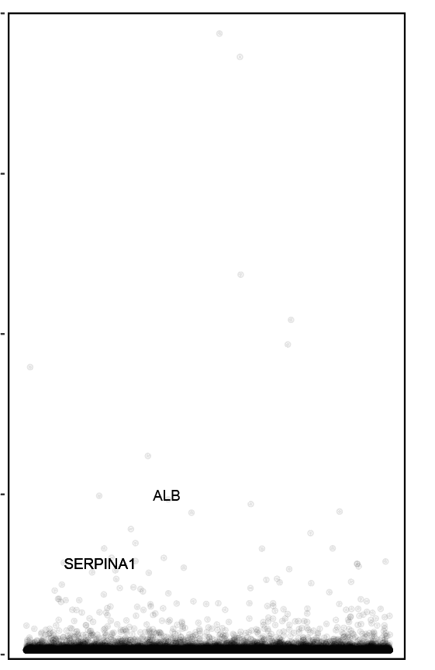
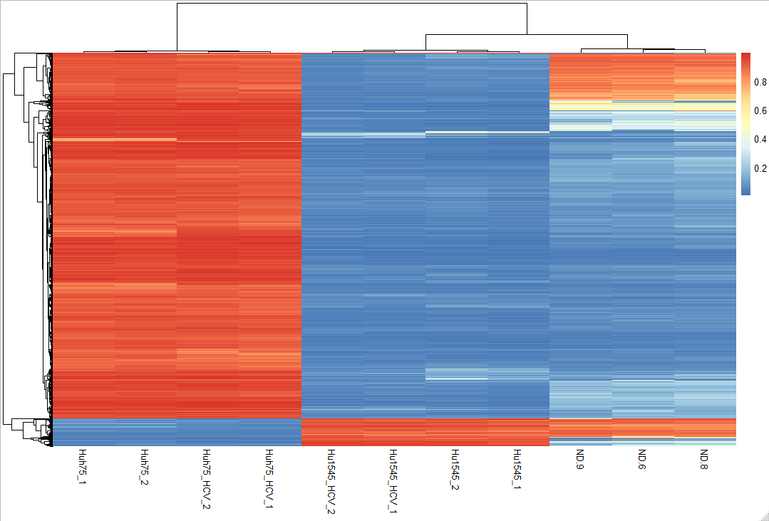
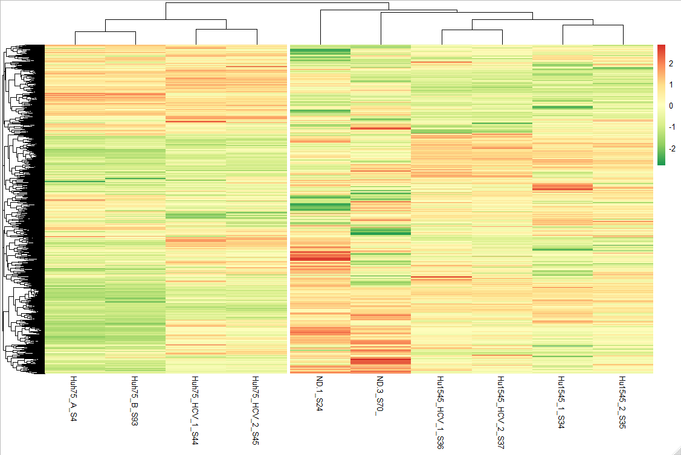
A
B
Gene expression
C
DNA methylation
4e05
high
high
3e05
5,000 genes
low
low
5,000 CpGs
Counts
2e05
1e05
Huh7.5
Huh7.5
Hu1545
Hu1545
Huh7.5
Huh7.5
Normal liver
Normal liver
Huh7.5 HCV
Normal liver
Hu1545
Hu1545
Huh7.5 HCV
Hu1545 HCV
Hu1545 HCV
Normal liver
Huh7.5 HCV
Normal liver
Huh7.5 HCV
Hu1545 HCV
Hu1545 HCV
0e00
Genes
Hlady et al Supplemental Fig. S2

Slide 6
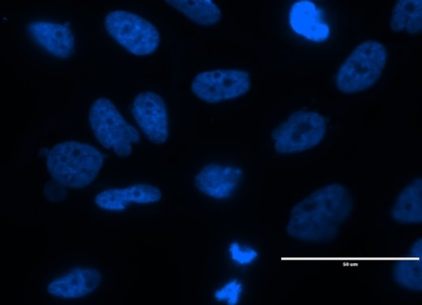
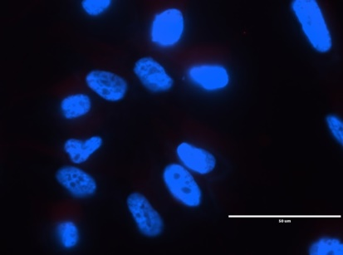
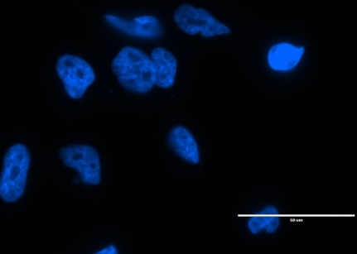
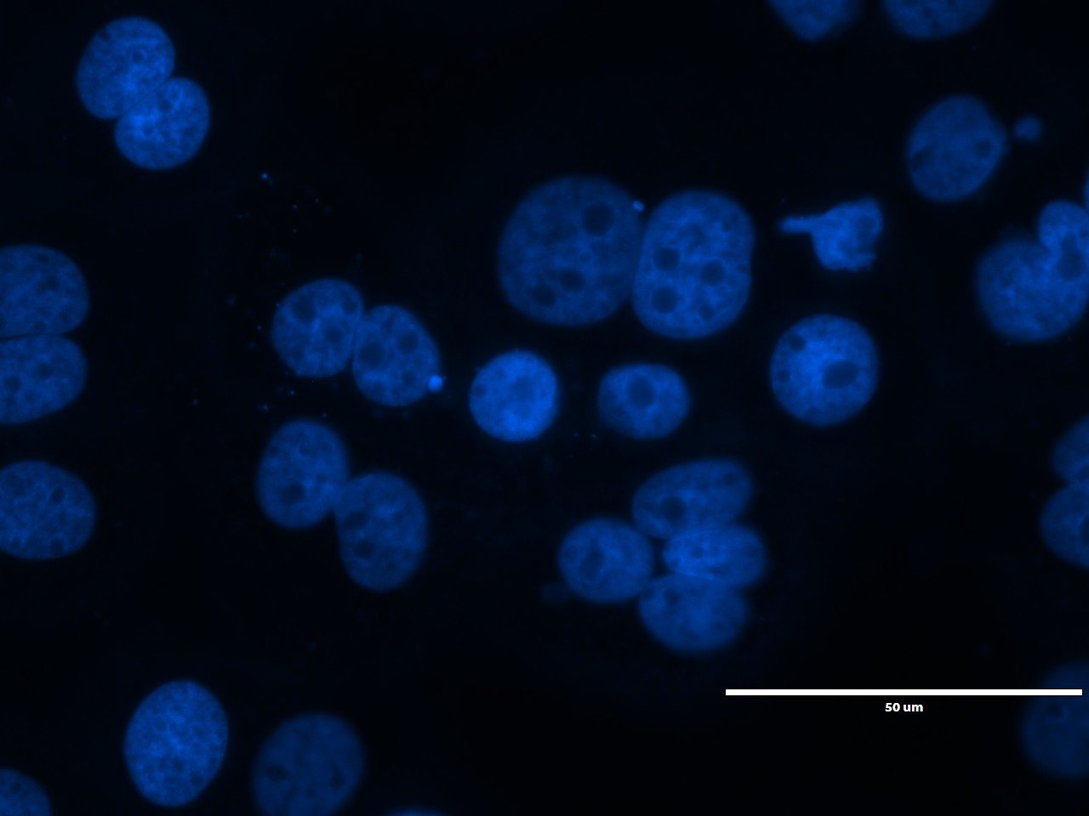
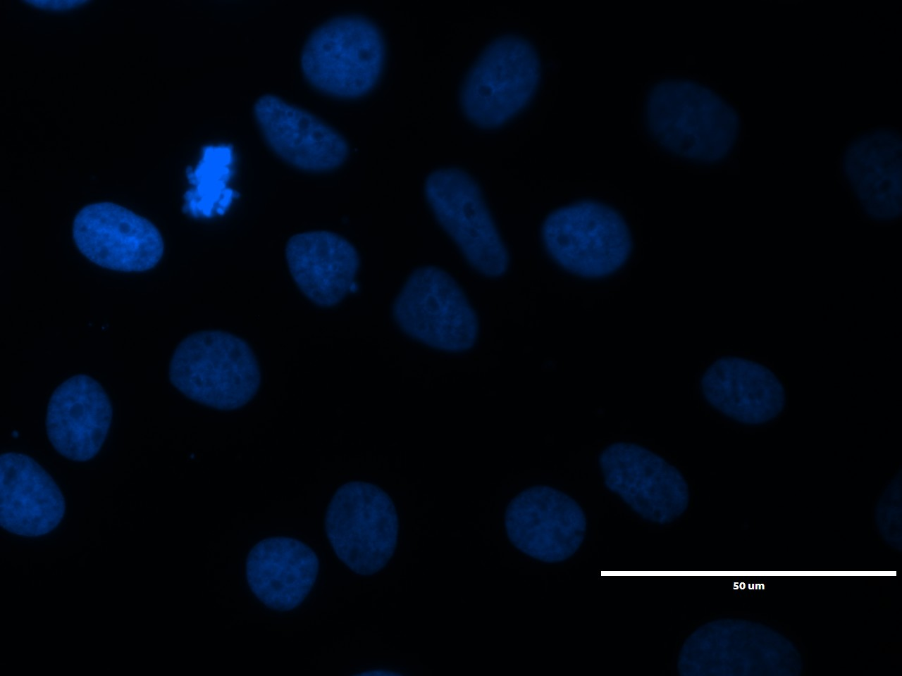
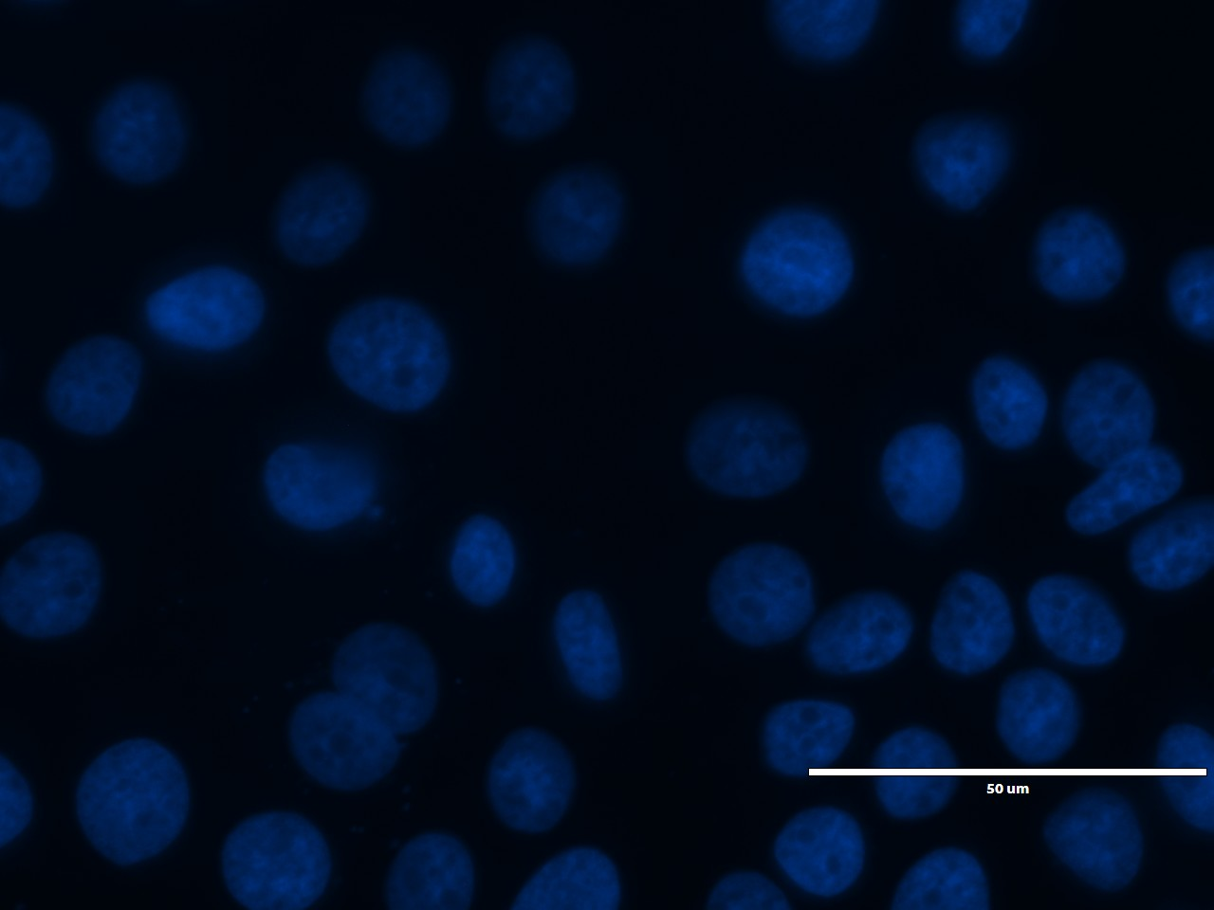
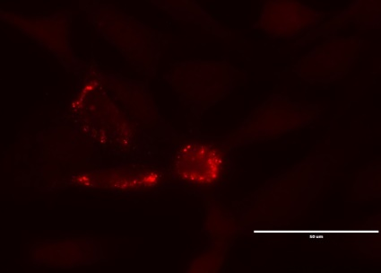


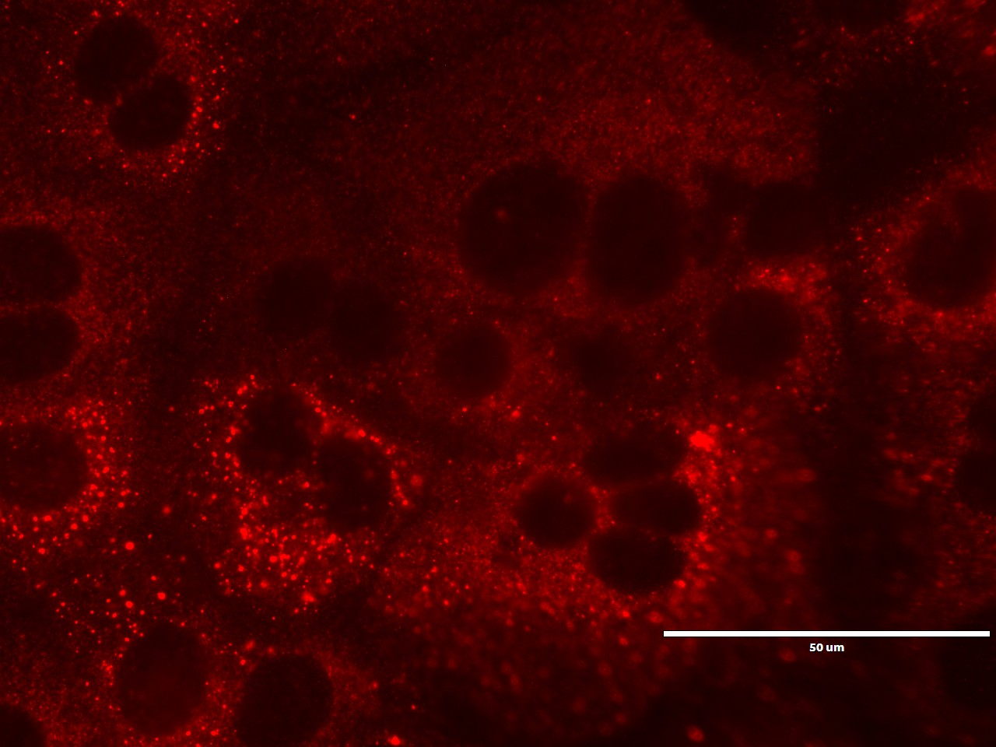

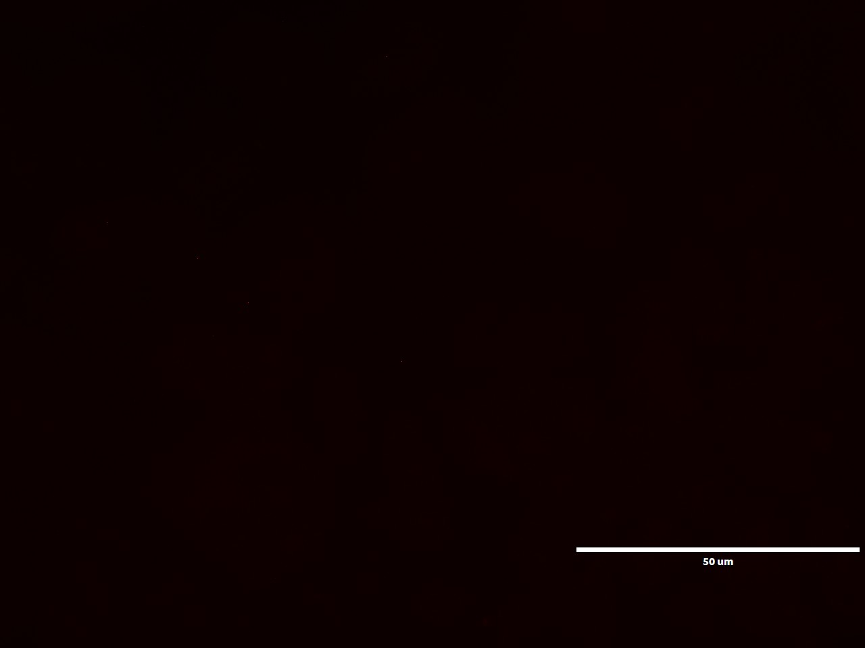
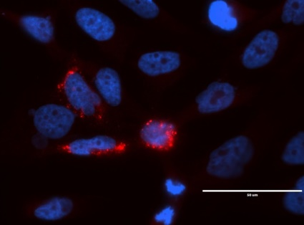

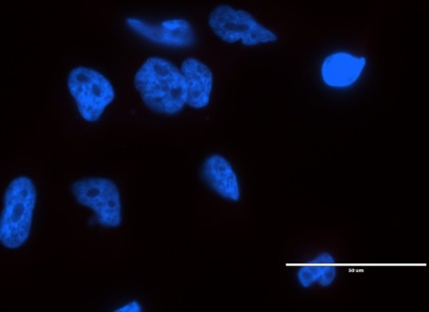
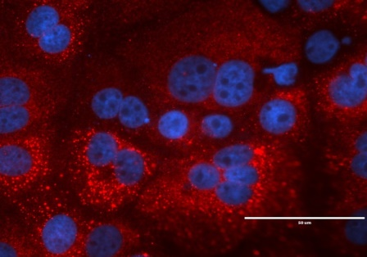
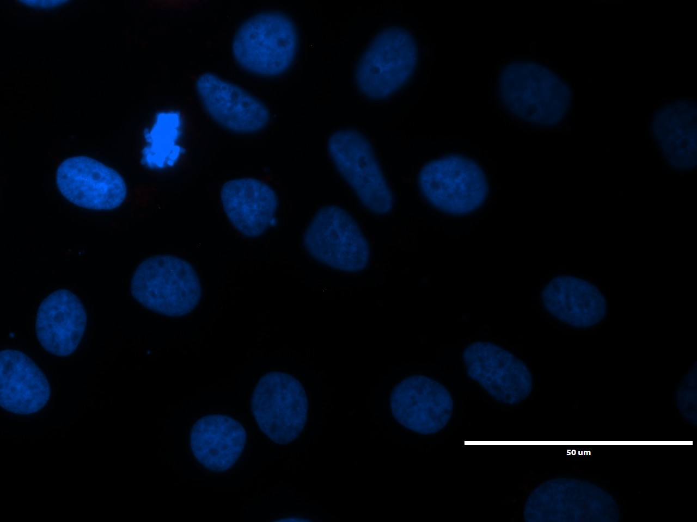
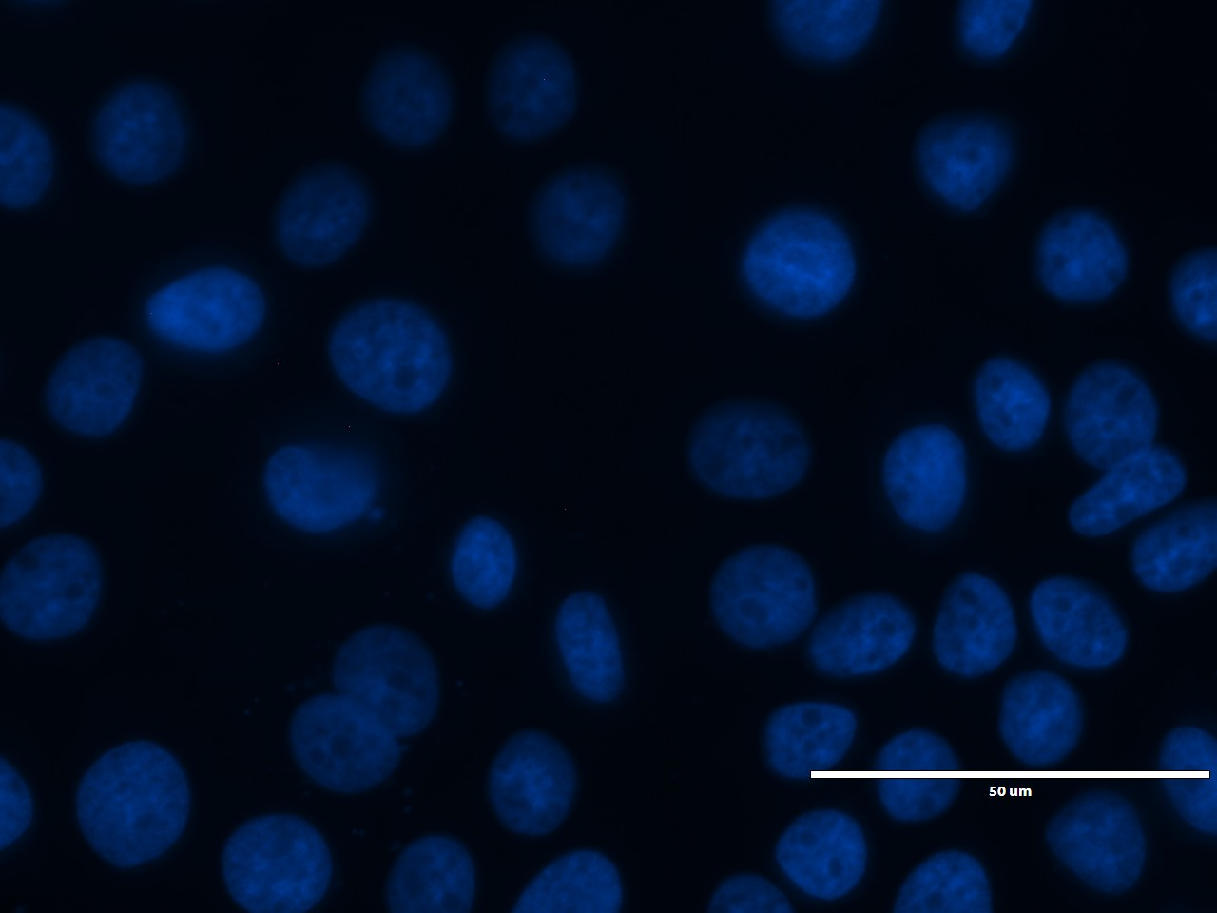
A
B
DAPI
(DNA)
NS5A HCV
Merge
Hu1545 HCV
Hu1545 HCV IFN
Hu1545 HCV DAA
Huh7.5 HCV
Huh7.5 HCV IFN
Huh7.5 HCV DAA
Hlady et al Supplemental Fig. S3

Slide 7
A
B
RGS7
SERPINA1
TNFSF10
ACSL1
SERPINF1
CYP27A1
DNMT3A
CPEB1
APOC1
Parent
HCV
HCV IFN
HCV DAA
Parent
HCV
HCV IFN
HCV DAA
Hlady et al Supplemental Fig. S4

Slide 8
A
B
Expression
H3K4me3
H3K27ac
Expression
H3K4me3
H3K27ac
Parent
HCV
HCV IFN
Parent
HCV
Parent
HCV
Parent
HCV
HCV DAA
HCV IFN
HCV IFN
HCV IFN
HCV 5-aza-dC
HCV DAA
HCV DAA
HCV DAA
HCV 5-aza-dC
C
D
Expression
H3K4me3
H3K27ac
Expression
H3K4me3
H3K27ac
Parent
HCV
Parent
HCV
Parent
HCV
Parent
HCV
HCV IFN
HCV IFN
HCV IFN
HCV IFN
HCV DAA
HCV DAA
HCV DAA
HCV DAA
HCV 5-aza-dC
HCV 5-aza-dC
Hlady et al Supplemental Fig. S5

Slide 9
A
qRT-PCR
B
DNMT3A ChIP-PCR
C
Hlady et al Supplemental Fig. S6

Slide 10
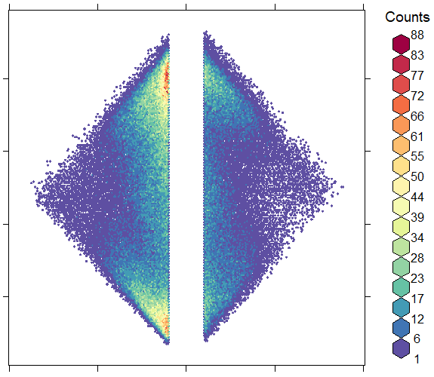
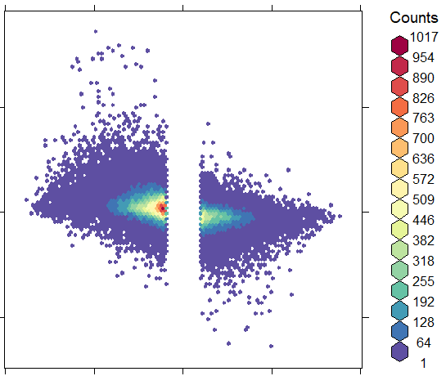
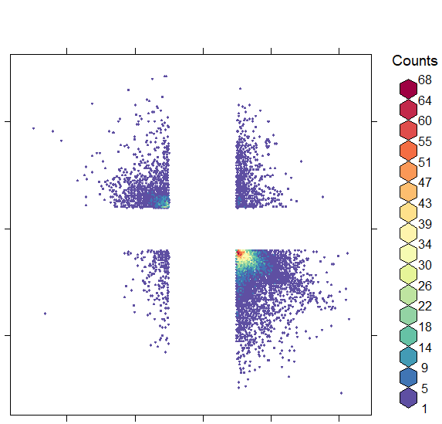
A
IFN
B
C
1
50
25
PC2
Mean methylation
HCV IFN
HCV IFN
HCV
0
DAA
HCV
IFN
HCV DAA
DAA
HCV DAA
Parent
0
-25
Parent
-50
-25
0
25
50
-0.5
0
0.5
PC1
HCV vs Parent
D
E
F
7,876
0.5
1,876
783
0.5
77
410
28
0.5
HCV IFN vs HCV methylation
0
0
53,151
28,818
HCV vs Parent
HCV IFN vs HCV
-0.5
-0.5
0.1
2,504
-10
0
10
269
8,658
HCV IFN vs HCV expression
0.5
0
-0.5
-0.4
0
0.4
HCV vs Parent
HCV DAA vs HCV
Hlady et al Supplemental Fig. S7

Slide 11
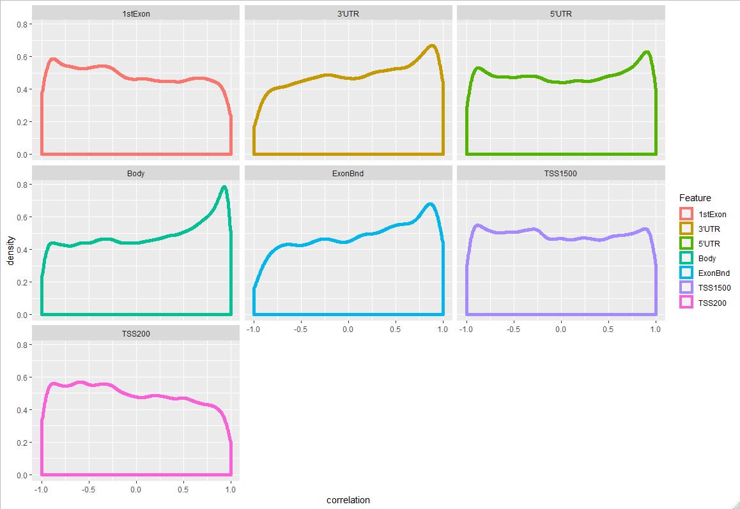
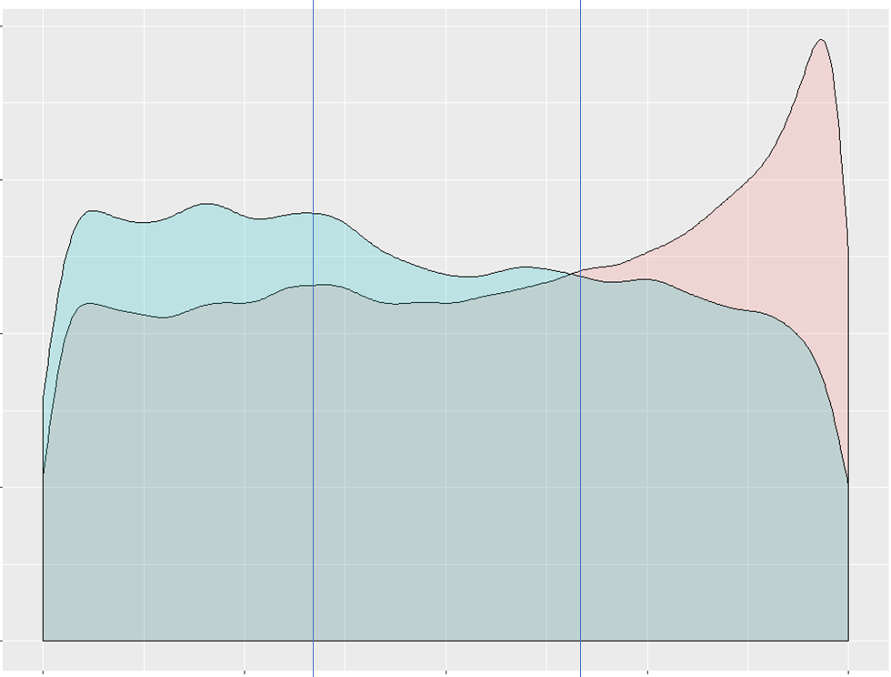
A
B
0.8
Body
0.8
TSS200
0.6
0.6
0.4
0.2
Density
0
0.4
Density
0.8
0.6
0.2
0.4
0.2
0
0
-1
-0.5
0
0.5
1
-1
-0.5
0
0.5
1
-1
-0.5
0
0.5
1
Pearson correlation
Pearson correlation
Hlady et al Supplemental Fig. S8

Slide 12
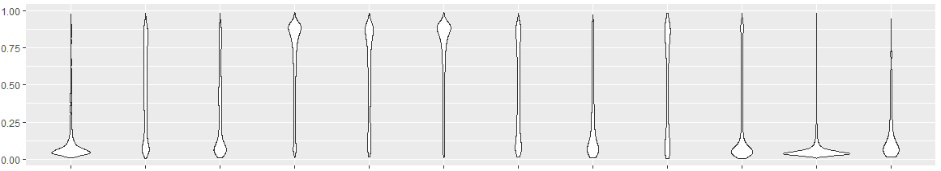
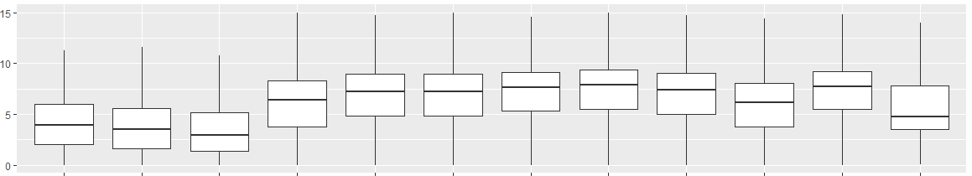
Methylation (β)
Expression level
State
1 | 2 | 3 | 4 | 5 | 6 | 7 | 8 | 9 | 10 | 11 | 12
Bivalent | RepressedPCWk | Repressed | Quiescent | Poised Enhancer | Weak Enhancer | Active Enhancer | Flanking Promoter U | Flanking Promoter D | Promoter | Active Promoter | Other
H3K27me3
ChromHMM
H3K4me3
H3K27ac
H3K4me1
Hlady et al Supplemental Fig. S9

Slide 13
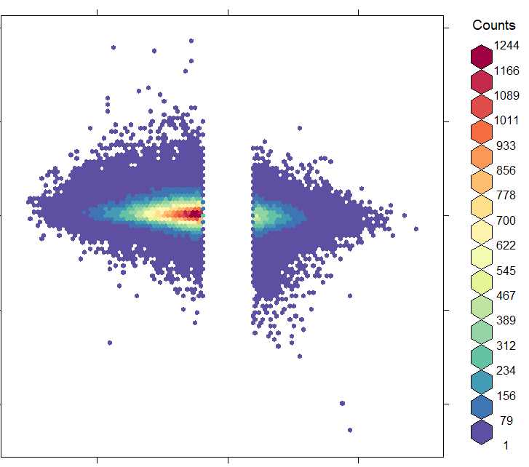
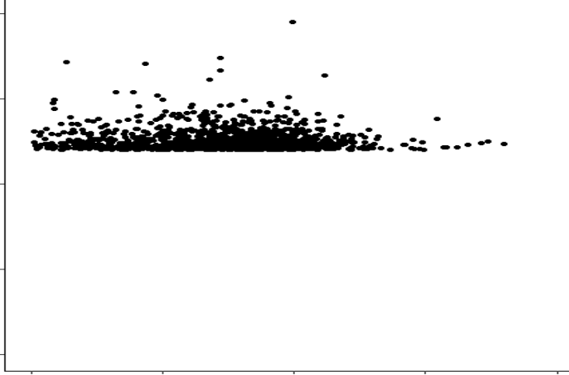
A
0.4
B
0
HCV DAA vs HCV
-0.4
-0.5
0
0.5
state
HCV vs Parent
DAA hyper
DAA hypo
DAA hyper down
DAA hypo down
C
D
0.5
40
10
10
0.4
0.3
0
HCV DAA vs HCV methylation
HCV DAA vs HCV
0.2
0.1
-0.5
-10
0
10
-0.5
0
0.5
HCV DAA vs HCV expression
HCV vs Parent
Hlady et al Supplemental Fig. S10

Slide 14
Total on 850k
866,091
Hypo w/ HCV
238,727 (27.6%)
Hyper w/ HCV
78,464 (9.1%)
Hyper w/ 5-azadC
33,915 (14.2%)
Hyper w/ IFN 3,097 (1.3%)
Hyper w/ DAA 1,069 (0.4%)
Hypo w/ 5-azadC
36,606 (46.7%)
Hypo w/ IFN: 5,239 (6.7%)
Hypo w/ DAA: 11,376 (14.5%)
Hypo w/ IFN and 5-azadC 1,009 (33.6%)
Hypo w/ DAA and 5-azadC 216 (20.2%)
Hypo w/ IFN and 5-azadC: 3,747 (71.5%)
Hypo w/ DAA and 5-azadC: 3,853 (33.9%)
Hlady et al Supplemental Fig. S11

Slide 15
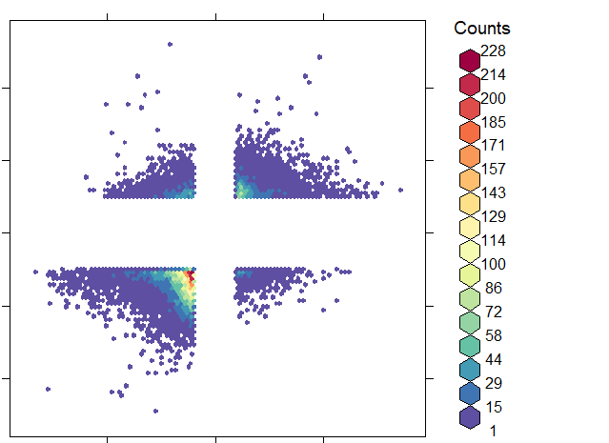
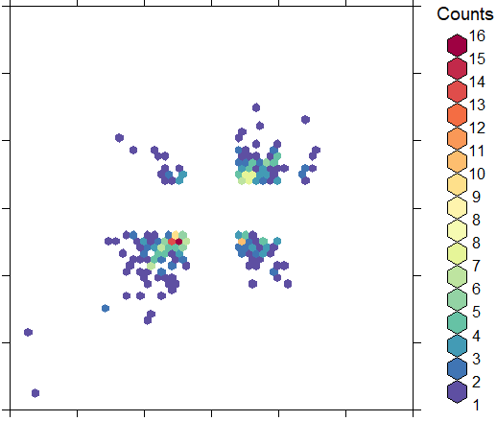
A
Methylation
B
Expression
693
2,938
0.4
10
0
IFN vs Parent
HCV IFN vs HCV
0
-0.4
-10
10,258
1,508
-0.5
0
0.5
-10
0
10
HCV vs Parent
HCV vs Parent
Hlady et al Supplemental Fig. S12

Slide 16
A
Expression
B
C
D
100
Percent alive
Parent
HCV
0
HCV IFN
HCV DAA
0
Survival (in days)
3,500
Hlady et al Supplemental Fig. S13

