Slide 1
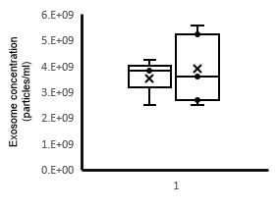
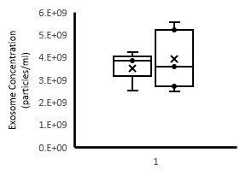
NS
NS
Exosomes from PBS treated monocytes
Exosomes from LPS treated monocytes
Exosomes from PBS treated monocytes
Exosomes from LPS treated monocytes
Supplemental Figure 2. Nanosight size and concentration characterization demonstrated no difference in the size of exosomes generated from PBS stimulated monocytes (n=3) of LPS stimulated monocytes (n=5). The data shown are mean +/- SD. 2-tailed t test analysis was performed for comparisons. NS = nonsignificant.

