Slide 1
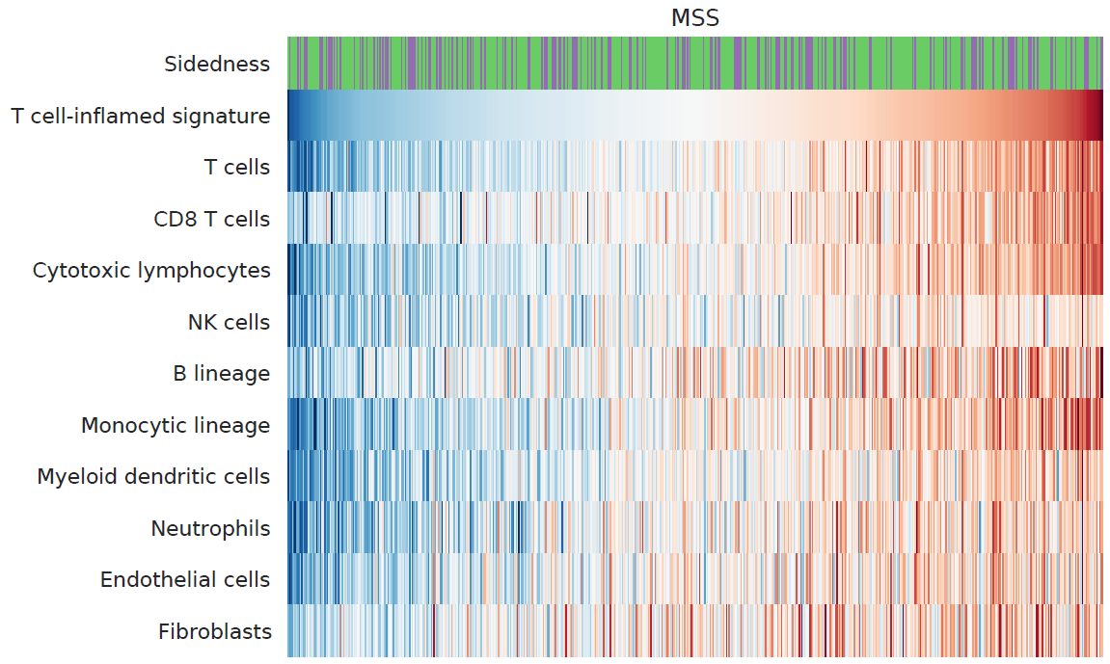
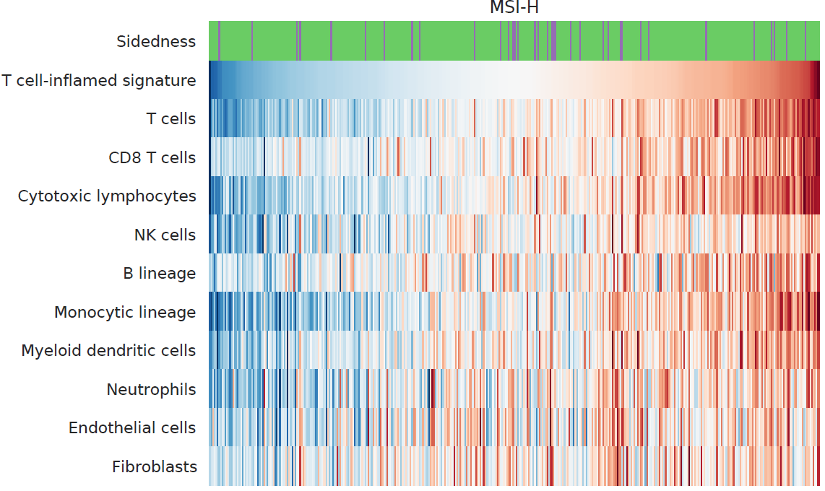
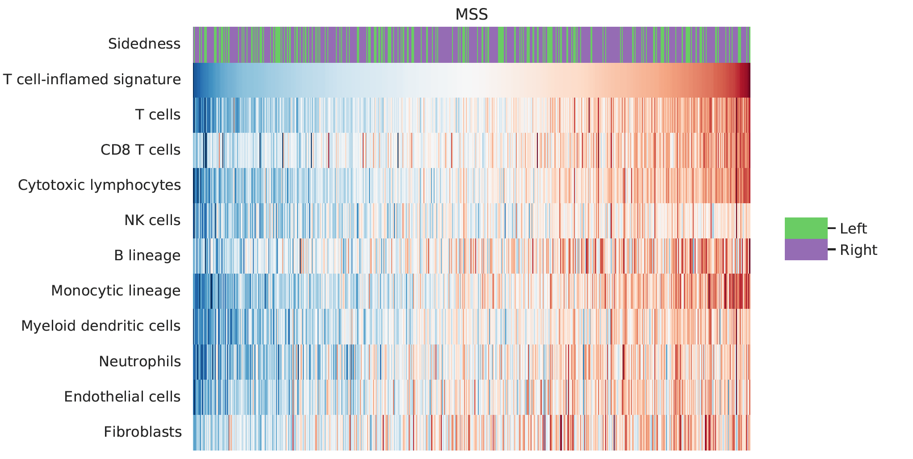
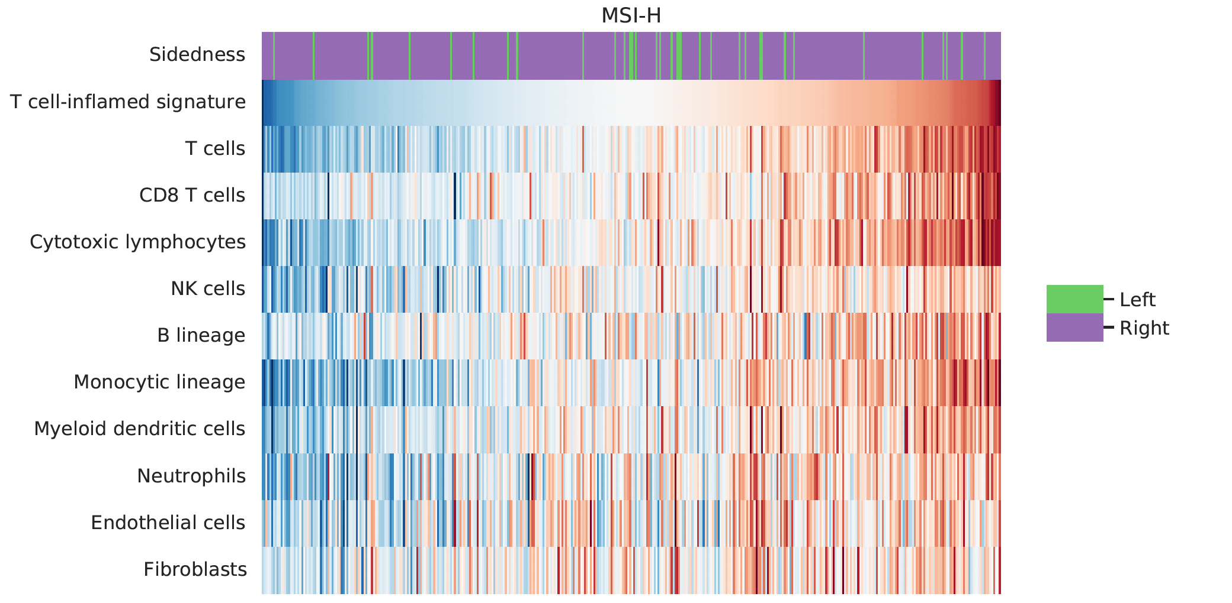

Panel A
Panel B
MSS/pMMR
MSI-H/dMMR
*
*
*
*
*
*
*
*p<0.05 (raw p-value)

