Slide 1
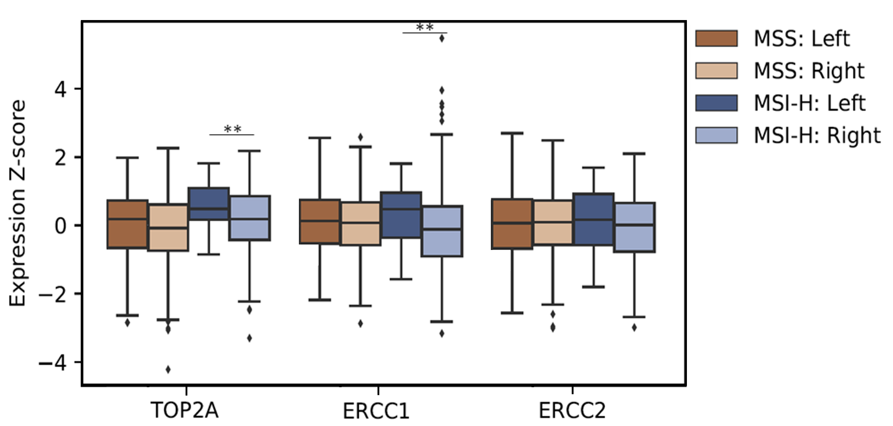
 |  | Median expression (TPM)
Gene | Subgroup | Left | Right | Fold change (Left/Right) | p-value | q-value
TOP2A | MSS | 35.2 | 28.7 | 1.2 | 0.067 | 0.15
 | MSI-H | 44.8 | 35.3 | 1.3 | 0.0066 | 0.030
ERCC1 | MSS | 9.2 | 8.9 | 1.0 | 0.27 | 0.31
 | MSI-H | 11.2 | 8.0 | 1.4 | 0.0049 | 0.030
ERCC2 | MSS | 5.7 | 5.8 | 1.0 | 0.42 | 0.42
 | MSI-H | 6.0 | 5.5 | 1.1 | 0.087 | 0.16

