Slide 1
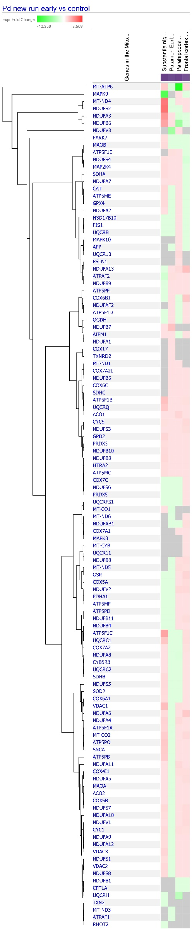
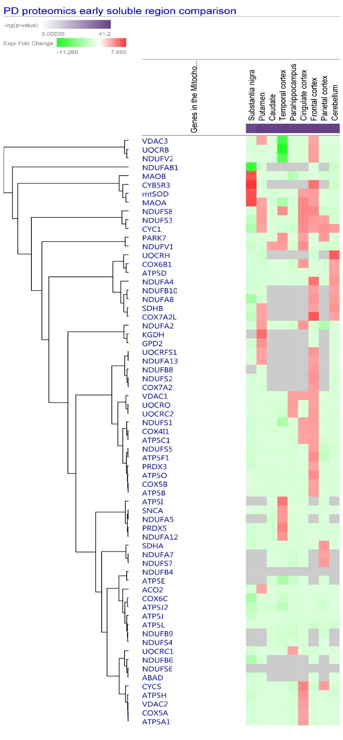
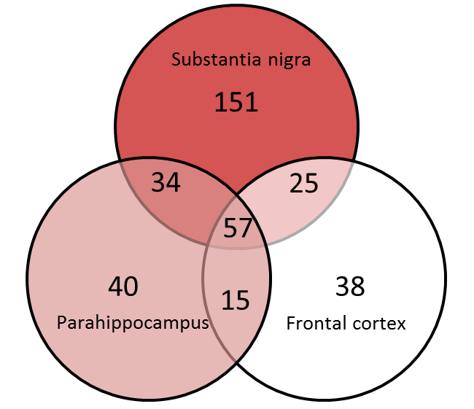
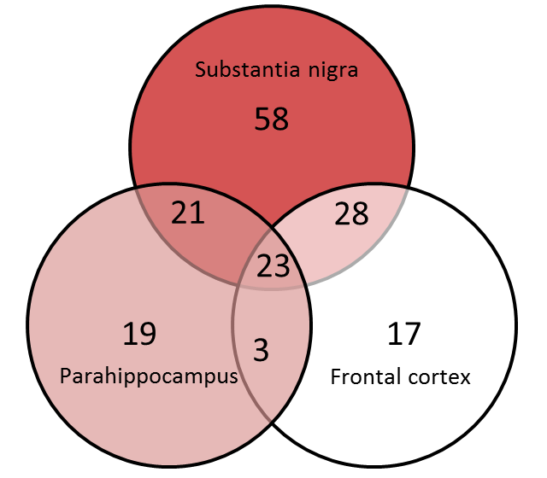
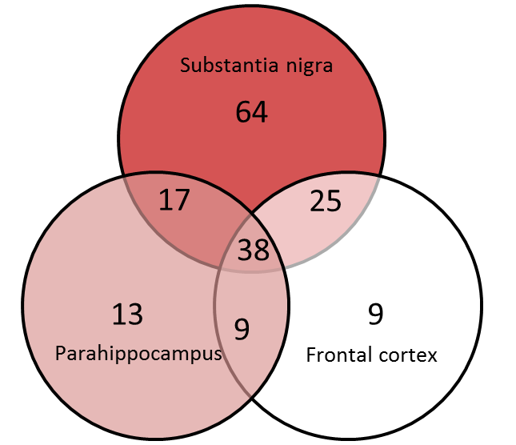
a
b
c
Notes:
Can we map the proteins to specific subpathways – group them into complex 1, complex 2, complex 3, complex 4, complex 5, antioxidome, fatty acid oxidation,
Acetylation changes for α-synuclein in sirtuin pathway?

